Slide 1




CRAFT #5
Introduction to Linux
Carlos Pizzino carlos@ingeniarius.pt
Panagiotis Karfakis panagiotis@ingeniarius.pt
30/07/2024

Slide 2
WHY C++?
With all the power that bash give us why should we use C++?
You can do much with bash but not everything
Complex applications written in C++ are easier to read and write than their bash counterparts
C++ has the all features bash has and provides even more, such as, abstraction, classes, templates, namespaces, Standard Library, memory allocation, and much more...
Still, bash is very convenient for some applications, such as high-level automation of the OS, installation scripts, backup scripts, cron tasks, etc.
1

Slide 3
WHY C++?
With all the power that bash give us why should we use C++?
They are programming languages with very different purposes, while C++ can do pretty much everything that Bash can; Bash main purpose is to allow quick integration of automated tasks using the OS shell commands and potentially user installed packages as well.
1
Notes:
They are programming languages with very different purposes, while C++ can do pretty much everything that Bash can; Bash main purpose is to allow quick integration of automated tasks using the OS shell commands and potentially user installed packages as well.
29

Slide 4
C++
An integrated development environment (IDE) is software for building applications that combines common developer tools into a single graphical user interface (GUI).
Although they are a little bit trickier to master, Nano and Vim are really powerful tools when properly used. They can save you a lot of development time.
1
Notes:
An integrated development environment (IDE) is software for building applications that combines common developer tools into a single graphical user interface (GUI). Although they are a little bit trickier to master, Nano and Vim are really powerful tools when properly used. They can save you a lot of development time.
29

Slide 5
C++
Let’s learn how to compile and execute C++ files
For that we need the package build-essential
Let’s make a .cpp hello world file (main.cpp)
You can work with Nano or Vim or you can install a desktop app
Let’s install Visual Studio Code:
- sudo snap install code --classic
VSCode is an IDE that will help you write C, C++, and Python, and many other programming languages. It is lightweight, free, and it is really easy to install extensions on it
1
Notes:
An integrated development environment (IDE) is software for building applications that combines common developer tools into a single graphical user interface (GUI). Although they are a little bit trickier to master, Nano and Vim are really powerful tools when properly used. They can save you a lot of development time.
29

Slide 6
C++
#include <iostream>
using namespace std;
// comment
int main() {
cout << "Hello, World!";
return 0;
}
1
Notes:
29

Slide 7
C++
Now we have a main.cpp ready, let’s compile it.
To create an executable we do g++ -Wall main.cpp -o main
This will create the executable main
Let’s run it with ./main
1
Notes:
29

Slide 8
MAKEFILE
To make compilation and linking (building) easier, makefiles were created
The name for the makefile file should be just Makefile with no extension
A makefile will help you compile stuff, better with an example:
main:
g++ -Wall main.cpp -o main
1
Notes:
29

Slide 9
MAKEFILE
But we need to be able to clean it too. This is our final file:
main:
g++ -Wall main.cpp -o main
clean:
rm main
To execute the make file just do the command make
To clean we need to do make clean
1
Notes:
29

Slide 10
GIT
git is a version control system that is designed to handle everything from small to very large projects with speed and efficiency.
git also started as a project by Linus Torvalds (remember him?).
Github is a popular git repository hosting website where many open-source projects can be found. It is also useful to build your programming portfolio.
Go to http://www.github.com
Create your github account if you don’t have one
Install the git package through apt
1
Notes:
29

Slide 11
GIT
To install the git package, simply execute the following commands:
sudo apt update
sudo apt install git
or:
sudo apt update && sudo apt install git
1
Notes:
29

Slide 12
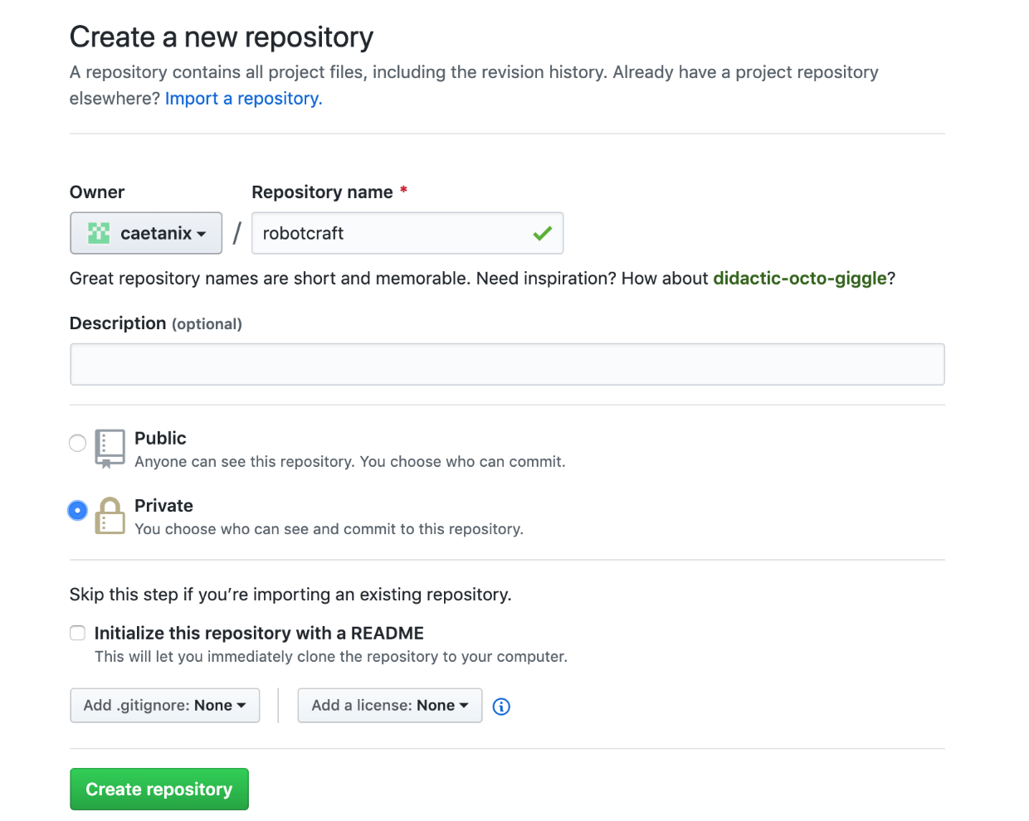
GIT
Create a private repository on github.com
11
Notes:
29

Slide 13
GIT
Create a folder named “robotcraft” and copy your files to that folder “main.cpp and Makefile”
Go to folder “robotcraft” to execute next commands
11
Notes:
29

Slide 14
GIT
git init
Initialized empty Git repository in /home/user/robotcraft/.git/
git config user.name “your name here”
git config user.email “your email here”
11
Notes:
29

Slide 15
GIT
echo "# my c++ application" >> README.md
create a file README.md to show some info on github
git add README.md
Add this file to next commit
git commit -m "first commit"
Create a commit with some comment
[master (root-commit) 677a316] first commit
1 file changed, 1 insertion(+)
create mode 100644 README.md
11
Notes:
29

Slide 16
GIT
git remote add origin https://github.com/caetanix/robotcraft.git
add local git to be sincronized with remote rep
git push -u origin master
push local modifications to remote repository
Username for 'https://github.com': caetanix
Password for 'https://caetanix@github.com':
Counting objects: 3, done.
Writing objects: 100% (3/3), 237 bytes | 237.00 KiB/s, done.
Total 3 (delta 0), reused 0 (delta 0)
To https://github.com/caetanix/robotcraft.git
* [new branch] master -> master
Branch 'master' set up to track remote branch 'master' from 'origin'.
11
Notes:
29

Slide 17
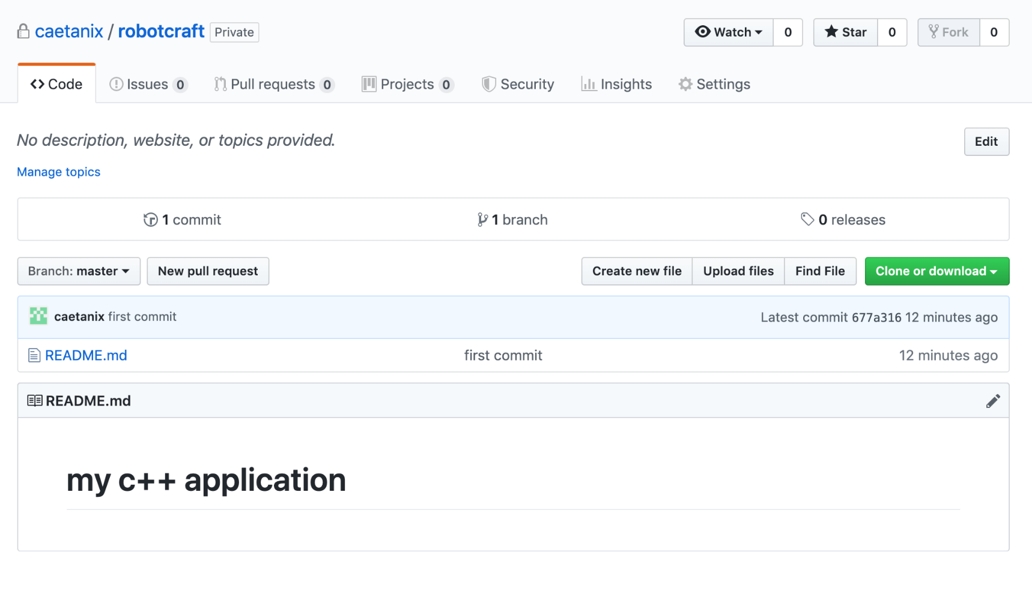
GIT
Go to github.com and check your repository
11
Notes:
29

Slide 18
GIT
Lets add the other files to our repository
git add Makefile main.cpp
Add this files to next commit
git commit -m "add main.cpp to remote"
[master eaffbaa] add main.cpp to remote
2 files changed, 15 insertions(+)
create mode 100644 Makefile
create mode 100644 main.cpp
11
Notes:
29

Slide 19
GIT
git push
push local modifications to remote repository
Username for 'https://github.com': caetanix
Password for 'https://caetanix@github.com':
Counting objects: 4, done.
Compressing objects: 100% (3/3), done.
Writing objects: 100% (4/4), 465 bytes | 465.00 KiB/s, done.
Total 4 (delta 0), reused 0 (delta 0)
To https://github.com/caetanix/robotcraft.git
677a316..eaffbaa master -> master
Branch 'master' set up to track remote branch 'master' from 'origin'.
11
Notes:
29

Slide 20
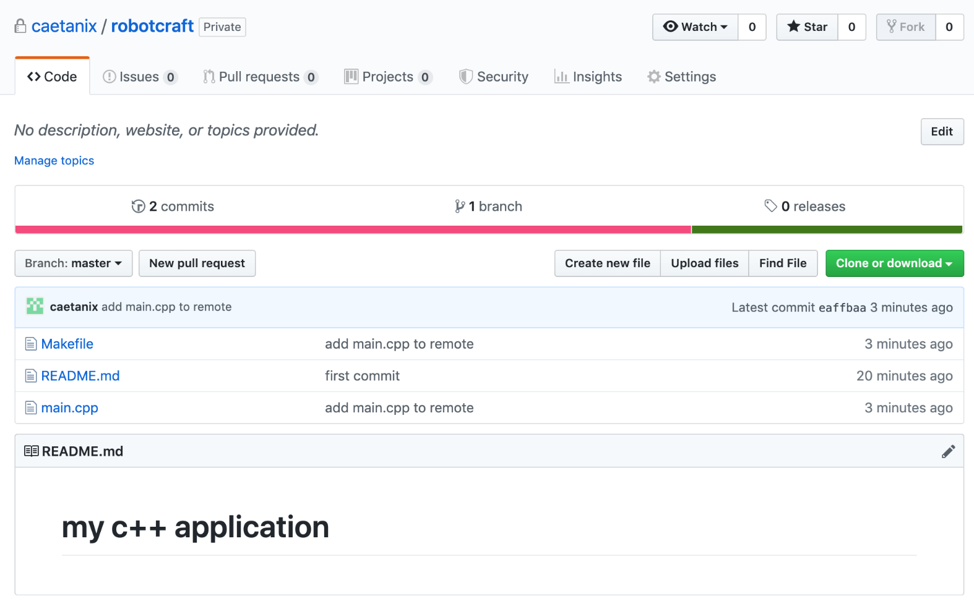
GIT
Go to github.com and check your repository
11
Notes:
29

Slide 21
GIT
Do some changes in main.cpp
git status
Check available local files modifications
On branch master
Your branch is up to date with 'origin/master'.
Changes not staged for commit:
(use "git add <file>..." to update what will be committed)
(use "git checkout -- <file>..." to discard changes in working directory)
modified: main.cpp
no changes added to commit (use "git add" and/or "git commit -a")
11
Notes:
29

Slide 22
GIT
git commit -a -m "some updates"
[master b761cea] some updates
1 file changed, 2 insertions(+)
git push
Username for 'https://github.com': caetanix
Password for 'https://caetanix@github.com':
Counting objects: 3, done.
Compressing objects: 100% (3/3), done.
Writing objects: 100% (3/3), 294 bytes | 294.00 KiB/s, done.
Total 3 (delta 2), reused 0 (delta 0)
remote: Resolving deltas: 100% (2/2), completed with 2 local objects.
To https://github.com/caetanix/robotcraft.git
eaffbaa..b761cea master -> master
11
Notes:
29

Slide 23
GIT
When you don’t have any changes in files
git status
Check available local files modifications
On branch master
Your branch is up to date with 'origin/master'.
nothing to commit, working tree clean
11
Notes:
29

Slide 24
GIT
Do some changes again in main.cpp
git status
Check available local files modifications
[…]
Changes not staged for commit:
(use "git add <file>..." to update what will be committed)
(use "git checkout -- <file>..." to discard changes in working directory)
modified: main.cpp
no changes added to commit (use "git add" and/or "git commit -a")
Now, we can discard our changes:
git checkout -- main.cpp
11
Notes:
29

Slide 25
GIT
Now, you can check file content and git status
git status
Check available local files modifications
On branch master
Your branch is up to date with 'origin/master'.
nothing to commit, working tree clean
11
Notes:
29

Slide 26
GIT
git push to upload, git pull to download
11
Notes:
29

Slide 27
GIT
Git is a great tool, but must be used with care
Please use it while developing your work on RobotCraft, that way you can track what you have done, and you possibly fallback to a stable version of your work, if something goes wrong
We just shown you the basic stuff, you need to explore it and become a Git Expert ☺
11
Notes:
29

Slide 28
TERMINATOR
Terminator is a bash terminal with tons of functions.
Let’s install it through apt, its called terminator
Explore the application
Split vertically (CTRL+SHIFT+E) and horizontally (CTRL+SHIFT+O)
You can put it on fullscreen by pressing F11 key
To check what it can do, execute the command man terminator and read it
11
Notes:
<number>

Slide 29
CRAFT #5
Thank you
Carlos Pizzino carlos@ingeniarius.pt
Panagiotis Karfakis panagiotis@ingeniarius.pt
24/07/2024

