Slide 1
Lobster: A GPU-Accelerated Framework
for Neurosymbolic Programming
ASPLOS ’26 · PAPER PRESENTATION
Paul Biberstein · Ziyang Li · Joseph Devietti · Mayur Naik
University of Pennsylvania · Johns Hopkins University
[Dakshinamoorthy A – da3232] · [COMS6998 - AI Native Computing] · [10/21]
arXiv 2503.21937 · github.com/P-bibs/Lobster

Slide 2
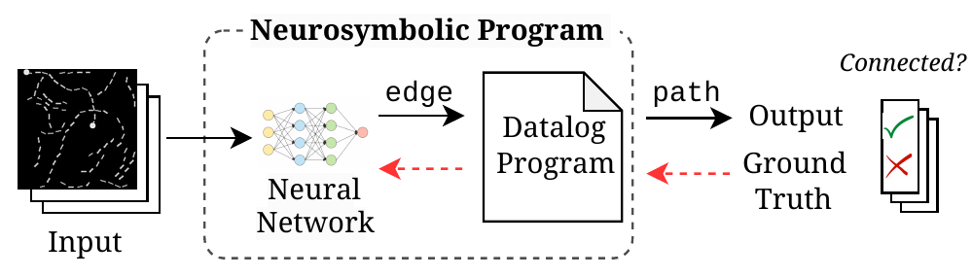
Neurosymbolic Programming vs. Classical Deep Learning
BACKGROUND · 1 OF 2
Fig. 1 · A network predicts edge facts with probabilities; a Datalog program derives path.
Gradients (red, dashed) flow back through the program, so training needs only the final yes/no label.
Deep learning
Neurosymbolic
The bottleneck
Learns from noisy, high-dimensional data like images and text. One model, trained end to end on GPUs.
A network extracts facts; a Datalog program reasons over them. Prior work reports better data efficiency, interpretability and generalizability.
Tracking every derivation of every fact, plus its gradient, is costly. Existing frameworks run this part on CPUs only.
Biberstein et al. · Lobster · ASPLOS ’26
2 / 13

Slide 3
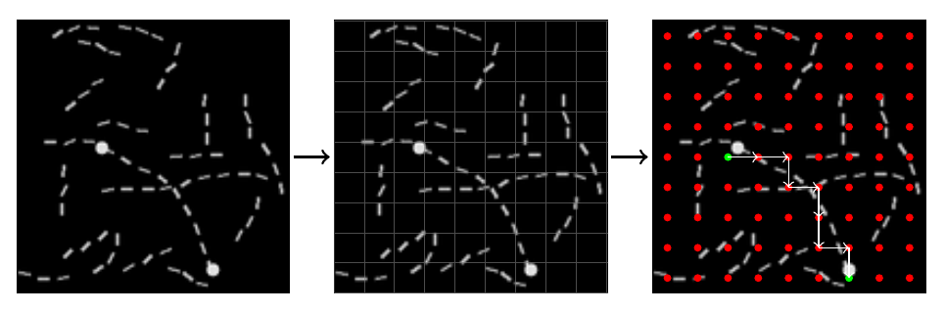
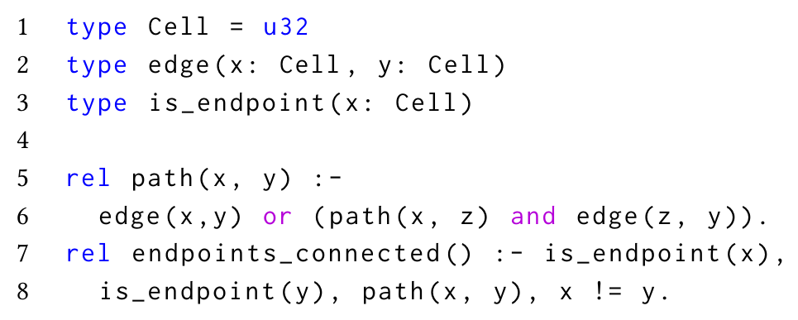
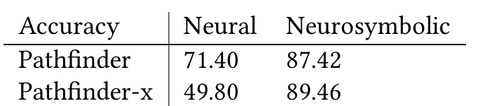
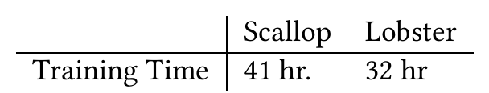
Running Example: Pathfinder
BACKGROUND · 2 OF 2
Fig. 3a · Image → n × n grid → extracted graph (green: endpoints)
Fig. 3c · The entire symbolic program; recursion on line 6
Overlay an n × n grid on the image; each cell is a vertex.
A CNN predicts probabilities for edge(i, j) and is_endpoint(i).
Datalog computes path (transitive closure) and asks whether the two endpoints connect.
Trained end to end from yes/no labels only, using diff-top-1-proofs.
Fig. 3d–e · Accuracy (from [27]) and training time
Biberstein et al. · Lobster · ASPLOS ’26
3 / 13

Slide 4
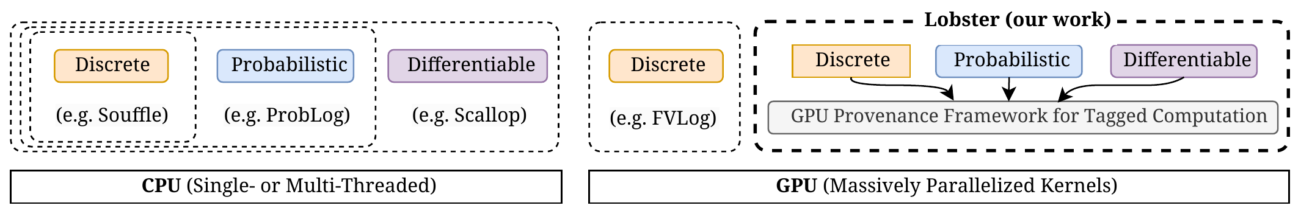
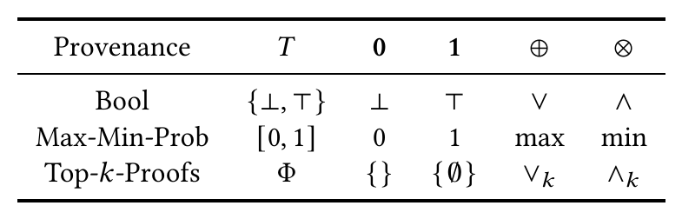

One GPU Back-End for Tagged Datalog
CORE IDEA · 1 OF 2
Fig. 2 · Existing engines vs. Lobster: discrete, probabilistic and differentiable reasoning, all on the GPU
Datalog
RAM
APM
GPU
Scallop front end
relational algebra
new IR (this paper)
CUDA kernels
Lobster reuses Scallop’s front end and query planner, then lowers relational algebra (RAM) into APM, an IR built for the GPU.
Fig. 5b · ⊕ merges alternative derivations; ⊗ joins a rule’s premises. Swap the semiring to change the reasoning mode; Lobster implements 7.
Biberstein et al. · Lobster · ASPLOS ’26
4 / 13

Slide 5
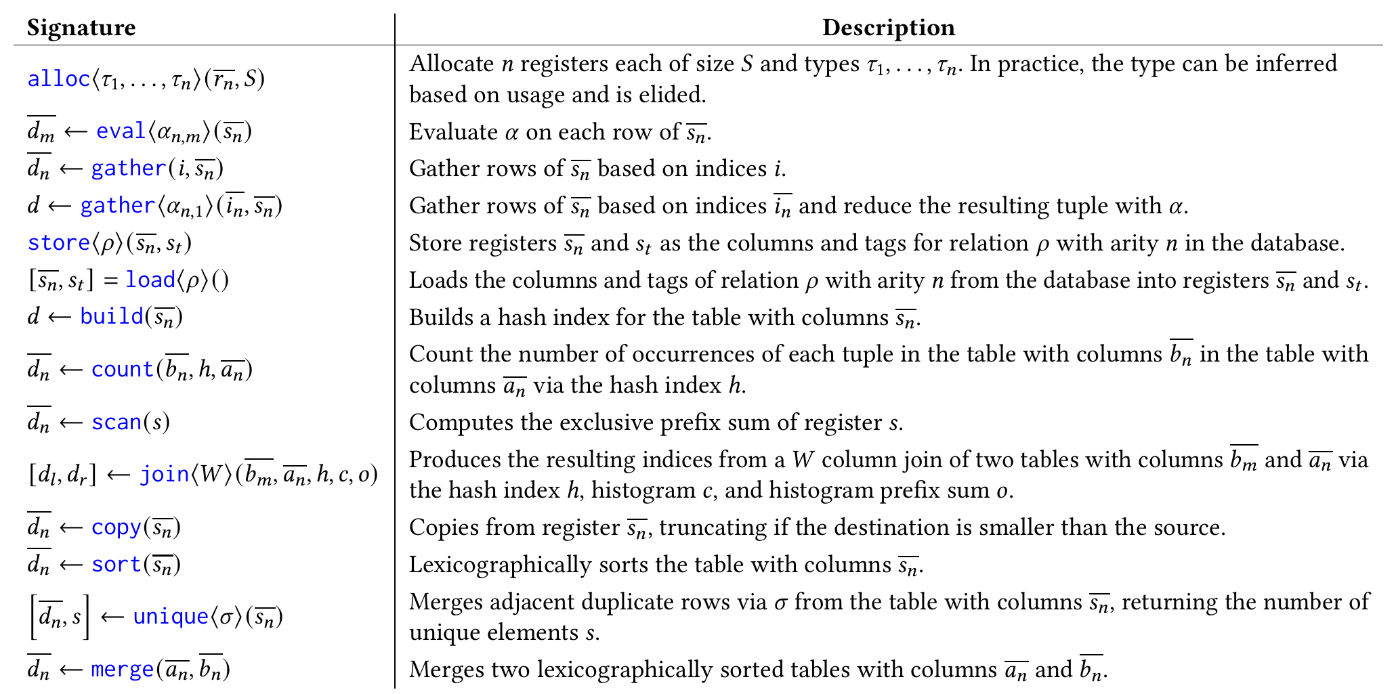
APM: An IR Shaped by GPU Constraints
CORE IDEA · 2 OF 2
LOCKSTEP WARPS
No control flow
Avoids divergence within 32-thread warps.
COSTLY ALLOCATION
SSA + explicit allocation
Sized up front; no B-trees or tries.
COALESCED ACCESS
Columnar vector registers
One buffer per column, plus one for tags.
“…once a program is compiled to APM, efficient GPU execution is assured.”
Table 1 · The complete APM instruction set: bulk data-parallel operations, no branches or loops
Sec. 3.2
Biberstein et al. · Lobster · ASPLOS ’26
5 / 13

Slide 6
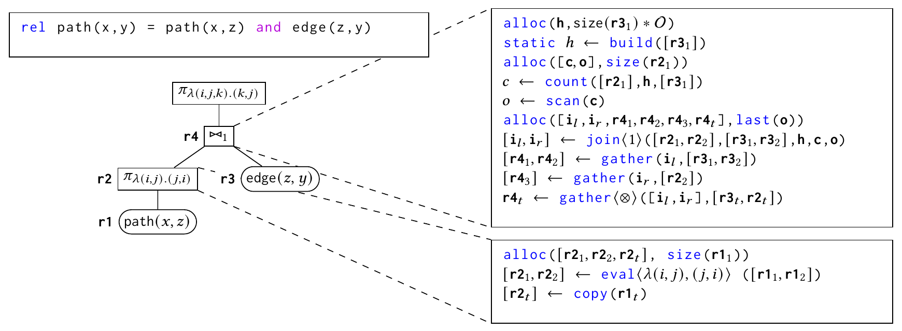
Compiling Relational Operators to APM
IMPLEMENTATION · 1 OF 2
Project
One thread per row. Output size equals input size, and tags copy through unchanged.
Join
GPU hash join. Count and prefix-sum size the output before it is written; each output tag is the ⊗ of its inputs’ tags.
Fig. 6 · path(x, y) = path(x, z) and edge(z, y): the RAM tree (left) and the APM it compiles to (right)
build → count → scan → join → gather
Semi-naive evaluation
Facts split into stable, recent and delta. Rules fire only on recent facts; dedup and merge also run on the GPU.
Biberstein et al. · Lobster · ASPLOS ’26
6 / 13

Slide 7
The Lobster Runtime
IMPLEMENTATION · 2 OF 2
~2,000
Lock-free hash table
Bytecode interpreter
new lines of Rust
Open addressing with linear probing. Stores row indices, not tuples, so any relation width fits, at the cost of one extra random read.
Projections that permute or drop columns become memory copies. Arithmetic and comparisons run on a tiny stack machine, one fact per thread.
~9,000
new lines of CUDA / C++
Fixed-size tags
Sequential operators
Scallop’s front end and query planner are reused, so existing Scallop programs run unmodified (authors’ claim).
Top-1 proofs instead of general top-k: each fact keeps one proof, the likelier one under ⊕. Proof size capped at 300.
Parallelism lives inside each operator; operators run one after another. The authors argue pipelining would not help.
Biberstein et al. · Lobster · ASPLOS ’26
7 / 13

Slide 8
Arena Allocation, Buffer Reuse, Static Registers
OPTIMIZATIONS · 1 OF 2
Arena allocation
Buffer reuse
Static registers
Every register dies at the end of an iteration, so allocating is a pointer bump and freeing is a no-op.
When an arena won’t fit in memory, over-allocate each buffer and reuse it across iterations; a register’s size tracks its size last iteration.
In a linear-recursive program each join has at most one IDB input; the EDB side never changes. Build its hash index once, keep it.
static h ← build([r3₁])
WHY APM MAKES IT EASY
WHY APM MAKES IT EASY
Every buffer is named by its alloc instruction. Prior GPU Datalog [44] did this for one merge buffer.
ASSUMES
No branches or loops, so each iteration makes the same fixed set of allocations.
Linear recursion, which the authors find in nearly all evaluated programs.
Ablated as “Alloc” (Fig. 10)
Ablated as “Alloc” (Fig. 10)
Not ablated on its own
Biberstein et al. · Lobster · ASPLOS ’26
8 / 13

Slide 9
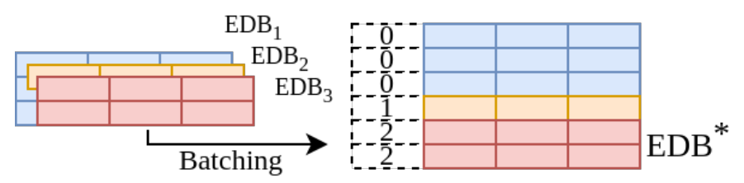
Batched Evaluation and Stratum Offloading
OPTIMIZATIONS · 2 OF 2
Batched evaluation
Stratum offloading
CPU
GPU
CPU
earlier strata
longest-running stratum + neighbours
later strata
Schematic of Sec. 5.3 (not a paper figure)
Fig. 7 · Samples in a batch share one database, told apart by a sample-id column
Relations start in CPU memory, and CPU–GPU copies are slow.
Move data to the GPU before the longest-running stratum, picked by counting recursive joins.
Grow that region to neighbouring strata until the boundary’s inputs and outputs are small: a min-cut-like choice.
Ablated as “Stratum” in Fig. 10.
Prepend a sample-id register to every table, run once, split results by id.
No new APM or RAM constructs; joins widen by one column, so samples never mix.
Costs 1 byte per row: batches rarely exceed 256 samples.
Biberstein et al. · Lobster · ASPLOS ’26
9 / 13

Slide 10
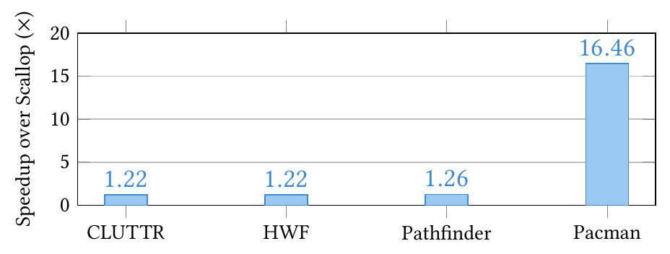
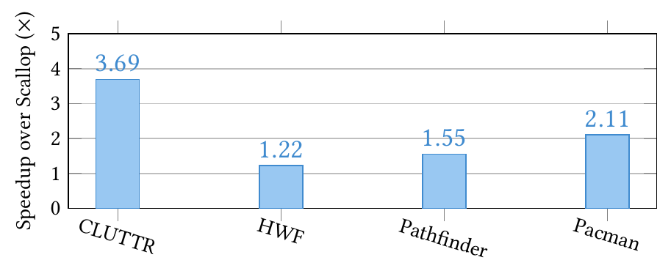
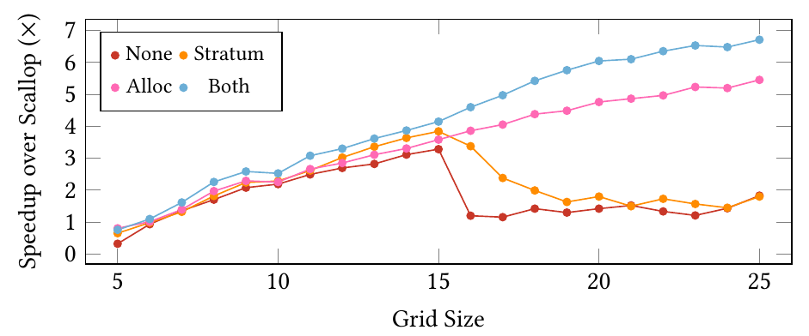
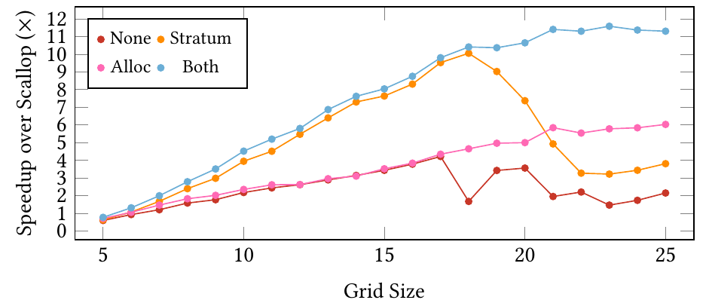
Neurosymbolic Training and Inference
RESULTS · 1 OF 2
Training: about 1.2× on three tasks, since neural time already on the GPU caps the gain (Amdahl). Symbolic-heavy Pacman gets 16.5×.
Fig. 8 · Training time vs. Scallop, end to end
Fig. 9 · Inference time vs. Scallop, pre-trained networks
Inference: 1.2–3.7×. CLUTRR and Pathfinder gain more than in training; Pacman gains less.
Scaling (symbolic time only): with neither optimization, gains collapse past size ~15–20; with both, they reach ~6.7× (Pacman) and ~11× (Pathfinder).
Fig. 10a · Pacman: speedup vs. maze size, with ablations
Fig. 10b · Pathfinder: speedup vs. grid size, with ablations
Biberstein et al. · Lobster · ASPLOS ’26
10 / 13

Slide 11
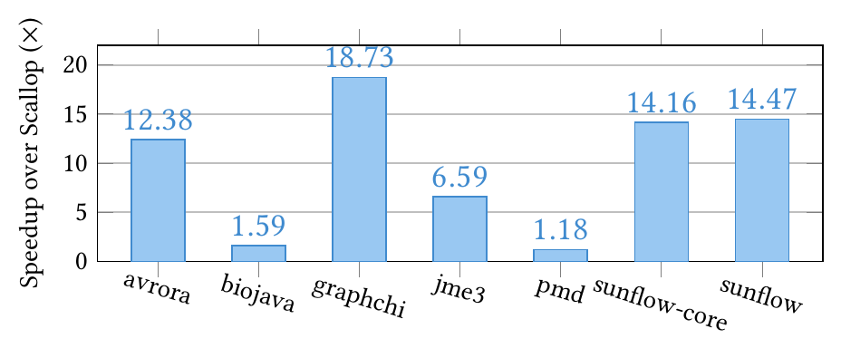
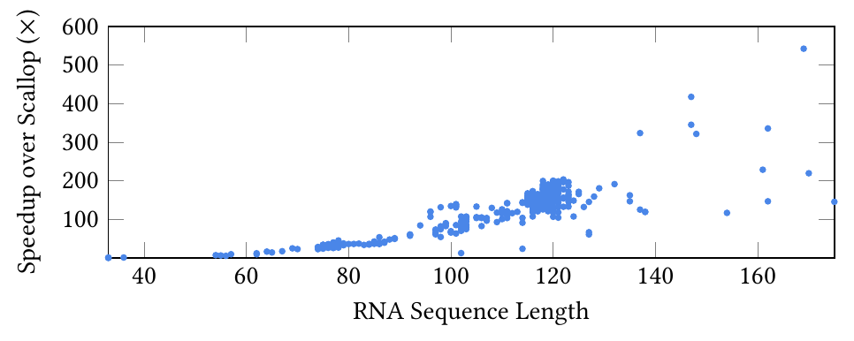
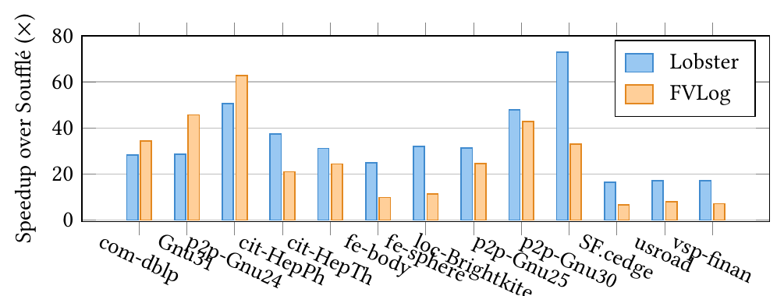
Probabilistic and Discrete Workloads
RESULTS · 2 OF 2
Probabilistic: ProbLog, which does exact inference, hit the 2-hour timeout on every input but one.
RNA SSP: often 100×+ on long sequences; 40% slower than Scallop on the shortest (28 bp).
Fig. 11 · Probabilistic static analysis vs. Scallop
Fig. 12 · RNA SSP vs. Scallop, by sequence length
Tables 3–4 · vs. FVLog (GPU)
Same Generation: faster on all 5 graphs both finish; completes 2 where FVLog runs out of memory; OOM on vsp_finan, which FVLog runs in 90 s.
Discrete: Scallop is 30–90× slower than Soufflé here, so FVLog is the only competitive baseline.
Fig. 13 · Transitive closure: speedup over Soufflé (CPU)
CSPA: geomean 1.27×; slower on httpd (3.61 s vs. 2.57 s).
Biberstein et al. · Lobster · ASPLOS ’26
11 / 13

Slide 12
Claims, Baselines, Methodology
CRITIQUE · 1 OF 2
“Lobster achieves an average speedup of 3.9x over Scallop”
“Lobster is at least twice as fast on each dataset”
Abstract
Sec. 6.4, Same Generation vs. FVLog
The averaging method and task set aren’t stated, and 3.9× can’t be rebuilt from the per-task figures. End-to-end training gains are about 1.2× on 3 of 4 tasks.
Table 3 shows SF.cedge at 14.01 s vs. 23.72 s, which is 1.7×. Lobster also runs out of memory on vsp_finan, which FVLog finishes in 90 s.
“Lobster implements 7 commonly used provenance semirings”
Baseline configuration
Sec. 6
Sec. 3.1
No Scallop or Soufflé thread counts, no repeat runs or variance. Neurosymbolic runs use an RTX 2080 Ti; discrete runs an A100 on another machine.
Only top-1 proofs, not Scallop’s general top-k, so every speedup is at k = 1. Larger k is called an easy extension but never measured.
Biberstein et al. · Lobster · ASPLOS ’26
12 / 13

Slide 13
Missing Evidence and Future Work
CRITIQUE · 2 OF 2
Missing evidence
No profiling. “Close to 100% utilization of the GPU memory bus” and bandwidth saturation are asserted, not measured.
Future work
No time or memory breakdown. Transfers, compile time and kernel time are never separated. Relations start in CPU memory: do network outputs round-trip through the host?
FROM THE AUTHORS
General top-k proofs (k > 1).
README: JIT kernels, stable batching, automatic stratum choice.
Narrow ablation. Only Alloc and Stratum, on two tasks; static registers, the hash table and batching are never isolated.
Untested assumptions. Linear recursion, top-1 proofs suffice, proofs of at most 300 facts, batches of at most 256.
Artifact gap. The public README calls batching “unstable” and says strata to offload must be picked by hand.
Biberstein et al. · Lobster · ASPLOS ’26
13 / 13

