Slide 1
Module 2: AI for Computing
Can deep reinforcement learning
discover faster algorithms?
AlphaDev · Faster sorting algorithms discovered using deep reinforcement learning
Mankowitz et al. | Nature 618 (2023)
Notes:
Today we have moved into Module 2, AI for Computing. Earlier, we focused on hardware and systems that make AI faster. This paper reverses the direction. Can deep reinforcement learning discover faster algorithms? To understand this problem, we first need to know: why optimize sorting at all?

Slide 2
Why optimize sorting at all?
The opportunity is in frequently used, tiny sorting routines—not asymptotic complexity.
General algorithms
Mature algorithms
Already extensively optimized, often O(n log n).
≠
Fully optimized code
Small sorting kernels
Fixed: exactly 3, 4, or 5 elements.
Variable: 1–3, 1–4, or 1–5 elements.
AlphaDev targets the constant factors in small, frequently called sorting routines.
Notes:
Sorting is a very fundamental question. We already know efficient algorithms like mergesort and quicksort, but AlphaDev is not trying to improve the big-O complexity of sorting. Instead, its main experiments focus on fixed and variable sorting. Fixed sorting is to sort exactly three, four, or five elements. It also studies variable sorting: handles one to three; one to four; and one to five elements. These tiny routines are repeatedly used inside larger library sorting algorithms. That makes even a small instruction-level improvement worth optimizing.

Slide 3
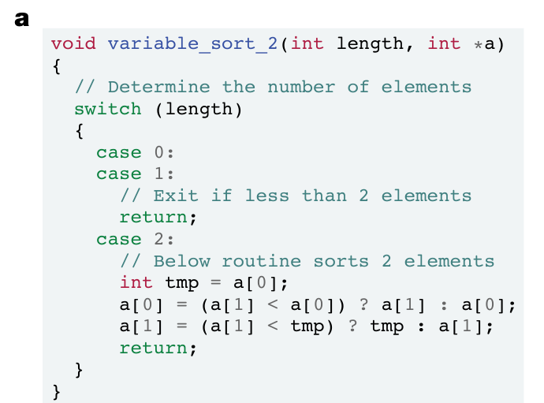
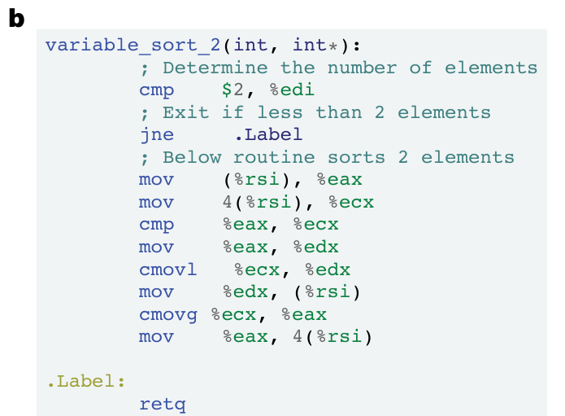
Why search at the assembly level?
A correct sorting algorithm can have many instruction-level implementations.
(a) High-level C++
(b) CPU instructions
More freedom: optimize instructions and data movement beyond fixed comparator patterns.
Closer to the CPU: instruction count and measured execution latency.
Nature (2023), Fig. 1 · cropped panels
Notes:
Why search at the assembly level instead of only searching C++ sorting strategies? Traditional small sorting implementations often follow a fixed sequence of compare-and-swap operations. But each high-level operation compiles into lower-level instructions such as moves, comparisons, and conditional moves. There may be opportunities to reuse values or reduce redundant data movement across those operations. This figure illustrates the two levels. By searching opcodes and operands directly, AlphaDev can optimize closer to actual CPU cost.

Slide 4
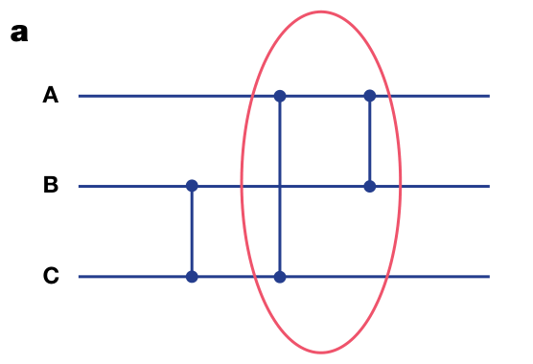
Discovery — AlphaDev swap move
A prior comparator establishes an invariant that later instructions can exploit.
After the first comparator:
B ≤ C
Therefore:
min(A, B, C)
↓
min(A, B)
Nature (2023), Fig. 3a · cropped
Notes:
Here is the AlphaDev swap move. In the three-input sorting network, the earlier comparator between B and C ensures B is no larger than C. Later, if we use a traditional routine, it computes minimum(A, B, C). But once B is not bigger than C, the same output is simply minimum(A, B). AlphaDev searches the underlying instruction sequence, so it can exploit across comparator boundaries

Slide 5
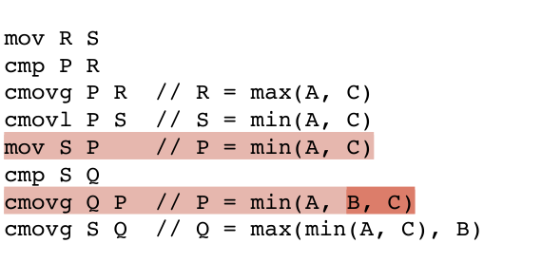
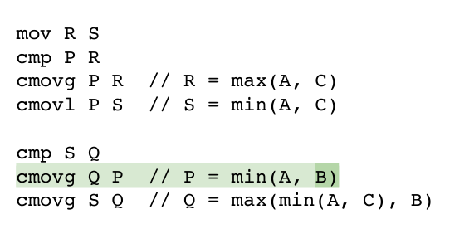
Discovery — What changed in the code?
The paper’s Fig. 3b–c: one instruction removed while preserving the sorted output.
Original
AlphaDev
Extra move: MOV S → P
Removes MOV by exploiting B ≤ C
Nature (2023), Fig. 3b–c · cropped to the changed instructions
Key point: a semantic constraint becomes a concrete instruction saving.
Notes:
Figure 3b and c show how that observation changes the assembly program. The original code contains an extra data movement. AlphaDev's code removes one instruction while preserving the same sorted output. Just one instruction—but it can be reused in frequently executed short sorts, and it matters.

Slide 6
RL Basics: The Markov Decision Process
An MDP models how an agent interacts with its environment.
Agent
Action aₜ →
Environment
Policy π(a|s): chooses actions
Value V(s): predicts future return
Executes action aₜ
Produces next state and reward
← (sₜ₊₁, rₜ)
MDP: (S, A, P, R, γ)
Markov property
States · actions · transition probabilities · rewards
γ is the discount factor.
The next state depends only on the current state and action—not the full history.
Goal: learn a policy that maximizes expected cumulative reward (return).
Notes:
We can formulate this as a reinforcement learning problem. Reinforcement learning is typically formulated as a Markov Decision Process, which consists of states, actions, transition probabilities, and rewards. In RL, an agent observes a state, selects an action using a policy, and receives the next state and a reward. The Markov property means that the next state depends only on the current state and action, not the full history. The agent's goal is to maximize reward, while a value function estimates the expected future return from a state. AlphaDev maps these concepts to the process of building assembly programs.

Slide 7
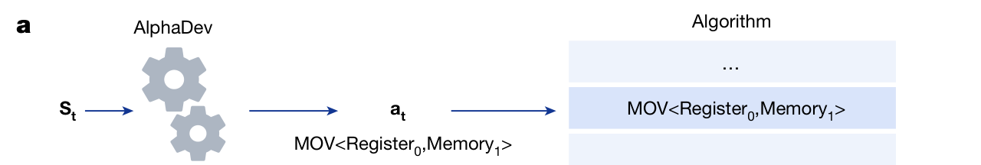
Technique 1 — AssemblyGame
An RL environment: build a sorting program one instruction at a time.
Nature (2023), Fig. 2a
State Sₜ = ⟨Pₜ, Zₜ⟩
Action aₜ
Program + register / memory state
Append a legal assembly instruction
Audience question: What should the reward measure?
Notes:
AlphaDev formulates a reinforcement learning environment AssemblyGame, a single-player game. We start from an empty program. Each action appends one legal assembly instruction. The state contains two parts: P_t is the program built so far, and Z_t is the resulting state of registers and memory on the predefined inputs. Then here's the question: how about the reward? If you were designing this RL agent, what is the reward? What should it measure?

Slide 8
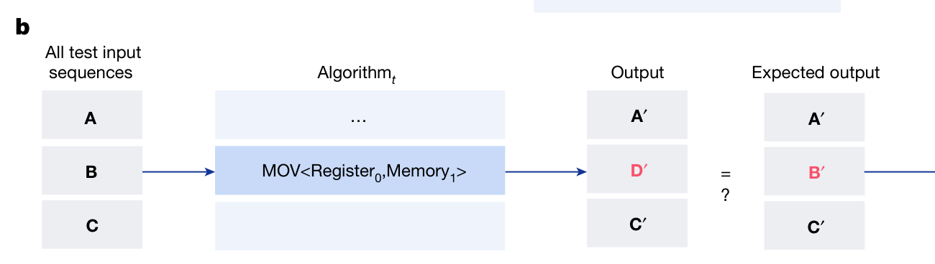
Technique 1 — Correctness and efficiency
A program must sort correctly; among correct programs, shorter or faster is better.
Nature (2023), Fig. 2b
Correctness
Efficiency
Compare observed and expected outputs
Instruction count / measured CPU latency
WHY NOT TABULAR RL?
Too many possible programs to memorize → Deep RL generalizes; MCTS explores promising paths.
Notes:
The paper uses two reward components: correctness and efficiency. Figure 2b shows the correctness check: execute the candidate program on test inputs and compare the outputs with the expected results. A very short program is useless if it sorts incorrectly. The efficiency encourages lower-cost code.
For efficiency, AlphaDev uses two different measures. For fixed sorting, the code has no branches, so every instruction is executed. For variable sorting, different inputs may follow different branches, so a shorter program is not necessarily faster. Instead, AlphaDev optimizes the actual CPU execution latency.
However, the space of possible assembly programs is enormous. Traditional tabular RL methods cannot efficiently represent policies and value functions for such a large and complex state space. This motivates deep reinforcement learning, which uses neural networks to generalize across states and guide the search toward promising programs.

Slide 9
Deep RL: Learning Policy and Value
Unlike tabular RL, neural networks approximate policies and values for large state spaces.
Deep Reinforcement Learning
Why use Deep RL?
A neural network estimates:
The number of partial programs is enormous
π(a | s)
Policy: promising next actions
Generalize across unseen states
V(s)
Value: expected future return
Learn promising instruction patterns
Learn from experience and search outcomes.
Supply policy priors and value estimates to guide search
Notes:
Unlike tabular reinforcement learning, deep RL uses neural networks to approximate the policy and value functions. Why do we need deep reinforcement learning here?
The main challenge is the enormous search space. Each assembly instruction has many possible combinations of opcodes and operands, so even a short program can have an enormous number of possible states.
Deep RL addresses this by using neural networks to learn patterns and generalize across different states, rather than memorizing each one.
Specifically, the policy network predicts promising next instructions, while the value network estimates the expected future reward of a partial program.

Slide 10
MCTS: Searching Through Possible Programs
Simulate possible instruction sequences before selecting the next move.
Each node is a partial assembly program
1
Selection
P₀
Follow a promising path in the tree.
2
Expansion
MOV
CMP
Add a new instruction / child state.
P₁
P₁′
3
Evaluation
Estimate the new state’s value.
CMOV
P₂
P₂′
P₂″
P₂‴
4
Backpropagation
Update search statistics on the path.
Highlighted path = a promising instruction sequence
After many simulations, visit counts guide the next instruction—and train the policy network.
Notes:
Next, Monte Carlo Tree Search, or MCTS, searches ahead before choosing the next instruction. Here, each node is a partial assembly program and each edge adds one possible instruction. The search repeats four steps: selection follows a promising path; expansion adds a new node; evaluation estimates its future value using the neural network; and backpropagation updates the statistics of earlier nodes.
It may sounds like a deep learning method. But actually this is different from backpropagation in deep learning. Here, we propagate search results through the tree, rather than gradients through a neural network.
After many simulations, AlphaDev chooses the next instruction based on search visit counts.

Slide 11
Technique 2 — AlphaZero-style DRL + MCTS
Neural predictions guide search; search outcomes improve the neural network.
Deep RL network
guide
Monte Carlo Tree Search
Policy π(a|s) · Value V(s)
Look ahead over instruction sequences
train
1
Select
→
2
Expand
→
3
Evaluate
→
4
Back up
AlphaDev extends AlphaZero: game moves become CPU instructions.
Notes:
Now that we‘ve seen how MCTS works, let’s look at how AlphaDev combines it with deep reinforcement learning. AlphaDev extends the AlphaZero framework, originally developed for board games, to the task of discovering assembly programs. The key idea is a continuous learning loop. The neural network guides MCTS, while MCTS produces an improved policy used to train the neural network. In short, the neural network improves search, and search improves the neural network.

Slide 12
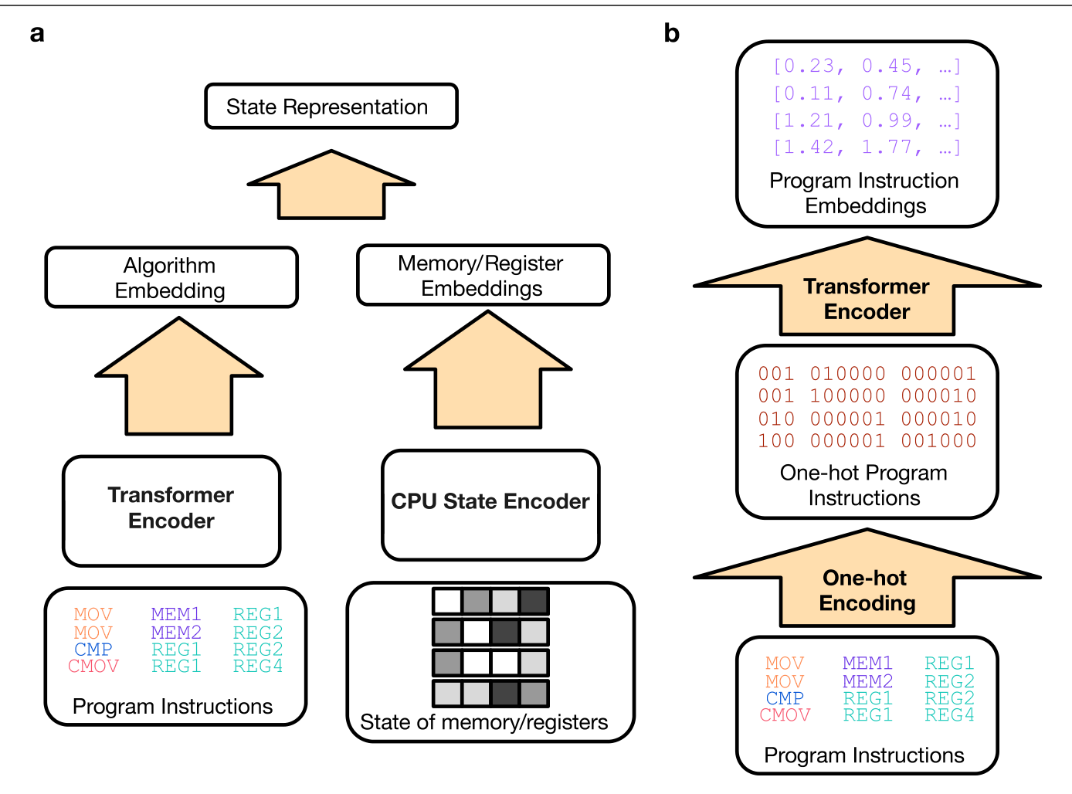
Technique 2 — Representing a partial program
AlphaDev combines the program text with the state it produces on a CPU.
Transformer
Opcodes + operands
CPU state encoder
Registers + memory
Combined → state embedding
for policy and value
Nature (2023), Extended Data Fig. 1
Notes:
This figure explains how AlphaDev represents a partial program for the deep RL network. There are two inputs. First, the sequence of opcodes and operands is encoded and passed through a Transformer encoder. Second, a CPU state encoder processes the resulting registers and memory. The two embeddings are combined into a state representation. That state representation supports the policy and value predictions used by MCTS.

Slide 13
From discovery to evidence
01
Swap move
An ordering invariant lets AlphaDev remove an instruction.
02
AssemblyGame
Build a correct, efficient program one instruction at a time.
03
DRL + MCTS
Learn where to search; MCTS looks ahead over programs.
Next: baselines, speedups, and critical analysis.
Notes:
We started with a concrete discovery: the swap move removes an instruction by exploiting an earlier ordering invariant. We then saw how AssemblyGame formulates the program search as DRL plus MCTS, and how it guides that search. Then we will talk about baselines, speedups, and critical analysis.

