Slide 1
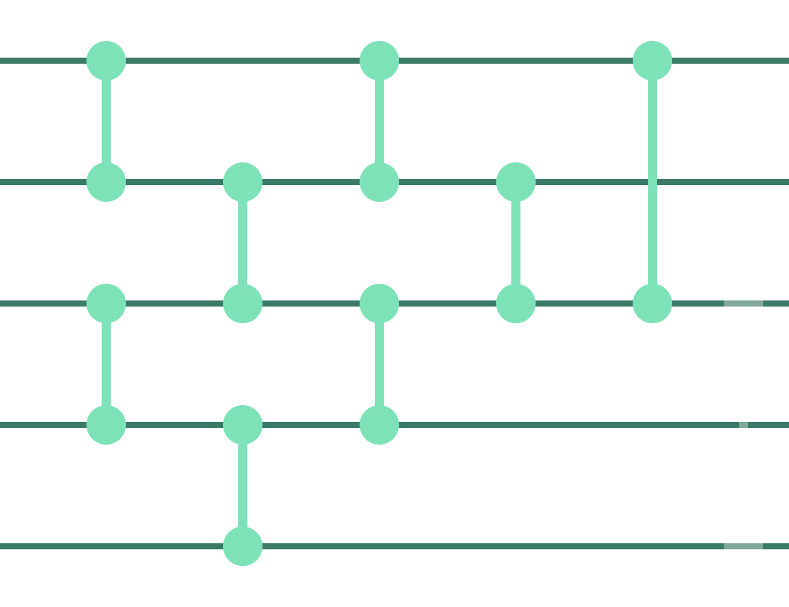
AlphaDev
PAPER PRESENTATION · PART 2
Faster sorting algorithms discovered using deep reinforcement learning
Baselines
Key results
Critical analysis
Mankowitz et al., Nature 618 (2023) · COMS 6998 AI-Native Computing · Zixin Wan
Notes:
My part covers three things: what AlphaDev is compared against, what it actually achieved, and where I think the paper’s claims deserve a closer look.

Slide 2



3 Benchmarks for AlphaDev
BASELINES
Human experts
Stochastic search
Brute force
Best known hand-written routines: sorting networks for fixed sizes, and a length check plus networks for variable sizes.
“AlphaDev-S”: the authors’ own STOKE-style superoptimizer. Cold start from an empty program, or warm start from a near-optimal one.
Enumerate ~10³² programs to check whether anything shorter than AlphaDev’s 17-instruction sort3 exists.
Asks: can RL beat people?
Asks: is RL better than plain search?
Asks: is the result optimal?
Two scores throughout: program length (a cheap proxy) and measured latency (what users actually feel).
Mankowitz et al., Nature 2023
Notes:
AlphaDev is compared against three things. First, the best human implementations — sorting networks. Second, a strong non-learning search method, a stochastic superoptimizer the authors re-implemented, in cold-start and warm-start versions. Third, brute force, used only to prove sort3 can’t get shorter than 17 instructions. Keep in mind the two metrics: length is a proxy, latency is what matters.

Slide 3
Shorter programs, especially VarSort
KEY RESULT 1 · PROGRAM LENGTH
■ Human
■ AlphaDev
(instructions, lower is better)
Sort3
18
17
28
~45%
Sort4
28 (tie)
Sort5
46
fewer instructions on VarSort4 and VarSort5
42
VarSort3
33
21
Fixed sorts: only −1 to −4, and a tie on sort4.
VarSort4
66
37
VarSort5
115
63
Source: Table 1a · Mankowitz et al., Nature 2023
Notes:
On fixed-length sorts the gains are small: one instruction on sort3, four on sort5, and a tie on sort4. The big story is variable-length sort, where AlphaDev cuts roughly 45% of the instructions on VarSort4 and VarSort5. Brute force confirms 17 is optimal for sort3.

Slide 4

Faster in practice, and shipped
KEY RESULT 2 · REAL SPEED
70%
1.7%
4–6%
~3×
faster libc++ sort on 5-element arrays (best case)
faster on arrays of 250k+ elements
lower latency on VarSort3–5 vs human code
faster VarInt decoding (protobuf, single-value input)
Merged into LLVM libc++: the first change to these sort routines in over a decade, and the first RL-discovered algorithm in the library.
Source: Table 1b and libc++ benchmarks · Mankowitz et al., Nature 2023
Notes:
Shorter code also turned into measured speed. The headline is up to 70% on five-element sorts, but at large array sizes the gain is about 1.7%. On variable sorts, latency drops by 4 to 6 percent. The method also transferred to protobuf VarInt decoding, about 3 times faster for a single value. And this isn’t just a paper result — it was merged into LLVM’s standard library.

Slide 5


New tricks humans had missed
KEY RESULT 3 · DISCOVERIES
“Swap move” and “copy move” follow one idea:
Earlier comparisons already proved B ≤ C
So one later step is redundant
Drop it: −1 instruction
A new VarSort4 strategy
Sort the first 3, then a simplified insert of the 4th: one shared path instead of a separate network per length.
Mankowitz et al., Nature 2023 · Figs. 3–4
Notes:
Beyond the numbers, AlphaDev found two small tricks, the swap move and the copy move. Both use the same idea: earlier comparisons have already established an ordering, so one later step is unnecessary, saving one instruction. It also found a structurally different VarSort4: sort three, then insert the fourth — which is where the big VarSort savings come from.

Slide 6
Who wins depends on the task
KEY RESULT 4 · RL VS. PLAIN SEARCH
Fixed-length sort
Variable-length sort
Cold-start search: finds no correct program
AlphaDev: lowest latency of all
Warm-start search: matches AlphaDev, and far faster (0.4 s vs ~6 min on sort3)
Programs explored: ≤12 million vs up to 31 trillion for search
Verdict: RL wins when branches make length ≠ speed
Verdict: plain search is enough
Source: Extended Data Tables 2–3 · Mankowitz et al., Nature 2023
Notes:
This is the most honest comparison in the paper. On fixed sorts, warm-started search matches AlphaDev and is much faster in wall-clock time. RL only clearly wins on variable sorts, where branching means shorter code isn’t automatically faster code, and AlphaDev explores far fewer programs. Hold on to this — it sets up the critique.

Slide 7
Impressive engineering.
But how big is the improvement, and against whom?
CRITICAL ANALYSIS
Effect size
Baselines
Cost, scale & rigor
Notes:
Now the critical part. I’ll ask three questions: how large the effect really is, whether the baselines are strong enough, and what it cost and how rigorous the evaluation is.

Slide 8
The headline number is the best case
CRITIQUE 1 · EFFECT SIZE
70%
Tiny arrays vs. real workloads
70% is 5-element arrays; at 250k+ elements the gain is ~1.7%.
Fewer instructions ≠ faster
Modern CPUs run out of order; dependency chains matter more than instruction count.
5 elements
Missing context
1.7%
How much real application time is spent sorting tiny arrays?
250k+ elements
Speed-up of libc++ sort · Mankowitz et al., Nature 2023
Notes:
The 70% number gets quoted a lot, but it’s for five-element arrays. At large sizes the end-to-end gain is about 1.7%. Also, fewer instructions doesn’t translate linearly into speed on out-of-order CPUs. And the paper never tells us how much real application time is spent on these tiny sorts — that’s what determines the real-world impact.

Slide 9




Are the baselines strong enough?
CRITIQUE 2 · BASELINES
Truly novel?
No compiler baseline
Swap and copy moves reuse known orderings, which is what peephole optimizers already look for.
No comparison with LLVM -O3 output or existing superoptimizers such as Souper.
Handicapped rival
“Programs explored” ≠ compute
AlphaDev-S is the authors’ own version and optimizes length only: weakest exactly where length ≠ speed.
Each AlphaDev step runs a neural net; search steps are nearly free. Wall-clock is the fairer metric.
Mankowitz et al., Nature 2023
Notes:
Four concerns about the baselines. The new tricks exploit known orderings, which is exactly what compiler peephole passes and superoptimizers do — but neither LLVM -O3 nor Souper is compared. The search baseline is the authors’ own re-implementation and can only optimize length, so it’s at a disadvantage on precisely the variable-sort task where AlphaDev wins. And counting programs explored hides that each AlphaDev step costs a neural-network evaluation.

Slide 10


Expensive, small-scale, lightly tested
CRITIQUE 3 · COST, SCALE & RIGOR
INPUT
500+ TPUs
Scale: stops at 5 elements; sort6–8 needed a different setup and saved only 1–3 instructions
for up to ~2 days
Hidden priors: hand-written pruning rules, never ablated
Optimistic stats: latency reported at the 5th percentile
OUTPUT
Correctness: VarInt checked on 80 test inputs, not proven
−1 to −4
Weak evidence: key design wins shown qualitatively (t-SNE)
instructions on fixed sorts
Compute: 512 TPU v4 actors + 16 TPU v3 cores (Methods) · Mankowitz et al., Nature 2023
Notes:
Hundreds of TPUs for up to two days to save a handful of instructions. Amortized over trillions of calls that might be worth it, but the paper never does the cost-benefit math. The approach also stops scaling around five elements, relies on hand-written pruning rules whose contribution isn’t measured, reports an optimistic latency percentile, verifies VarInt only by testing, and supports key design choices with qualitative evidence like t-SNE plots.

Slide 11
The lasting idea isn’t the faster sort. It’s a learned cost model that replaces measurement.
TAKEAWAY
<0.002%
of candidate programs were actually timed; a latency “value head” predicted the rest.
FOR DISCUSSION
1. Would a strong compiler or superoptimizer baseline have found the same tricks?
2. When does predicting cost beat measuring it, and how do we catch the model when it’s wrong?
Notes:
To wrap up: I think the most transferable idea is not the sort itself but the learned latency model — AlphaDev measured fewer than 0.002% of programs and predicted the rest. That pattern shows up across AI-for-systems, including our own project, where predictions drift when they don’t capture state like queueing. Two questions for discussion.

