Slide 1

COMS 6998 · AI-NATIVE COMPUTING
AlphaEvolve
A coding agent for scientific and algorithmic discovery
Novikov, Vũ, Eisenberger, Dupont, Huang, Wagner, … Kohli, Balog · Google DeepMind · arXiv 2506.13131 (2025)
Presented by Lei(Raymond) Chi
Notes:
Target time: 0:00 to 0:20. Introduce yourself and the paper in one breath: AlphaEvolve is Google DeepMind's evolutionary coding agent from 2025, a white paper rather than a peer-reviewed venue paper. The orange path in the tree is the idea for the whole talk: many programs get proposed, most die, and one lineage keeps improving under an automated grader. Plan for the talk: background (2 min), the loop and three key techniques (5 min), a Borg walkthrough and selected results (4 min), ablations and critique (7 min), a 30-second takeaway, then discussion.

Slide 2
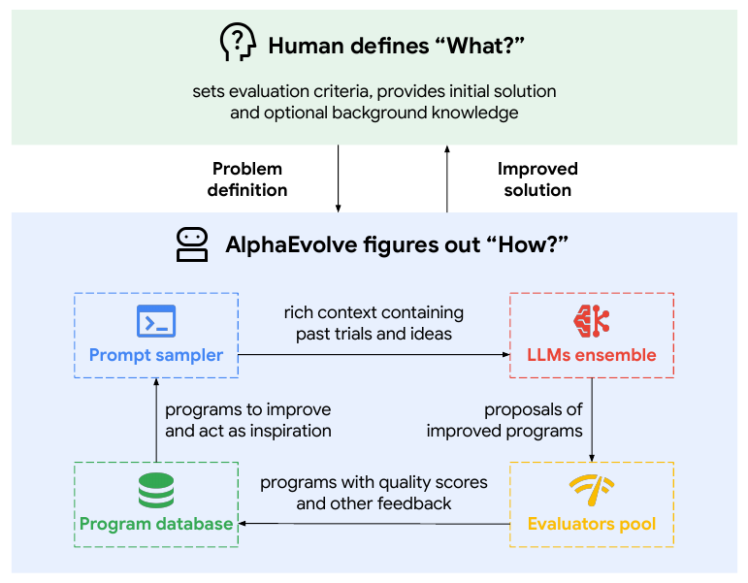
Program search with automated feedback
Human-defined task
An initial program and an evaluator specify what counts as a better solution.
Iterative code search
LLMs propose edits. Execution supplies feedback. A population preserves useful programs for later trials.
Goal: new algorithms, or programs that build a solution (often better than searching for it directly).
02
Notes:
Target time: 0:20 to 0:55. Introduce the claim through Figure 1. Humans define the evaluation criteria and initial program. Follow the cycle of prompt construction, LLM edits, execution and storage. The claim is that this process can discover useful algorithms across multiple domains. Leave performance results for the case studies. Source: https://arxiv.org/pdf/2506.13131. The screenshot preserves the source figure; explanatory text outside it is presenter commentary. Also state the paper's two goals: discover new algorithms, or find solutions that an algorithm can construct. Searching for the constructing program often works better than searching for the answer directly.

Slide 3
BACKGROUND
Many systems problems are search problems with a grader
If you can write h(program) → scores, you can search over programs instead of searching over answers.
CLUSTER
KERNEL
HARDWARE
MATH
Job scheduling
Matmul tiling
RTL circuits
Constructions
Grader: stranded CPU and memory in a fleet simulator
Grader: measured runtime on real TPUs across input shapes
Grader: area and power, gated by functional verification
Grader: the bound itself, checked exactly
Before AlphaEvolve: hand-tuned heuristics, autotuning sweeps, problem-specific deep RL (AlphaTensor, AlphaDev), and genetic programming with hand-written mutation operators.
03
Notes:
Target time: 0:55 to 1:30. Background the TA asked for. The key framing: AlphaEvolve only works where a machine can grade the candidate. Walk the four cards left to right, which is also the order of the results later, and note they span the course's stack: cluster, kernel, hardware, plus math. Then the prior art line: hand heuristics and autotuning are slow and per-shape; deep RL (AlphaTensor for matmul, AlphaDev for sorting, both DeepMind) works but needs a custom environment and action space per problem; classical genetic programming needs humans to design mutation operators. AlphaEvolve's pitch is that an LLM can be a general mutation operator.

Slide 4
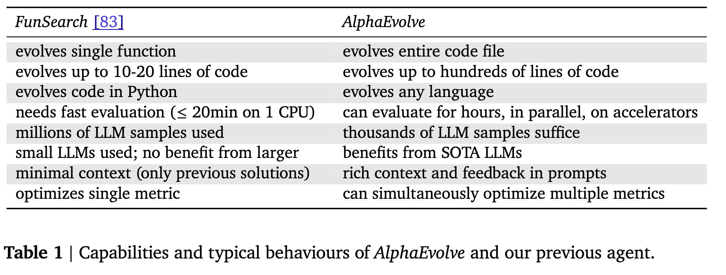
BACKGROUND
Changes from FunSearch (Nature 2023)
04
Notes:
Target time: 1:30 to 2:00. Thirty seconds only. FunSearch is the direct predecessor from the same group: it evolved a single short Python function with a small code model, millions of samples, and cheap CPU evaluation. AlphaEvolve changes three things: it evolves whole files in any language, it can spend hours of accelerator time grading each candidate, and it uses frontier models with rich context, needing thousands of samples rather than millions. The middle card is the one that matters for this course. Remember the sample-count claim; no actual cost is reported, which comes back in the critique.

Slide 5
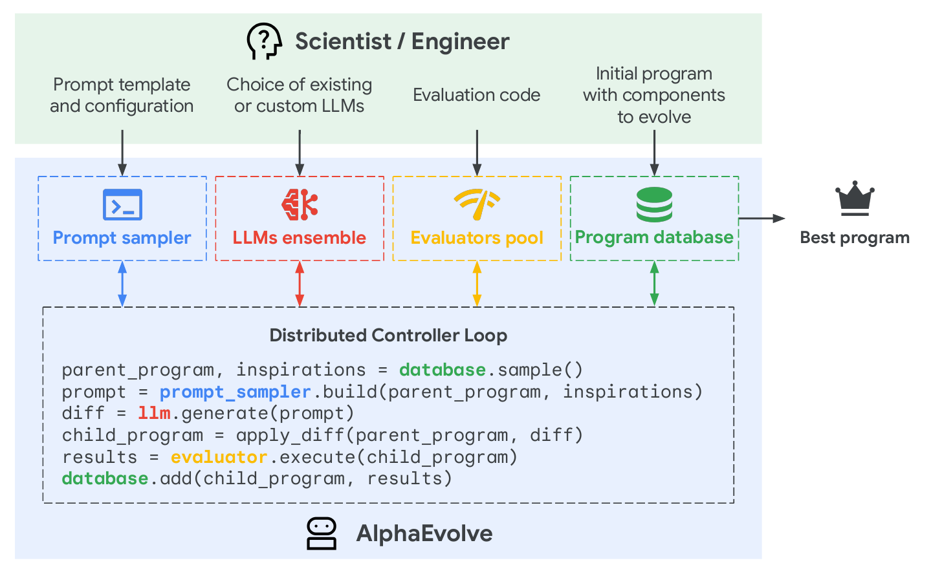
MECHANISM
The AlphaEvolve discovery process
05
Notes:
Target time: 2:00 to 3:15. Use the expanded process diagram. Identify the four colored modules, then walk through the six lines in the distributed controller. The user supplies evaluation code and an initial program; the system samples parents and inspirations, builds prompts, applies code diffs, executes the evaluator, and stores outcomes. This is the map for the three techniques that follow. Source: https://arxiv.org/pdf/2506.13131. The screenshot preserves the source figure; explanatory text outside it is presenter commentary.

Slide 6
KEY TECHNIQUE 1 OF 3
A task is a skeleton, evolve blocks and a grader
Only marked blocks mutate
# EVOLVE-BLOCK-START
Fixed surrounding code keeps the integration interface; the evaluator rejects children that fail.
def init_fn(): ...
def loss_fn(decomp, target): ...
def optimizer(): return optax.adam(lr)
The grader returns a dict
def sweep(): return hyper.zipit([...])
Several scalar metrics, all maximized. Extra metrics add diversity.
# EVOLVE-BLOCK-END
The seed can be trivial
def evaluate(program) -> dict[str, float]:
Functions that just return constants are a valid starting point.
best, frac = run_seeds(program, targets)
return {"neg_rank": -best, "hit_rate": frac}
Abstraction is a design choice
Evolve the answer, a constructor, or a search algorithm.
06
Notes:
Target time: 3:15 to 4:30.
PRESENTATION CUE: The user supplies an initial program and evaluator, then marks which code may change. The fixed skeleton preserves an interface, not correctness. Invalid children can still fail. The code shown is a simplified sketch, not a verbatim code listing from the paper.
• Abstraction is a design choice (your independent explanation): choose the representation that AlphaEvolve will search over before a run. (1) Direct representation: code contains the candidate answer itself, such as point coordinates. (2) Constructor: code generates a candidate from a compact rule. (3) Search procedure: code iteratively improves a candidate under a time budget. For a packing problem these mean changing coordinates, changing a rule that lays out points, or changing an optimizer that moves points around. These choices bias which answers are easy to find.
• Matrix multiplication example: the evolved artifact is the numerical search procedure that finds a decomposition. The final decomposition is an output of that procedure. This distinction is also the subject of backup slide 21.
• Source: AlphaEvolve §2.1. The preference for constructors on symmetric solutions and search procedures on asymmetric ones is the authors’ hypothesis, not a theorem. https://arxiv.org/pdf/2506.13131

Slide 7
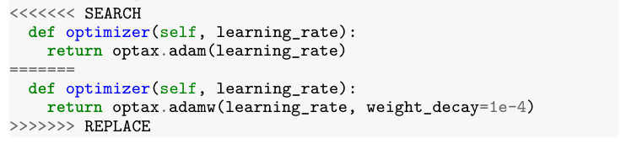
KEY TECHNIQUE 2 OF 3
Prompt context and a generated code edit
How the prompt is assembled
SEARCH / REPLACE output
Task instructions and problem context
Parent code, scores and execution outputs
Inspiration programs from the database
Request for SEARCH/REPLACE diffs
Illustrative edit: replace Adam with AdamW.
Meta-prompt evolution
The LLM also proposes new instruction text. These variants co-evolve in a separate database alongside the programs.
Model ensemble: Gemini 2.0 Flash supplies many candidates; Gemini 2.0 Pro supplies fewer, higher-quality proposals.
07
Notes:
Target time: 4:30 to 5:45.
PRESENTATION CUE: The sampler combines code, measured feedback and task context into a prompt. The code-writing LLM returns a SEARCH/REPLACE edit. The screenshot is Figure 3(c), an illustrative supervised-learning example; it is not the actual matrix-multiplication run.
• How the prompt is built: sample a parent program and other programs for inspiration; include code plus scores and execution outputs; add the user's task background, equations or papers; include instructions about permissible changes and the required diff format. The slide is a conceptual ingredient list, not a claim that every prompt uses one exact ordering. The paper also randomizes some template choices to increase diversity.
• Meta-prompt evolution: programs are not the only evolving objects. In an additional generation step the LLM proposes instruction/context text, which co-evolves in a separate database. An illustrative instruction might be “try changing the initialization as well as the optimizer.” That example is mine, not a quoted prompt from the paper. Changing the instruction can change the kinds of program edits the next LLM call proposes.
• What is known versus inferred: the paper states that instruction/context variants co-evolve in a separate database. It does not specify the exact scoring, credit-assignment or selection algorithm for them. It is natural to expect downstream program performance to inform their usefulness, but do not present that implementation as documented fact. The meta-prompt ablation is on tensor decomposition only.
• Why two models: the ensemble balances throughput and capability. Gemini 2.0 Flash supplies many proposals per unit time; Pro supplies fewer, higher-quality proposals. Both propose edits within the same search. Do not imply Pro formally verifies Flash or that a fixed handoff schedule is reported.
• No model-weight learning is implied: the evolutionary loop changes programs and prompt text. This is different from updating Gemini’s neural-network weights.
Source: AlphaEvolve §2.2–2.3, Fig. 3 and §4. https://arxiv.org/pdf/2506.13131

Slide 8
KEY TECHNIQUE 3 OF 3
Grade cheaply first, and keep diversity alive
Evaluation cascade
Evolutionary database
Stage 1 · tiny test, kills broken code
Inspired by MAP-Elites and islands: retain strong but different programs across subpopulations.
Stage 2 · harder test cases
Async pipeline: controller, LLM samplers and evaluators, tuned for throughput rather than latency.
Stage 3 · full evaluation
Expensive evaluation can become the bottleneck, and making it fast is a systems problem.
In practice: each matmul candidate runs from many random seeds through the cascade and is scored on the best rank and the share of seeds that reach it. Borg candidates are scored in a fleet simulator that replays historical workloads.
AlphaEvolve §2.4 to §2.6
08
Notes:
Target time: 5:45 to 7:00.
PRESENTATION CUE: This slide answers two questions: how do we avoid spending full evaluation compute on bad candidates, and how do we avoid keeping only one kind of program?
• Evaluation cascade: run cheap tests first, then progressively more expensive tests only for promising programs. A syntax error, invalid output or poor early score can stop a candidate before it consumes the full budget. This is a resource-allocation mechanism. The cascade need not have exactly three stages; the three boxes are a schematic.
• Example: a generated matrix-decomposition search program can first be tested with a small budget or fewer randomized starts. Stronger candidates get more expensive evaluation. The exact stage sizes are task-dependent; do not invent a fixed number of seeds for this diagram.
• Evolutionary database: retaining only one winner can make every new prompt look alike. Retain several good but different candidates so one promising family does not immediately eliminate all alternatives. MAP-Elites keeps elites across different niches; island models maintain separate populations that can exchange information. The paper says its database is inspired by a combination of these ideas, without publishing the exact niche definitions or population algorithm.
• Multiple scores can help diversity: programs that excel on different metrics can supply different ideas to future prompts even when one metric is the final target.
• Asynchronous pipeline: model calls and evaluations run concurrently. The goal is high total throughput, rather than forcing all workers to wait for each candidate in sequence. Expensive evaluation can become a bottleneck; the paper does not measure it as the universal bottleneck.
• There are two kinds of scores in the upcoming Borg example: the deployed heuristic scores machines for one job; the evaluator scores an entire candidate heuristic using fleet-level outcomes.
Source: AlphaEvolve §2.4–2.6. https://arxiv.org/pdf/2506.13131

Slide 9

PUTTING IT TOGETHER · WORKED EXAMPLE
One task through the loop: Borg scheduling
INPUTS
MAY CHANGE
STAYS FIXED
Job’s CPU and memory needed; machine’s CPU and memory free
Placement priority for one job–machine pair
Borg’s feasibility checks: only valid machines get ranked
1
2
3
4
5
Seed
Prompt
Mutate
Grade
Verify
Start from the production heuristic
Current heuristic plus its simulator score
LLM diff edits the scoring function
Grade the whole heuristic on historical fleet snapshots
Unseen recent workloads, then fleet rollout
Steps 2 to 4 are the generic loop applied here; the paper does not publish the Borg prompts, run length or intermediate scores. An early version of AlphaEvolve was used.
09
Notes:
Target time: 7:00 to 8:30.
PRESENTATION CUE: Borg places jobs on machines. AlphaEvolve changes one placement heuristic offline, while Borg’s feasibility checks remain fixed. The deployed result is ordinary code; an LLM is not called for each scheduling decision.
• Background on Borg: it is Google’s cluster-management system. Users submit jobs made of tasks with resource requirements. Borg coordinates where tasks run while respecting resource and other placement constraints. This presentation simplifies one placement decision to CPU and memory; that is not Borg’s entire scheduling policy.
• Why placement matters: a machine can have spare CPU but insufficient memory for a waiting task, while another machine has spare memory but insufficient CPU. These fragments can be hard to use even though the fleet has resources left in aggregate. Better resource packing can leave capacity in combinations that future tasks can use.
• Score 1, machine priority: given one job and one feasible candidate machine, the evolved function uses the job’s required CPU/memory and the machine’s available CPU/memory to return a priority. Borg uses the score to rank feasible machines, alongside its other scheduling objectives. A higher score means a preferred placement under this heuristic.
• Score 2, AlphaEvolve fitness: a fleet simulator runs a candidate heuristic against historical workload/capacity snapshots and measures its fleet-level performance. This is the feedback used to evolve the heuristic. The paper does not publish a full Borg evaluator formula or the intermediate score history. Do not equate a yellow point in the next heatmap with measured fleet utilization.
• Follow the loop: production heuristic as seed; parent/context in a prompt; LLM code edit; simulator feedback; further search. Then unseen recent workloads and fleet deployment validate the selected heuristic. Steps 2–4 are the generic loop applied to this case, not a published Borg-specific prompt transcript.
Sources: AlphaEvolve §3.3.1, https://arxiv.org/pdf/2506.13131 ; Borg, Verma et al. (2015), https://research.google/pubs/large-scale-cluster-management-at-google-with-borg/

Slide 10
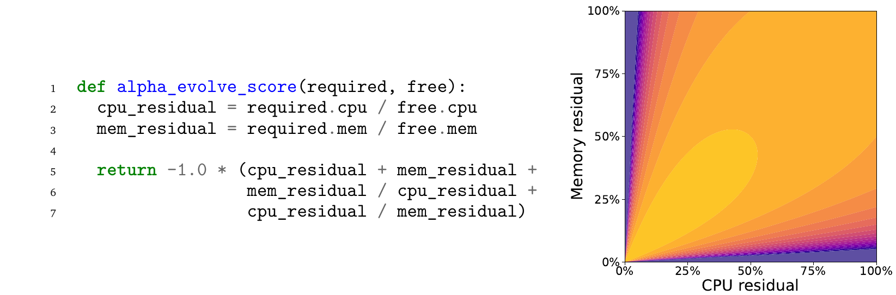
RESULT 1 · DATA CENTER SCHEDULING
The discovered Borg heuristic and its score surface
How to read the heatmap
Better packing makes previously stranded capacity usable: 0.7% of fleet compute, confirmed after rollout.
Axes: job requirement / available resource, for CPU and memory. Yellow means higher placement priority. These ratios are not leftover capacity.
10
Notes:
Target time: 8:30 to 9:15.
PRESENTATION CUE: The left side is the actual discovered scoring function. The right side plots that function; it is not a speedup chart or a history of training.
• Axes: x = job CPU required / machine CPU available; y = job memory required / machine memory available. Despite the variable names “cpu_residual” and “mem_residual,” these values are fractions consumed from the currently available resources, not the fractions left over afterward. A value of 0.5 means the job would use half of the available amount of that resource.
• Color: the code computes s = -(x + y + y/x + x/y). Higher scores are less negative. Yellow indicates higher priority and purple lower priority. Borg prefers higher-priority feasible placements. The heatmap is not evidence of a percentage speedup.
• Numerical illustration: with x = y = 0.5, the score is -3. With x = 0.8 and y = 0.2, it is -5.25. Under this heuristic the first pair gets higher priority. The ratio terms penalize imbalance because x/y + y/x is at least 2, with equality at x = y. The x+y term also matters, so balance alone does not determine the whole score. This algebra is my interpretation of the code, not a separate claim by the authors.
• What “recovered” means: better placement makes capacity that would otherwise be stranded usable for more work. It does not make individual CPUs run 0.7% faster, and the paper does not establish a 0.7% reduction in total electricity use. An illustrative fleet with 100 comparable capacity units would make about 0.7 additional units usable; these are hypothetical units, not actual machine counts.
• How to react to 0.7%: small per unit, potentially valuable across a continuously running fleet. The important research evidence is the progression from historical simulation to unseen workloads to post-rollout measurements. The paper does not provide enough detail to convert the percentage into a dollar value or a number of physical servers.
Source: AlphaEvolve Fig. 6 and §3.3.1. https://arxiv.org/pdf/2506.13131

Slide 11
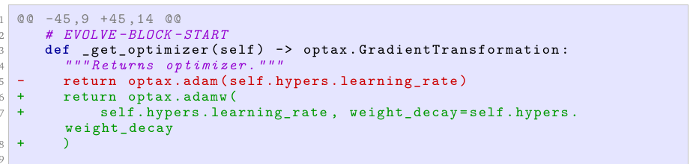
RESULT 2 · MATRIX MULTIPLICATION
Evolving a matrix multiplication search algorithm
An actual optimizer change in the evolved tensor-decomposition program
What evolves
What is verified
A numerical solver for tensor decompositions. The LLM edits its optimizer, initialization, loss and sweep.
An exact decomposition using 48 complex multiplications for 4×4 matrices, versus Strassen’s 49.
11
Notes:
Target time: 9:15 to 10:00.
PRESENTATION CUE (short version): AlphaEvolve evolves a numerical search program. That program finds an exact matrix-multiplication algorithm. The code screenshot is one edit in the search program, not the final 48-multiplication formula.
• Start with familiar multiplication: C = AB for two 4×4 matrices has 16 output entries. Each output is a sum of four products, so the standard method uses 64 scalar multiplications. Strassen uses seven products for 2×2 matrices; applying it twice gives 7×7 = 49 products for 4×4 matrices.
• How can fewer products suffice? Form linear combinations of A’s entries and linear combinations of B’s entries; multiply selected pairs; combine those products to recover all of C. A suitable tensor decomposition encodes those combinations. A decomposition with r terms supplies an algorithm with r scalar multiplications. Finding one with r = 48 proves the minimum rank is at most 48, not that 48 is optimal.
• Two nested searches: the outer AlphaEvolve loop edits a numerical solver. The inner solver searches for a low-rank tensor decomposition. The outer loop can change initialization, the loss function, optimizer or parameter sweep. Candidates are evaluated across randomized starts, including best rank and the fraction of successful starts.
• Read the screenshot: red deletes Adam; green adds AdamW with a weight-decay parameter. Here Adam/AdamW optimize the candidate decomposition’s coefficients. This is not Gemini’s own training optimizer, and it is not the 48-step matrix multiplication procedure. The complete run accumulated 15 mutations across several parts of the solver, so the screenshot does not establish that AdamW alone caused the result.
• Exactness: numerical discovery alone is insufficient. The evaluation rounds coefficients toward integers or half-integers and checks an exact decomposition. The released finite object can be independently verified. The result uses 48 complex-valued multiplications for 4×4 complex matrices, improving on recursive Strassen’s 49 in that arithmetic setting. AlphaTensor’s 47 refers to arithmetic mod 2, a different setting.
• Boundaries: fewer scalar multiplications do not by themselves prove lower runtime on a GPU; additions, memory traffic and complex arithmetic matter. This mathematical example is distinct from the next slide’s TPU tiling result. The 1% Gemini-training reduction does not come from deploying the rank-48 algorithm.
Source: AlphaEvolve §3.1, Fig. 4, Tables 2–3 and Appendix A. https://arxiv.org/pdf/2506.13131

Slide 12
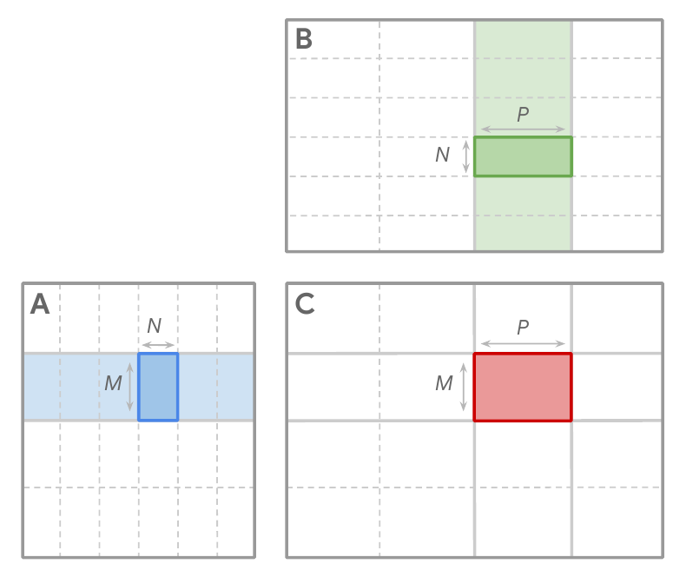
RESULT 3 · AI FOR COMPUTING
Kernel tiling on real TPU workloads
Search space
Choose tiles: A is M×N, B is N×P, and C is M×P. Change the tiling rule, keeping AB=C fixed.
Evaluation
Measure runtime on real TPUs. Reserve half of the collected input shapes for evaluation.
Reported result: 23% average kernel speedup and 1% less Gemini training time versus the expert heuristic. Gemini, the model inside AlphaEvolve, helped speed up its own training.
Other cases: XLA IR edits (32% attention speedup); TPU RTL simplification (no area/power gain quantified).
12
Notes:
Target time: 10:00 to 11:00.
PRESENTATION CUE: This case keeps matrix multiplication fixed and optimizes how it is partitioned for the TPU. Unlike the previous slide, it is a runtime improvement to a practical kernel, not discovery of a new multiplication identity.
• Why tiles? Moving data between memory and compute is expensive. A kernel breaks a large multiplication into smaller blocks that fit the accelerator’s working memory and can reuse inputs. Larger blocks can improve reuse but consume more resources; smaller blocks can waste computation or increase data movement. The best choice depends on shapes, fused operations, hardware and compiler details.
• Read Figure 7: the blue A tile is M rows by N columns. The green B tile is N rows by P columns. Their product contributes to a red C tile of M rows by P columns. The kernel accumulates contributions across the remaining blocks of the shared inner dimension. M, N and P in this figure are tile dimensions, not a claim that the full input has only those dimensions.
• What AlphaEvolve changes: a heuristic that maps the actual kernel/input situation to tile sizes. It evolves the rule, rather than merely finding one tile size for one fixed shape. The existing kernel still computes AB = C. Preserving the underlying operation is the intended correctness boundary; arbitrary malformed code still needs rejection.
• Evaluator: measure real runtime on TPU accelerators. The authors collect realistic input shapes; half drive optimization and half are held out for evaluation. This split tests generalization beyond the shapes directly optimized.
• Result interpretation: the paper reports 23% average kernel speedup over the expert-designed heuristic, corresponding to about 1% less overall Gemini training time. A kernel is only part of a training run, so a larger local speedup can yield a smaller end-to-end reduction. These percentages should not be added together. The months-to-days statement concerns kernel-optimization turnaround, not all experiments or all human effort.
• “Improves its own training”: Gemini supplies proposals inside AlphaEvolve; the discovered heuristic is used in Gemini’s training infrastructure. This is an infrastructure feedback loop across training runs, not the running model rewriting and immediately retraining itself during the search.
• Other cases in the footer: direct XLA IR editing speeds one attention configuration by 32%, with 15% separately for pre/postprocessing. The RTL case removes unnecessary bits while preserving functionality; no chip-level area or power percentage is quantified, and synthesis tools independently found that simplification too.
Source: AlphaEvolve Fig. 7 and §3.3.2–3.3.4. https://arxiv.org/pdf/2506.13131

Slide 13
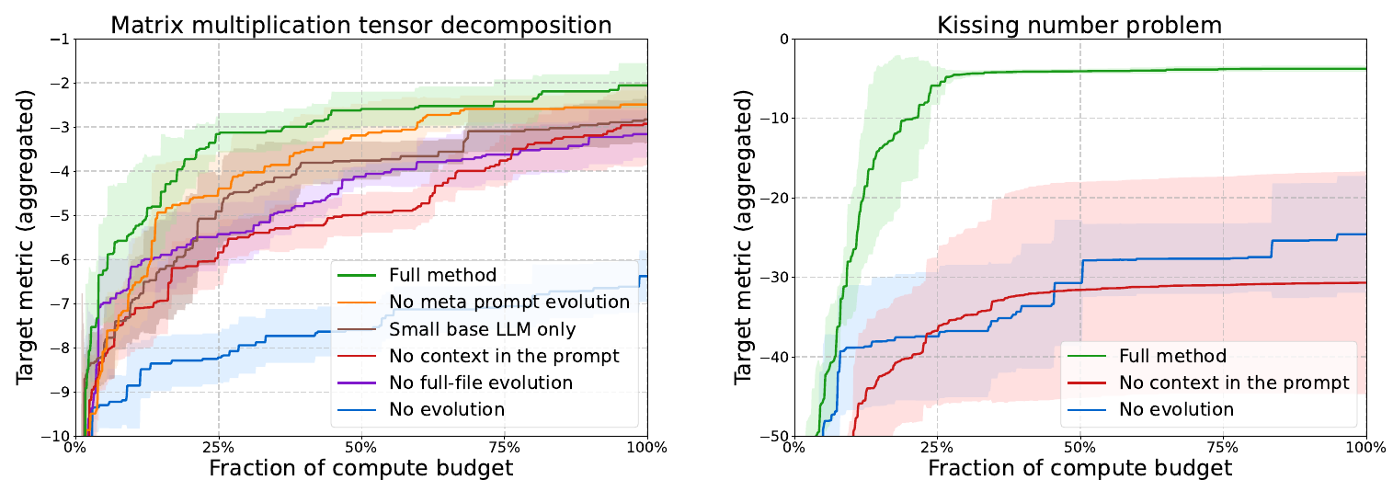
ABLATIONS
Ablations on two mathematical tasks
Read the curves
Compare the full method with No evolution. These math tasks support the mechanism; systems gains lack equivalent ablations.
x: fraction of compute budget.
y: aggregate metric, higher is better. Three runs.
Novikov et al. (2025), Fig. 8 and §4. Screenshot from the paper
13
Notes:
Target time: 11:00 to 12:30. Read both panels directly: tensor decomposition on the left and kissing numbers on the right. The green curve is the full method. Compare it first with the blue No evolution baseline, which repeatedly samples from the same initial program. The horizontal axis is a fraction of the compute budget, not an absolute cost. The caption describes intra-target standard deviation averaged over three independent runs; the bands are not confidence intervals. Meta-prompt and full-file ablations appear only on tensor decomposition. Close with the limitation: no equivalent ablations establish the drivers of production systems improvements. Source: https://arxiv.org/pdf/2506.13131. The screenshot preserves the source figure; explanatory text outside it is presenter commentary.

Slide 14
CRITIQUE 1 · RESULT VALIDITY
How strong is the evidence that the results work?
MATHEMATICAL RESULT
PRODUCTION RESULT
A finite object that can be checked independently
Borg was checked beyond the simulator
The released rank-48 decomposition supports exact correctness. It does not prove that rank 48 is optimal.
Unseen workload tests and fleet measurements support practical value under Google’s conditions.
CORRECTNESS BOUNDARY
ASSESSMENT
The guarantee depends on the task interface
Strong evidence for selected results
Borg ranks feasible machines. IR edits instead require reference tests and expert verification.
Correctness and deployment evidence establish useful outputs. They do not establish search efficiency.
14
Notes:
Target time: 12:30 to 14:00.
PRESENTATION CUE: The question for this slide is result validity: do the reported outputs actually work? A critique evaluates both strengths and limitations; it need not be negative. This slide should explain why confidence in some claims is justified, then mark the boundary of that confidence.
• Mathematical result: the released rank-48 decomposition is a finite object whose identities can be checked. This supports correctness of the new multiplication procedure independently of rerunning AlphaEvolve. It does not prove optimal rank or efficient discovery.
• Production result: Borg has unseen-workload tests and fleet measurements after rollout; the tiling heuristic has held-out shapes. These are stronger than reporting optimization on the same simulator examples alone. They remain evidence under Google’s tested conditions.
• Correctness boundary: Borg changes a ranking among machines already judged feasible. Kernel tiling preserves the mathematical operation. Direct compiler IR edits instead require reference-output tests and final expert verification. Avoid the blanket statement “most edits cannot break correctness”; guarantees depend on the search interface.
• Assessment: useful output quality is well supported for selected cases. Discovery cost and causal contribution of individual components are separate questions, addressed on the next slide. This is the analytical purpose of the strengths slide rather than a repeat of headline gains.
Source: AlphaEvolve §3.1 and §3.3. https://arxiv.org/pdf/2506.13131

Slide 15
CRITIQUE 2 · SEARCH EFFICIENCY
Is this an efficient way to obtain the gains?
SEARCH COST
SYSTEMS BASELINES
Per-result token counts, LLM calls and evaluator compute are not reported. The cost of discovery remains unclear.
Production heuristics are relevant baselines. Equal-budget sampling or autotuning would test the search method itself.
COMPONENT EVIDENCE
ASSESSMENT
“No evolution” helps isolate the loop on two math tasks. Equivalent systems ablations are missing.
The paper demonstrates useful discoveries, but does not establish superior gains per unit of search compute.
15
Notes:
Target time: 14:00 to 16:00.
PRESENTATION CUE: The question for this slide is search efficiency: did the method obtain the gains more efficiently than available alternatives? All four cards address that one question.
• Search cost: aggregate statements such as thousands of samples are not per-result budgets. The paper does not provide the token counts, LLM calls and evaluator compute needed to judge gains per unit of discovery cost for each result. Engineering turnaround is a different measure and should not be ignored, but it also does not replace a compute-cost comparison.
• Systems baselines: beating an expert-designed production heuristic is meaningful evidence of a useful output. It does not isolate whether evolutionary memory is a more efficient way to find that output than repeated LLM sampling or classical autotuning under comparable budgets and information.
• Component evidence: acknowledge the No evolution ablation. It repeatedly prompts from the same starting program and helps test the loop on two math tasks. The ablations include other component removals as well. The gap is the absence of equivalent systems ablations; do not claim the paper has no baseline at all or proves nothing about evolution.
• Assessment: the evidence establishes capability and useful discoveries. It does not establish that the full method is the most efficient route to those gains. That is a narrower and more defensible conclusion than declaring every production baseline unfair.
Source: AlphaEvolve Table 1, §3.3 and §4. https://arxiv.org/pdf/2506.13131

Slide 16
CRITIQUE 3 · GENERALITY
How far do the results generalize?
EVALUATOR COVERAGE
HUMAN-DEFINED SEARCH SPACE
Success depends on what the grader captures
The setup still requires domain expertise
A simulator or sampled input set is a proxy for deployment. Held-out shapes and fleet checks help, but do not establish robustness to every workload change.
Humans define the evaluator, choose what code may change and select the problems. Some matrix targets also received expert-seeded ideas.
The curated problem set demonstrates breadth, but does not establish a success rate across science in general. Reproducing the systems results also requires Google’s internal infrastructure.
Authors’ stated boundary: a task needs an automated evaluator. Tasks requiring manual experimentation are outside the scope of this setup.
16
Notes:
Target time: 16:00 to 18:00.
PRESENTATION CUE: The question for this slide is generality: what conditions must hold before we expect this success on another problem? Both columns concern those conditions. There is no proposed-experiment section.
• Evaluator coverage: optimizing a proxy only guarantees success on what the proxy measures. Systems evaluators may use historical simulation or a finite input-shape set. A new workload can expose failures or weaker performance outside those conditions. Held-out shapes, fleet rollout and expert verification mitigate that risk; the paper does not show that all proxy gaps disappear. Do not claim observed reward hacking or unavoidable failure; this is a methodological risk.
• Human-defined search space: domain experts choose the abstraction, the editable code, the evaluator and the tasks. Some matrix sizes also benefit from expert-seeded starting ideas. The automated search begins after that setup. Human input does not negate the discovered result, but limits claims about autonomy and unassisted breadth.
• Curated task selection: the percentages for 50+ mathematical construction problems describe that expert-selected set. They are not an estimated success probability on arbitrary scientific problems. The paper does not quantify how these tasks compare in difficulty with equal-budget human search or alternative algorithms. That supports a task-selection limitation; it does not support stating as fact that the tasks are easy, neglected or merely brute-force wins. Record age alone is also not a controlled difficulty measure.
• Reproducibility: mathematical outputs can be checked without recreating the discovery process. Reproducing the systems search requires internal infrastructure and unavailable setup details. Keep those two kinds of reproducibility distinct.
• Authors’ stated scope: an automated evaluator is essential. Tasks requiring manual experimentation are outside this setup. This is an application boundary, not a claim that every natural-science problem is excluded.
Source: AlphaEvolve §2.1, §3.1–3.3 and §6. https://arxiv.org/pdf/2506.13131

Slide 17
TAKEAWAYS
Three things to remember
01
The evaluator is the interface. Any problem with a trustworthy automated grader, even an expensive one, becomes searchable by code-writing LLMs.
02
Systems wins are small per unit but compound. 0.7% of a fleet and 1% of Gemini training, found in days instead of months.
03
Capability is shown; efficiency is not. Cost reporting and budget-matched baselines are the missing piece.
17
Notes:
Target time: 18:00 to 18:30, which ends the prepared talk with a buffer under the 20-minute cap. One breath per point. First, writing a trustworthy evaluator is now the main job, and it can be slow and expensive as long as it is parallel. Second, for systems, the percentages are modest but apply to infrastructure that runs constantly at enormous scale, and engineering time dropped from months to days. Third, the paper shows the approach can work, not that it is the most efficient way to get these results. Then open discussion.

Slide 18
Thank you!
Any Questions?
19
Notes:
Not presented. Jump here only if a question needs it.

Slide 19
APPENDIX
Backup slides
20 · Selected matrix multiplication results
21 · Evolving the search procedure
22 · Open math problems
23 · AlphaDev and KernelBench
For questions only
19
Notes:
APPENDIX GUIDE (not part of the prepared talk): this divider introduces optional explanations. Slide 20 explains what the matrix-multiplication table means. Slide 21 explains why evolving a search algorithm differs from evolving its answer. Slide 22 illustrates the kinds of mathematical constructions. Slide 23 connects AlphaEvolve to AlphaDev and KernelBench. Use a backup only when a question calls for it; do not add all four to the 20-minute talk.

Slide 20
BACKUP · MATRIX MULTIPLICATION
Selected upper bounds on tensor rank
⟨m,n,p⟩ | Best known before | AlphaEvolve
⟨4,4,4⟩ (complex) | 49 | 48
⟨3,4,7⟩ | 66 | 63
⟨4,5,6⟩ | 93 | 90
⟨3,4,6⟩ | 56 | 54
⟨2,4,5⟩ | 33 | 32
⟨5,5,5⟩ | 93 | 93
14 targets improved; matched or beat the best known for every m, n, p ≤ 5. ⟨3,4,7⟩, ⟨4,4,4⟩ and ⟨4,4,8⟩ use complex-valued multiplications. Some targets were seeded with the authors’ own ideas.
Selected rows from Table 2 of the paper
20
Notes:
BACKUP 20: HOW TO READ THE MATRIX-MULTIPLICATION TABLE
• A row ⟨m,n,p⟩ means multiply an m×n matrix by an n×p matrix to obtain an m×p matrix. For example ⟨3,4,7⟩ means (3×4) times (4×7), producing a 3×7 result. The usual algorithm uses mnp scalar products; smarter identities can use fewer.
• Each number is a multiplication count achieved by a known exact algorithm, hence an upper bound on the minimal tensor rank. Lower is better. A row changing 49 to 48 says an algorithm with 48 products exists; it does not prove no algorithm using 47 exists.
• The selected rows demonstrate both improvements and a tie. ⟨5,5,5⟩ remains 93; this is a matched best-known result, not a failure or improvement. Across the full Appendix A table there are 54 targets: 14 improved, 38 tied and 2 behind prior best-known results. This slide contains selected rows, not that full table.
• Arithmetic setting matters: the ⟨4,4,4⟩, ⟨3,4,7⟩ and ⟨4,4,8⟩ algorithms use complex-valued products. Do not interpret these counts as an identical number of ordinary real-valued hardware multiplies, or compare directly with mod-2 counts without qualifying the field.
• How to present: “This table records concrete algorithms, not just approximate numerical fits. The main example is the 48-product complex 4×4 construction; the other rows show the method also finds useful decompositions for different shapes.” The strongest claim is existence of the verified constructions, not guaranteed wall-clock speedups.
Source: AlphaEvolve Tables 2–3 and Appendix A. https://arxiv.org/pdf/2506.13131

Slide 21

BACKUP · THE TRICK BEHIND THE MATH RESULTS
Evolve the search procedure, not the answer
each generation: a heuristic gets a fixed budget (e.g. 1000 s) and starts from the previous best construction
START
EARLY HEURISTICS
LATE HEURISTICS
Random or trivial
Big jumps
Fine polishing
A simple construction, no expert tailoring
Good at large gains from crude starting points
Good at nudging near-optimal configurations
Why it works: selection rewards heuristics that improve already-good solutions, producing a multi-stage search that no human wrote.
Authors’ hypothesis: constructor functions suit highly symmetric solutions; custom search suits non-symmetric ones.
AlphaEvolve §2.1 and §3.2
21
Notes:
BACKUP 21: EVOLVING THE SEARCH PROCEDURE
• Two levels: the final object might be a point configuration, but the code being evolved is a procedure for finding or improving such a configuration. AlphaEvolve searches over search algorithms.
• Example (illustrative, not a logged run): the current object is a circle packing. One search program tries large moves to escape a poor arrangement; another makes small coordinate adjustments near a dense packing. Under a fixed time budget, selection favors a program that improves the current best construction.
• Read the sequence: the overall process begins with a simple or random construction. Early searchers can make large improvements. Later searchers receive an already strong construction and must improve it further; their useful behavior can be different. The process therefore yields a sequence of specialized refinements. It does not require every generation to start again from random points.
• Why it may help: a short program can encode many coordinated moves, or a repeatable search strategy, that would be difficult to discover by mutating an answer’s coordinates directly. This is an empirical design idea, not a proof that evolving search always wins.
• Abstraction: a direct candidate, a constructor and an improvement algorithm impose different search biases. The paper hypothesizes that constructors suit highly symmetric answers, while custom search can help with asymmetric ones. Keep this qualification.
• The 1000-second budget is an example used in the paper’s discussion of mathematical searches, not a fixed budget for every AlphaEvolve experiment.
Source: AlphaEvolve §2.1, §3.2 and §6. https://arxiv.org/pdf/2506.13131

Slide 22
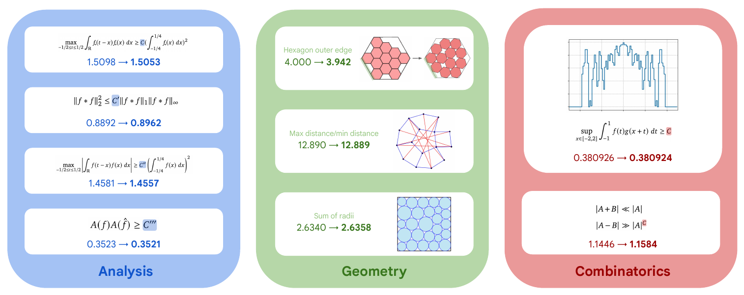
BACKUP · OPEN MATH PROBLEMS
Examples of mathematical constructions
The output can be a geometric configuration, a function, or a finite set. AlphaEvolve evolves the program that searches for it.
Across 50+ problems: approximately 75% matched prior constructions and 20% improved them.
Novikov et al. (2025), Fig. 5, §3.2 and Appendix B. Screenshot from the paper
22
Notes:
BACKUP 22: WHAT THE MATHEMATICAL-CONSTRUCTIONS FIGURE SHOWS
• This is a gallery of candidate mathematical objects. It is not a diagram of the AlphaEvolve architecture. The columns group examples from analysis, geometry and combinatorics.
• Analysis (blue): the objects are functions that improve numerical bounds in inequalities. A good explicit function can supply a stronger bound, even though it does not determine the exact optimal constant. You do not need to derive every norm or integral in this backup figure during the talk.
• Geometry (green): points, polygons or circles are arranged to improve a geometric objective. The drawings show particular configurations. Depending on the problem, improvement can mean packing into a smaller boundary, reducing a maximum-distance/minimum-distance ratio, or increasing the sum of packed radii.
• Combinatorics (red): one panel illustrates the minimum-overlap construction with a function graph; the other concerns cardinalities of sumsets and difference sets of finite sets. For a set A, A+A contains pairwise sums and A−A contains pairwise differences. These are examples of objects optimized under a mathematical objective, not general-purpose kernel benchmarks.
• Read each arrow with its own objective: some upper bounds improve by decreasing, while some lower bounds improve by increasing. There is no single global “bigger is better” rule for the printed values. The external evaluate() score can be signed so that the system maximizes it.
• Approximately 75% matched prior constructions and 20% improved them in the studied 50+ problem set. These describe the curated task set, not success rates over all mathematical research. A stronger construction or bound usually leaves the underlying open problem unresolved.
• The 593-sphere kissing construction in 11 dimensions is another headline example discussed in §3.2. Do not identify the two-dimensional drawings in this figure as literal pictures of that 11-dimensional configuration.
Source: AlphaEvolve Fig. 5, §3.2 and Appendix B. https://arxiv.org/pdf/2506.13131

