Slide 1
KernelBench: Can LLMs Write Efficient GPU Kernels?
Anne Ouyang, Simon Guo, Simran Arora, Alex L. Zhang, William Hu, Christopher Ré and Azalia Mirhoseini
Stanford University and Princeton University, ICML 2025
Mingkai Li and Shufeng Chen
COMS 6998 - AI for Software Systems
Notes:
Slide 1: title page
Presenter A. Target 30 seconds. Guide section, Source scope.
Spoken text
Good morning. We are presenting KernelBench, a benchmark published at ICML 2025. It asks whether a language model can turn a PyTorch workload into GPU code that produces the right answer and runs faster. Kernel development requires both knowledge of the computation and knowledge of the hardware. KernelBench gives models a setting where we can measure both. We will explain the task format, the evaluation, and the feedback loop, then discuss the results and the limits of the check.
Sources
Original paper, abstract and Sections 1 and 3, pages 1 to 5. ICML publication: https://proceedings.mlr.press/v267/ouyang25a.html.

Slide 2
GPU kernels and PyTorch operators
A GPU kernel is a function launched on the GPU, where thousands of threads run the same code on different data.
In an add kernel, thread i computes out[i] = a[i] + b[i], and threads run in blocks of 256.
A PyTorch operator is one library call, such as torch.matmul.
PyTorch Eager, the default mode, runs each operator by calling a tuned library kernel, such as cuBLAS for matmul.
out = a + b one PyTorch operator
one kernel launch on the GPU
block 0 | thread 0 out[0] = a[0] + b[0]
| thread 1 out[1] = a[1] + b[1]
| ...
| thread 255 out[255] = a[255] + b[255]
block 1 | thread 0 out[256] = a[256] + b[256]
| ...
Every thread runs the same line of code on its own index i.
Notes:
Slide 2: GPU kernels and PyTorch operators
Presenter A. Target 55 seconds. Guide section, GPU background.
Spoken text
A GPU kernel is a function launched on the GPU. Many threads execute its code on different pieces of data. Threads are organized into blocks. In this example, each block has 256 threads, and each thread adds one pair of elements. Block zero handles indices zero through 255. Block one begins at index 256.
A PyTorch operator is a library operation, such as matrix multiplication. PyTorch Eager executes operations as Python reaches them and dispatches GPU work through libraries. Matrix multiplication commonly uses cuBLAS, NVIDIA's matrix library.
Our addition example has one operator and one kernel launch. That correspondence depends on the operation. A more complicated operator can launch several kernels. KernelBench lets the model replace part or all of this GPU computation while keeping the PyTorch module interface.
Sources
Original paper, Sections 3.1 and 3.2, pages 3 to 4, Appendix C.1, page 20. NVIDIA CUDA programming model.

Slide 3
Memory traffic and operator fusion
GPU memory has a small fast part, registers and shared memory, and a large slow part, global memory.
Eager runs the GELU activation as about eight separate kernels, and each one reads and writes global memory.
A fused kernel computes the whole formula per element, so it reads x once and writes the output once.
Operator fusion is what torch.compile, the PyTorch compiler, does for chains like this one with rule-based heuristics.
GELU(x) = 0.5 * x * (1 + tanh(sqrt(2/pi) * (x + 0.044715 * x^3)))
Eager runs 8 kernels, pow, mul, add, mul, tanh, add, mul and mul, each a round trip to global memory.
Fused runs 1 kernel, gelu_kernel, with one read of x and one write of the output.
GELU formula as written in the KernelBench Level 1 task.
Notes:
Slide 3: Memory traffic and operator fusion
Presenter A. Target 60 seconds. Guide section, Fusion and GELU.
Spoken text
Fusion creates an opportunity to beat a sequence of tuned library calls. GPUs have fast registers and shared memory close to the computation, plus larger global memory. Repeatedly writing intermediate results to global memory can be expensive.
GELU is an activation function. This task writes its approximation as a sequence of powers, additions, multiplications and a hyperbolic tangent. Eager executes about eight kernels for this expression. Intermediate tensors travel through global memory between those kernels.
A fused kernel loads one element of x, computes the whole expression, and stores one output element. Intermediate values can stay in registers. Fusion reduces memory traffic and kernel launch overhead. KernelBench reports a 2.9 times speedup for this example.
PyTorch's compiler, torch.compile, also performs fusion. That makes the compiler baseline useful when asking how much of a model's improvement an existing compiler already provides.
Sources
Original paper, Section 6.1, page 10, Appendix D.2, pages 24 to 25, Appendix B.4, pages 18 to 19. Eight launches describes this expression's illustrative Eager decomposition and depends on the implementation.

Slide 4
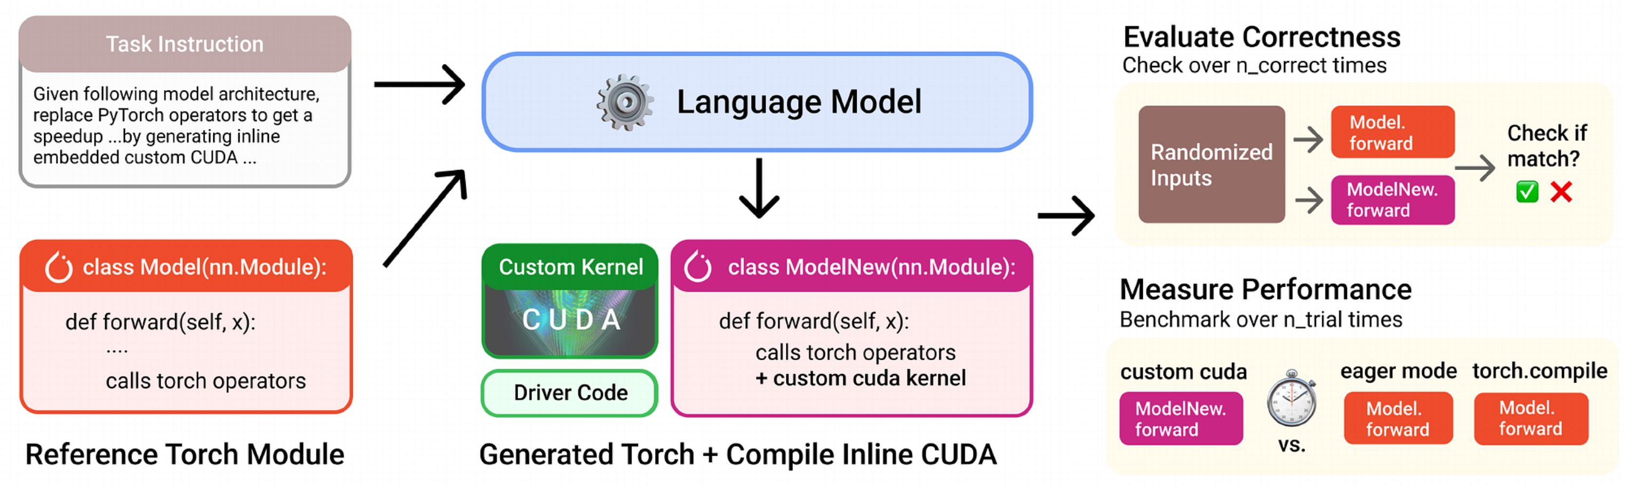
Task format of KernelBench
Each task is a PyTorch class Model, and its get_inputs returns inputs of fixed shape and random values.
A language model must return a class ModelNew that may replace any operators, in CUDA or another language.
Levels 1, 2 and 3 hold 100 single operators, 100 chains of 3 to 6 operators and 50 full models such as AlexNet.
No reference kernels ship, so the benchmark only judges what a model writes.
Source: KernelBench, Figure 1 and Section 3.
Notes:
Slide 4: Task format of KernelBench
Presenter A. Target 65 seconds. Guide section, Task interface.
Spoken text
First comes the task format. Each task is a PyTorch program with a class named Model and a forward method. A helper called get_inputs creates the input tensors. Shapes are fixed for the task, while input values are generated randomly. Another helper supplies arguments used to initialize the module.
A language model reads this program and returns ModelNew with the same interface. It can replace a single operator, fuse a chain, or change the algorithm across the forward function. CUDA, Triton and other programming tools are allowed.
KernelBench contains 250 tasks. Level 1 has 100 individual operators. Level 2 has 100 short chains, usually three to six operators, where fusion is useful. Level 3 has 50 full architectures.
PyTorch supplies the reference behavior. KernelBench supplies no hand-written optimized target kernel. This lets it evaluate different implementations and hardware through the same interface.
Sources
Original paper, Figure 1, page 2, Sections 3.1 to 3.3, pages 3 to 4, Appendix A, pages 15 to 16.

Slide 5
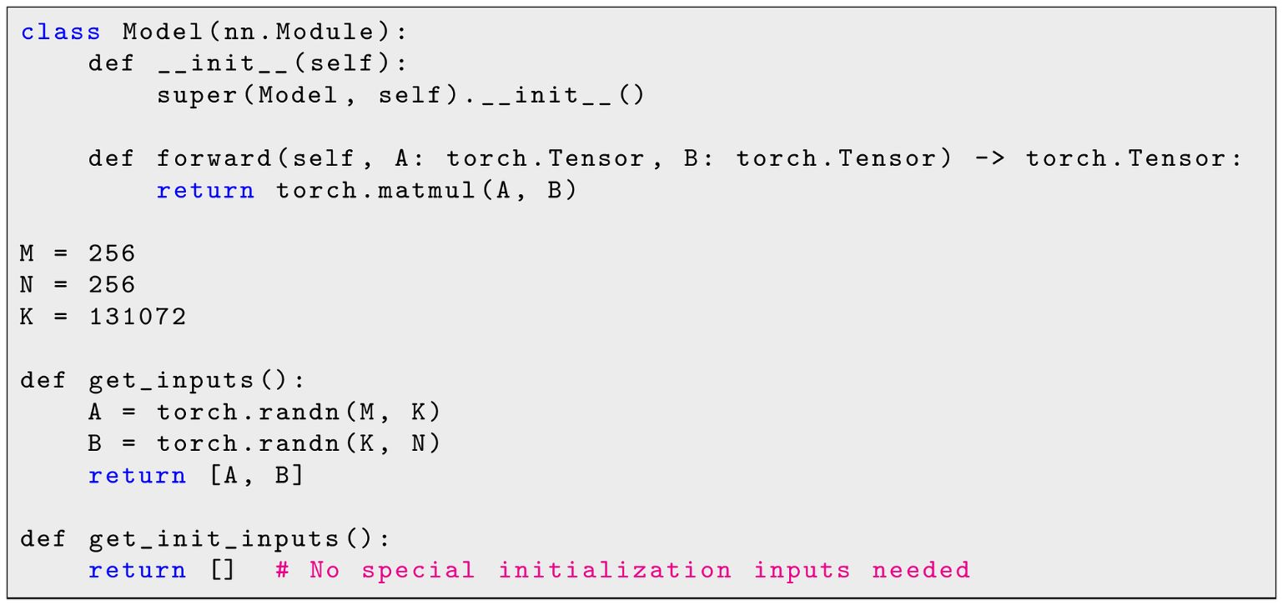
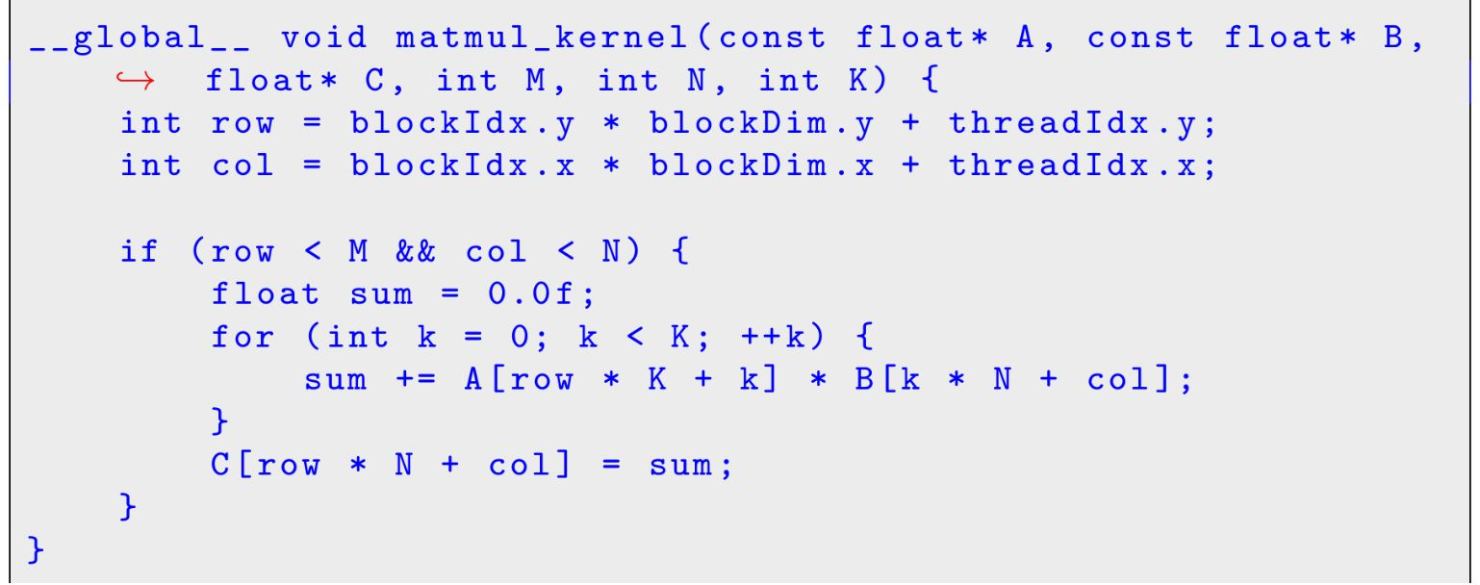
Worked example of a Level 1 task
Model computes torch.matmul of A, 256 by 131072, and B, 131072 by 256, on random inputs.
A simple answer gives each output element one thread, which loops over all 131072 values of K.
ModelNew also carries its C++ wrapper and compile call, so the harness runs it as an ordinary PyTorch module.
Kernel from an example model output, first line rewrapped
Task file with docstrings and imports cut
Source: KernelBench, Appendix A.
Notes:
Slide 5: Worked example of a Level 1 task
Presenter A. Target 45 seconds. Guide section, Complete task example.
Spoken text
Here is the appendix's matrix multiplication task. Matrix A has 256 rows and 131072 columns. Matrix B has 131072 rows and 256 columns. Their output has 256 by 256 elements.
This example assigns one thread to each output element. Each thread multiplies a row of A by a column of B and sums over all 131072 values of K. Blocks contain 16 by 16 threads.
ModelNew also contains the C++ wrapper and a load_inline call that compiles the CUDA extension. This shows the required interface. Appendix A presents it as an example model output, with no claim that this simple kernel beats cuBLAS.
Sources
Original paper, Appendix A, pages 15 to 16.

Slide 6
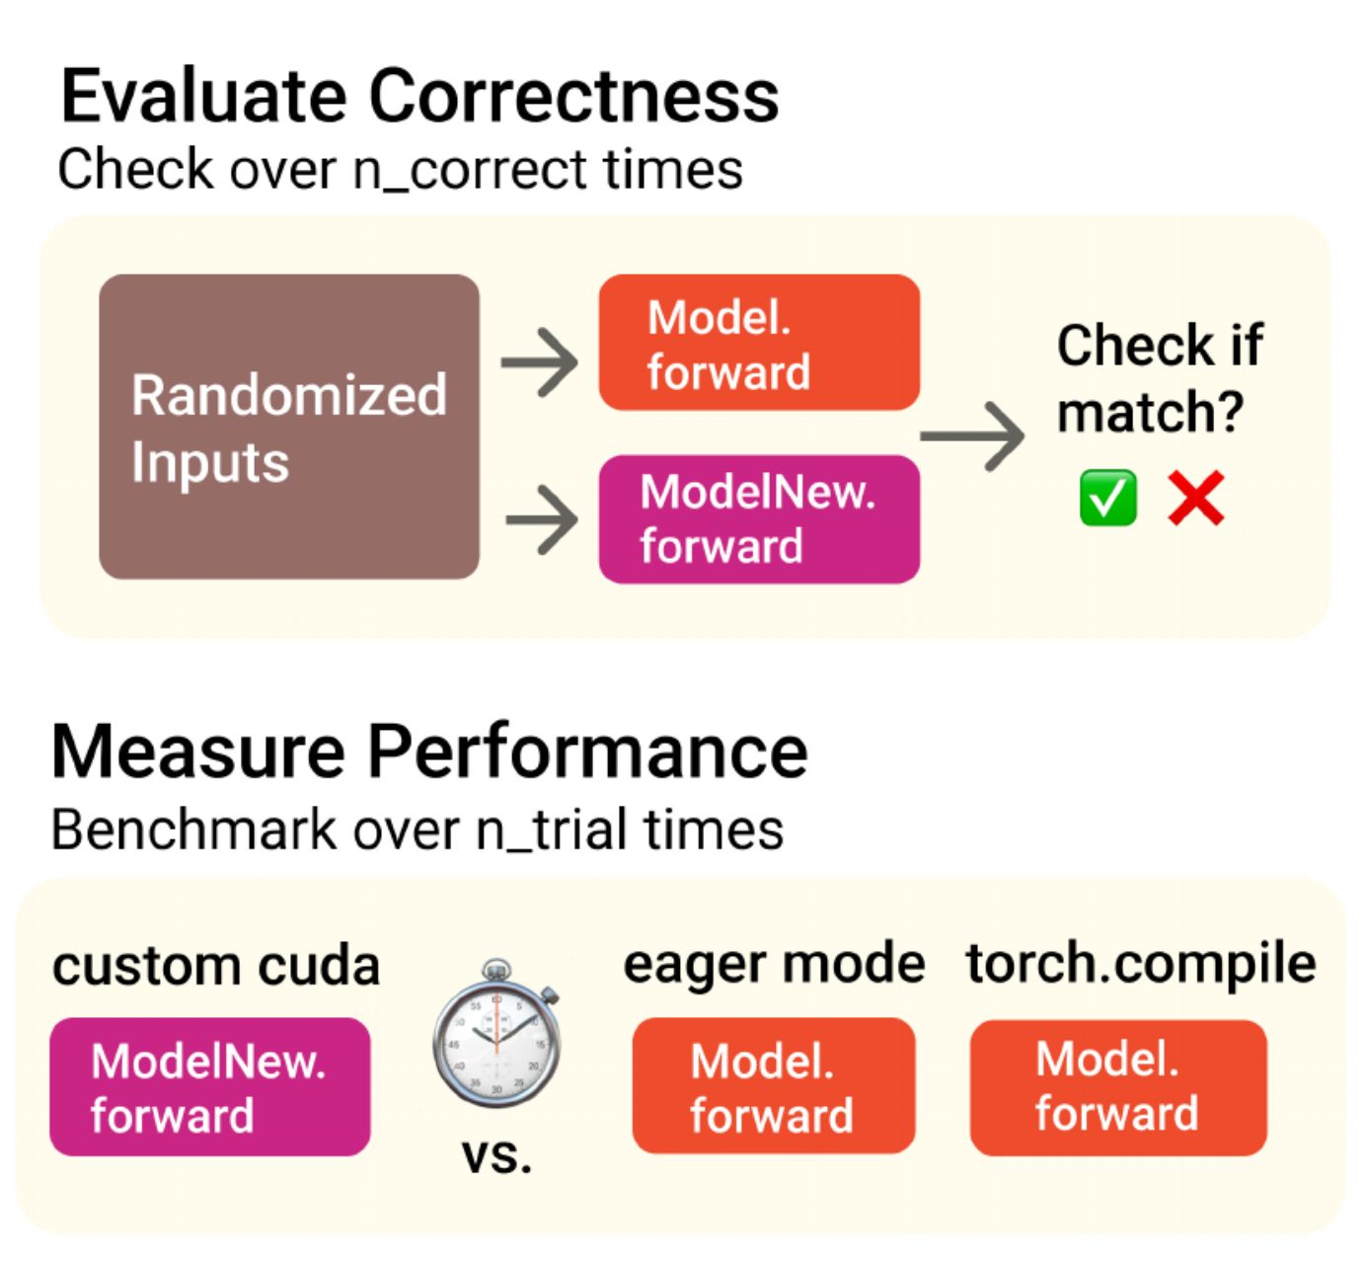
Correctness and timing protocol
A kernel is correct only if its output matches Model on all five random input sets.
Released code accepts each element within 0.01 plus 1 percent of its value, using torch.allclose.
Timing takes the mean of 100 runs after 3 warmups, and run-to-run variation stays under 3 percent.
Speedup is Eager time over ModelNew time on one NVIDIA L40S GPU, so 2 ms against 1 ms is 2x.
Sources: KernelBench, Figure 1 and Appendix B; tolerance from the released evaluation code.
Notes:
Slide 6: Correctness and timing protocol
Presenter A. Target 70 seconds. Guide section, Correctness gate and Timing and score.
Spoken text
Second comes evaluation. KernelBench runs Model and ModelNew on five random input sets at the task's fixed shape. All five comparisons must pass.
Released evaluation code uses torch.allclose with both absolute and relative tolerance set to 0.01. More precisely, the allowed difference is 0.01 plus one percent of the candidate value's magnitude, because the candidate is the second argument to that call. Passing establishes agreement on these tests.
Authors compared five tests with 100 tests on 100 generated kernels. Increasing the test count did not change which kernels passed in that sample. That supports their choice for that sample, while leaving other shapes and distributions open.
For timing, each module gets three warmup runs and 100 timed runs using CUDA events. Their mean enters the score. KernelBench reports variation below three percent in its setup. Speedup is reference time divided by candidate time. Two milliseconds divided by one millisecond gives a speedup of two. Main results use one NVIDIA L40S GPU.
Sources
Original paper, Section 3.3, pages 4 to 5, Appendix B.1, page 17. Versioned evaluation code: https://github.com/ScalingIntelligence/KernelBench/blob/v0/src/eval.py. The slide's phrase about one percent is clarified here with the exact argument order.

Slide 7
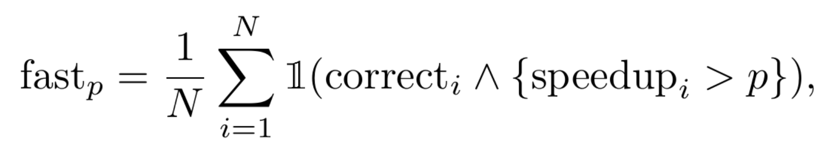
Single metric for correctness and speed
fast_p is the share of tasks whose kernel is correct and more than p times faster than Eager.
fast_0 is the correctness rate, and fast_1 is the share of tasks that beat Eager.
One number ranks a model with a few very fast kernels against one with many slow kernels.
Task | Correct | Speedup | fast_0 | fast_1 | fast_2
A | yes | 2.00x | counts | counts | no
B | yes | 0.80x | counts | no | no
C | no | 5.00x | no | no | no
D | yes | 1.02x | counts | counts | no
Score |  |  | 75% | 50% | 0%
Four example tasks, scored at p of 0, 1 and 2
Definition from KernelBench, Section 3.3; the four tasks are an example made for this talk.
Notes:
Slide 7: Single metric for correctness and speed
Presenter A. Target 65 seconds. Guide section, Metric interpretation.
Spoken text
KernelBench combines correctness and performance in fast_p. It is the fraction of all tasks where the candidate passes the correctness check and its speedup is strictly greater than p. Failed tasks remain in the denominator.
At p equal to zero, this gives the correctness rate, fast_0. At p equal to one, fast_1 counts correct candidates that beat the reference.
Our four-task example makes the boundary clear. A is correct at two times speedup. B is correct at 0.8 times. C is wrong even though it runs five times faster. D is correct at 1.02 times. Three out of four count for fast_0. A and D count for fast_1. None count for fast_2, because exactly two does not exceed two.
This metric includes both correctness and speed. At a single threshold, however, it gives equal credit to a large speedup and a small one. Looking at several thresholds preserves more of the performance picture.
Sources
Original paper, Section 3.3, page 5, Figure 3, page 6. Four-task example is illustrative.

Slide 8
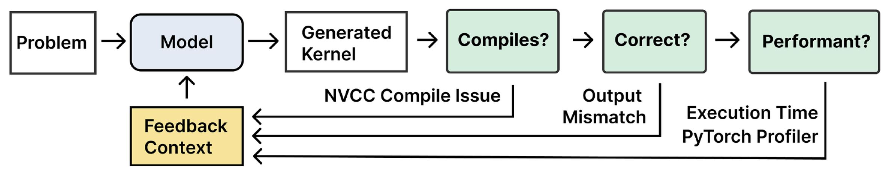
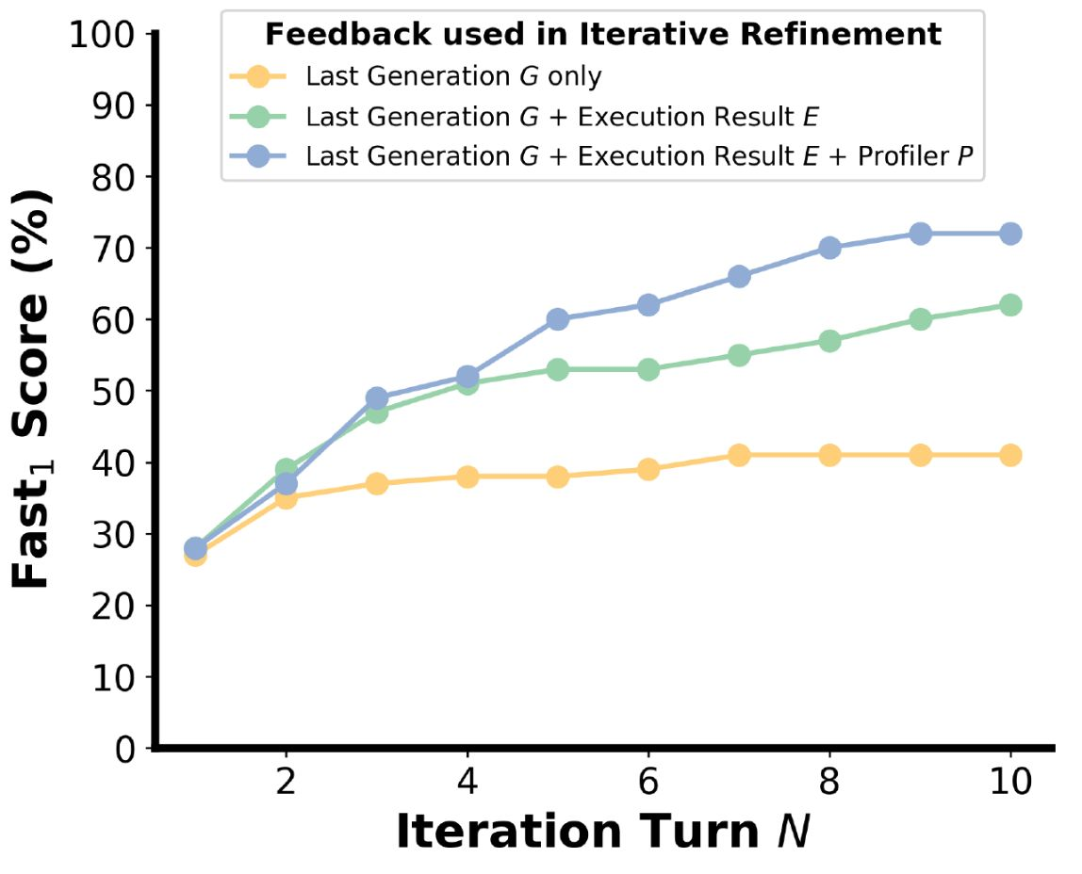
Repeated sampling and iterative refinement
Repeated sampling draws k different kernels per task, and at k of 100 DeepSeek V3 on Level 2 goes from 4 to 37 percent.
Iterative refinement returns the last kernel G, compiler and run output E, and profiler output P, for 10 turns.
With all three signals, DeepSeek R1 on Level 2 rises from 36 to 72 percent.
At an equal budget of 10 calls, refinement beats sampling in 5 of 6 comparable cases.
Source: KernelBench, Figures 5 and 6, Table 2 and Section 5.1.
Notes:
Slide 8: Repeated sampling and iterative refinement
Presenter A. Target 80 seconds. Guide section, Figures 5 and 6 and feedback.
Spoken text
Third comes using more generation attempts. Repeated sampling draws several candidates for each task at a higher temperature. A task succeeds if at least one candidate is correct and faster. DeepSeek V3 on Level 2 rises from four percent with one attempt to 37 percent with 100 samples.
Iterative refinement uses feedback. G is the previous generated code. E contains compiler and execution results. P is a profiler table showing which operations consume time. Each new attempt receives these signals and tries again over ten turns.
By turn ten, DeepSeek R1 finds at least one passing, faster candidate on 72 percent of Level 2 tasks with all three signals, compared with 36 percent in the separate one-shot table. At a budget of ten calls, the best refinement condition beats sampling in five of the six comparable model and level pairs. Equal call counts still allow different token counts, generation times and GPU evaluation costs. R1 has no repeated-sampling result in this comparison because its API did not expose the required temperature control.
My partner will now cover the results and our critique of the evaluation.
Sources
Original paper, Section 5.1, pages 7 to 8, Figures 5 and 6, Table 2, Appendix B.2 and B.3, pages 17 to 18. Table 1's 36 percent and Table 2's 72 percent come from separate reported conditions. The plotted first refinement point differs from Table 1.

Slide 9
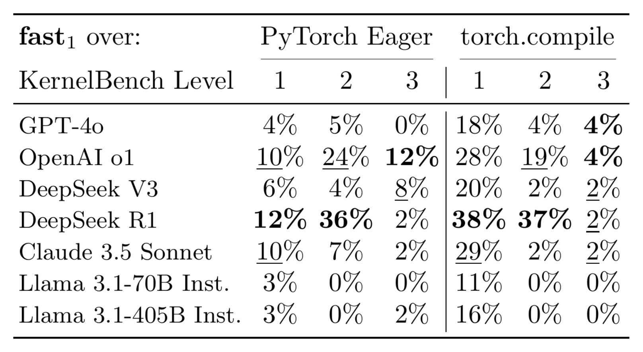
One-shot results against PyTorch Eager
Seven models wrote one kernel per task with greedy decoding, which always takes the most likely token.
DeepSeek R1 on Level 2 is the best result, beating Eager on 36 percent of tasks.
On Level 1 no model passes 12 percent, and on Level 3 OpenAI o1 leads with 12 percent.
Over all 250 tasks, R1 beats Eager on 49, fewer than one in five.
Left block, fast_1 over PyTorch Eager. Right block, fast_1 over torch.compile.
Source: KernelBench, Table 1.
Notes:
Slide 9: One-shot results against PyTorch Eager
Presenter B. Target 75 seconds. Guide section, Table 1 and one-shot generation.
Spoken text
Thanks. Table 1 gives the one-shot results. Seven models generate one candidate per task using greedy decoding, which selects the most likely next token. This experiment has no iterative feedback.
Table 1's left block compares against Eager. DeepSeek R1 on Level 2 has the best cell at 36 percent. Fusion gives the model opportunities across a chain of operators. Level 1 is harder to improve because many individual operations already use tuned library implementations. Its best result is 12 percent. On Level 3, o1 leads at 12 percent, while R1 solves one of the 50 tasks faster than Eager.
Across all 250 tasks, R1 has 12 wins in Level 1, 36 in Level 2 and one in Level 3. That is 49 wins, or 19.6 percent. A strong result on one level does not establish broad success.
Its right block compares against torch.compile. Some Level 1 scores increase because compile has runtime overhead on small workloads. Its compilation time is excluded from that explanation.
Sources
Original paper, Table 1 and its footnote, page 5, Sections 4.2 and 4.3, page 6. R1 total is calculated as 12 + 36 + 1. Table cells govern the Level 3 claim because the introduction contains an inconsistent figure.

Slide 10
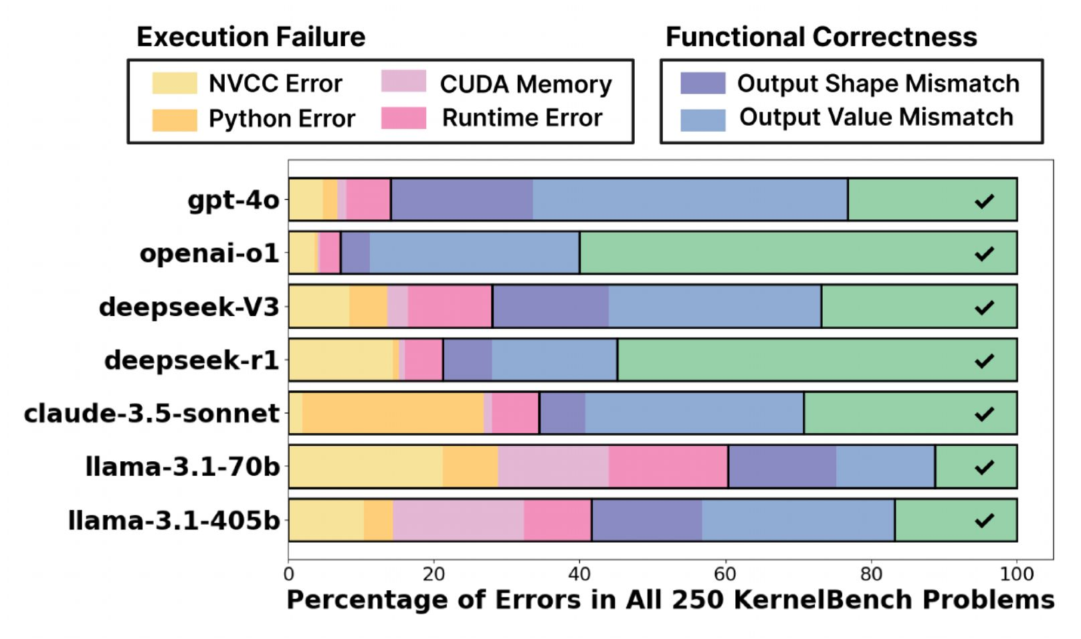
Failure modes and winning kernels
OpenAI o1 and DeepSeek R1 fail on under 55 percent of tasks, and the other five models on over 70 percent.
Wrong output values are the largest failure type for six of the seven models.
Each winning kernel the paper shows cuts memory traffic or work, such as the 2.9x fused GELU and the 13x diagonal multiply.
No kernel makes successful use of tensor cores, the matrix-multiply units on recent NVIDIA GPUs.
Source: KernelBench, Figure 2 and Section 6.1.
Notes:
Slide 10: Failure modes and winning kernels
Presenter B. Target 80 seconds. Guide section, Figure 2 and failure categories.
Spoken text
Figure 2 separates failures into NVCC errors, Python errors, CUDA memory errors, other runtime errors, wrong output shapes and wrong output values. NVCC is NVIDIA's CUDA compiler. Green represents candidates that pass the check.
Reasoning models fail on fewer than 55 percent of tasks. Other models fail on more than 70 percent. Much of that advantage comes from reducing execution failures. Wrong output values remain the largest failure category for six of the seven models.
Successful examples show useful optimization patterns. Fused GELU runs 2.9 times faster. A matrix multiplication followed by division, reduction and scaling runs 2.6 times faster by avoiding a large intermediate tensor. A cosine similarity loss gets 2.8 times speedup using shared-memory reductions.
Diagonal multiplication gets 13 times speedup by exploiting its structure. We will return to whether this belongs in a kernel benchmark.
Tensor cores are specialized matrix multiplication units. KernelBench found no successful tensor-core use in the generations it analyzed. This statement describes those experiments and models. It does not cover all later kernel generators.
Sources
Original paper, Figure 2, page 5, Section 4.2, page 6, Section 6.1, pages 9 to 10, Appendix D, pages 23 to 28.

Slide 11
Limits of the correctness check
Every task checks five random inputs of one fixed shape, and nearly every task draws them from the standard normal.
With a tolerance of 1e-2, an all-zero output passes wherever the true value lies within 0.01 of zero.
Five inputs were calibrated on 100 kernels from models with no reason to game the check.
Date | Sakana AI CUDA Engineer
2025-02-20 | Sakana AI announces an agent that evolves kernels for KernelBench tasks, with 10 to 100x speedups.
2025-02-20 | Outside testers find the 150x example 3x slower, and it passes only when PyTorch runs first.
2025-02-21 | Sakana writes that the search can "trick the verification sandbox" and hardens its harness.
2025-09-16 | Sakana's later report finds its average speedup on 200 tasks falls from 3.13x to 1.49x once loophole tasks are removed.
Sources: KernelBench, Appendix B and released code; Sakana AI announcement, 2025-02-20; TechCrunch, 2025-02-21; Gigazine, 2025-02-25; Sakana AI, arXiv 2509.14279.
Notes:
Slide 11: Limits of the correctness check
Presenter B. Target 105 seconds. Guide section, Correctness limits and Later evidence and attribution.
Spoken text
Our first concern is test coverage. Each task uses one shape, five random input sets and mostly standard-normal values. Small-output errors can hide inside the tolerance. For example, if the true output is 0.004 and the candidate returns zero, their difference is below the absolute tolerance. A whole zero tensor passes only if every element satisfies the check.
This five-input calibration used 100 generated kernels. A speed-seeking search can produce different failure patterns, including attempts that exploit the evaluation environment.
This timeline shows later evidence of this risk. In February 2025, Sakana AI announced an evolutionary kernel search with large speedups. Outside testers reported an example whose correctness depended on the reference running first, and whose independent timing was much slower than the claim. Sakana then acknowledged verification loopholes and hardened its harness. Independent replication details on this slide come from reporting about those tests.
Sakana's September report is a separate experiment from the same organization. Its framework's reported mean speedup over 200 tasks falls from 3.13 to 1.49 when loophole tasks are excluded. Those numbers do not measure a re-evaluation of the original KernelBench paper's models.
One task exposes a boundary question. KernelBench presents diagonal row scaling as a successful optimization. Sakana's later report classifies that task as an exploit. Row scaling preserves the operation on the finite input domain used here. Their disagreement concerns what optimization the task should reward.
Sources
Original paper, Appendix B.2, page 17, Appendix D.1, page 23. Sakana September report: https://sakana.ai/ai-cuda-engineer/. Later paper: https://arxiv.org/abs/2509.14279. Secondary reporting supplies the independent 150x replication details listed on the slide. See source-checks.md for the checked links.

Slide 12
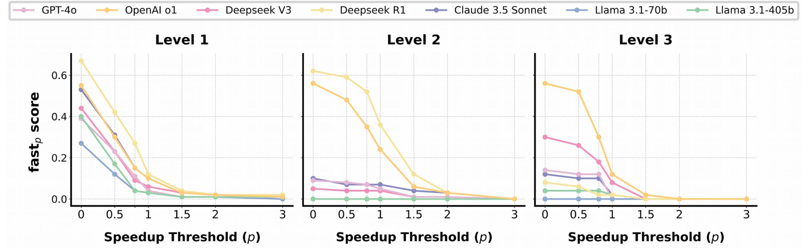
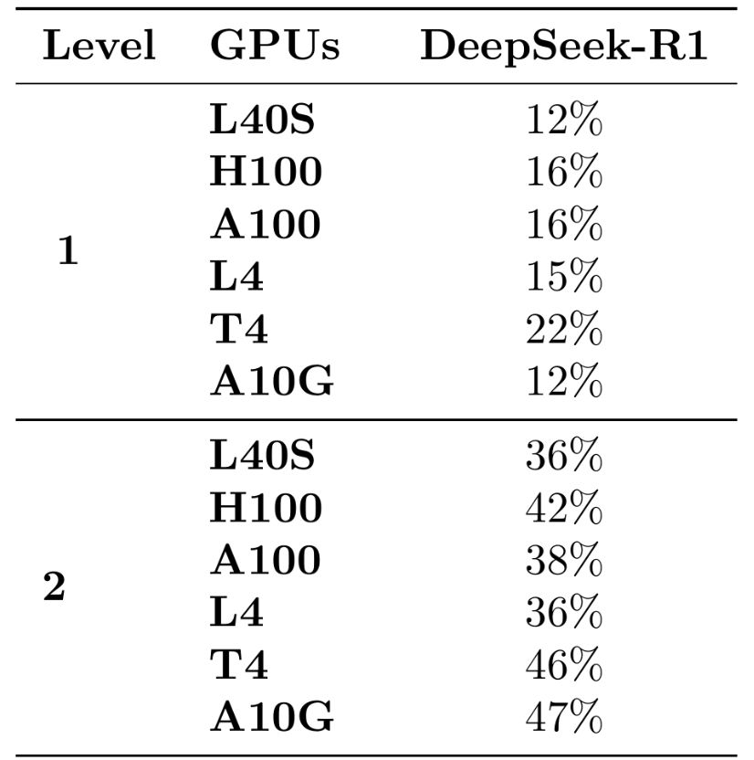
Limits of the baseline and the metric
Eager runs 32-bit float matrix multiplies without TF32, a tensor-core mode with about twice the peak rate on the L40S.
fast_1 counts a 1.01x and a 13x kernel alike, and Figure 3 shows how far the score moves with p.
R1's Level 2 kernels score 36 percent on an L40S and 47 percent on an A10G with no change to the code.
A 2026 rerun with a TF32 baseline and hidden tests puts the best model at 0.88x of PyTorch.
fast_p against the threshold p. DeepSeek R1 is the light yellow curve.
Sources: KernelBench, Figure 3 and Table 14; PyTorch 2.5 CUDA notes; NVIDIA L40S data sheet; KernelBench-Verified, arXiv 2607.16241.
Notes:
Slide 12: Limits of the baseline and the metric
Presenter B. Target 100 seconds. Guide section, Baseline and scope limits.
Spoken text
Our second concern is the comparison target. These tasks use FP32 inputs. Under the relevant PyTorch defaults, FP32 matrix multiplication does not use TF32. TF32 uses tensor cores with reduced multiplication precision and FP32 accumulation. For L40S, NVIDIA lists roughly twice the dense peak throughput for TF32 as for ordinary FP32. A peak rate does not predict a particular task's speedup, and convolution has different defaults.
This metric also depends strongly on the threshold. A 1.01 times and a 13 times kernel each give one fast_1 win. Small wins need repeated measurements because the reported timing variation can change a result near one. Figure 3 shows the score across thresholds.
Hardware changes the comparison too. Unchanged R1 Level 2 code scores 36 percent on L40S and 47 percent on A10G. Both the candidate and the reference respond to the hardware.
A 2026 follow-up, KernelBench-Verified, adds a TF32 baseline and hidden input distributions. It reports a best-model geometric mean speedup of 0.88 times PyTorch under its revised protocol. That is a later study with different models and evaluation rules. Its geometric mean is a different metric from fast_1, so it supports concern about the protocol without directly replacing this table.
Sources
Original paper, Figure 3, page 6, Table 14, page 33. PyTorch 2.5 CUDA semantics: https://pytorch.org/docs/2.5/notes/cuda.html#tensorfloat-32-tf32-on-ampere-and-later-devices. L40S specifications: https://www.nvidia.com/en-us/data-center/l40s/. KernelBench-Verified: https://arxiv.org/abs/2607.16241.

Slide 13
Freedom and invariants of an AI kernel optimizer
KernelBench lets the model choose the operators, the algorithm and the language of the whole forward function.
It holds fixed only output agreement on five inputs of one shape within 1e-2, and a faster mean time.
An optimizer whose objective is speedup changes whatever the check leaves unpinned.
We would add hidden shapes and distributions, a run of the candidate alone, a TF32 baseline and a cap on peak memory.
Sources: KernelBench, Section 3; Sakana AI, arXiv 2509.14279; Kevin-32B, Cognition, 2025-05-06; KernelBench-Verified, arXiv 2607.16241.
Notes:
Slide 13: Freedom and invariants of an AI kernel optimizer
Presenter B. Target 80 seconds. Guide section, Forward and deployment.
Spoken text
This week's question asks which parts an AI optimizer should be free to change and which properties must stay invariant. KernelBench allows changes to the operators, the algorithm and the programming language across the forward function.
Its measured success requires output agreement on the prescribed tests and faster mean execution. Its released harness also checks execution failures and output shape. It provides limited evidence about behavior outside that workload.
Our proposal is to define the allowed input domain first, then test hidden shapes and distributions inside that domain. A fixed-shape deployment can still use a specialized kernel. Candidate evaluation should also run independently of the reference, use a baseline with a stated precision policy, and measure peak memory.
For training, we would additionally test gradients, repeated execution, stream behavior and state changes. A faster forward pass alone leaves those questions open.
These additions have costs in evaluation time and implementation freedom. That tradeoff is part of the benchmark design. I will hand back to my partner for the discussion.
Sources
Original paper, Section 3, pages 3 to 5. Later Sakana report: https://arxiv.org/abs/2509.14279. Kevin report: https://cognition.com/blog/kevin-32b. KernelBench-Verified: https://arxiv.org/abs/2607.16241. Additional deployment checks are proposals for this discussion.

Slide 14
Questions for discussion
This week's question asks what an AI optimizer should be free to change and which properties must stay invariant.
Is the 13x diagonal kernel a real optimization, or a flaw in how the task was written?
If you could fix one part of the correctness check, which would it be, and what honest kernels would the fix reject?
Before a generated kernel goes into a real training run, what should we require of it beyond matching outputs?
Notes:
Slide 14: Questions for discussion
Presenter A. Target 35 seconds before discussion. Guide section, Reserve answers.
Spoken text
Thanks. Let us start with the diagonal example. It replaces a dense diagonal matrix multiplication with row scaling. Should a benchmark reward this algorithm change?
Next, if we changed one part of the correctness check, which change would give the most confidence, and which valid specialized kernels could it exclude?
Finally, before using a generated kernel in training, what would we require beyond matching forward outputs?
We can take these one at a time. Our starting view on the first is that the task's declared contract should determine which algebraic changes are allowed.
Sources
Original paper, Appendix D.1, page 23. Course week 8 discussion theme. Discussion answers in cluely/01-audience-qa.md and cluely/02-slide-qa.md.

Slide 15
Backup
Notes:
Slide 15: Backup
Reserve section. Excluded from the main talk.
Spoken text
These last two slides provide the complete feedback results and the diagonal multiplication example for questions.
Sources
Deck navigation only.

Slide 16
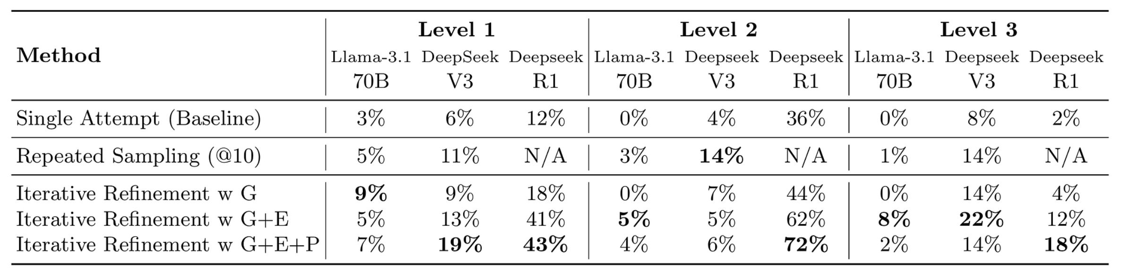
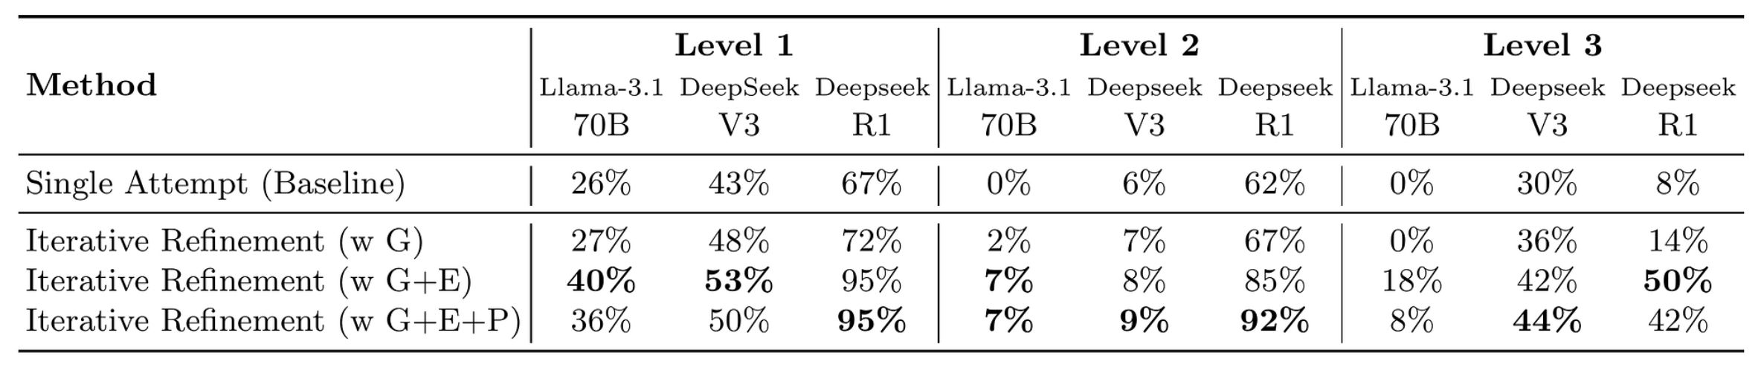
Full results of sampling and refinement
Table 2 gives fast₁ for each method at an equal budget of 10 calls.
Table 9 gives fast₀, the share of tasks with a correct kernel, after 10 turns.
With G, E and P, R1 reaches a correct kernel on 95 and 92 percent of Level 1 and 2 tasks.
Table 2, fast₁ at an equal budget of 10 calls
Table 9, fast₀ after 10 turns of refinement
Source: KernelBench, Tables 2 and 9.
Notes:
Slide 16: Full results of sampling and refinement
Presenter answering the question. Guide section, Figures 5 and 6 and feedback.
Spoken text
This upper table compares fast_1 at ten generation calls per task. Sampling selects among independent candidates. Refinement uses earlier code and feedback. Five of the six comparable cells favor the best refinement condition. R1 has no repeated-sampling entry under this setup, so it is excluded from that count.
This lower table measures fast_0 after ten refinement turns. With generated code, execution output and profiler output, R1 reaches 95 percent correctness on Level 1 and 92 percent on Level 2. Its corresponding fast_1 scores are 43 and 72 percent. Passing the output check and beating the reference are separate outcomes.
Profiler feedback is useful in some settings, while execution feedback already explains much of the gain. This table supports comparing the reported conditions. It leaves token cost and wall-clock search cost unresolved.
Sources
Original paper, Table 2, page 8, Table 9, page 30, Appendix B.2 and B.3, pages 17 to 18.

Slide 17
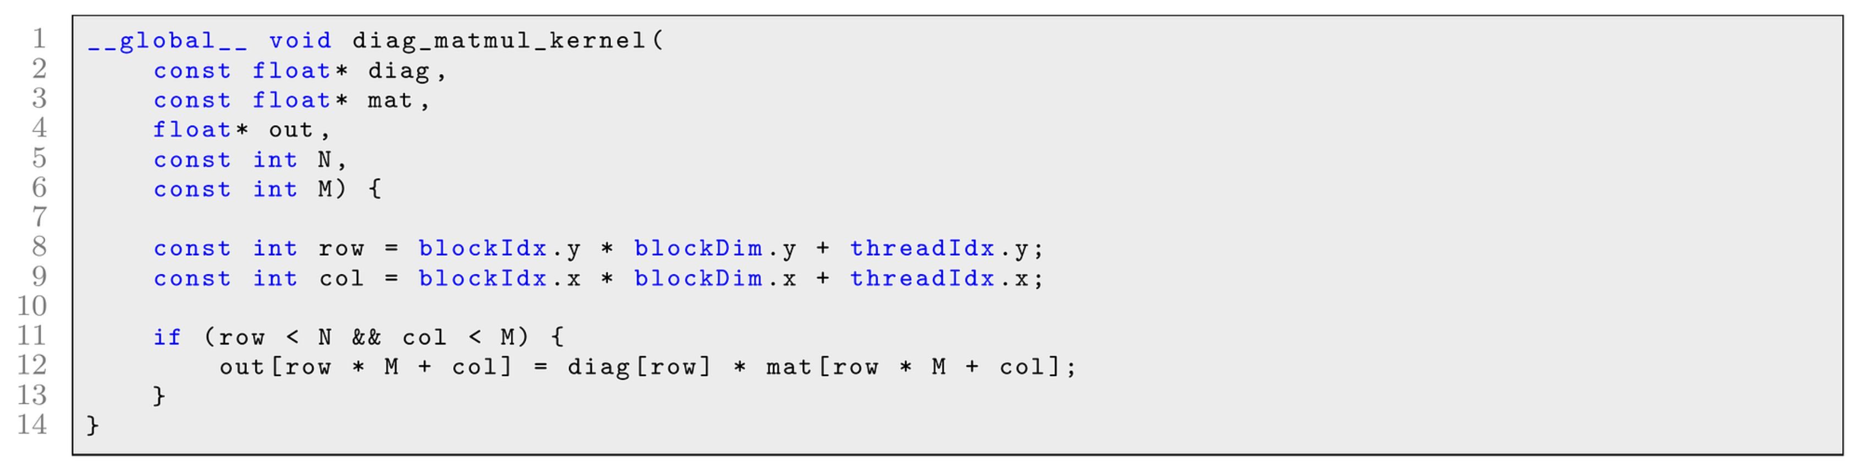
Diagonal matrix multiply kernel
Reference computes torch.diag(A) @ B, which first builds an N by N matrix that is zero off the diagonal.
Generated kernel scales each row of B by one value of A and runs 13x faster.
Sakana's later report lists the same task as an example of an exploit.
Sources: KernelBench, Appendix D.1; Sakana AI, arXiv 2509.14279, Appendix A.4.1.
Notes:
Slide 17: Diagonal matrix multiply kernel
Presenter answering the question. Guide section, Diagonal multiplication.
Spoken text
Let A contain two and three. Let B have first row one and four, and second row five and six. Multiplication by the diagonal matrix scales B's first row by two and its second row by three. Our result has first row two and eight, and second row fifteen and eighteen.
Reference code builds a dense diagonal matrix and calls matrix multiplication. Generated code directly scales each row. It avoids constructing the matrix and reduces the arithmetic from cubic to quadratic work for square B. KernelBench measures a 13 times speedup for its example on L40S.
Sakana's later report labels this task an exploit. Our position is that row scaling satisfies the forward function's mathematical specification. Benchmark designers should state whether it rewards algorithm changes or restricts candidates to a particular computational structure. That contract decides the interpretation.
Sources
Original paper, Section 6.1, page 10, Appendix D.1, page 23. Later Sakana report, Appendix A.4.1: https://arxiv.org/abs/2509.14279. The 2 by 2 example is illustrative.

