Slide 1
SGLang
Efficient Execution of Structured Language Model Programs
Zheng, Yin, Xie, Sun, Huang, Yu, Cao, Kozyrakis, Stoica, Gonzalez, Barrett, Sheng
Stanford · UC Berkeley · SJTU · Texas A&M | NeurIPS 2024 · arXiv:2312.07104
COMS 6998 · Fall 2026 · Paper presentation
Notes:
[0:20] I’m Gavin, I’m Pingchuan, we will be presenting SGLang today.

Slide 2
Background: how an LLM generates text
PREFILL — read the whole prompt in one pass
How attention uses the KV cache
You
are
a
helpful
assistant
.
Hi
KV
KV
KV
KV
KV
KV
KV
New token → compute Qₜ, Kₜ, Vₜ
DECODE — one token per forward pass
Qₜ · Kᵀ → attention scores
→ "!"
→ "How"
→ "can"
→ "I"
→ …
softmax → attention weights
KV cache: the per-token Key/Value tensors from attention, saved so later tokens don't recompute them.
Decode is memory-bound: throughput comes from big batches, and KV cache is what fills GPU memory.
weights × V → context vector
→ predict the next token
Paper §3 and Appendix A.1
Notes:
[1:15] First of all, some quick background on how an llm generates text. An LLM generates in two phases prefill and decode. Prefill processes the prompt and computes the attention state for those tokens. Decode then produces new output one token at a time. Each attention layer creates Query, Key, and Value vectors. During decoding, the new token's query is compared with the keys from the tokens already in context. Softmax turns those scores into attention weights, and those weights combine the values into a context vector used to predict the next token. The important role of the KV cache is that the old Keys and Values are already saved, so they do not need to be recomputed at every decoding step.

Slide 3
LM Programs
Two properties:
Few-shot learning
few-shot examples
Q1
Many LLM calls with control flow: branching, loops, or dependencies between calls.
Structured I/O: inputs and outputs follow a format， enabling integration with existing software.
few-shot examples
Q2
Self-consistency
question
sample 1
question
sample 2
Consequence
Multi-turn chat
turn 1Q
turn 1A
Calls inside one program, and across program instances, often share long common prefixes.
history
turn 2Q
turn 2A
history
turn 3Q
turn 3A
Paper §1 and Fig. 9 (Appendix A)
Notes:
[0:45] The two properties of today’s LM programs motivate SGLang: the first is multiple LLM calls and the second is structured IO, which means inputs and outputs follow a format. As the consequence, calls inside an LM program often share long common prefixes. By prefix, I mean the context that comes before the new request. On the right are some prompting techniques mentioned in the paper, in few-shot learning, every question has the same examples in front. Self-consistency is where the model answers the same question many times and evaluate the best answer. Multiturn chat Chat is where every turn resends the full history.

Slide 4
Prior Systems
1
2
3
KV cache is discarded
Decode one token at a time
Tedious Programming
vLLM / TGI / TensorRT-LLM free a request's KV cache when it finishes. The next call with the same prefix re-runs prefill from scratch.
When the regex allows exactly one continuation, e.g. {"summary": ", each token still costs a forward pass.
Manual string building, output parsing and threading for parallel calls. The OpenAI-API version of Fig. 2 takes 2.1× the code.
Paper §1–2
Notes:
[1:00] Prior systems are slow on these workloads because engines like vLLM are optimized per request and don't know the program structure, which causes three problems
First, when a request finishes, its KV cache is freed, so the next call with the same prefix pays the full prefill again. Second, for JSON-constrained output, engines mask invalid tokens but still decode one token per forward pass, even for fixed text like the opening brace and field name. Then on the front end, you end up manually concatenating strings and managing threads. The paper reports that the API version of their example is 2.1 times longer.

Slide 5
SGLang = a frontend language + runtime optimization
Frontend
Interpreter
Runtime
DSL embedded in Python
async streams, one per prompt
RadixAttention, Compressed FSM, API speculative execution
Primitives
gen
call the model, store the result; optional regex=
select
pick the highest-probability option
+= / extend
append text to the prompt state
fork / join
copy the prompt state for parallel branches
image / video
multimodal inputs
s["var"]
fetch a result (blocks until ready)
Calls are non-blocking, like launching CUDA kernels, so independent branches run in parallel within one program.
Paper Fig. 1, §2, Table 1
Notes:
[0:45] “SGLang has two main parts: frontend language and runtime optimizations. The frontend is a domain specific language embedded in Python, so users can write an LM program using simple primitives like gen, select, fork, and join. The interpreter executes these operations as asynchronous streams. This is important because independent branches do not have to wait for each other, so they can run in parallel. Then the runtime takes care of the system-level optimizations, including RadixAttention for KV-cache reuse, compressed FSM for faster constrained decoding, and speculative execution for black-box APIs.

Slide 6
RadixAttention
Cache KV pairs
After a request finishes, its prompt and output KV stays in the tree as a cache.
Prefix match
A new request walks the tree and reuses the longest matching prefix.
LRU
When memory is full, evict the least-recently-used leaf. Shared ancestors survive longest.
Reference counts
Nodes used by the running batch are pinned and never evicted.
One memory pool
Cache and running requests share GPU memory; the cache shrinks when the batch needs room.
Frontend hint
On fork, the interpreter sends the shared prefix first
Paper §3. Compatible with continuous batching, PagedAttention and tensor parallelism.
Notes:
[1:30] The first optimization is called radix attention, it focuses on the prefill stage.The basic idea is to keep KV cache on a radix tree even after a request finishes, instead of immediately throwing it away. When a new request comes in, the runtime looks at the radix tree and finds the longest prefix that already exists, so it can reuse the corresponding KV and skip part of the prefill. When GPU memory becomes full, SGLang uses an LRU policy and evicts the least recently used leaf node. Shared ancestor prefixes tend to stay longer because they are useful to more requests. It also uses reference counts, so KV that is currently being used by the active batch is pinned and cannot be evicted. Also note that the cache and active requests share the same GPU memory pool, so the cache can shrink when a larger batch needs more space. Finally, when the frontend performs a fork, the interpreter sends the shared prefix first, so all branches can reuse that prefix instead of recomputing it.”

Slide 7
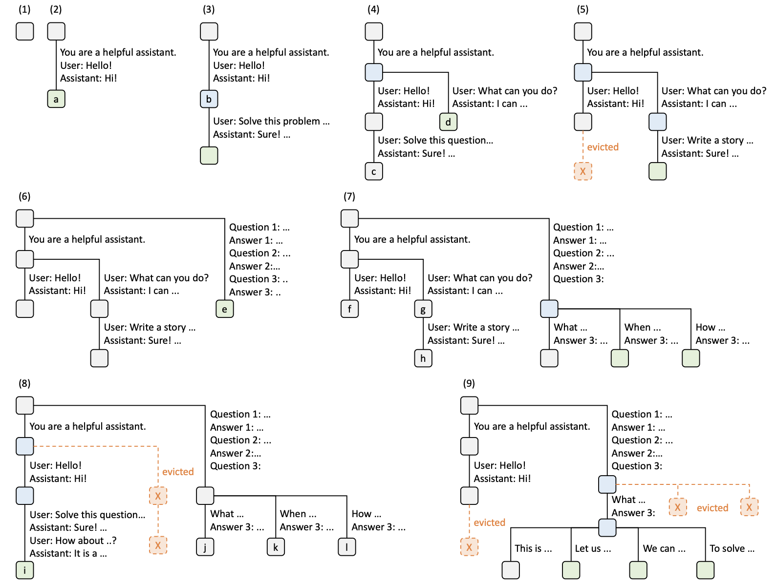
RadixAttention
(2)
First chat is inserted as one edge.
(4)
Second chat arrives; node splits so both share the system prompt.
(5)
Memory is full, so the LRU leaf "c" is evicted.
(7)
Few-shot batch shares the examples at node "e"
(9)
Self-consistency: several samples branch off one question.
green = new blue = cache hit orange X = evicted
Paper Fig. 3
Notes:
Figure 3 shows how RadixAttention dynamically builds and updates the radix tree as different workloads arrive. Green nodes are newly added, blue means the prefix is reused from cache, and orange nodes are evicted. First step, tree’s empty. In step 2, the first chat is inserted as one path. In step 4, a second chat arrives with the same system prompt, so the tree splits at the system prompt and both chats reuse that part. In step 5, memory becomes full, so the least-recently-used leaf is evicted. Then in step 7, a few-shot workload arrives. Several requests share the same examples, so those examples become another shared prefix in the tree. Finally, step 9 is an example of self-consistency, which creates multiple samples from the same question, so they branch from one common prefix. The key point is that the same radix tree can automatically capture different kinds of prefix sharing across chats, few-shot prompts, and repeated sampling.

Slide 8
Cache-aware scheduling
Queue: A1, B1, A2, B2 (A* share prefix A, B* share prefix B; the cache fits one prefix)
FCFS
A1 miss
B1 miss
A2 miss
B2 miss
4 prefills
Longest prefix first
A1 miss
A2 hit
B1 miss
B2 hit
2 prefills
Theorem 3.1
However, when online...
For a batch of requests, visiting the radix tree in DFS order gives the optimal cache hit rate, if cache size ≥ the longest request. Longest-shared-prefix-first is equivalent to DFS.
Future requests are unknown, so new arrivals can break the DFS order.
Cannot guarantee optimal cache hit rate
Paper §3, Algorithm 1, Appendix A.3. Cache hit rate = cached prompt tokens / prompt tokens.
Notes:
[1:30] The paper also introduces cache-aware scheduling to be used alongside radixattention. It is basically the reordering of the awaiting requests by the length of the shared prefixes. The execution order is crucial because, let’s say we have two prefixes A and B, and requests A1 A2 have prefix A, and B1 B2 have prefix B, the cache only fits one prefix. With first-come-first-served policy, we’d have to evict each prefix just before it's needed again. When A1 misses, prefix A’s KV is calculated and stored; then B1 comes in and finds nothing to share misses again, so we’d have to calculate KV for prefix B, so on so forth. If we instead sort the queue by matched prefix length and run longest-match first, A2 would be executed right after A1 because it shares one common prefix with A1. As a result we only need two prefills.
The paper formalizes this scheduling algorithm in Theorem 3.1. For a batch of requests, visiting the radix tree in DFS order gives the optimal cache hit rate, if cache size ≥ the longest request. Longest-shared-prefix-first is equivalent to DFS.The paper provides a proof for this but the intuition is simple, they are both trying to get to the bottom of each subtree before starting another path because this maximizes the prefixes shared before eviction happens.
However, this applies only to offline batches. Online, you can’t see the future requests, you only have a limited number of known requests to plan from, and new arrivals can break the dfs order.

Slide 9
Why does cache-aware scheduling improve throughput?
1
Less work per request
2
More room for batching
cache hit ↑
↓
fewer prompt tokens re-prefilled
↓
GPU work per request ↓
↓
throughput ↑
more KV is shared
↓
KV memory usage ↓
↓
larger active batch
↓
throughput ↑
Paper §3, §6.2–6.3
Notes:
[0:55] cache-aware scheduling improves throughput, because it leads to higher cache hit rate and more room for batching. Without good scheduling, having large batches often means occupying more GPU memory, therefore more eviction, which leads to less cache hit. But with scheduling, high hit rate and large batch size can coexist because the prefixes evicted are not likely to be used in the near future. As a result, high hit rate and large batch sizes are gonna increase throughput together.

Slide 10
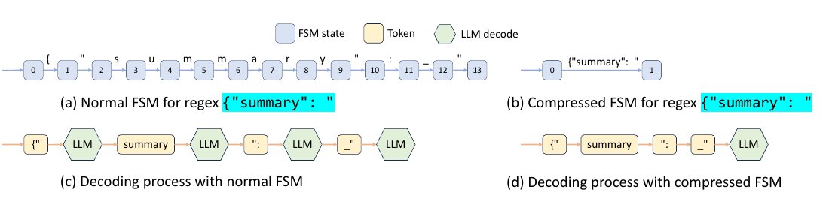
Compressed FSM
How normal FSM decodes
The waste
The fix
Regex → finite state machine. At each step, tokens that don't match any outgoing edge get their logits masked to zero.
In (a) and (c), {"summary": " has only one legal path but still takes one forward pass per token.
Merge chains of single-successor, single-string edges into one edge. When decoding reaches it, append the whole string at once
Paper Fig. 4, §4, Appendix B. Jump-forward text is retokenized with the model's tokenizer so token boundaries match training.
Notes:
“Next is the second runtime optimization, compressed FSM, specifically for constrained decoding. Normally, a regex is converted into a finite state machine. At each decoding step, the runtime checks which tokens are allowed by the current FSM state and masks out all invalid tokens. The problem is that sometimes there is only one legal continuation. For example, in this JSON prefix, {\"summary\": \", the model doesnt really have a choice on what tokens to generate. But a normal FSM still takes multiple decoding passes to get through the sequence, like in figures a and c. But as you can see in b and d here, SGLang compresses these deterministic chains into a single edge. When decoding reaches such an edge, the runtime can jump forward and append the whole string directly.

Slide 11
For black-box APIs: speculative execution
s += context + "name:" + gen("name", stop="\n") + "job:" + gen("job", stop="\n")
Naive: 2 API calls
SGLang: often 1 call
Call 1 stops at "\n" after the name.
Call 2 resends the whole context to get the job.
The context's input tokens are paid twice.
Ignore the first stop and let call 1 keep generating.
The interpreter matches the extra output against "job:" + gen(...).
If it matches, skip call 2.
Evidence: one GPT-3.5 task extracting 3 fields from Wikipedia pages; about 3× lower input-token cost with few-shot prompting
Paper §5 and §6.2
Notes:
Finally, for black-box APIs such as GPT-3.5 or GPT-4, SGLang cannot directly control the KV cache or the decoding process, so it uses speculative execution instead. Suppose the program first asks the model to generate a name, and then makes another call to generate the job. Normally, since radixattention is not available here, the first call stops after the name, and the second call has to resend the whole context again. So the input tokens are paid twice. SGLang, on the other hand, lets the first call continue generating past the original stop condition. After generating the name, SGLang lets the same API call speculate into the next field. If it correctly generates the expected job field, the second call can be skipped. . The interpreter then checks whether this extra output matches the next part of the program. If it matches, SGLang would skip the second API call entirely. In the paper’s GPT-3.5 extraction experiment, this reduced input-token cost by about three times.

Slide 12
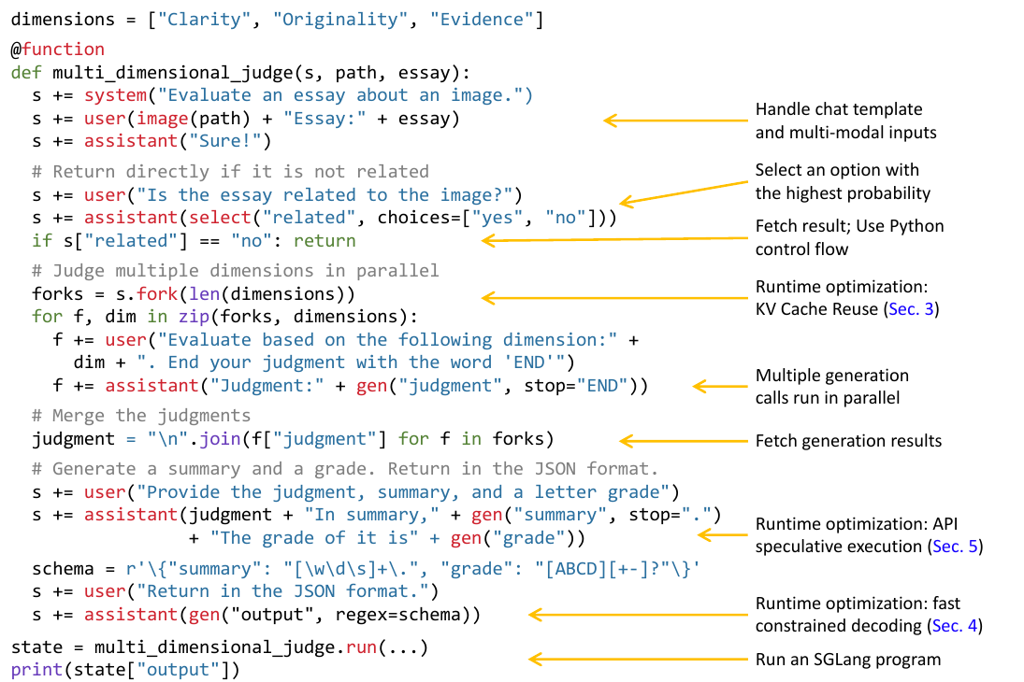
Example: multi-dimensional essay judge
fork(3)
RadixAttention
The 3 branches share the whole prefix, so its KV is computed once.
gen × 3
Interpreter
The branches run concurrently because calls are asynchronous
regex=schema
Compressed FSM
Fixed JSON text is emitted without decoding it token by token.
gen + gen
API speculative exec.
Two adjacent API calls can be merged into one.
Paper Fig. 2 (branch-solve-merge prompting)
Notes:
Here is the running example from the paper, a multi-dimensional essay judge. The program first checks whether the essay is related to the image. If it is, it forks into three branches to judge clarity, originality, and evidence. This is where the different parts of SGLang work together. The three branches share the same prefix, so RadixAttention can reuse the KV cache instead of recomputing it three times. Because the generation calls are asynchronous, the interpreter can run the three branches concurrently. Later, the program generates structured JSON output with a regex constraint, so the compressed FSM can jump over deterministic parts of the JSON format. And the two adjacent generation calls for the summary and grade can potentially be combined using API speculative execution, assuming the program executes on a black box api backend.

Slide 13
Baselines and assumptions
Baselines
Assumptions
vLLM v0.2.5 (default API server). High-throughput inference engine with PagedAttention and continuous batching. The runtime baseline.
Guidance v0.1.8 on llama.cpp. A Python language for controlling LLMs. The closest frontend baseline.
LMQL v0.7.3 on HF Transformers. A query language for LLMs.
Multimodal: the LLaVA authors' original HF implementation. API: OpenAI GPT-3.5.
Same-results rule: optimizations that change outputs are turned off so every system computes the same result.
LM programs share prefixes. Few-shot, agents, chat and branching all reuse context; hit rates of 50–99% on the benchmarks.
Exact reuse, no approximation. Only identical token prefixes are reused, so outputs match recomputation.
Memory is the bottleneck. Freed KV memory becomes a bigger batch, which is where throughput comes from.
Two measurement modes. Throughput with a large batch of programs; latency with one program at a time.
One serving instance. Main results use a single server (with tensor parallelism); data parallelism is in App. A.4.
Paper §6.1, §6.2, Appendix A.4, Appendix C
Notes:
[0:40] Before the results, a quick look at the setup. SGLang is compared against three systems. vLLM is the main serving engine baseline. Guidance and LMQL are two other languages for programming LLMs. For image and video models, they compare against the original LLaVA code, and for API models they use GPT-3.5. All systems are set up to produce the same outputs, so the comparison is only about speed.
The main assumptions: LM programs share a lot of prefix, reuse is exact so outputs don't change, and GPU memory is the bottleneck, so the memory saved by sharing turns into bigger batches and higher throughput.

Slide 14
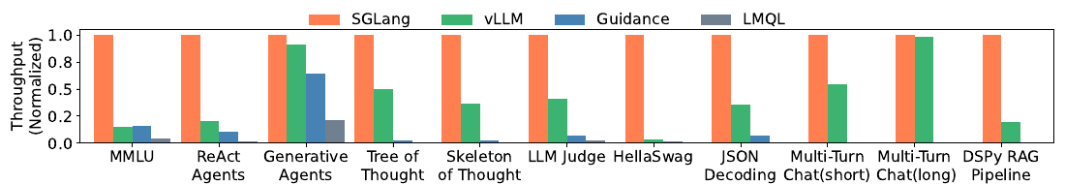
Results
6.4×
3.7×
96%
1.7×
higher throughput
lower latency
of the optimal cache hit rate, on average
lower first-token latency in production (Vicuna-33B, Chatbot Arena)
Llama-7B on one A10G; vs. vLLM v0.2.5, Guidance v0.1.8, LMQL v0.7.3. Trends hold on Mixtral-8x7B and Llama-2-70B with tensor parallelism; up to 6× on LLaVA image/video models.
Paper Fig. 5, Fig. 7, Table 2, §6.2
Notes:
[0:45] Now let's look at the results. Across eleven different workloads, SGLang achieves up to 6.4 times higher throughput, and up to 3.7 times lower latency. The cache-aware scheduler also works well in practice, reaching about 96 percent of the best possible cache hit rate. And this isn't just on benchmarks: when they deployed SGLang on Chatbot Arena, they saw cache hit rates of 52 to 74 percent, and the time to the first token dropped by 1.7 times for Vicuna-33B. The chart below shows the throughput comparison on Llama-7B, where each group of bars is one workload and everything is normalized so SGLang equals one. You can see that the orange SGLang bar is the highest in every case, and the same trend holds on larger models and on image and video models.

Slide 15
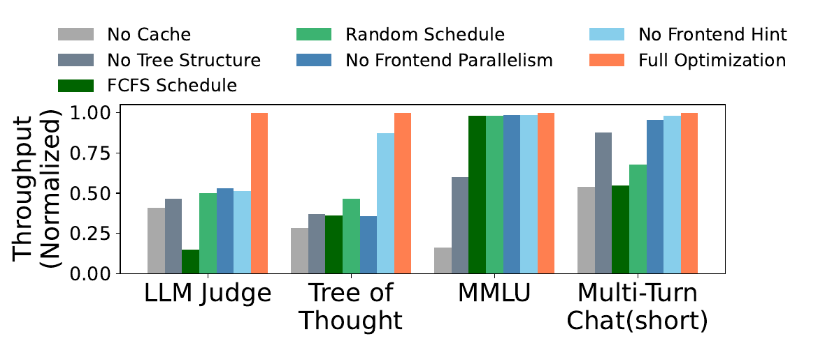
Where the speedup comes from
Workload
Speedup
MMLU, HellaSwag
Reuse few-shot examples; HellaSwag also shares the question across choices
ReAct, generative agents
Reuse agent template and earlier calls
Tree / skeleton of thought
Parallel branches plus shared prefixes
JSON decoding
Compressed FSM decodes multiple tokens at once
< 0.3% overhead with no reuse (0.2 s of 74.3 s on ShareGPT), so it's on by default.
Multi-turn chat, long outputs
Almost no gain: decode dominates, and caching only saves prefill
Paper §6.2–6.3, Fig. 8(c)
Notes:
[0:30]So where does this speedup come from? It depends on the workload. For few-shot benchmarks like MMLU and HellaSwag, every question starts with the same examples, so SGLang computes them once and reuses them. Agents benefit the same way by reusing their template and earlier calls. Tree-of-thought programs gain from running branches in parallel, and JSON decoding gets faster because the fixed parts of the format are written in one step. The one case that barely improves is multi-turn chat with long answers, because most of the time goes into writing the answer, and caching only speeds up reading the prompt.
The chart on the right is an ablation, where they turn off one component at a time. Every component turns out to matter, and when there's nothing to share, the overhead is under 0.3 percent. That's the paper, so now let's take a critical look at it.

Slide 16
Claims vs. evidence
Claim | Evidence in the paper | Verdict
Up to 6.4× over SOTA systems | Baseline is vLLM v0.2.5, before it had automatic prefix caching. The gain largely measures "caching vs. no caching". | Partial
Cache-aware scheduling is optimal | Proof only for an offline batch with cache ≥ longest request. Online is an approximation; 96% of optimal empirically. | Supported
Compressed FSM speeds up decoding | 1.6× on one JSON benchmark. No accuracy study, though App. B.3 admits jump-forward distorts probabilities. | Partial
API speculative execution cuts cost | A single extraction task; relies on "careful prompt engineering". No failure-rate numbers. | Weak
Negligible overhead | 0.2 s out of 74.3 s on ShareGPT with zero KV cache reuse. | Supported
Paper §5–6, footnote 3, Appendix A.3, B.3
Notes:
[1:00]We now turn to a critical assessment, beginning with the paper's main claims and the strength of the evidence behind each. The 6.4 times throughput improvement is only partially supported: the primary baseline is an earlier version of vLLM without automatic prefix caching, so the result mainly demonstrates the benefit of caching over no caching. The optimality of cache-aware scheduling is supported by a formal proof and reaches 96 percent of the optimal hit rate in practice, although the proof assumes all requests are known in advance. The compressed state machine is also partially supported, as it is evaluated on a single JSON benchmark with no analysis of its effect on output quality. API speculative execution has the weakest evidence, relying on one task and reporting no failure rate. Finally, the low-overhead claim is well supported, with less than 0.3 percent overhead measured on a workload with no shared prefixes.

Slide 17
Analysis: Performance Results
Normalized bars only
An older baseline
Gains track sharing, by design
Fig. 5–7 give no absolute programs/s. On HellaSwag the vLLM bar is near zero, which, read literally, implies far more than the "up to 6.4×" headline. Readers can't reconcile the two.
Footnote 3: vLLM v0.2.5 was chosen because RadixAttention had since been partly merged into vLLM. The comparison is "reuse vs. no reuse", not "SGLang's reuse vs. another reuse".
Where there is little to share (generative agents, long multi-turn chat), vLLM is at ~0.9–1.0. The largest wins are on benchmarks built around shared prefixes.
Paper Fig. 5, §6.1 footnote 3. Bar heights are read from the figure and are approximate.
Notes:
Now I want to look more critically at the headline performance results. The first issue is that the main figures only show normalized throughput, not absolute programs per second. That makes the headline ‘up to 6.4×’ difficult to reconstruct directly from the plots. Second, the vLLM baseline is version 0.2.5. The paper explains that newer vLLM had already partially integrated RadixAttention, so the comparison is against an older baseline without those newer reuse mechanisms. Third, the size of the gain is highly workload-dependent. The biggest speedups appear on workloads with a lot of shared-prefix reuse, while generative agents and long multi-turn chat are much closer to vLLM. So the main takeaway is not that SGLang is uniformly six times faster, but that its benefits are strongest when the workload exposes substantial prefix sharing or parallel structure

Slide 18
Analysis: Throughput Contributions
Throughput without… | Part | LLM Judge | Tree of Thought | MMLU | Multi-turn chat
cache | runtime | ≈0.41 | ≈0.28 | ≈0.16 | ≈0.54
tree structure (table-based cache) | runtime | ≈0.47 | ≈0.37 | ≈0.60 | ≈0.88
cache-aware schedule (FCFS instead) | runtime | ≈0.15 | ≈0.36 | ≈0.98 | ≈0.55
cache-aware schedule (random instead) | runtime | ≈0.50 | ≈0.47 | ≈0.98 | ≈0.68
frontend parallelism | frontend | ≈0.53 | ≈0.36 | ≈0.99 | ≈0.96
frontend hint | frontend | ≈0.51 | ≈0.87 | ≈0.99 | ≈0.98
Workload-specific
An unexplained result
Usability claim is thin
The frontend roughly doubles throughput for branching programs, but adds ~nothing for prefix-only workloads, which a plain server with prefix caching could already capture.
On LLM Judge, FCFS with the cache (≈0.15) is worse than no cache at all (≈0.41). Thrashing? Eviction overhead?
"2.1× fewer lines of code" comes from one example. No user study, no comparison on more programs.
Paper Fig. 8(c), §2, §6.3
Notes:
Here I’m looking at which parts of SGLang actually contribute to throughput. The table is an ablation study, where full optimization is normalized to one, and each row disables one component. The top four rows are runtime features. Removing the cache, the radix-tree structure, or cache-aware scheduling can significantly reduce throughput, especially for workloads like LLM Judge and Tree of Thought. The bottom two rows are frontend features. Frontend parallelism matters a lot for branching workloads, but has almost no effect on MMLU or multi-turn chat. The frontend hint is even more workload-specific. There is also one surprising result: on LLM Judge, using FCFS scheduling with the cache performs worse than disabling the cache entirely, and the paper does not explain why. So the main takeaway is that the performance gain does come from frontend–runtime co-design, but the contribution of each component depends strongly on the workload.”

Slide 19
Additional Comments
1
The cache vanishes under load
2
String prefix ≠ token prefix
3
Page size = 1 token
Under heavy load, SGLang may evict all cached KV to make room for a larger batch.
Reduces cache hit rate exactly when prefill savings are most valuable.
Plain LRU does not consider recomputation cost or how many future requests may reuse a prefix.
RadixAttention matches exact token prefixes, not raw text.
Tokenization near string boundaries can change when more text is appended.
Reduce reuse in multi-turn settings, but the paper does not quantify the effect.
SGLang stores KV in a paged layout with one token per page.
The paper does not compare the GPU-side cost of one-token pages against larger page sizes.
Notes:
I want to end with three additional system-level concerns that are not fully answered by the paper. First, cache-aware scheduling helps reuse KV before eviction, but it cannot eliminate the memory tradeoff. Cached KV and the active batch share the same GPU memory pool, so under heavy load the system may still evict cached prefixes to make room for a larger batch. The interesting question is how much this weakens RadixAttention exactly at peak load. Second, reuse is based on exact token prefixes, not just matching text. Small tokenization differences near boundaries can reduce reuse, especially in multi-turn settings. The paper does not quantify how important this effect is. Third, SGLang uses one-token pages. That gives very fine-grained prefix matching, and the paper talks about the little CPU overhead, but it does not compare this design against larger page sizes in terms of GPU-side overhead.

Slide 20
Thank you
Notes:
Thank you. Happy to take questions.

