Slide 1

OpenAI's Jalapeño chip
Presenter:
Shen Li
Yichen Xu
Adapted from OpenAI: You Can Just Build Chips

Slide 2
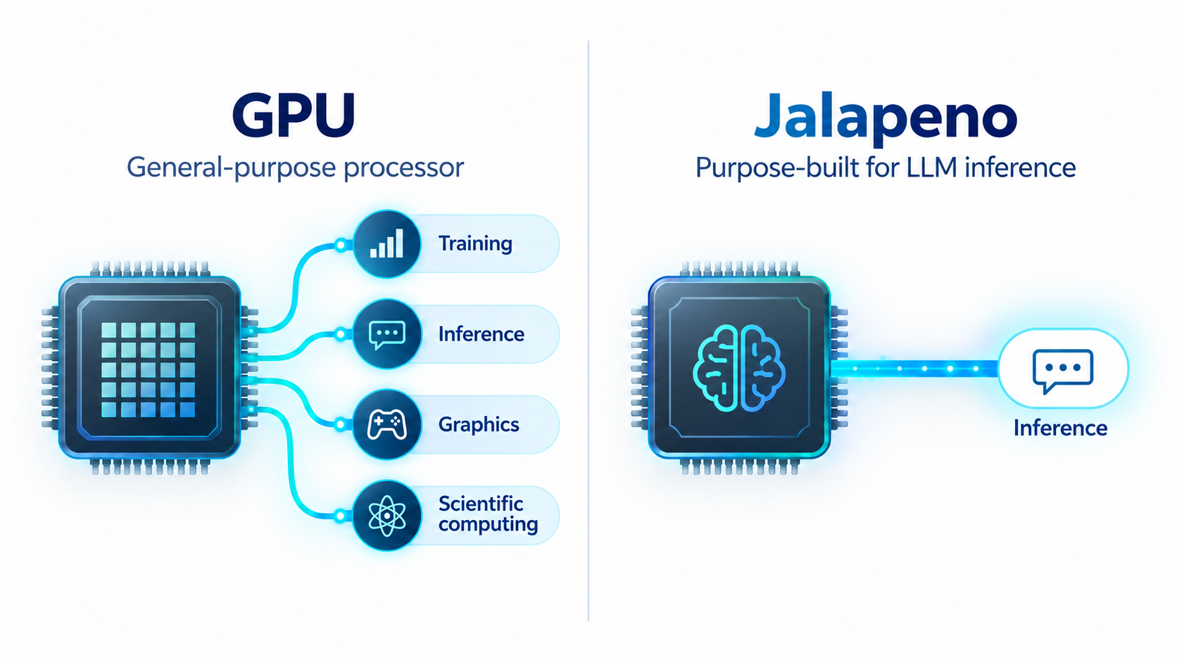
What is the Jalapeno Chip?

Slide 3

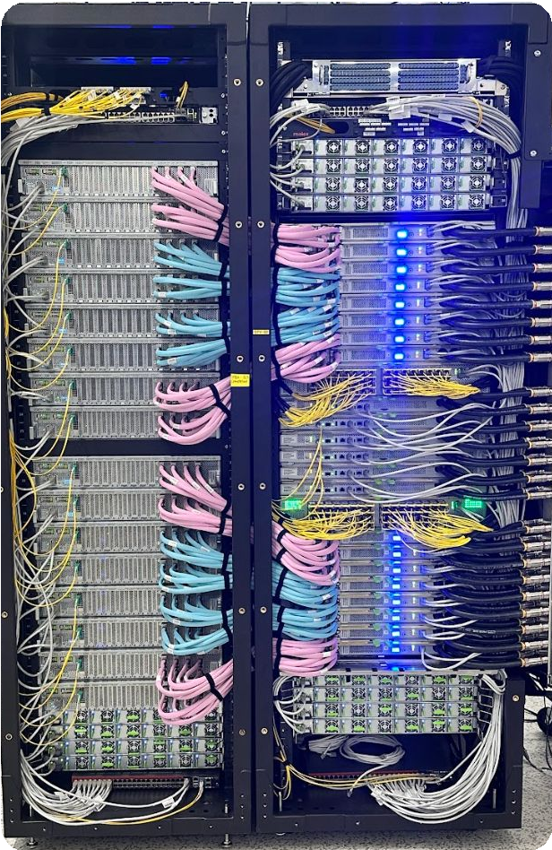
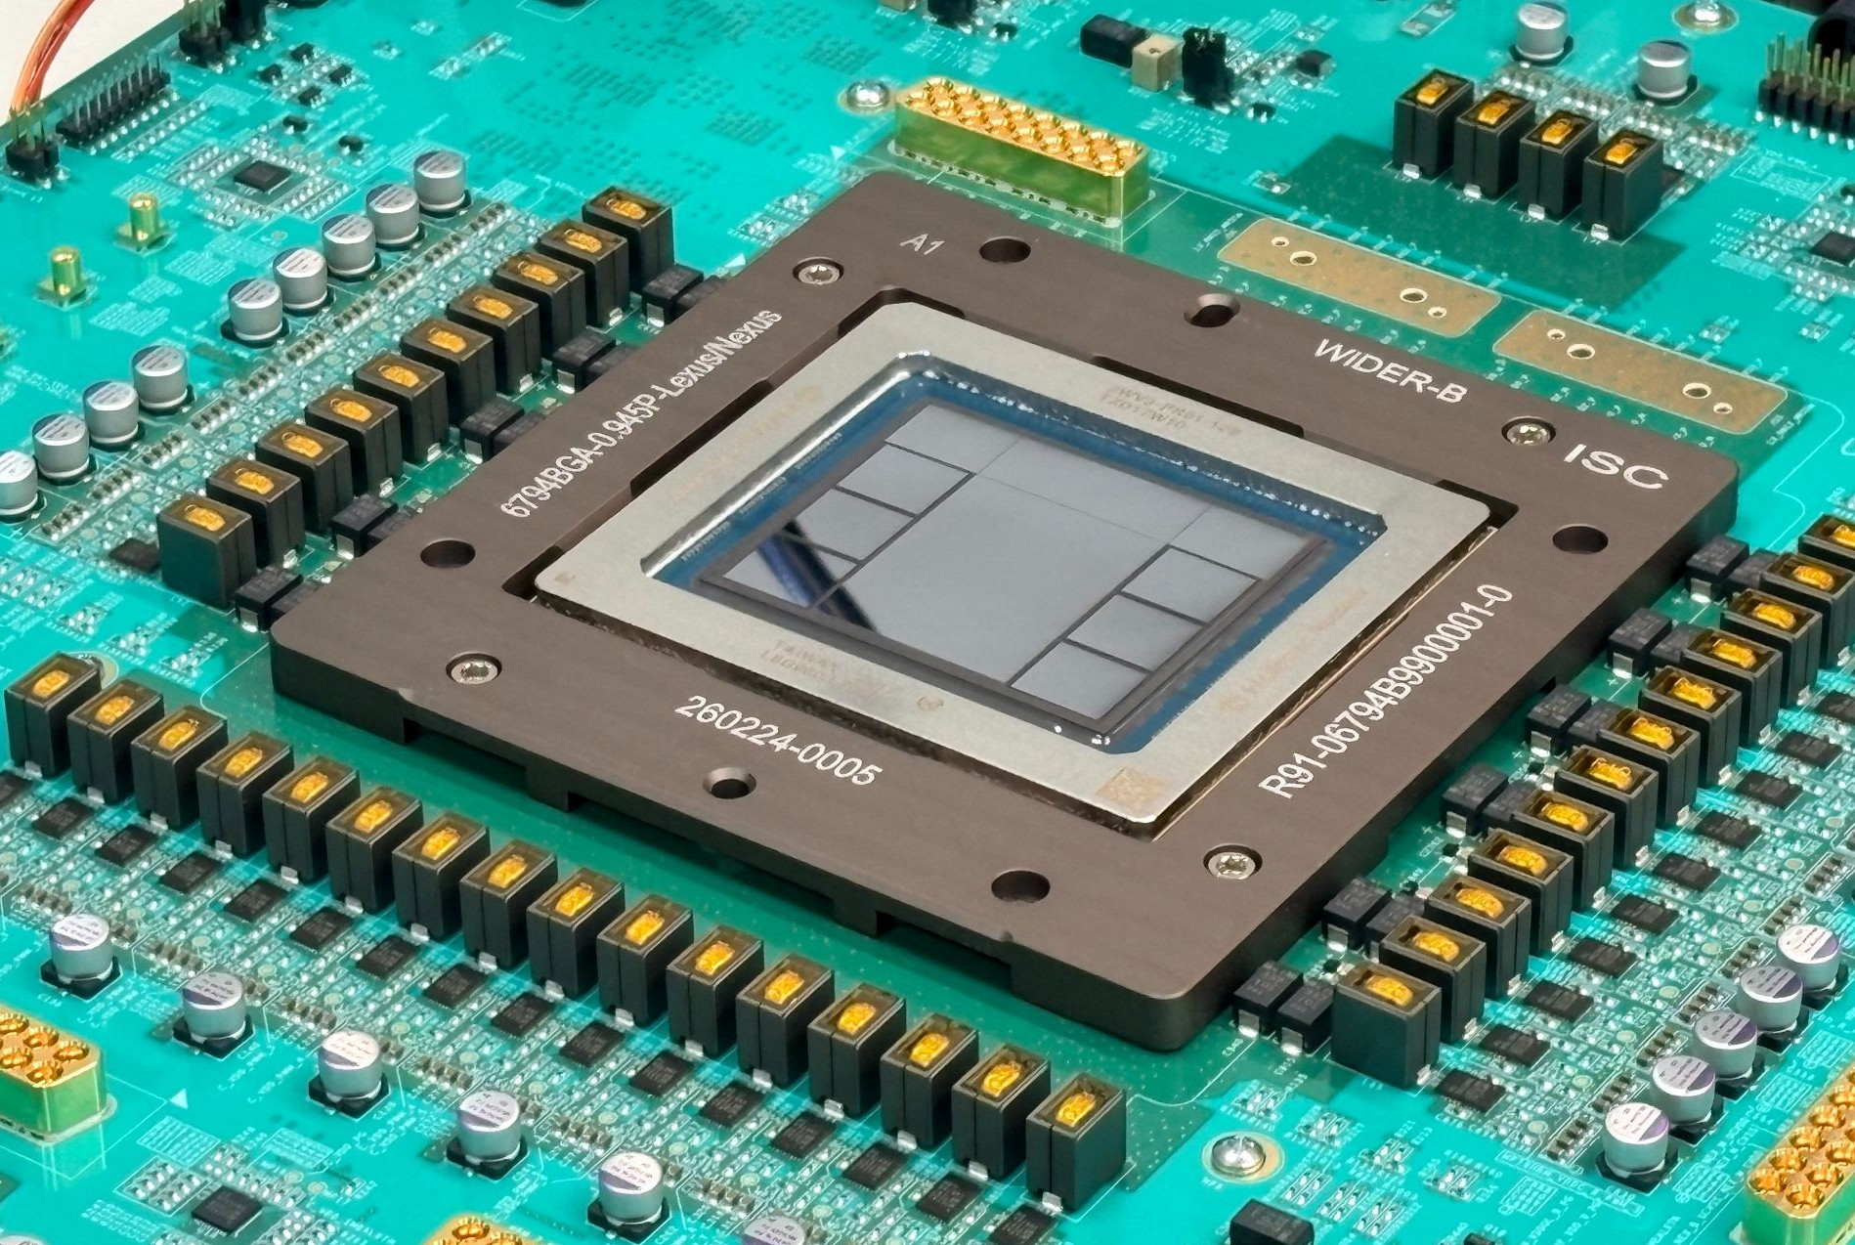
Photos of Jalapeño ASIC and host + accelerator rack pair
2

Slide 4
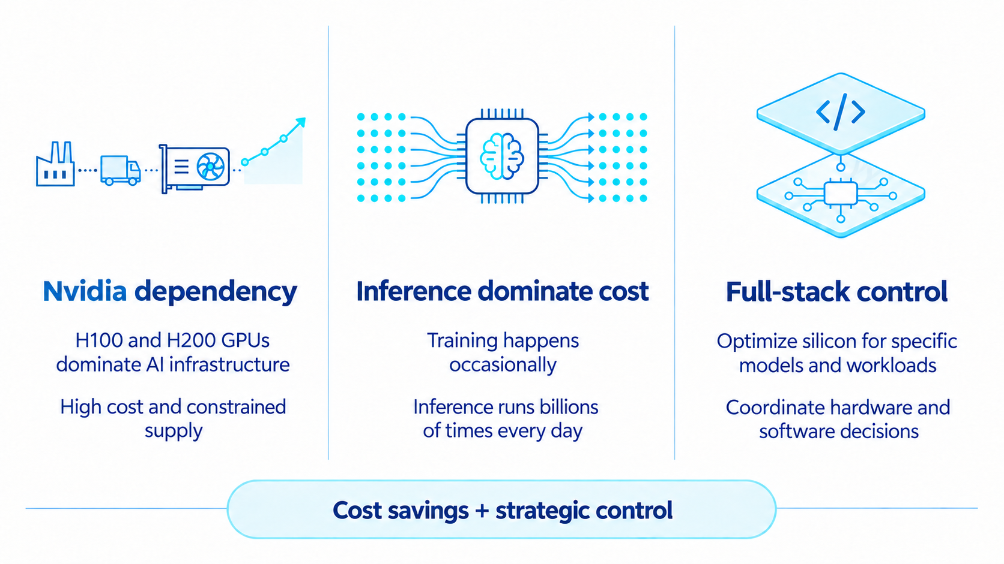
Why Did OpenAI Build a Custom Chip？

Slide 5
Project timeline
Starting point: How to optimize compute for OpenAI’s workloads?
Once the importance of inference and agentic workloads came into focus, the need for a new design was clear
Oct’24
Architecture Concept
Feb’25
Initial RTL
Apr’25
Codex CLI
Jul’25 RTL
Freeze
Nov’25 Tapeout
Feb’26
Codex Desktop
May’26
First Silicon
May’26 Jul’26
Codex runs ChatGPT on Jalapeño Work
9 months
RTL(Register Transfer Level) is a level that use code to describes how a chip works.
Tapeout is when the finished chip design is sent to the factory to be made.
3

Slide 6

Performance

Slide 7
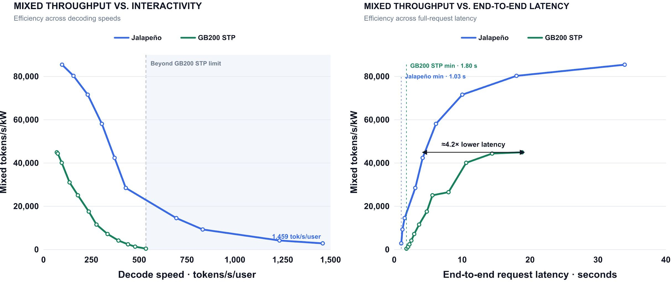
Jalapeño is pareto frontier at GPT-OSS 120B
THROUGHPUT-per-kW FRONTIER
InferenceX · GPT-OSS-120B · nominal 8k/1k · package TDP: Jalapeño 700 W; GB200 1,200 W

Slide 8
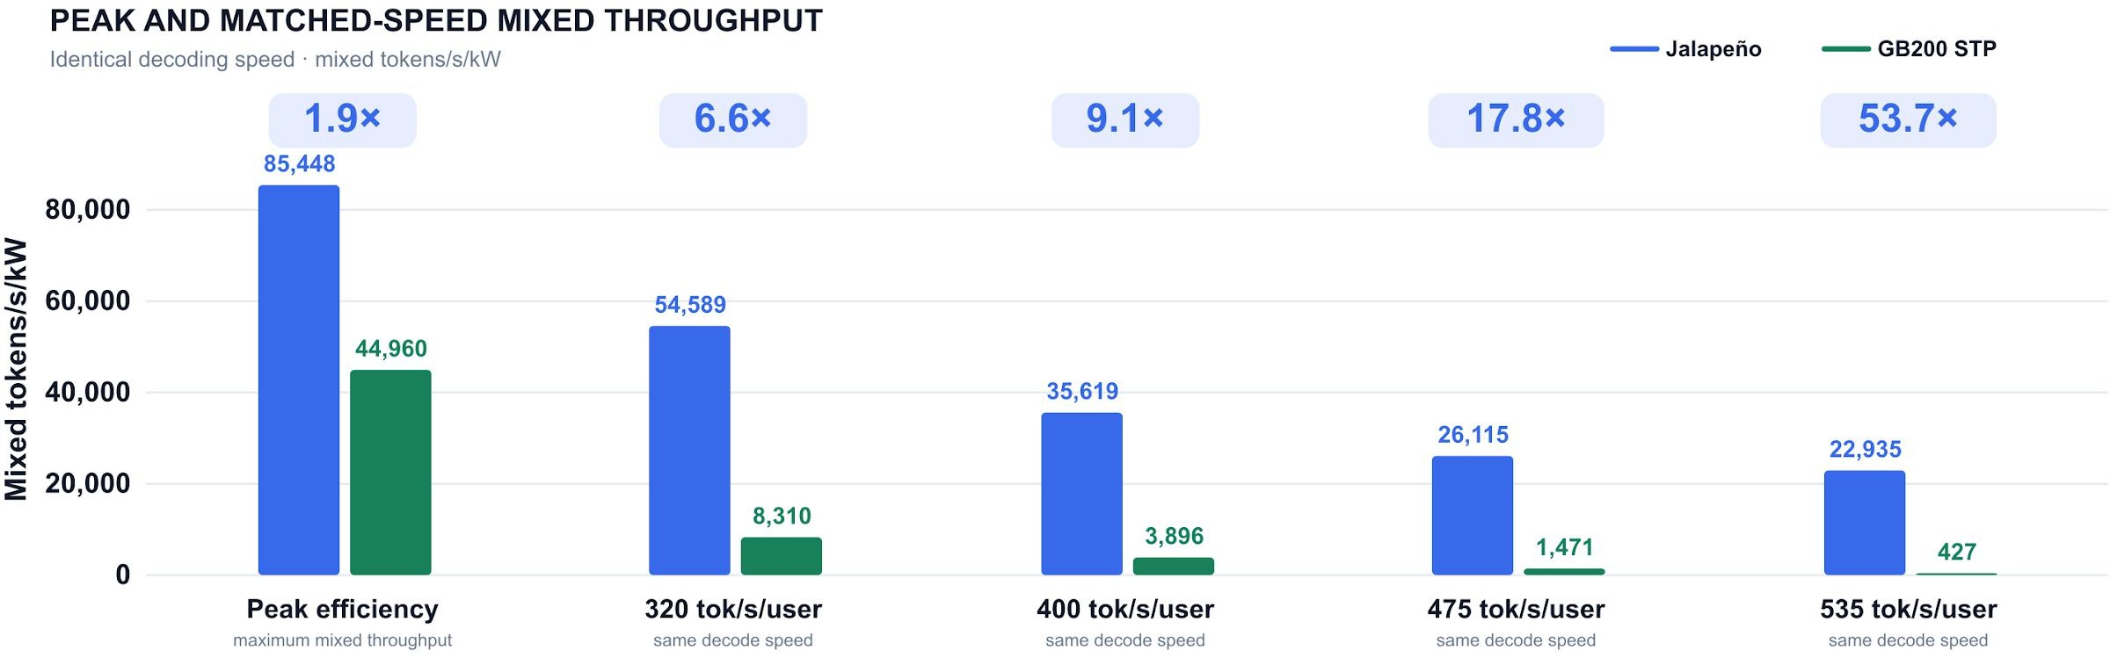
Jalapeño leads across GPT-OSS operating points
PEAK AND MATCHED THROUGHPUT
InferenceX · GPT-OSS-120B · nominal 8k/1k · package TDP: Jalapeño 700 W; GB200 1,200 W
≈1.9×
higher peak mixed TPS / kW
85,448 vs. 44,960 mixed / kW
≈1.7×
lower end-to-end latency
1.03 s vs. 1.80 s
≈2.7×
lower min TBT
0.69 vs. 1.87 ms
(1,459 vs. 535 tok/s/user)
≈53.7×
more throughput at previous TBT
22,935 vs. 427 mixed / kW
(at 535.28 tok/s/user)

Slide 9
Optimization

Slide 10
A request spans three distinct hardware regimes
01
Prefill
Encode context
02
Draft model
Speculate
03
Spec-verify
Decode
FLOPs + attention
Attention-heavy and primarily compute-bound. Low memory-BW demand; communication is easier to schedule smoothly.
Network latency
Small models at ultra-low batch for latency serving—and low batch elsewhere. Low network bandwidth, but extreme latency sensitivity.
Attention + HBM BW
Attention less memory bound with GQA and spec tokens. At low latency, MoE is memory-bandwidth hungry and communication arrives in bursts.
Compute Memory BW Comms
HIGH LOW SMOOTH
Model Batch Comms
SMALL ULTRA-LOW
LATENCY BOUND
Attention MoE Comms
COMPUTE HBM BW BURSTY
Each phase hits a different bottleneck; what matter is end-to-end latency.

Slide 11
System choice: KV moves or the active silicon mix varies
Disaggregated specialization Unified, internally heterogeneous
One balanced chip
Prefill
Compute
KV
Draft
Latency
KV
Verify
Memory + compute
Compute
Memory
Network
KV
Network + synchronization at every phase boundary
Activate the right ratio by phase; unused units go dark
Heterogeneity moves inside the chip—not across a KV-moving network.
Specialized hardware, but KV state must move between systems
Locality is king: keep KV local and activate the right resources
The chip changes the active mix of compute, memory, and network for each phase while unused resources go dark.

Slide 12
Prefill
Draft
One balanced chip
One balanced chip
Compute
Memory
(Gated）
Network
(Gated)
Compute
(Part)
Memory
(Gated）
Network
(Gated)
KV
KV
Verify
One balanced chip
Compute
Memory
Network
KV

Slide 13
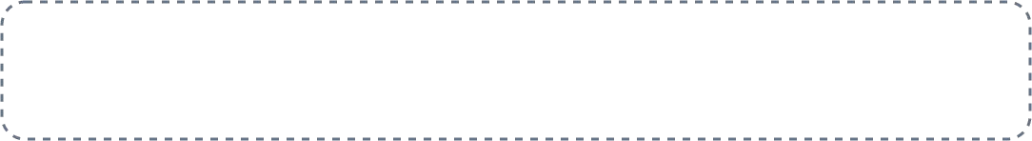
Changing ratios → inefficiency in heterogeneous fleets
Example of changing workload ratios
Prefill
Draft
Verify
Ratio affected by
Model architecture
Token efficiency
Context length
Mix A
Attention algorithms
Speculative acceptance
Latency vs. throughput
Mix B
Mix C
Specialized, heterogeneous fleet
Underused chips still draw power, rack space, incurring high baseline costs
Single balanced chip
Silicon utilization varies by phase, unused blocks are gated
SINGLE BALANCED CHIP
Prefill (Active)
Draft (Idle)
Verify (Idle)
Compute
Memory (Gated)
Network (Gated)
e.g.
1 GB300
2 GB200
1 GB300
e.g.
1 Jalapeno
Observation: unified chip can make system stay in balance when workload changes.
Dark silicon is cheaper than idle accelerators.

Slide 14
Jalapeño chip design

Slide 15
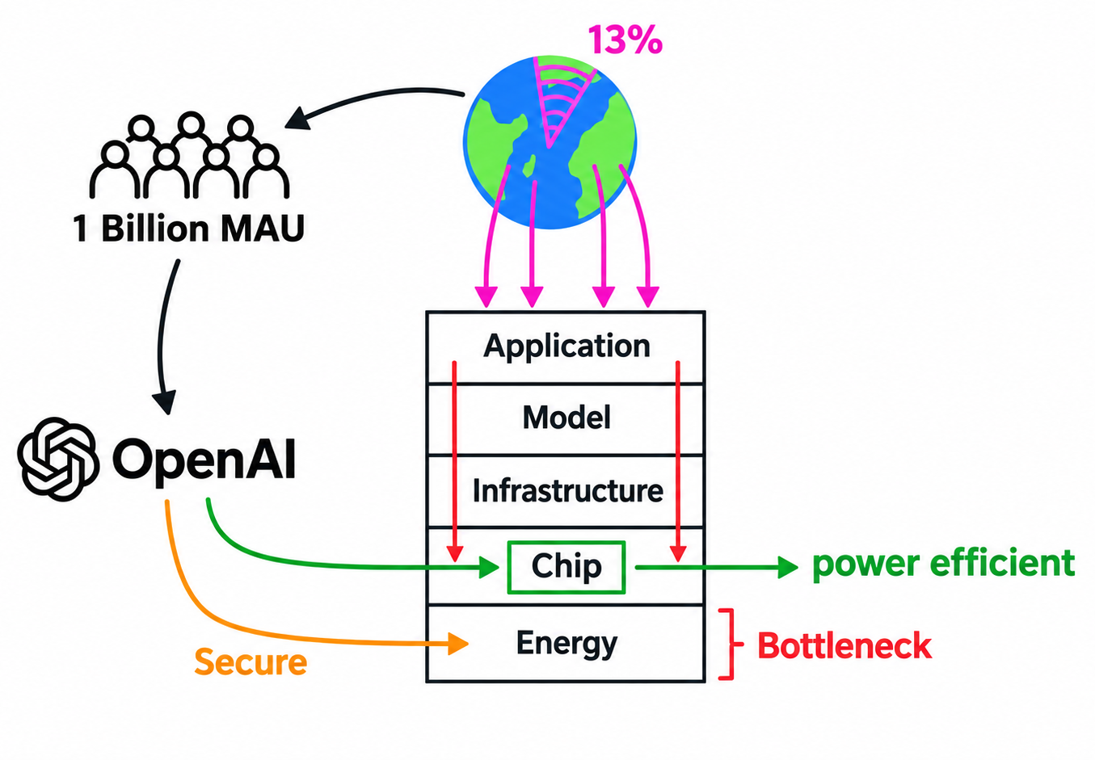
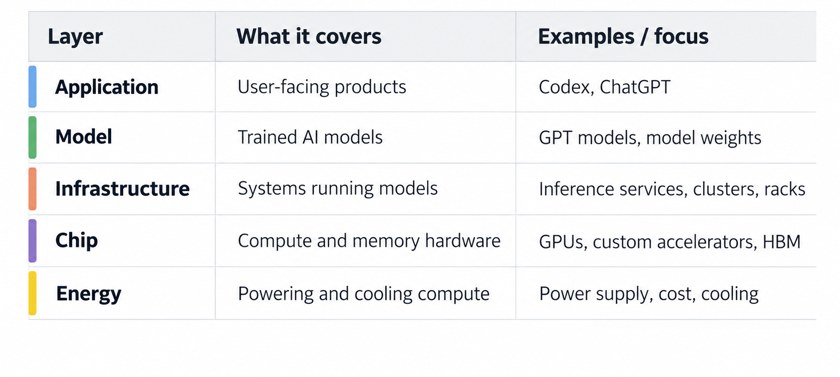
Jalapeño chip design motivation
Scale drives chip design: 1 billion MAU drives the need for more efficient compute, with energy as a key bottleneck.
OpenAI defined the inference workloads and chip architecture; Broadcom handled silicon implementation and networking for the larger system
Source: Adapted from CalebWritesCode, YouTube video (Aug. 27, 2026).

Slide 16
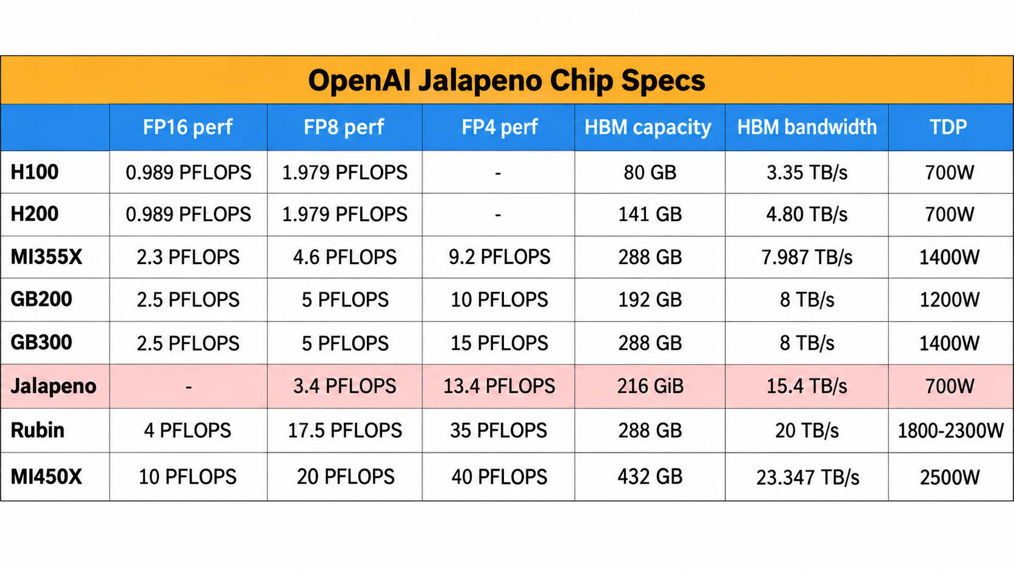
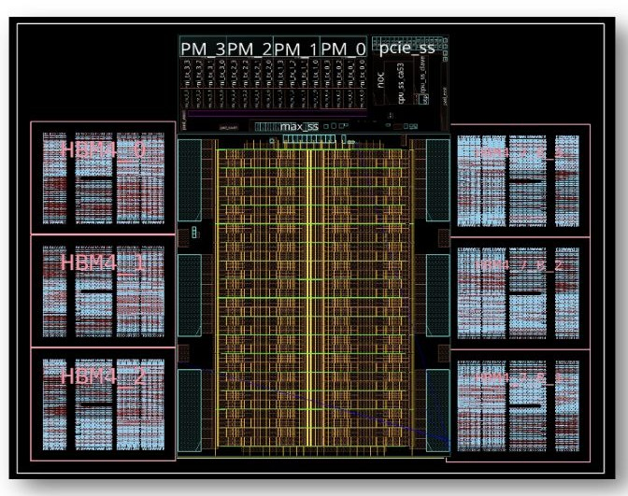
Jalapeño chip spec
FPX perf: compute capability, HBM capacity: model weight size & KV cache, HBM bandwidth: how fast the chip can read data in HBM
Jalapeno achieves comparable FP4 perf but with 2x smaller TDP
Six HBM4 stacks deliver 216 GB and 15.4 TB/s: 3× H100’s memory capacity ~5× bandwidth
https://newsletter.semianalysis.com/p/openai-jalapeno-better-than-nvidia

Slide 17

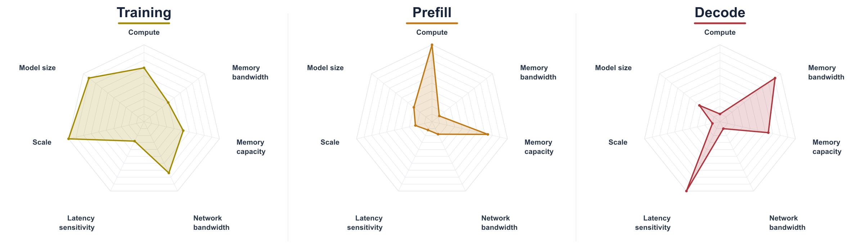
Workload requirements @ each stage
Training: Large models must be spread across many GPUs, and network between racks
Prefill: Process input tokens in parallel through attention and MLP layers, while building the KV cache.
Decode: Read each layer weight & KV cache, tokens one by one, appending new K/V after each step.

Slide 18
1+ PB/s
128-chip aggregate HBM4 bandwidth
Raw HBM bandwidth implies extraordinary token rates
0.5 TB
1T parameters × 4 bits per full model read
÷
=
2,000+
full-model weight reads / second
THEORETICAL BANDWIDTH-ONLY CEILING · NOT ACHIEVED
1000 - 2,000
tokens / s / user
without speculative decoding
5,000 - 10,000
tokens / s / user
with speculative decoding
Reality: we are nowhere close to either rate
The gap tells us that raw HBM bandwidth is not the sole limiting resource

Slide 19
Co-design the architecture to address the bottleneck
FASTEST LOCAL PATH
Pair each core slice with an HBM
slice to expose a low-latency, high-bandwidth local view.
HBM slice 1 HBM slice 2 HBM slice 3 HBM slice 64
SPECIALIZED CROSS-CORE
local view
local view
local view
…
local view
Collective network optimizes bandwidth and latency of
common comms patterns.
Core slice 1
Core slice 2
Core slice 3
Core slice 64
PRESERVE FLEXIBILITY
Shared NoC for general comms
and access to scale-up network.
Collective network · High bandwidth, low latency
General NoC · Lower bandwidth, higher latency · More flexible
Scale-up Ethernet bridge
Keep common operands local; use the shared path only when necessary
Explicit placement and distributed control prevent data movement/synchronization from dominating execution

Slide 20
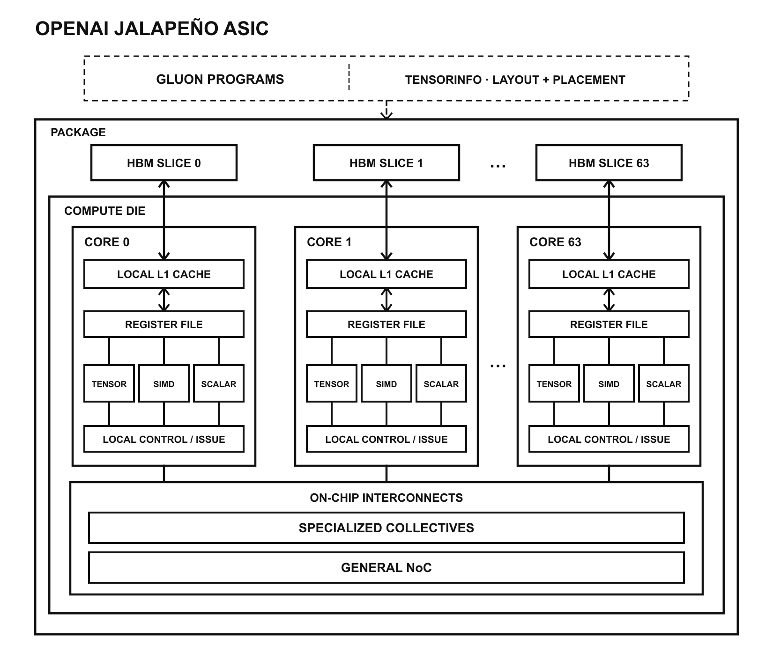
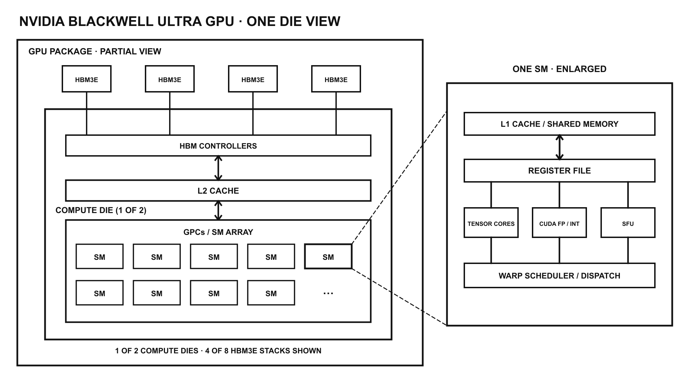
Jalapeño v.s. NVIDIA GPU chip architecture
Blackwell has better flexibility: GPU SMs use hardware scheduling and a shared memory hierarchy
Jalapeño has custom optimization: each 64 core paris with a local HBM slice, allowing model state such as weights and KV cache to be placed near the compute that uses it.
The trade-off shifts to data placement: Jalapeño can shorten common data paths, but software must decide where data lives and when it moves between slices.

Slide 21
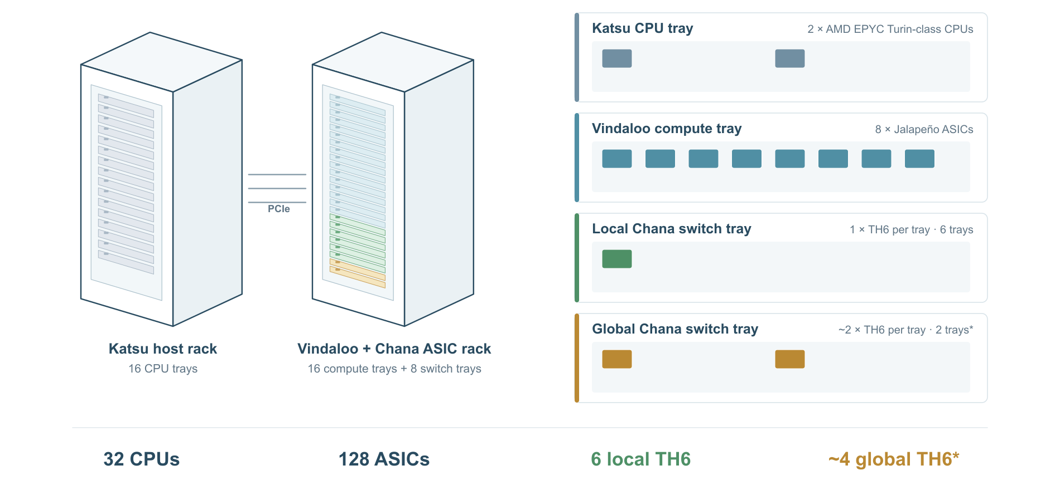
Jalapeño scale up/out
32 CPUs in the Katsu host rack connect via PCIe to 128 Jalapeño ASICs in the Vindaloo rack.
local switches connect ASICs within the rack, while global switches extend the network across racks.

Slide 22
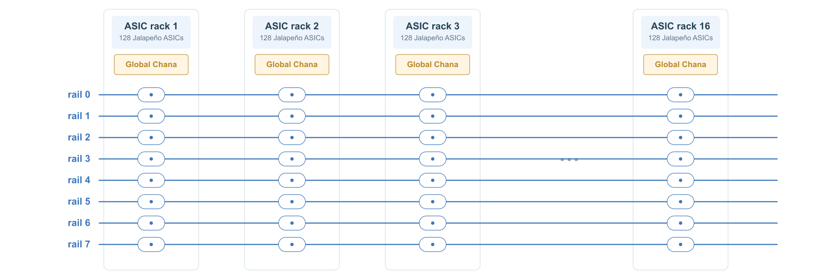
Jalapeño scale up/out
Eight parellel rails connect 16 ASIC racks, 2048 ASICs in the globale domain

Slide 23
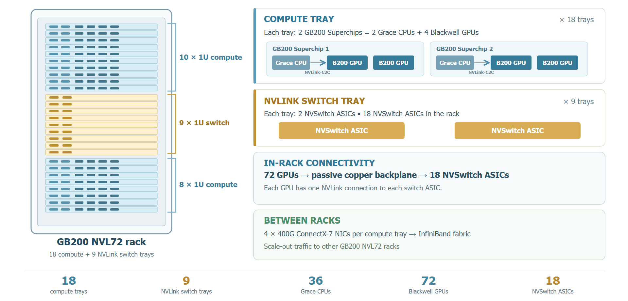
NVIDIA GB200 NVL72
18 compute trays house 36 Grace CPUs and 72 Blackwell GPUs.
InfiniBand connects racks: 18 NVSwitch ASICs handle in-rack communication
Souce: NVIDIA GB200 NVL Partition User guide

Slide 24
Execution: continuous convergence—not a complete spec
The specification becomes precise through the loop—not before it
01
02
03
04
05
Vision
Start before every detail is known.
Workload
Run programs that represent the real workloads.
Simulate
Full architecture simulation validates perf early.
RTL + QoR
Implement, synthesize, rapid feedback.
Convergence
Track DV, PD, and performance together.
MEASURE → VERIFY → LEARN → CHANGE → REPEAT
Win by shortening the loop and running it relentlessly
Vision starts the process;
representative programs, cycle-accurate simulation, QoR, and DV/PD/performance feedback converge it.

Slide 25
AI helped us build Jalapeño faster and made it better
Internal AI model
IMPACT 1 · LATE-STAGE VEOLOCITY
XLS HW language
A controllable optimization surface
Major changes landed up until the day of RTL freeze
AI + DESIGNER
propose measure optimize
Clear semantics
Enough control to optimize
IMPACT 2 · MEASURED PPA WINS VS OPTIMIZED HUMAN BASELINE
Improved building blocks
Fast QoR feedback
Robust verification
Fast tooling
BF16 mul |  | 56%
FP4 dot | 21%
FP32 acc | 10%
AI-guided optimization Generate → Verify → Measure PPA
Block-level PPA improvements
10% Matrix Unit area 8% SIMD Unit area
XLS: a High Level Synthesis toolchain

Slide 26
You Can Just Build Things … Chips
A MULTI-GENERATION ROADMAP
Each generation compounds our learnings
WHAT JALAPEÑO UNLOCKS
01
ECONOMICAL LOW-LATENCY SERVING
Frontier models become practical at interactive SLA latency.
GEN 3
Planned
GEN 2
02
BETTER PERFORMANCE PER WATT
The advantage extends to non-interactive inference as well.
Approaching tapeout
GEN 1
03
ARCHITECTURE UNLOCKS HBM
The main bottleneck is exposing aggregate HBM bandwidth—not adding more raw bandwidth.
Jalapeño
Jalapeño is our first take. Gen 2 already improves on it, and the path to Gen 3 is taking shape.
Thanks to the entire OpenAI team + our incredible partners, especially Broadcom & Celestica
34

Slide 27
Conclusion
Designed for end-to-end inference: Jalapeño keeps model state local and adjusts the active compute, memory, and network resources across prefill, draft, and verify.
Strong performance across models: It reached 1,459 tokens/s/user on GPT‑OSS 120B and 1.9× higher peak mixed throughput per kW than the compared GB200 system. Results on DeepSeek R1 and Kimi K2.5 show it is not limited to OpenAI models.
Compute–memory architecture codesign: Each compute core is paired with a local HBM slice. Software can place weights and KV state near the cores that use them.
Nine months from initial RTL to tapeout: With AI helped in circuit implementation, the team moved from initial RTL in February 2025 to tapeout in November 2025, while making major changes up to the July RTL freeze.
Next challenge: Peak FP8 compute trails GB300 (3.4 vs 5 PFLOPS), and measured token rates remain below the deck’s bandwidth-only estimate. Better use of aggregate HBM bandwidth, less synchronization, and more mature serving software are the clearest areas to improve.

