Slide 1
In-Datacenter Performance Analysis of a Tensor Processing Unit
Jouppi et al. · ISCA 2017 · Google
Can domain-specific hardware provide a better cost–energy–performance point for production neural-network inference?
Production hardware
TPU v1 deployed in Google datacenters since 2015
Inference ASIC
Not a simulator or prototype
Compared against contemporary general-purpose platforms
Intel Haswell CPU + NVIDIA K80 GPU
Presenters:
Lizhong Wang
Jiangrui Xu

Slide 2
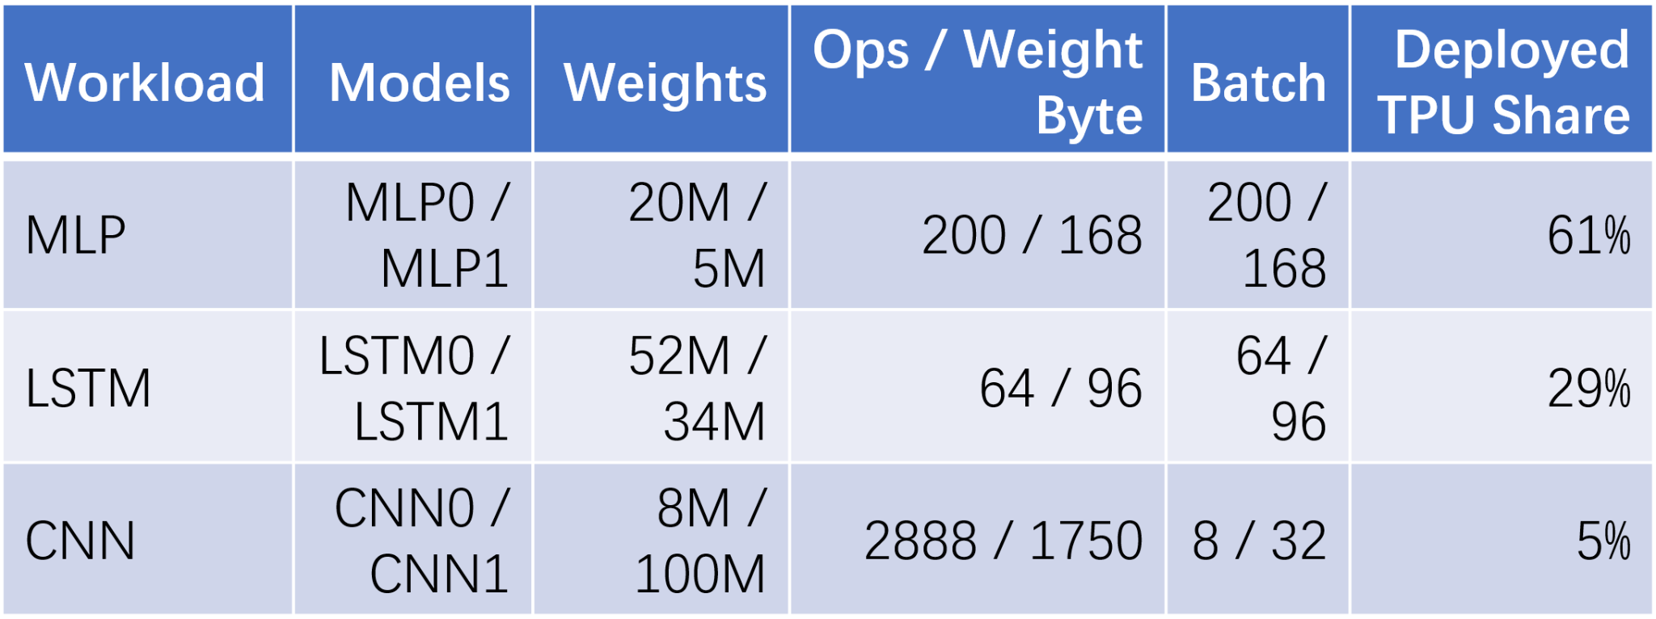
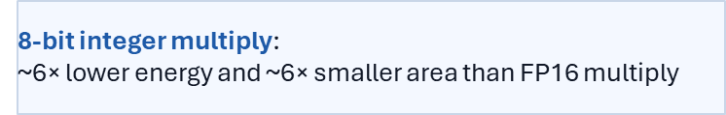
Why Inference? Workload Properties That Matter
Training
• Primarily performed in floating point
• GPUs are well suited
• Less constrained by response-time deadlines
Inference
• Quantization → often 8-bit integers
• User-facing services
• Strict response-time limits
• Weight access is costly in both time and energy
Six production applications represent 95% of TPU inference use.
Models require 5M–100M weights.
The measured TPU inference workload was dominated by MLPs and LSTMs, not CNNs.
The target workload is quantizable, weight-heavy, latency-sensitive, and mostly MLP/LSTM.

Slide 3
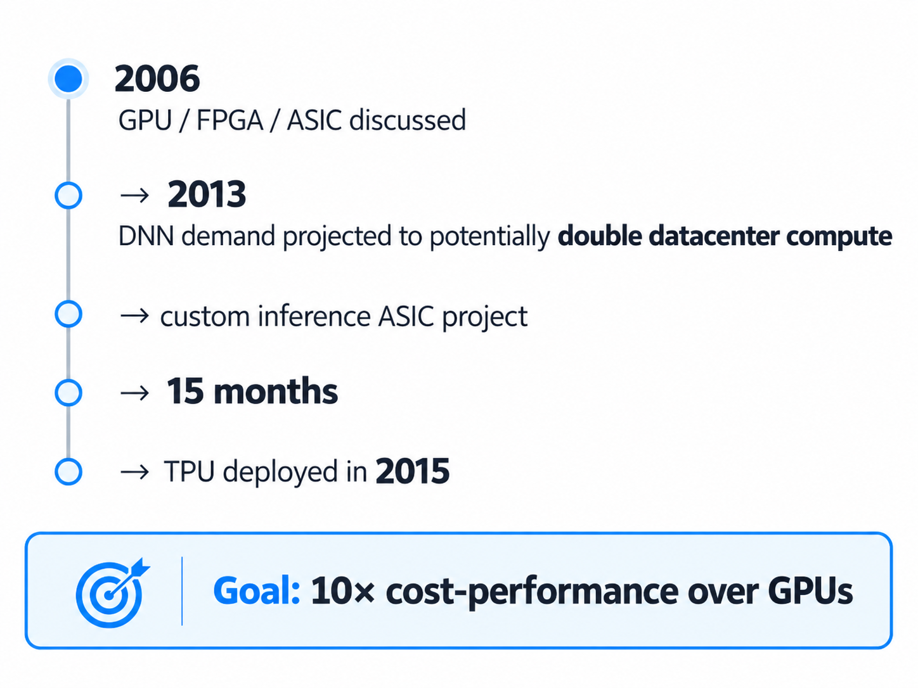
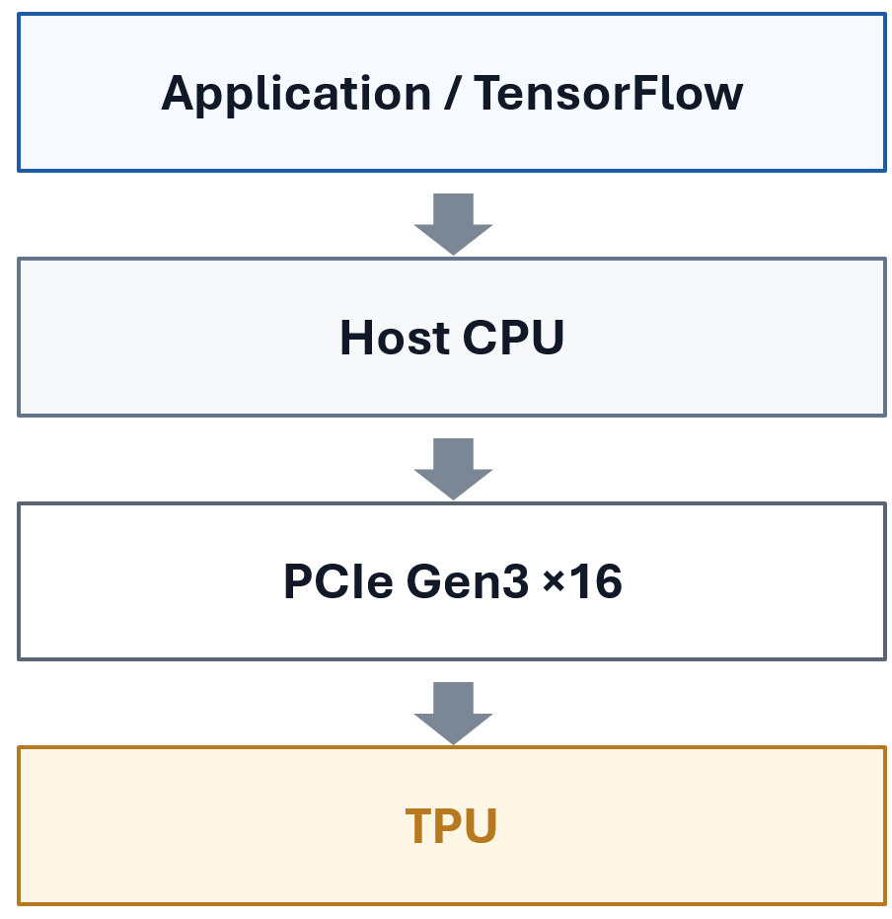
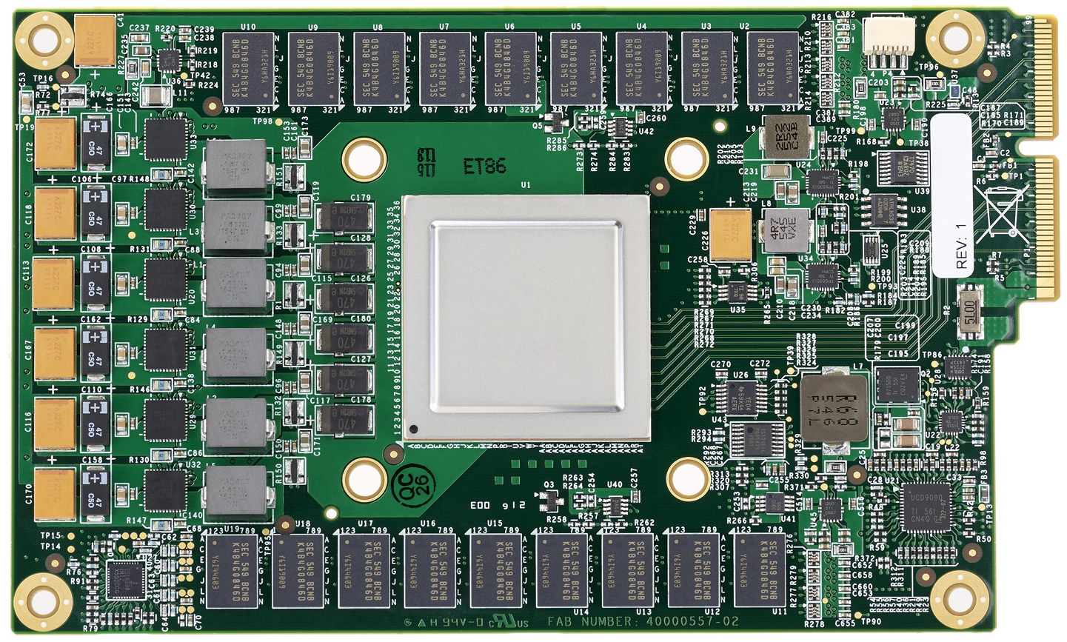
From Workload Pressure to a Deployable ASIC
System-level form
Deployment-driven design
• PCIe coprocessor
• Plug into existing servers
• Host-issued instructions; no on-TPU fetch
• Run whole inference models on TPU to minimize host interaction
(~3 min/day voice search per user)
TPU board deployed in existing servers

Slide 4
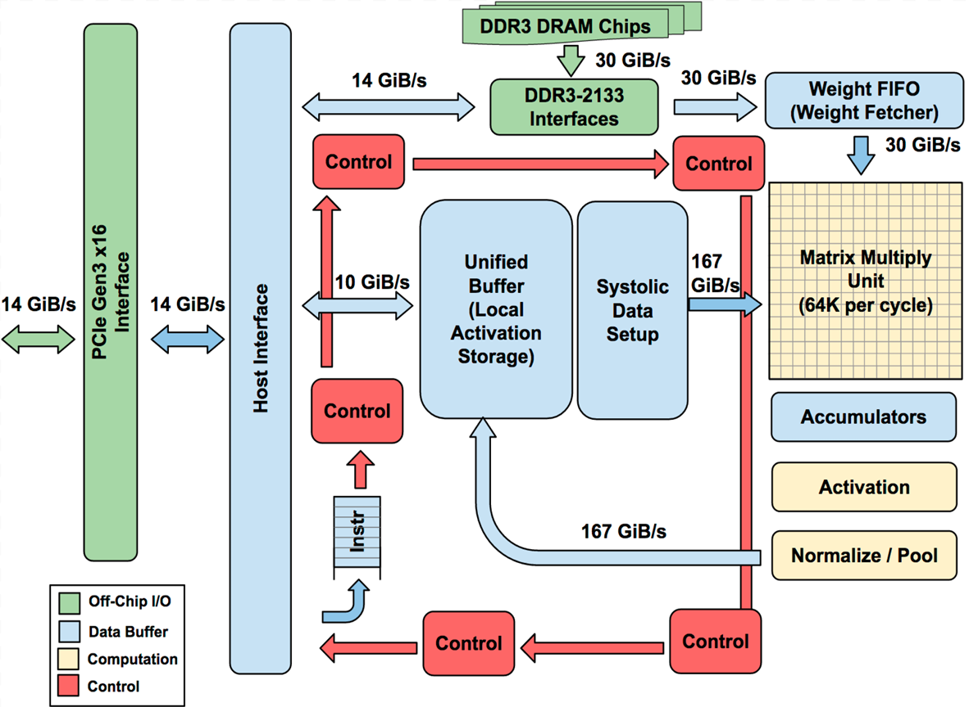
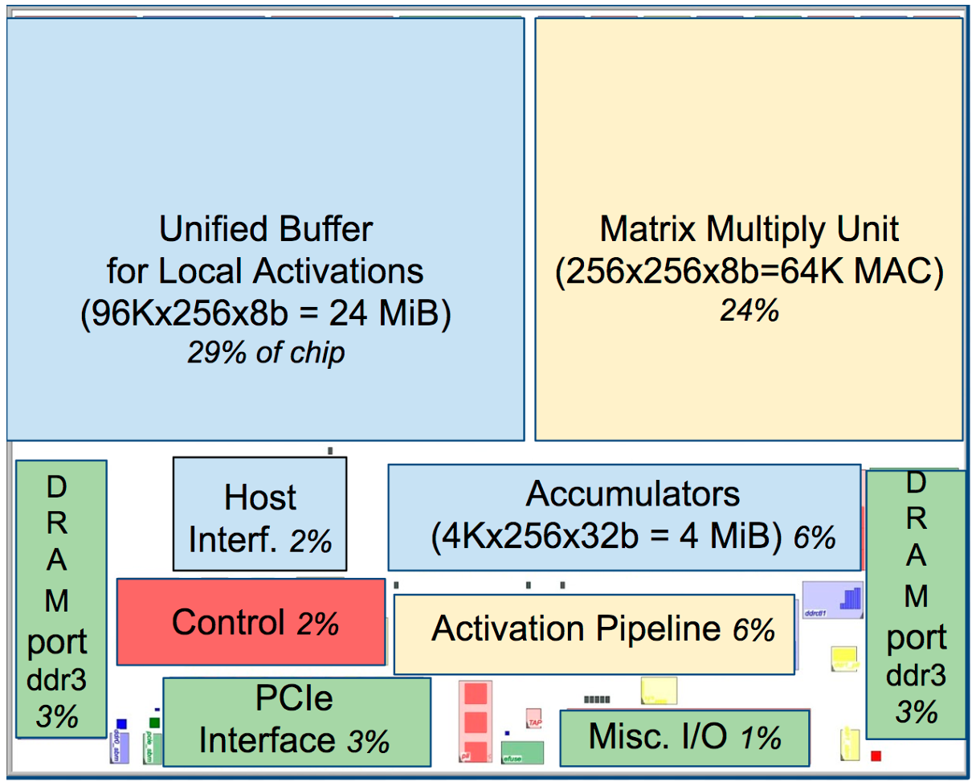
TPU Architecture: Large Datapath, Simple Control
Key Architecture Facts
PCIe coprocessor: host sends TPU instructions over PCIe Gen3 ×16; internal blocks are typically connected by 256-byte-wide paths.
Matrix Multiply Unit: 256 × 256 = 65,536 MACs, supporting signed/unsigned 8-bit multiply-add.
Accumulation: 16-bit products are accumulated in 4 MiB of 32-bit accumulators; the MXU produces one 256-element partial sum per cycle.
Memory organization: 24 MiB Unified Buffer stores intermediate activations; weights come from 8 GiB off-chip Weight Memory through the Weight FIFO.
Floorplan of TPU die: 67% datapath, 10% I/O, only 2% control

Slide 5
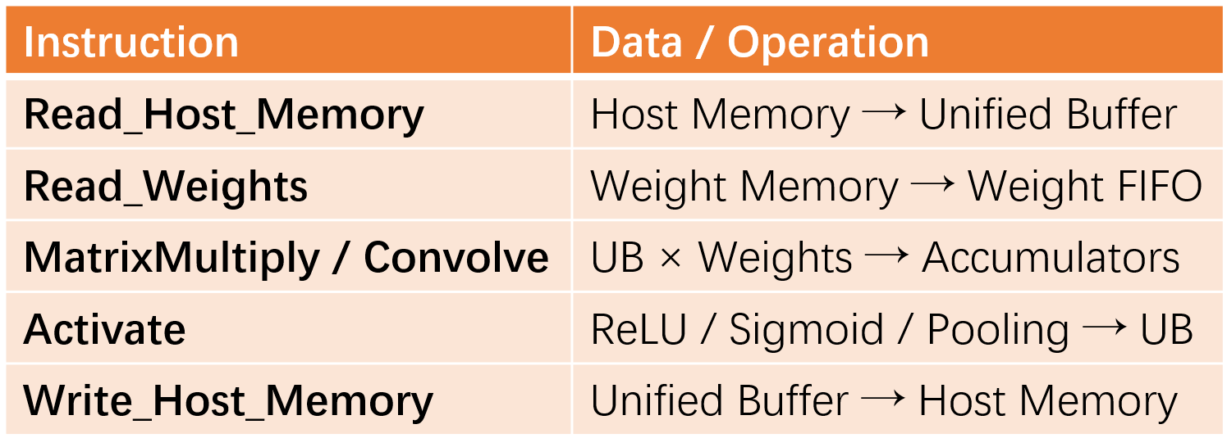
TPU Instruction Set & Execution Model
Execution philosophy
4-stage CISC pipeline
Overlap other instructions with MatrixMultiply
Read_Weights = decoupled access / execute
MXU stalls if weight or activation is not ready
Layer dependency → RAW stall + explicit synchronization
ISA characteristics
~12 instructions · CPI ≈ 10–20 · repeat field
Instructions arrive over relatively slow PCIe → coarse-grained instructions amortize instruction-delivery overhead.

Slide 6
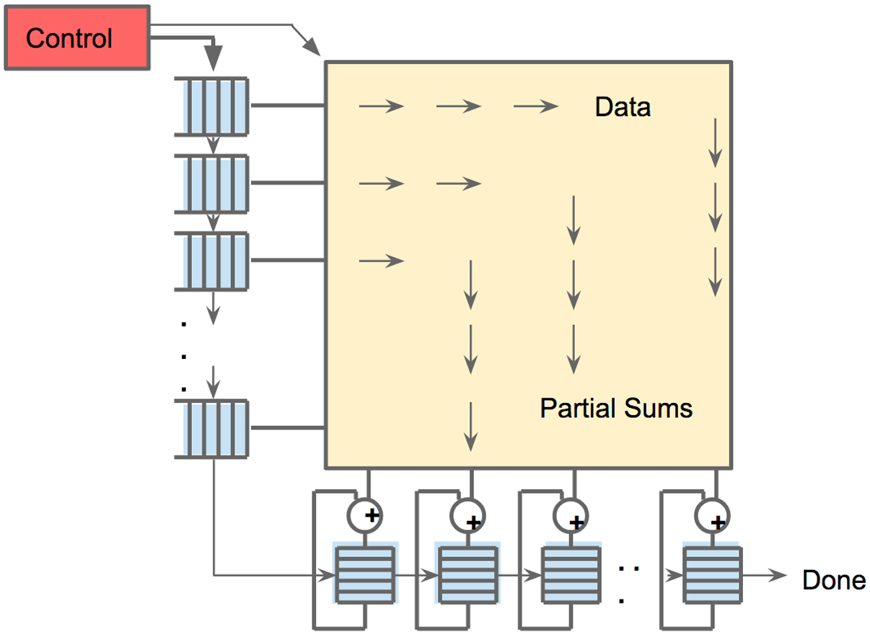
Systolic Execution: Minimize Data Movement
Large SRAM accesses consume much more power than arithmetic.
The 256×256 array is as much about data reuse as raw compute.
Systolic execution
Data enters from the left
Weights loaded from the top
Weights are preloaded
MAC computation propagates as a
diagonal wavefront
Why systolic?
Reduce reads/writes of the Unified Buffer
Software abstraction
Hidden for correctness
Latency still matters for performance
Systolic data flow of the Matrix Multiply Unit

Slide 7
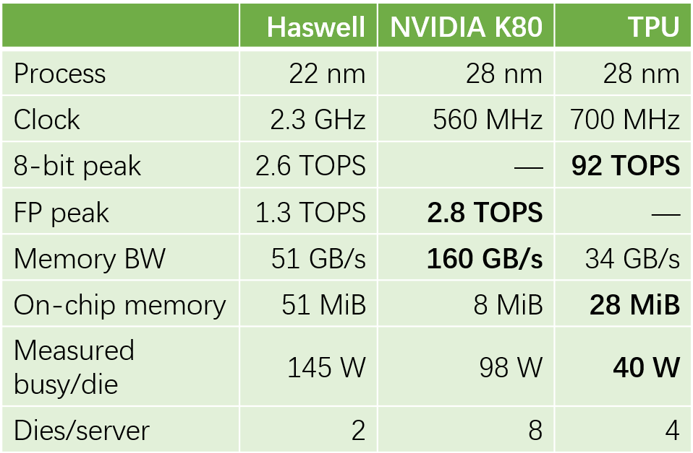
Evaluation Setup: Contemporary Datacenter Baselines
Comparison methodology
Contemporary platforms
All available in 2015, when TPU was deployed
Datacenter-class reliability
Internal SRAM + external DRAM require at least SECDED
Realistic configurations
Not systems assembled solely to win benchmarks
Normalization
Most performance results: per die
TCO/performance-Watt section: whole server

Slide 8
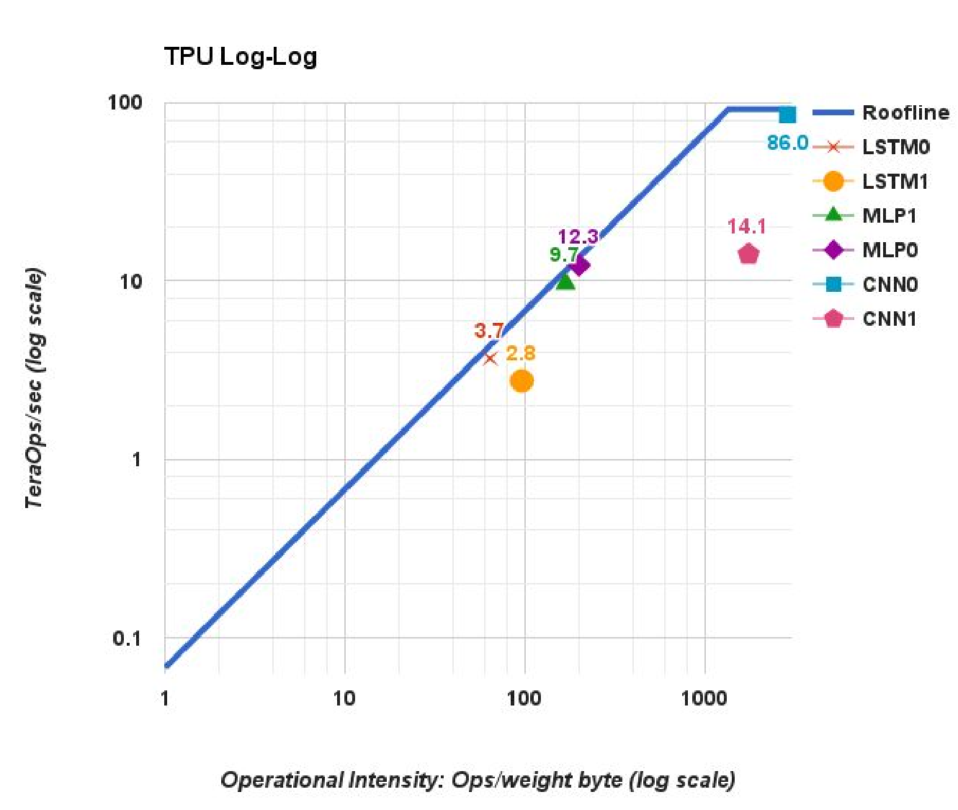
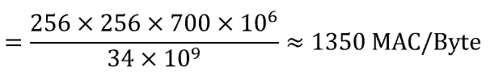
Performance Analysis: Roofline
\[ \text{Ridge Point} = \frac{\text{Peak Compute}}{\text{Memory Bandwidth}} = \frac{256 \times 256 \times 700 \times 10^6} {34 \times 10^9} \approx 1350\ \text{MAC/Byte} \]
The Performance of 5 NN applications is almost close to its roofline, with only one exception (CNN1):
Roofline with 6NN Applications:
Throughput vs. Operational Intensity
Memory Bandwidth Bounded
some layers in CNN1 have shallow feature depths and subsequent layers are dependent on the former one:
Shallow feature depth → cannot fully fill the 256×256 MAC array → lower utilization and performance.
Significantly Below Roofline
Mac Array Bounded
​99% response time: 7ms
Why 99% response time:
Inference is user-facing, so users should not wait too long for a response. Therefore, latency is as important as throughput, and often more important for interactive services.

Slide 9
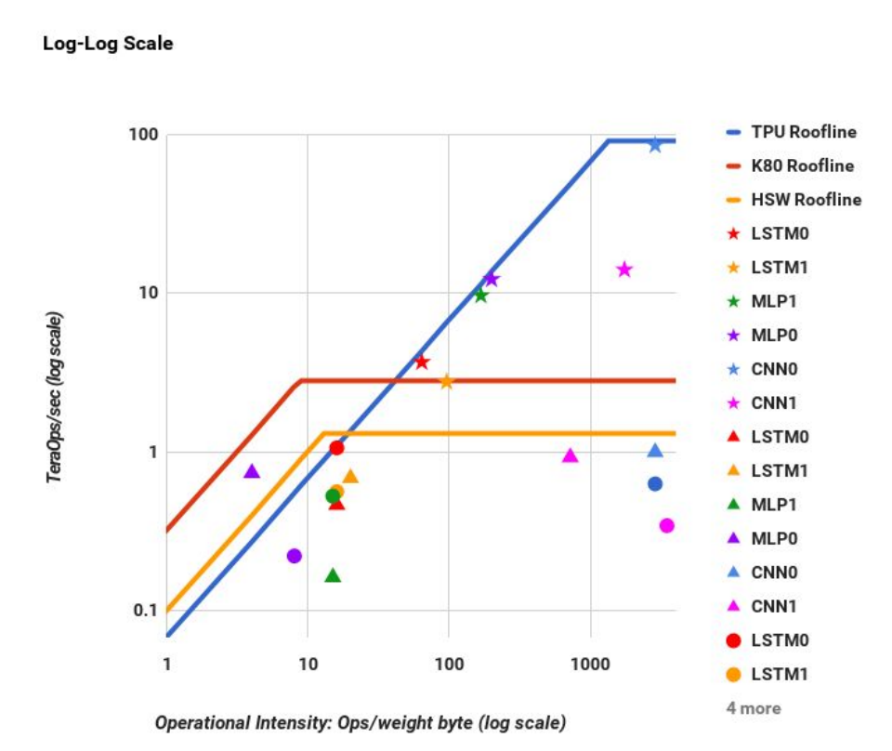
Performance Analysis: A Comparison
Roofline & Throughput Comparison:
CPU vs. GPU vs. TPU
Conclusion:
TPU’s Simple Architecture: Data Transfer + Computation
More chip area can be used for MAC units
More deterministic execution → performance closer to the roofline
Much Better Energy Efficiency (Perf./Watt: 196 x CPU, 68 x GPU, Total Perf./Watt: 86 x CPU, 41 x GPU )
​TPU has the largest computation unit
​CPU’s & GPU’s Performance are below their rooflines:
Limited by the 7ms 99th-percentile latency constraint: CPU features such as cache misses, OoO execution, and speculation make execution less deterministic, can’t reach maximum performance
per die throughput under 7ms 99th-percentile latency :
TPU (80%) > CPU (42%) > GPU (37%)
DRAM Bandwidth:
GPU > CPU > TPU

Slide 10
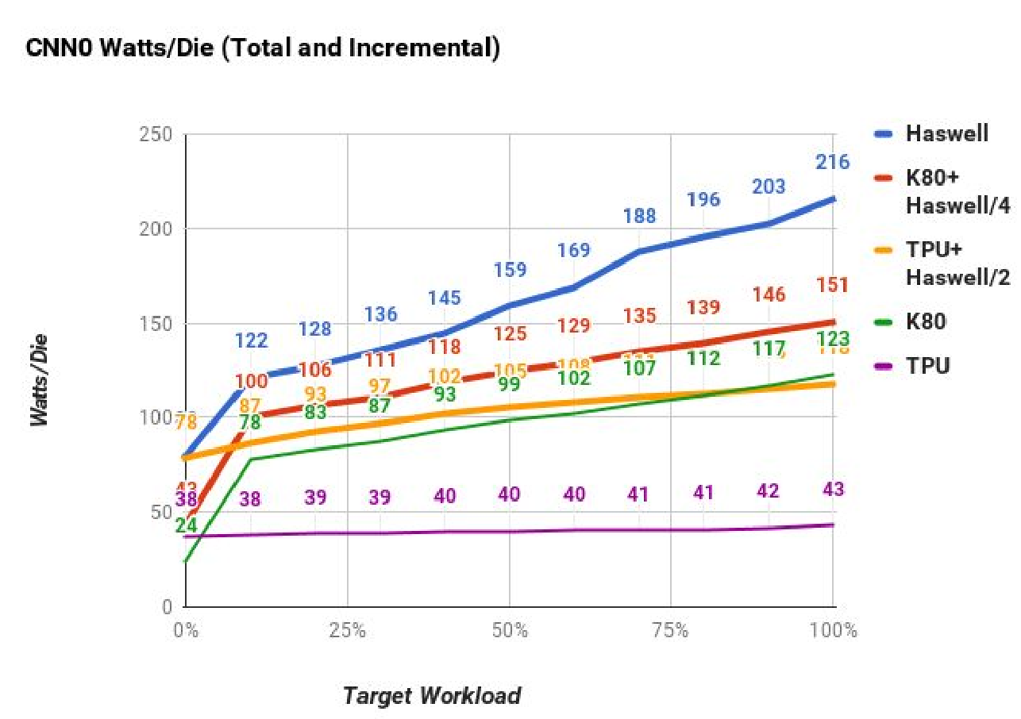
Energy Proportionality
Key takeaway
Power should scale with workload — but low-load power remains high
At 10% load, power is still:
• Haswell: 56% of full-load power
• K80: 66% of full-load power
• TPU: 88% of full-load power
Interpretation:
TPU has the lowest absolute power, but poor energy proportionality.
Why it matters
TDP sets the power/cooling budget, but electricity cost depends on average consumed power across varying workloads.
System-level note
Haswell + 4 TPUs: <20% extra power, but 80× faster on CNN0 than Haswell alone.
Watts / Die vs. Workload
Source: Section 6 values normalized to full-load power.

Slide 11
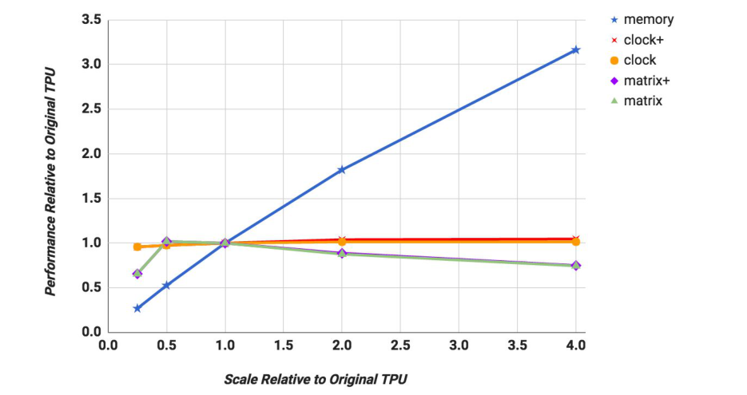
Evaluation of Alternative TPU Designs
Key question: if we redesign TPU, should we spend area on memory, clock, accumulators, or a larger matrix unit?
Design knobs tested
“+” means accumulators are scaled too — but clock+ and matrix+ scale differently.
memory: increase weight-memory bandwidth
clock: increase clock frequency only
clock+: clock + more accumulators to keep more memory requests in flight
matrix: increase matrix-unit dimension only
matrix+: larger matrix + accumulators scale with dimension²
Clock+ = ↑ clock + ↑ accumulators
Matrix+ = ↑ matrix dimension + ↑ accumulators ∝ dim²
Unified Buffer insight
weighted-mean TPU performance sensitivity
24 MiB built-in, but improved allocator reduced max needed to 14 MiB → extra capacity became margin for larger models.
What the model says
4× memory bandwidth → ~3× performance. Higher clock gives little average gain. Bigger matrix units can hurt utilization (2D fragmentation).
Critical note: the TPU′ result is model-based, not measured on fabricated hardware; host CPU time is only partially included.

Slide 12
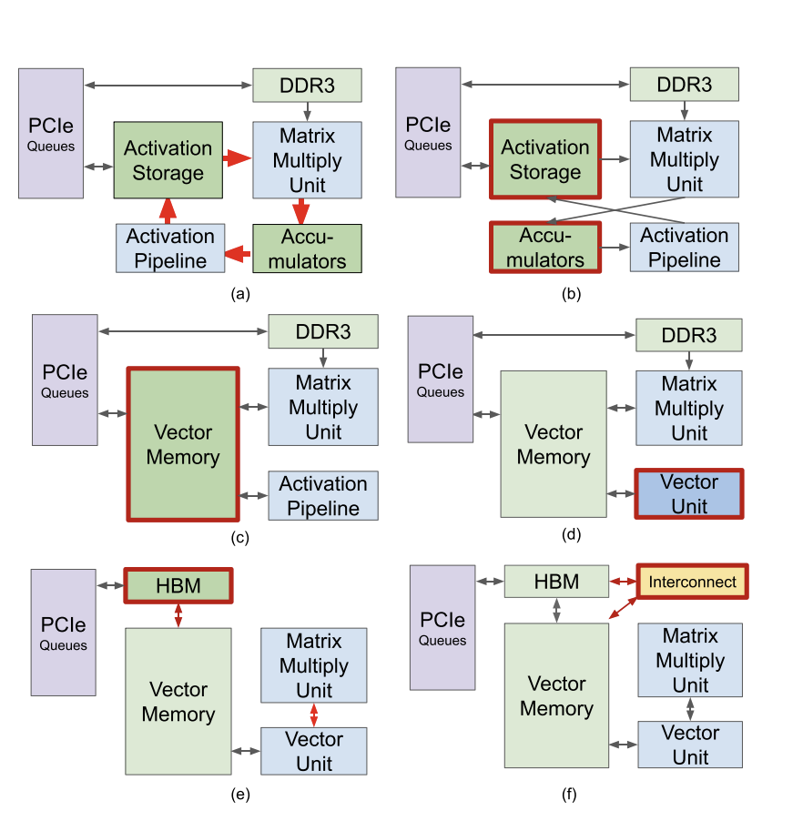
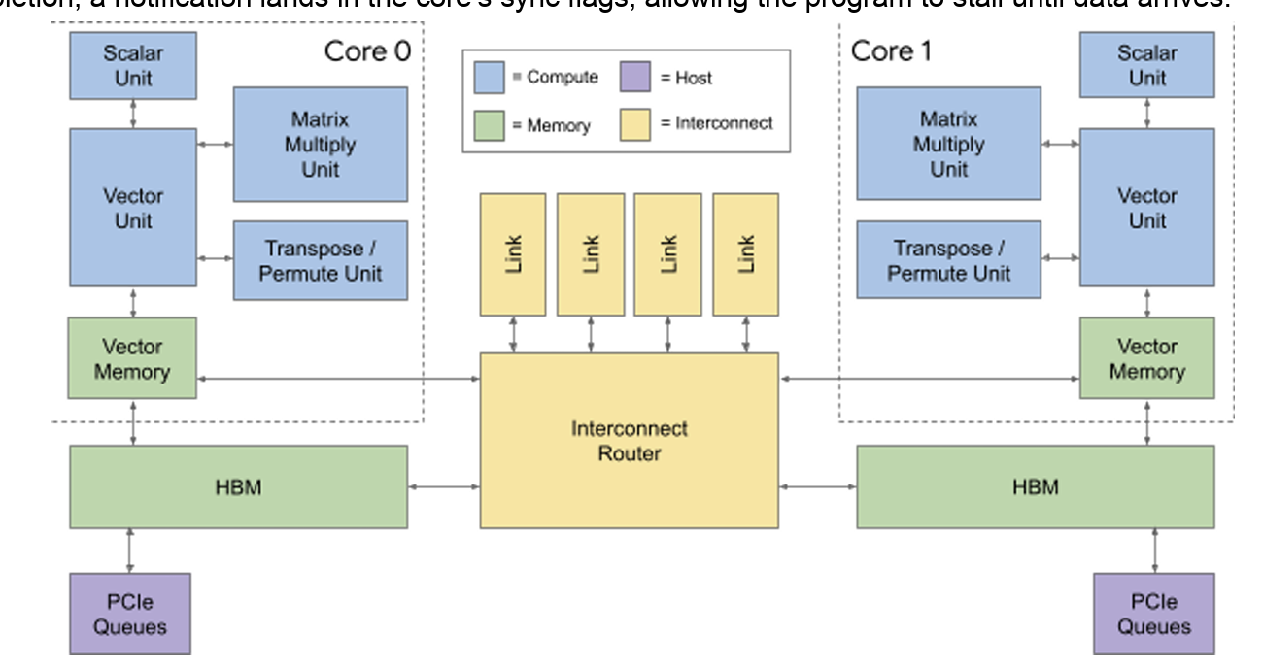
Transforming the TPUv1 into the TPUv2
Architectural Evolution of TPU v2
(a) Baseline design
Separate Activation Storage and Accumulators
Dedicated Activation Pipeline
Weights stored in DDR3
(b → c) Unified on-chip memory
Merge Activation Storage and Accumulators into a larger Vector Memory
Simplifies data movement and improves flexibility
(c → d) More programmable computation
Replace the fixed-function Activation Pipeline with a Vector Unit
Supports more general element-wise / activation operations
(d → e) Higher memory bandwidth
DDR3 → HBM
Much higher bandwidth to better feed the Matrix Multiply Unit
(e → f) Scale beyond one chip
Add a high-speed Interconnect
Enables efficient TPU-to-TPU communication and large-scale systems
Transforming the TPUv1 datapath into the TPUv2 datapath
two TensorCores in TPU v2

Slide 13
Thank you!

