Slide 1

Embodied.cpp
A Portable Inference Runtime of
Embodied AI Models on Heterogeneous Robots
Ryan Ma & George Wang
01
Notes:
Timing: 0:00–0:30. Today we are discussing a systems paper about executing trained robot models. A runtime manages how model operations, memory, hardware and robot interfaces work together. The main question is whether a common C++ runtime can make different robot models cheaper to deploy without materially weakening control. The story begins with why embodied models matter, then explains the runtime, examines comparative evidence and considers future potential. The six critical questions are woven into that story. We will keep paper results separate from later repository documentation.
Section: Explanation
Source: https://arxiv.org/abs/2607.02501v3
Ling Xu et al. arXiv:2607.02501v3 9 August 2026

Slide 2
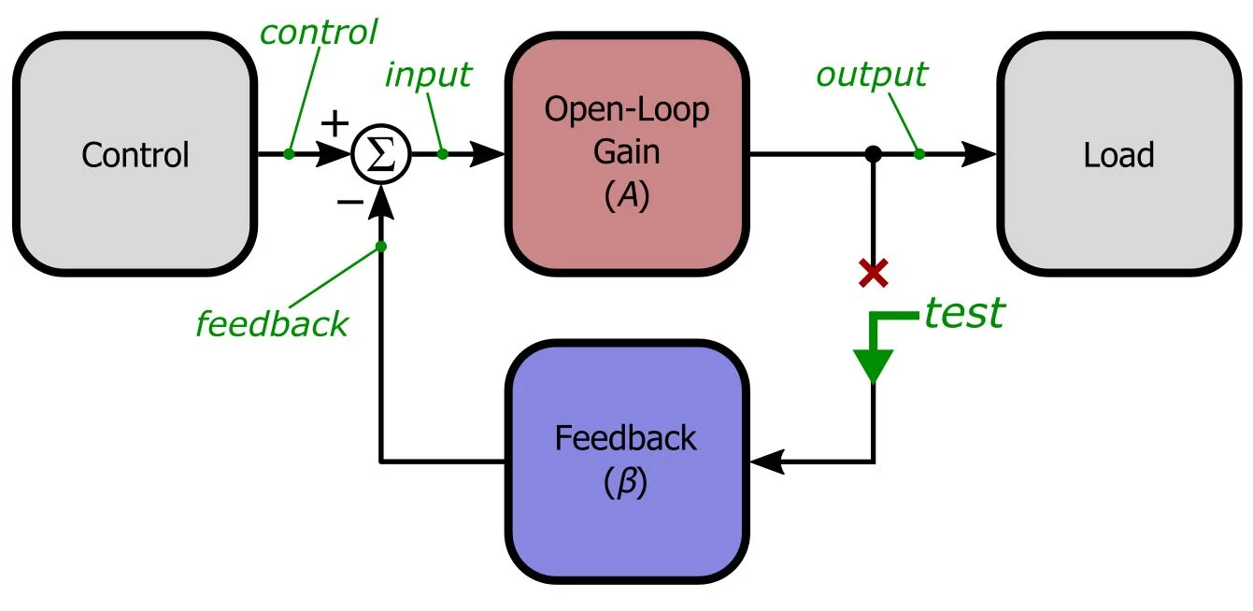
Terminology
VLA | Vision Language Action Model
WAM | World-Action Model
Closed Loop Control | Previous input feeds next output
Embodied Inference | Runs inside a robot and update based on environment
Input
02
Notes:
Timing: 0:30–2:00. Start with the ambition: transfer the broad knowledge of foundation models into physical action. VLA models combine language and visual understanding with action generation. The pi0.5 paper reports generalization to manipulation tasks in previously unseen homes, using diverse training data. GR00T N1 combines vision-language reasoning with a fast action-generating module and uses real, human-video and synthetic data. WAM research goes further by explicitly predicting future states as part of control. These examples explain the research interest: more general behavior, richer training signals and anticipation of physical consequences. They do not establish universal robot competence or that every WAM outperforms every VLA. Transition: what exactly do VLA and WAM mean?
Additional sources: https://arxiv.org/abs/2504.16054 and https://arxiv.org/abs/2503.14734
Section: Explanation
Source: https://arxiv.org/abs/2607.02501v3
Context: pi0.5 (2025), GR00T N1 (2025) and Embodied.cpp §2.1. Motivations, not a popularity metric.

Slide 3
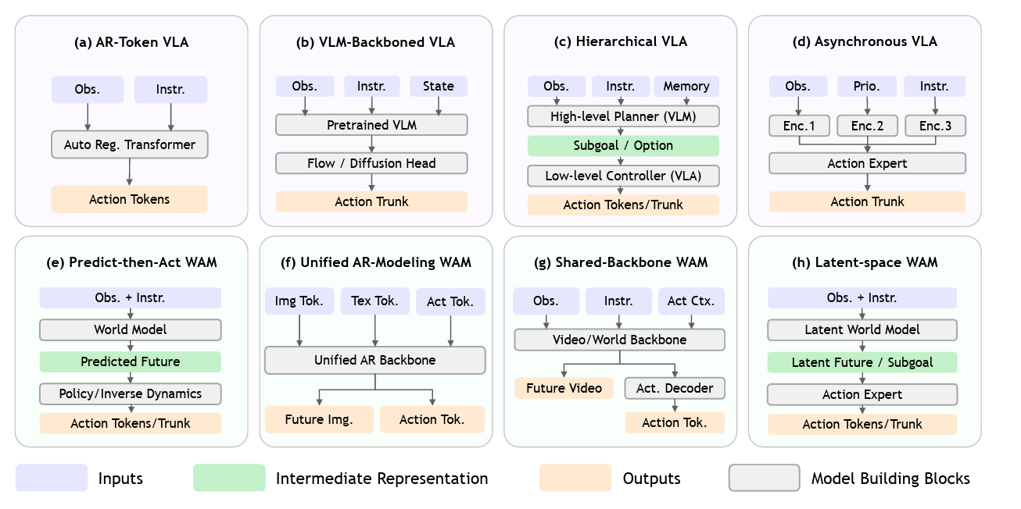
Problem for current VLA and WAM models
Model specific Python code
Handwritten Sensor wrapper
Backend-Specific Inference path
Platform specific control logic
02
Notes:
Timing: 0:30–2:00. Start with the ambition: transfer the broad knowledge of foundation models into physical action. VLA models combine language and visual understanding with action generation. The pi0.5 paper reports generalization to manipulation tasks in previously unseen homes, using diverse training data. GR00T N1 combines vision-language reasoning with a fast action-generating module and uses real, human-video and synthetic data. WAM research goes further by explicitly predicting future states as part of control. These examples explain the research interest: more general behavior, richer training signals and anticipation of physical consequences. They do not establish universal robot competence or that every WAM outperforms every VLA. Transition: what exactly do VLA and WAM mean?
Additional sources: https://arxiv.org/abs/2504.16054 and https://arxiv.org/abs/2503.14734
Section: Explanation
Source: https://arxiv.org/abs/2607.02501v3
Context: pi0.5 (2025), GR00T N1 (2025) and Embodied.cpp §2.1. Motivations, not a popularity metric.

Slide 4
Key requirements for current VLA and WAM models
Multi rate Execution
Latency-first closed loop control
Extensible embodied Inferences
02
Notes:
Timing: 0:30–2:00. Start with the ambition: transfer the broad knowledge of foundation models into physical action. VLA models combine language and visual understanding with action generation. The pi0.5 paper reports generalization to manipulation tasks in previously unseen homes, using diverse training data. GR00T N1 combines vision-language reasoning with a fast action-generating module and uses real, human-video and synthetic data. WAM research goes further by explicitly predicting future states as part of control. These examples explain the research interest: more general behavior, richer training signals and anticipation of physical consequences. They do not establish universal robot competence or that every WAM outperforms every VLA. Transition: what exactly do VLA and WAM mean?
Additional sources: https://arxiv.org/abs/2504.16054 and https://arxiv.org/abs/2503.14734
Section: Explanation
Source: https://arxiv.org/abs/2607.02501v3
Context: pi0.5 (2025), GR00T N1 (2025) and Embodied.cpp §2.1. Motivations, not a popularity metric.

Slide 5
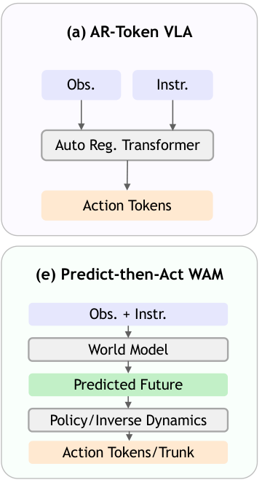
VLA: From V(Vision) L(Language)->A(Action)
What are VLAs?
An end to end model that maps visual and language (inputs) to action (output)
Inputs:
Camera observations / images
Human commands
Robot state (optional)
…
Output:
Action tokens or trajectories
…
03
Notes:
Timing: 2:00–3:00. VLA means vision-language-action. Given images, language and often robot state, it produces robot actions. The top figure is one token-generating VLA example. WAM means world-action model in this paper: predicting the future forms an explicit part of online action generation. The bottom example first predicts a future and then converts it into an action. These are representative examples, not the only two architectures. Other models use continuous action heads, shared backbones or latent futures. An action chunk is several predicted future commands. The execution runtime has to handle these structural differences.
Section: Explanation
Source: https://arxiv.org/abs/2607.02501v3
Paper §2.1 and Figure 1, panels (a) and (e), cropped. CC BY 4.0

Slide 6
WAM (World Action Model): VLA+Imagine Before Act
What are WAMs?
WAMs are a new variant of VLAs which is currently getting popular.
WAM = VLA+future(world state) prediction
Cascaded WAMs: First predict the future in pixel space or latent space (e.g. generate a video of how the future will evolve), then, using this as a prior, generate the action
Joint WAMs: Future prediction & action prediction at the same time.
Pros: Let the model learn the ability to understand how the world will evolve.
Cons: Introduce additional backbones or modules, increasing latency
03
Notes:
Timing: 2:00–3:00. VLA means vision-language-action. Given images, language and often robot state, it produces robot actions. The top figure is one token-generating VLA example. WAM means world-action model in this paper: predicting the future forms an explicit part of online action generation. The bottom example first predicts a future and then converts it into an action. These are representative examples, not the only two architectures. Other models use continuous action heads, shared backbones or latent futures. An action chunk is several predicted future commands. The execution runtime has to handle these structural differences.
Section: Explanation
Source: https://arxiv.org/abs/2607.02501v3
Paper §2.1 and Figure 1, panels (a) and (e), cropped. CC BY 4.0

Slide 7
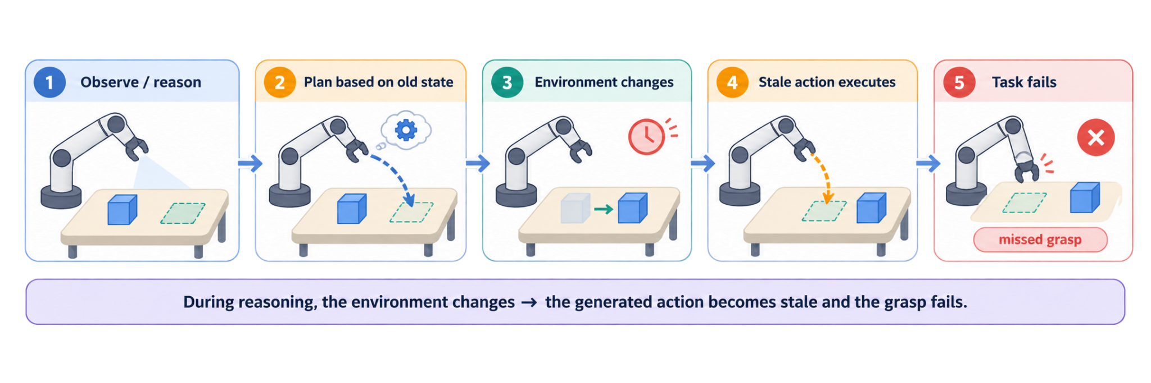
Latency is a big problem in physical AI
LLM: Don’t need to respond in real time, can take long to reason/ Can also process many inputs at the same time
VLA/WAM: The world is continuously changing/ Only batch-1 input for most of the cases
03
Notes:
Timing: 2:00–3:00. VLA means vision-language-action. Given images, language and often robot state, it produces robot actions. The top figure is one token-generating VLA example. WAM means world-action model in this paper: predicting the future forms an explicit part of online action generation. The bottom example first predicts a future and then converts it into an action. These are representative examples, not the only two architectures. Other models use continuous action heads, shared backbones or latent futures. An action chunk is several predicted future commands. The execution runtime has to handle these structural differences.
Section: Explanation
Source: https://arxiv.org/abs/2607.02501v3
Paper §2.1 and Figure 1, panels (a) and (e), cropped. CC BY 4.0

Slide 8
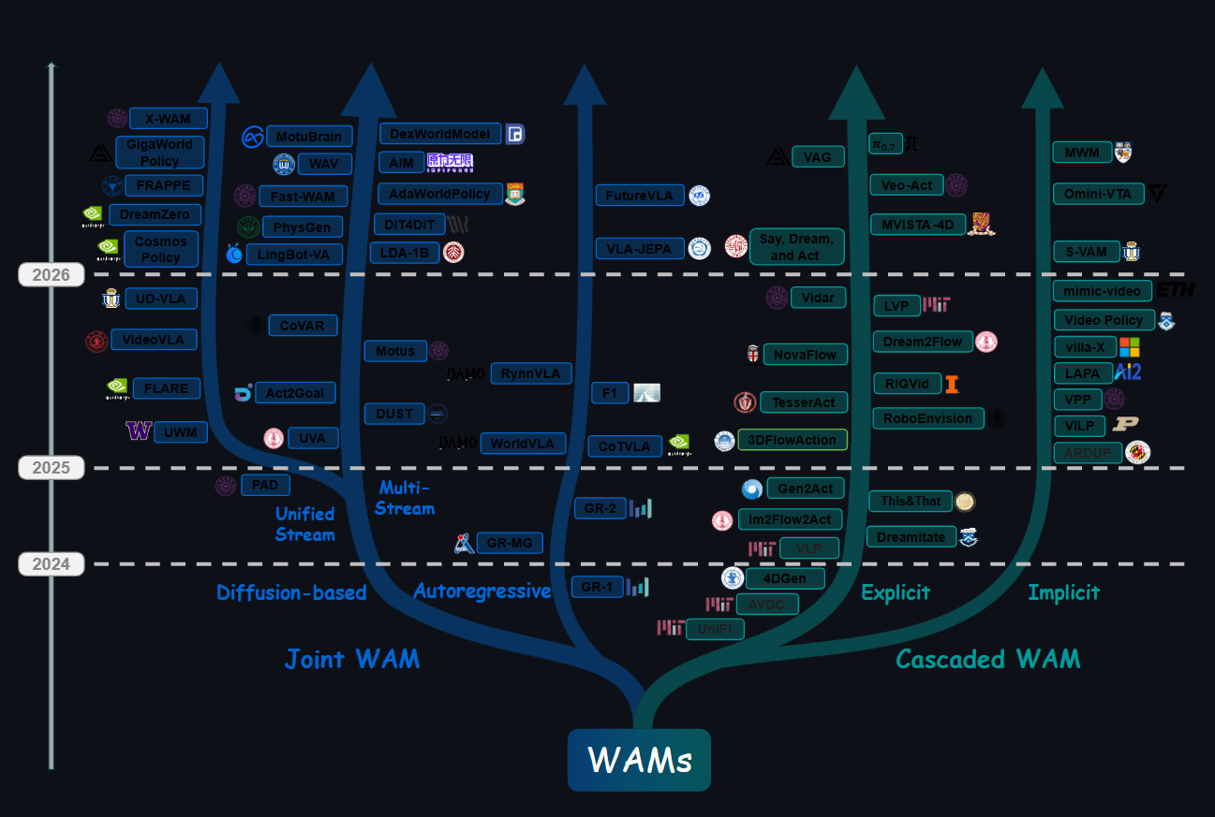
A fixed framework? Not really, VLAs and WAMs varies a lot
Source:https://github.com/OpenMOSS/Awesome-WAM
03
Notes:
Timing: 2:00–3:00. VLA means vision-language-action. Given images, language and often robot state, it produces robot actions. The top figure is one token-generating VLA example. WAM means world-action model in this paper: predicting the future forms an explicit part of online action generation. The bottom example first predicts a future and then converts it into an action. These are representative examples, not the only two architectures. Other models use continuous action heads, shared backbones or latent futures. An action chunk is several predicted future commands. The execution runtime has to handle these structural differences.
Section: Explanation
Source: https://arxiv.org/abs/2607.02501v3
Paper §2.1 and Figure 1, panels (a) and (e), cropped. CC BY 4.0

Slide 9
Prior Work in Inference Acceleration
Resource-constrained device inference
Embodied / VLA–WAM inference
1. Heterogeneity-aware placement & partitioning
Latency models, CPU–GPU co-execution, and network-aware offloading. E.g., NN-Meter; CoDL/Band; EdgeNN; AoDNN/CoActo/Jellyfish.
4. VLA execution-path redesign
Parallel action decoding, chunking, compact/asynchronous policies, and action-aware compression. E.g., OpenVLA-OFT; SmolVLA; TurboVLA; ActQuant; PolicyTrim.
2. Resource, priority & memory management
Scheduling and serving under tight compute/memory budgets. E.g., Niagara; SensiX++; Pantheon/Miriam; InfScaler; FlexNN/SwapNet/vMCU.
5. Cross-step reuse & embodied scheduling
Reuse slow-changing state and refresh only modules needed for control. E.g., VLA-Cache; ActionCache; OxyGen; Reflex; Jetson-PI; Fast-in-Slow; DAM-VLA.
3. Edge LLM specialization
Flash-resident weights, sparse experts, KV-cache reuse, and accelerator-specific paths. E.g., LLM in a Flash; HeteGen; EdgeMoE; MobiLoRA; NPU paths.
6. WAM / world-prediction optimization
Make future generation schedulable, compressible, and reality-aligned. E.g., Fast-WAM; LaWAM; MemoryWAM; LiLa-WAM; When to Trust Imagination; Adaptive-WAM.
Notes:
Slide summarizes Section 2.3 as a taxonomy: device-level inference acceleration and embodied/VLA-WAM inference optimization, with representative examples only.

Slide 10
Remaining gap: from isolated tricks to a portable runtime
Prior work often optimizes one model, one state representation, or one schedule. Embodied.cpp targets a runtime that composes these optimizations across VLA + WAM.
Prior work
Embodied.cpp
useful, but isolated
portable runtime layer
One model
Shared runtime core
One state representation
compose
VLA
WAM
Future models
One execution schedule
Multi-rate scheduling
State/buffer reuse
Backend-specific execution
Hard to reuse across model families
Goal: turn model-specific acceleration tricks into reusable runtime capabilities.
Source: Embodied.cpp paper, Sec. 2.3–3.2

Slide 11
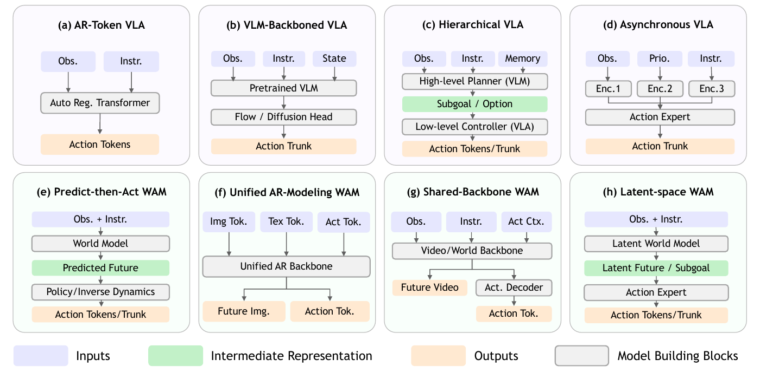
Step 1: Identify a shared structure across VLA and WAM
Different models look different, but online inference can be decomposed into inputs, a shared backbone, model-specific heads / prediction, and action outputs.
Different architectures, similar inference skeleton
Encoder>VLM/Transformer->Prediction Head->Output(Action/World State)
Key idea:
Put common computation in the runtime core;
put model-specific differences in plugins.

Slide 12
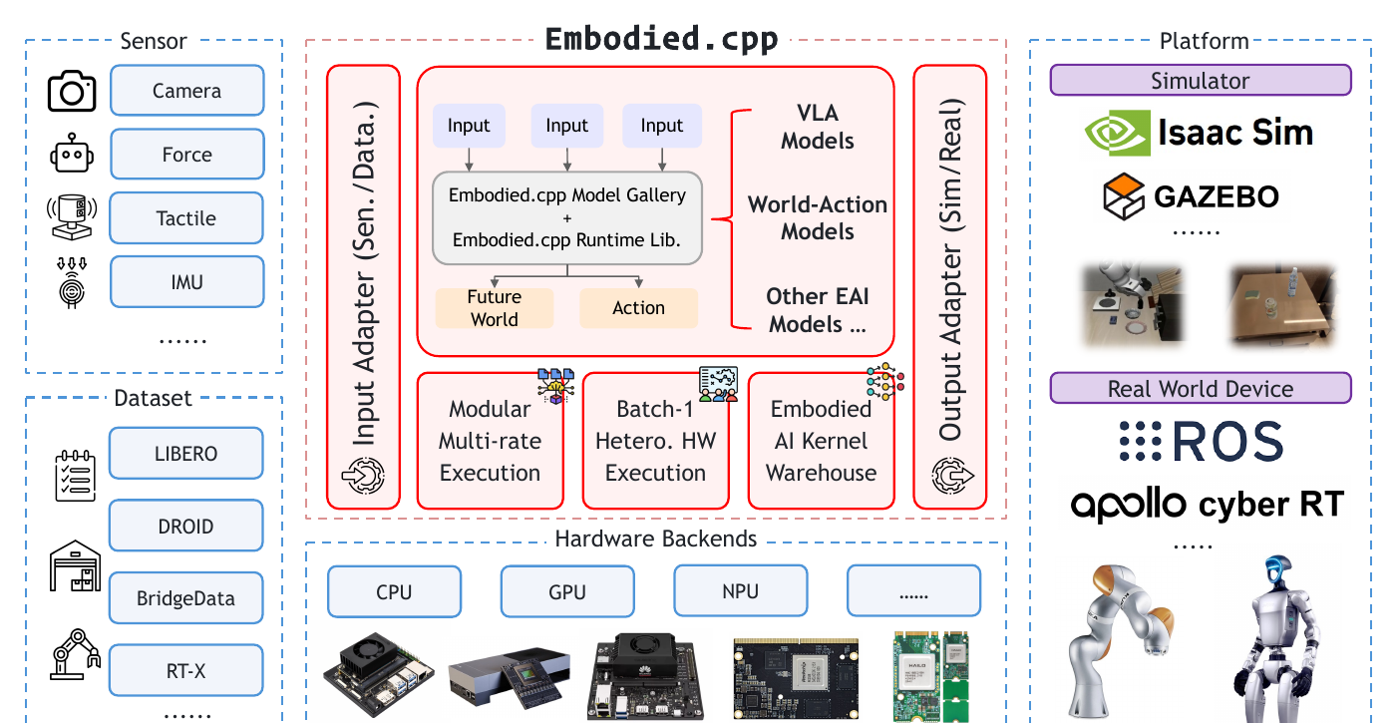
Step 2: Turn the shared structure into a modular runtime
Separate the model side, systems side, and robot side: stable core, extensible edges.
Five layers
1 Input adapters
unify sensor / dataset inputs
2 Sequence builders
construct tokens / state / history
3 Backbone execution
shared backbone path
4 Head plugins
action heads / WAM predictive modules
5 Deployment adapters
connect simulators / real robots
Source: Embodied.cpp paper, Fig. 2 / Sec. 3.2

Slide 13
Step 3: Multi-rate execution
Do not run the full model at every step: refresh each module at its own rate and reuse shared state.
Control ticks
0
1
2
3
4
5
6
7
Medium-rate refresh
Perception / encoder
VLM / reasoning
Low-rate refresh
WAM predictive branch
Run on demand
Action head
High-rate control
Only refresh modules whose state must change
action head reuses the latest available state
Shared state / feature pool
Why it matters: robots need continuous actions; heavy modules cannot be re-run at every control tick.
Source: Embodied.cpp paper, Sec. 3.1–3.2

Slide 14
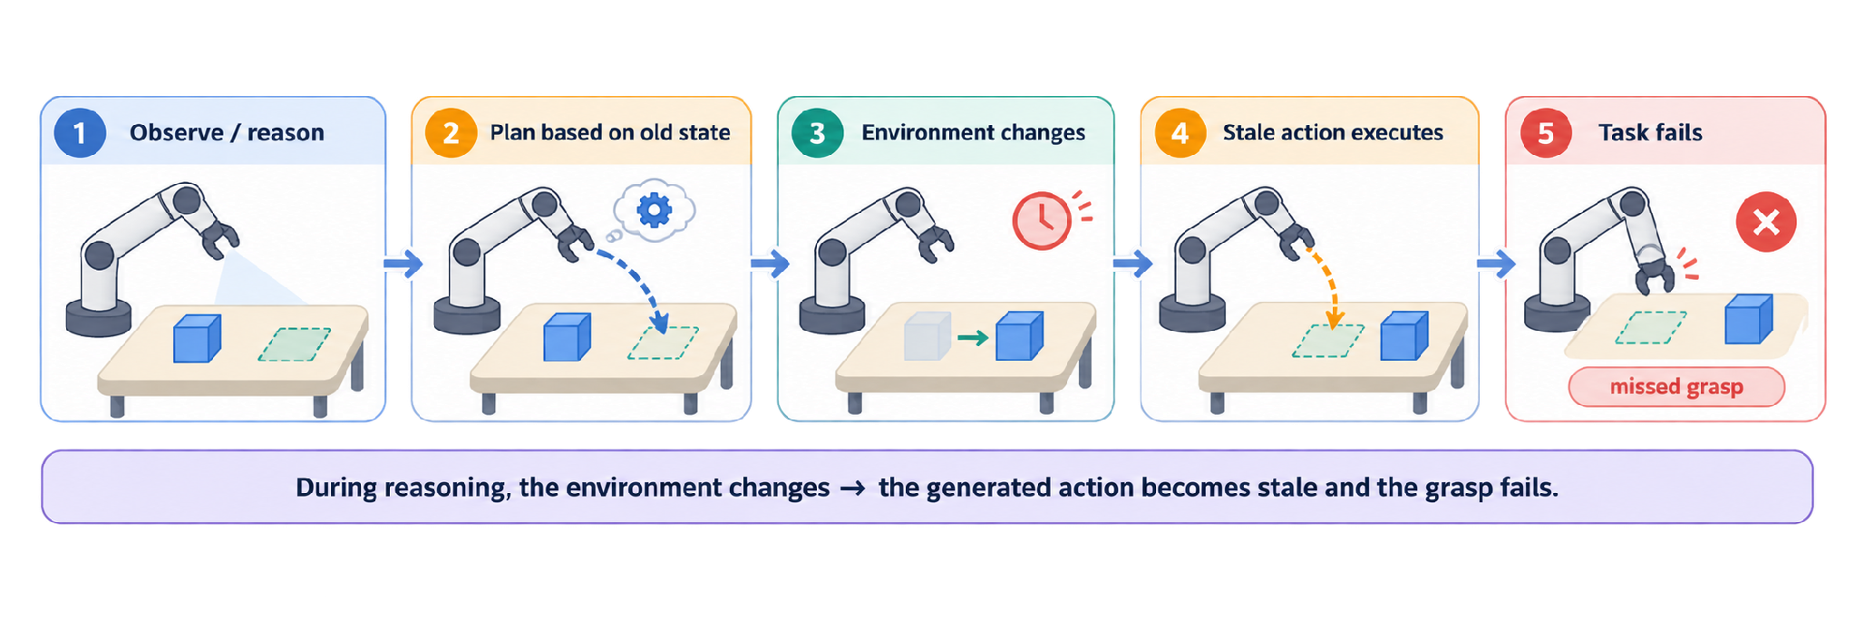
Step 4: Make each required inference step cheaper
Step 3 decides what runs. Step 4 makes that required work cheaper。
Motivation: stale action
Make required inference cheaper
1 Reuse cached state
KV cache / VLA-Cache
2 Skip unnecessary compute
DeeR-VLA early exit
3 Remove runtime overhead
Buffers / fewer copies / backend path
Slow inference can act on outdated world state.
Simple takeaway: avoid recomputing or moving data unless it is needed now.
Reuse/skip work only when the cached state is still valid for the current control step.

Slide 15
Results
Models | Compared configurations | Reported outcomes
3 VLA models | Python, C++, 8-, 6-, 4-bit C++ | Latency, success rate and VRAM Each Python baseline = 1.00
2 WAM models | Python and C++ | Success (%) and peak VRAM (GB) No latency result
10
Notes:
Timing: 11:00–12:00. The VLA experiment evaluates three models across a Python baseline, C++ and three quantized C++ variants. Each model’s Python result independently equals one for latency, memory and success. A value of 0.48 for latency means 48 percent of that model’s Python latency. It does not mean 0.48 milliseconds. The WAM experiment reports actual success percentages and VRAM in gigabytes for two models. Table 3 cannot rank absolute latency across models because their denominators differ. The paper does not provide the hardware and detailed task protocol needed to reconstruct the reported comparisons.
Section: Explanation
Source: https://arxiv.org/abs/2607.02501v3
Paper §4, Tables 3 and 4

Slide 16
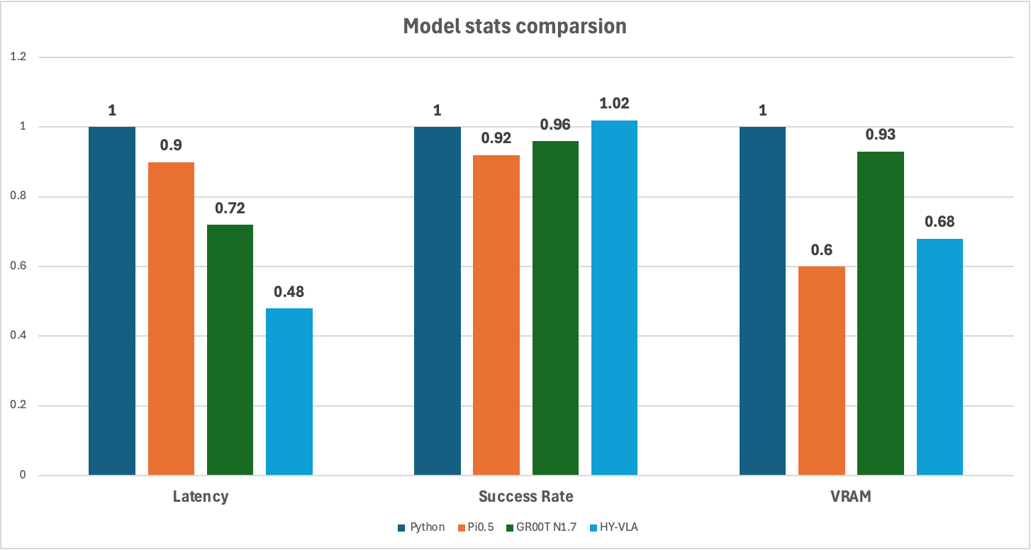
Results
Normalized Closed loop Deployment: pi0.5, GR00TN1.7, HY-VLA
Latency: lower better
Success Rate: higher better
VRAM: lower better
15
Notes:
Timing: 16:15–17:15. My selected hidden assumption is that reuse of buffered features and differently timed modules preserves action relevance when the environment changes quickly. This is a hypothesis to challenge, not an experimentally established defect. A robot may generate an action quickly using an old camera feature. Lower compute latency alone does not guarantee that the action reflects current conditions. Fast motion, unexpected contact or sensor delay could break the assumption. A useful diagnostic is observation age: the time an action is applied minus the time its observation was captured. Measure this alongside p99 latency, deadline misses and success while perturbing the scene. The paper’s aggregate table does not show these dynamics.
Section: Critical analysis
Source: https://arxiv.org/abs/2607.02501v3
Presenter hypothesis, motivated by paper §§3.1–3.2. Not a reported failure.

Slide 17
Results
Deployment: Cosmos3, LingBot-VA
“Python/CPP”
“Python/CPP”
WAM Models | Success Rate(%) | VRAM usage(GB)
Cosmos3 | 48/48 | 21.84/19.49
LingBot-VA | 100/98 | 24.75/16.44
13
Notes:
Timing: 14:15–15:00. This table extends coverage to WAM deployments. Cosmos3 uses 19.49 rather than 21.84 GB, a 10.8 percent reduction, while success changes from 49 to 48 percent. LingBot-VA uses 16.44 rather than 24.75 GB, a 33.6 percent reduction, with success changing from 100 to 98 percent. Here the success changes are one and two percentage points because we have actual percentages. The WAM table gives no latency results, trial counts or intervals. It supports feasibility and lower memory in these configurations, but does not show WAM speedup or statistical equivalence in control quality.
Section: Explanation
Source: https://arxiv.org/abs/2607.02501v3
Paper Table 4. Memory reductions calculated from reported GB values.

Slide 18

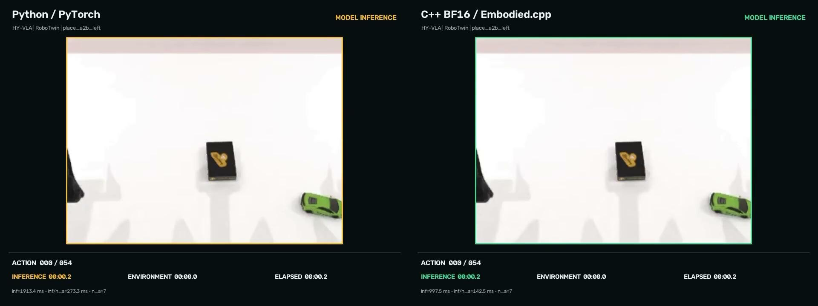
GR00T N1.7
HY-VLA
Cumulative inference time 2.5 s → 1.7 s (⬇32%). End-to-end execution time 14.6 s → 13.3 | Cumulative inference time 9.4 s → 6.6 s (⬇30%). End-to-end execution time 14.8 s → 12.0 s.
15
Notes:
Timing: 16:15–17:15. My selected hidden assumption is that reuse of buffered features and differently timed modules preserves action relevance when the environment changes quickly. This is a hypothesis to challenge, not an experimentally established defect. A robot may generate an action quickly using an old camera feature. Lower compute latency alone does not guarantee that the action reflects current conditions. Fast motion, unexpected contact or sensor delay could break the assumption. A useful diagnostic is observation age: the time an action is applied minus the time its observation was captured. Measure this alongside p99 latency, deadline misses and success while perturbing the scene. The paper’s aggregate table does not show these dynamics.
Section: Critical analysis
Source: https://arxiv.org/abs/2607.02501v3
Presenter hypothesis, motivated by paper §§3.1–3.2. Not a reported failure.

Slide 19
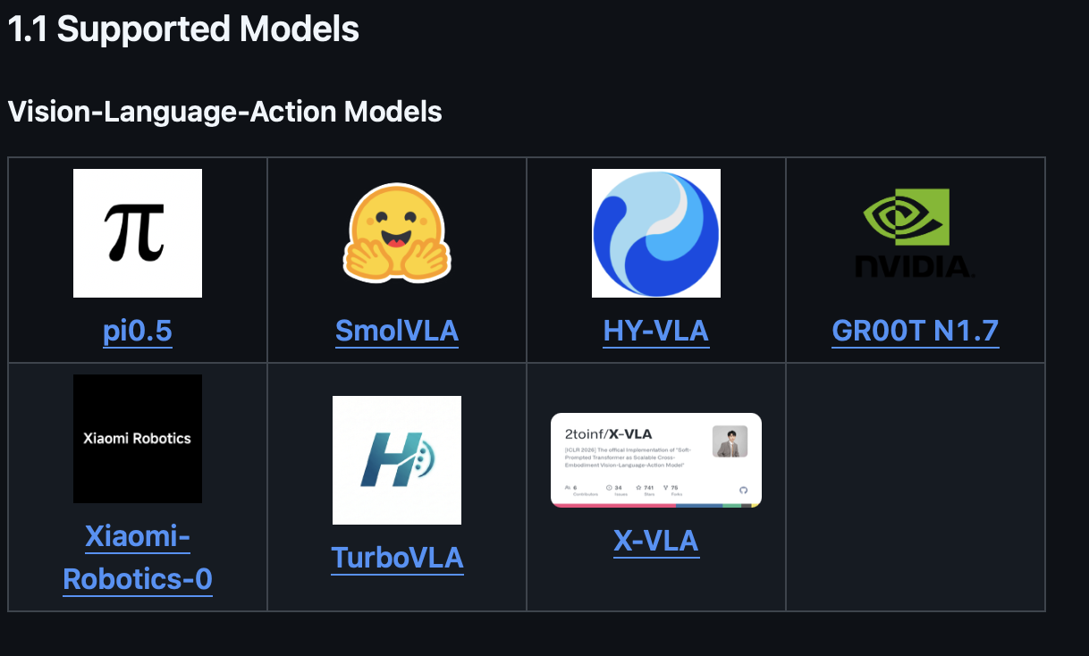
Questions about the paper
Insufficient experimental detail limits reproducibility
No ablation explains where the improvement comes from
The evaluation does not establish broad hardware portability
Python baseline itself is not enough
16
Notes:
Timing: 17:15–18:30. Now connect the results to the project’s future potential. A shared runtime could lower the integration burden when researchers add a new policy or world model. Modular execution could allow costly world prediction to refresh less often than fast action generation. Smaller memory footprints could expand the set of devices that can host a policy. These are plausible opportunities, not established outcomes of the current benchmark. The unproven leap is predictable, quality-preserving control across many robots and hardware targets. To support that conclusion, we need per-device evidence, timing tails, freshness measurements and experiments that quantify the work required to integrate an unseen architecture. This slide addresses question 5 and motivates the additional experiment on the next slide.
Section: Explanation
Source: https://arxiv.org/abs/2607.02501v3
Potential applications inferred from the architecture. Not demonstrated outcomes.

Slide 20
Thank you
16
Notes:
Timing: 17:15–18:30. Now connect the results to the project’s future potential. A shared runtime could lower the integration burden when researchers add a new policy or world model. Modular execution could allow costly world prediction to refresh less often than fast action generation. Smaller memory footprints could expand the set of devices that can host a policy. These are plausible opportunities, not established outcomes of the current benchmark. The unproven leap is predictable, quality-preserving control across many robots and hardware targets. To support that conclusion, we need per-device evidence, timing tails, freshness measurements and experiments that quantify the work required to integrate an unseen architecture. This slide addresses question 5 and motivates the additional experiment on the next slide.
Section: Explanation
Source: https://arxiv.org/abs/2607.02501v3
Potential applications inferred from the architecture. Not demonstrated outcomes.

Slide 21
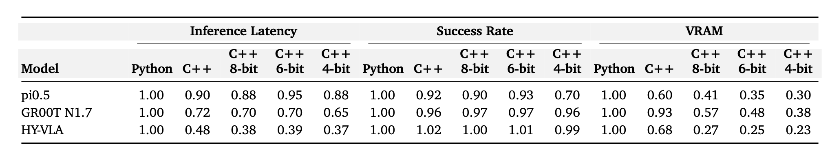
Backup
18
Notes:
Timing: 20:00–25:00. Facilitation plan: Give the audience about 15 seconds to choose an answer to question 1, then take two responses for a total of 90 seconds. If needed, remind them that pi0.5 4-bit has 0.30 VRAM and 0.70 success relative to Python. Spend the next 90 seconds on question 2: ask which exact counterfactual makes a runtime comparison fair, and whether a baseline should have equal memory or equal numerical precision. Spend 90 seconds on question 3: require one concrete result that would raise or lower confidence, rather than a general wish for more experiments. Use the last 30 seconds to close: the paper’s efficiency results are promising, and stronger matched closed-loop evidence would establish where they generalize. Backup slides contain the complete VLA values and ratio arithmetic.
Section: Discussion
Source: https://arxiv.org/abs/2607.02501v3
5 minutes. Questions target the claim, evidence and next experiment.

Slide 22
References
Main paper
Xu et al., Embodied.cpp (2026)
https://arxiv.org/abs/2607.02501v3
Research context
pi0.5: arxiv.org/abs/2504.16054
GR00T N1: arxiv.org/abs/2503.14734
Implementation and evidence audit
github.com/SEU-PAISys/Embodied.cpp
Benchmark standard and validation ledger under eval/
22
Notes:
Primary paper: Ling Xu et al., Embodied.cpp: A Portable Inference Runtime of Embodied AI Models on Heterogeneous Robots, arXiv:2607.02501v3. Context sources: Physical Intelligence et al., pi0.5, arXiv:2504.16054, and NVIDIA et al., GR00T N1, arXiv:2503.14734. Repository sources: https://github.com/SEU-PAISys/Embodied.cpp , https://github.com/SEU-PAISys/Embodied.cpp/blob/main/eval/VLA_BENCHMARK_STANDARD.md , https://github.com/SEU-PAISys/Embodied.cpp/blob/main/eval/THREE_MODEL_VALIDATION.md . Paper measurements and later repository evidence remain separate. The future directions, illustrative walkthrough and proposed experiment are presenter analysis.
Section: Backup
Source: https://arxiv.org/abs/2607.02501v3
Figures: Xu et al., CC BY 4.0. Repository documentation accessed 6 October 2026.

