Slide 1
Text creation with Deep Neural
network
Wansang Lim

Slide 2
Data set
Yelp review data set
- example:
Dos Mas has to be one of the worst Mexican food restaurants we
have ever been to. So where do I begin, we got the menu and there
was not much of a selection. So we decided to…………
- data size: 6.2 GB → reduced to 1/10th
- source: https://www.yelp.com/dataset
2. Reddit clean jokes dataset
- example:
1,"What did the bartender say to the jumper cables? You better not try
to start anything."
2,"Don't you hate jokes about German sausage? They're the wurst!"
- data size: 140K
- source: https://raw.githubusercontent.com/amoudgl/short-jokes-dataset/master/data/reddit-cleanjokes.csv

Slide 3
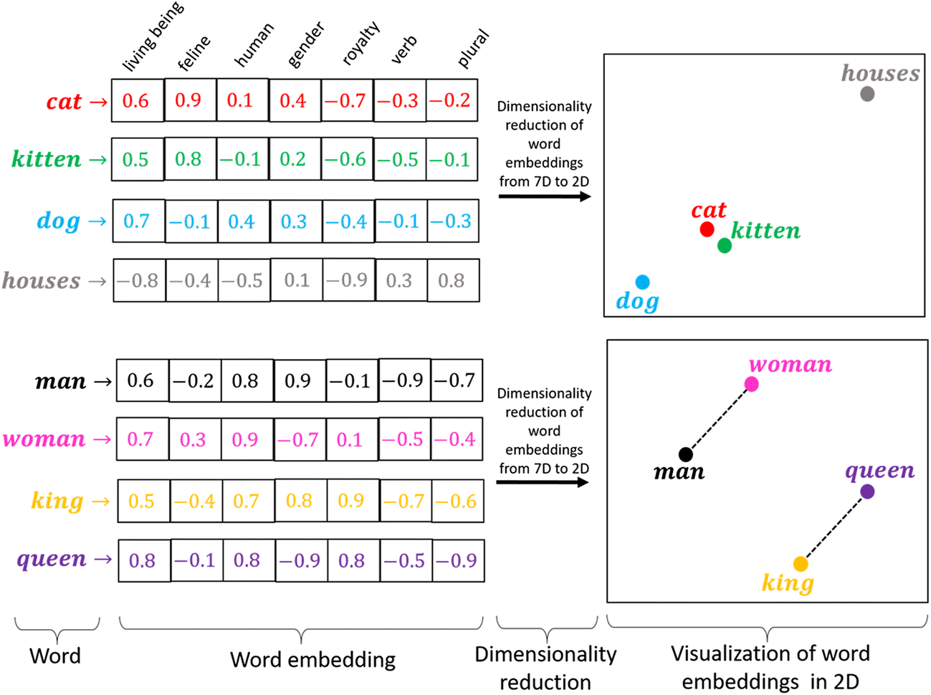
Word2Vec for yelp
Dimentionality reduction
Measure similarity between word
Top 5 similar word
korean -> japanese, asian, chinese, filipino
taiwanese
Kimchi ->, kimchee, bulgogi, japchae,
bibimbap, chigae
car -> vechicle, jeep, cars, vehicles, suv
we -> expensed, ugrades, hlm, saltlik,
tumbleweeds

Slide 4
Recurrent Neural Net(RNN)
Input is sequential information such as word sequence or
temperature
2. The output of previous sequence is used as input
for next sequence

Slide 5
Long and short term memory
(LSTM)
Limitation of RNN – Gradient vanishing and exploding
LSTM controls flow of the previous information and prevents gradient vanishing
The earlier information passes to future sequence

Slide 6
RNN structure – previous 4 words are given
The RNN recurrently predict next 5th sequence
"the food we want the joons and the jambalya the”
"we are convnced that ddnt and redonkulous unbeliev readi tranishing"
ddnt - "never tickle a sleeping dragon; found in Harry Potter book series"
redonkulous – “significantly more absurd than ridiculous”
- The average similarity for the test set is around 0.5
LSTM structure – previous 4 words are given
“apple is good but U-turns whenever Savage 141 weigh the hippie joke He was”
Future Work
Spelling check, standard English
Grammar check with parser in nltk

