Slide 1
Live AI Video Monitoring
Real-time behavior detection across many camera feeds — on the DGX Spark
Multi-feed CCTV wall
AI behavior events
Runs on DGX Spark
DGX Spark Hackathon · ASB 2026

Slide 2
THE PROBLEM
Watching feeds doesn't scale
• Security teams stare at walls of camera feeds — attention fades, incidents are missed.
• Anti-social behavior (loitering, vandalism, fights, intrusion) is easy to miss in real time.
• Cloud video AI means streaming sensitive footage off-site: cost, latency, privacy risk.
• Operators need the crucial moments surfaced, not hours of raw video.

Slide 3
OUR SOLUTION
An AI monitoring wall that flags what matters
Multi-feed wall
AI behavior events
Crucial info panel
Snapshot evidence
Up to 9 live camera feeds in one grid, looping or live.
A local vision model watches a configurable watchlist and raises events.
Each event: camera, time, type, confidence, severity + plain-language description.
A thumbnail of the exact frame where each event happened.

Slide 4
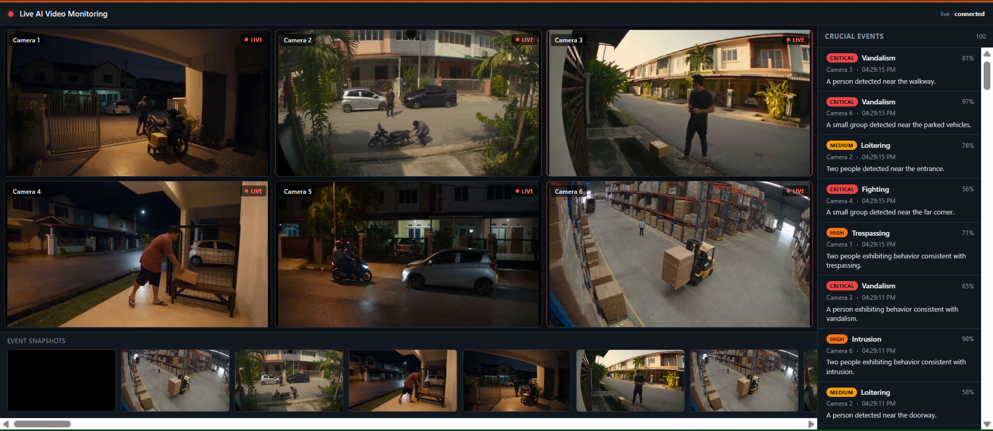
THE DASHBOARD
One screen: wall, events, evidence

Slide 5
HOW IT WORKS
A streaming pipeline, GPU-ready
Feeds
Frame batcher
Omni model
Events + UI
→
→
→
Video files / cameras, looped per source
Short clips sampled for temporal context
Local VLM scores the watchlist (DGX Spark GPU)
Live list, snapshots, WebSocket push
Key design: video playback never blocks on the model. Analysis runs on worker threads; stale work is dropped under load, so the wall stays smooth while the GPU does the heavy lifting.

Slide 6
WHY DGX SPARK
Edge AI, on-prem, private
• Runs the vision model locally — footage never leaves the premises.
• GPU throughput handles multiple feeds with low latency, no cloud bills.
• Swappable model adapter: plug in your 'omni' model via an OpenAI-compatible endpoint.
• Config-driven: define feeds and the behavior watchlist in a single YAML file.

Slide 7
TECH & STATUS
Built and working
Stack
Status
• FastAPI backend (Python)
• OpenCV feed looping + MJPEG / frame polling
• WebSocket live event push, in-memory store
• Single static HTML dashboard — no build step
• Swappable omni-model adapter (mock + OpenAI-compatible)
• 6 live feeds running on the wall
• Events + snapshots flowing end-to-end
• 33 automated tests passing
• DGX Spark run guide in the README
• Next: wire in the production omni model

Slide 8
See the crucial moments. Instantly.
Private, on-prem AI video monitoring on the DGX Spark.
github.com/wanadzhar913/DGX-Spark-Hackathon-ASB-2026

