Slide 1
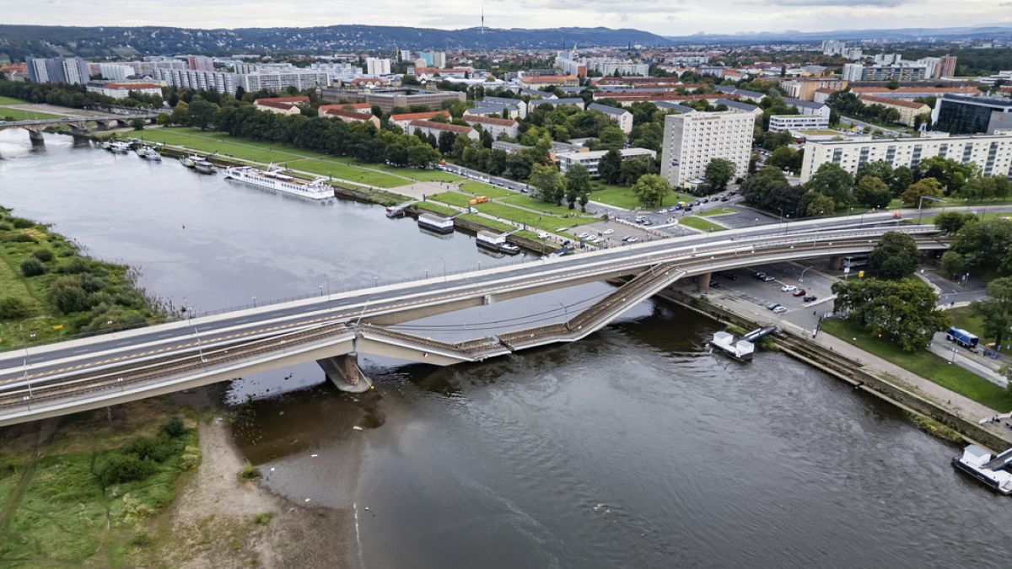

Taking Actions according to his policy
Environment:
Bridge in operation
Agent
States or Observations
Rewards (Cost, Utility)

Slide 2
Taking Actions according to his policy
Environment:
Bridge in operation
Agent
States or Observations
Rewards (Cost, Utility)

Slide 3
Taking Actions according to his policy
Environment:
Bridge in operation
Agent
States or Observations
Rewards (Cost, Utility)

Slide 4
Taking Actions according to his policy
Environment:
Bridge in operation
Agent
States or Observations
Rewards (Cost, Utility)

