Slide 1
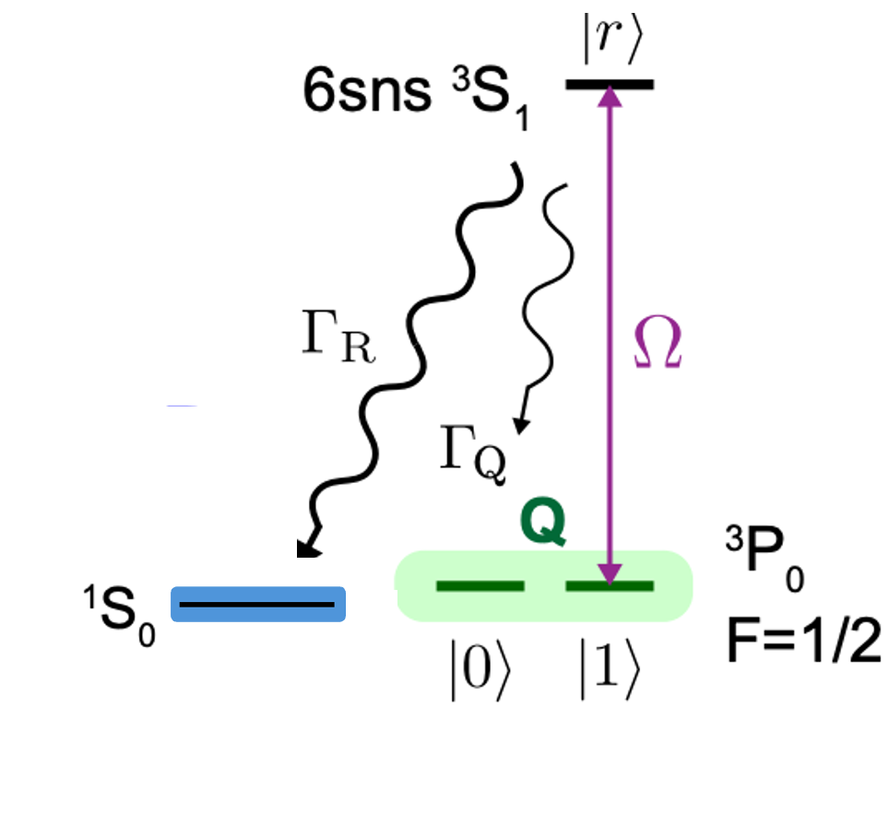
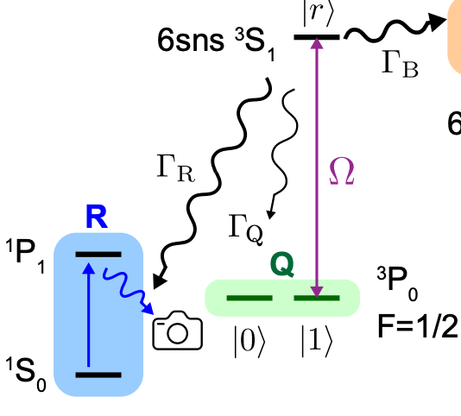
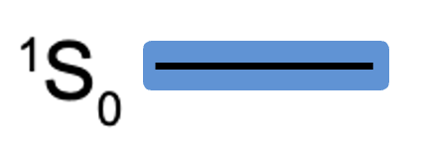

Slide 2
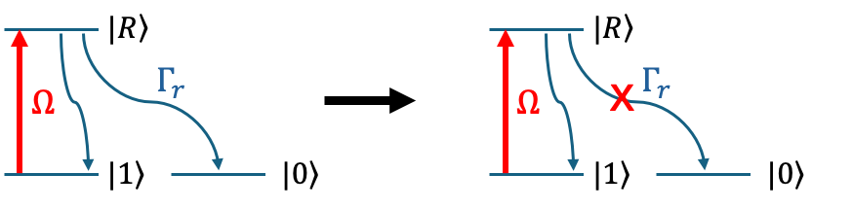
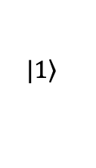
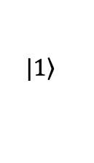
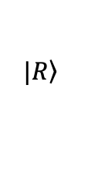
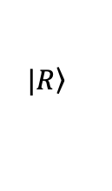




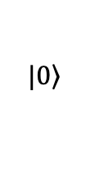
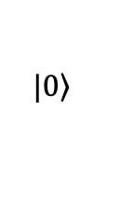
$$|\left.R\right\rangle$$
$$|\left.R\right\rangle$$
$$Γ_{r}$$
x
$$Γ_{r}$$
$$Ω$$
$$Ω$$
$$|\left.1\right\rangle$$
$$|\left.0\right\rangle$$
$$|\left.1\right\rangle$$
$$|\left.0\right\rangle$$

Slide 3
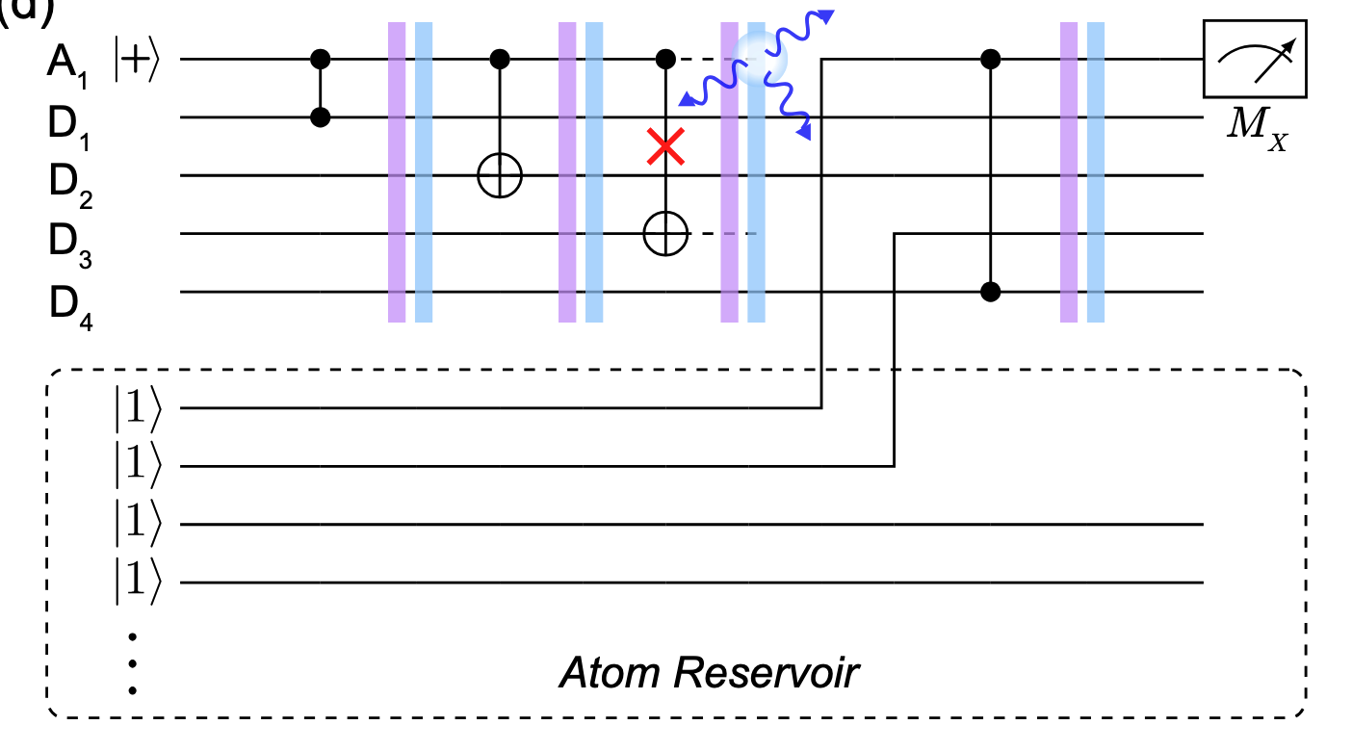
Fast and parallel fluorescence detection
Replace atoms with errors from resevior (can be regarded as random pauli errors with known location

Slide 4
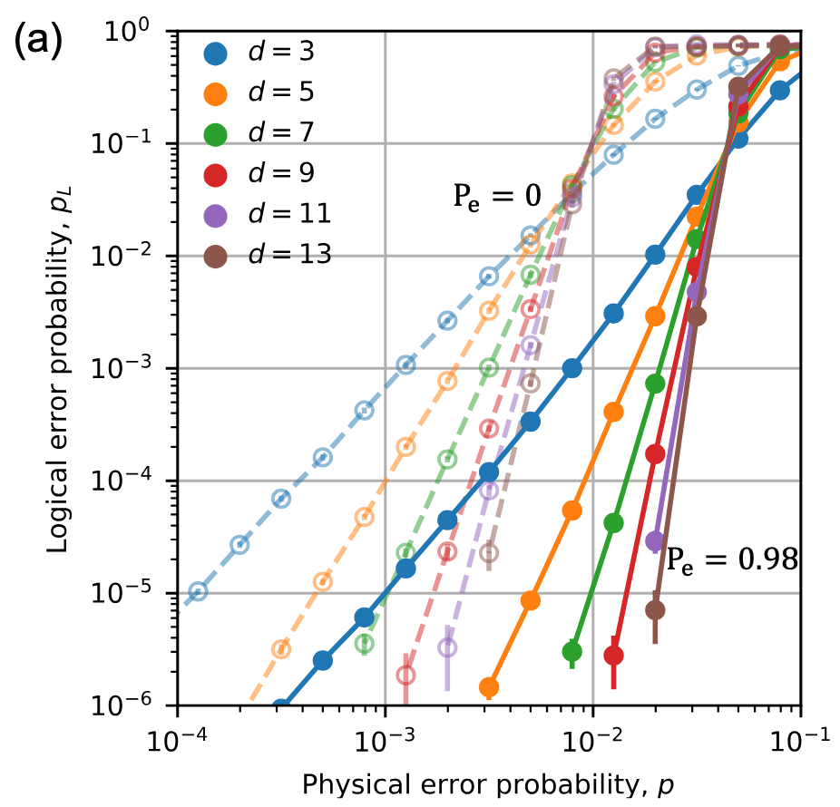


$$P_{th}=0.937\%$$
$$P_{th}=4.15\%$$

Slide 5
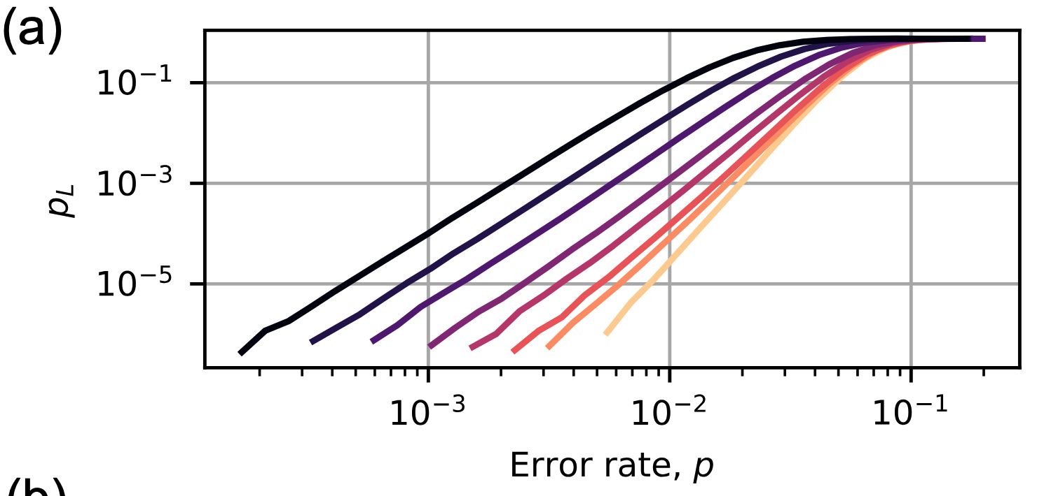
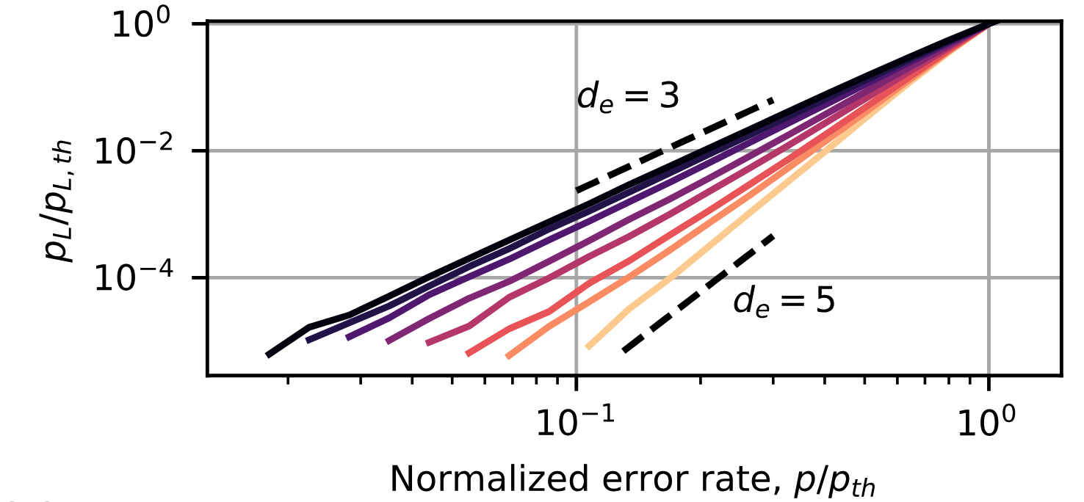
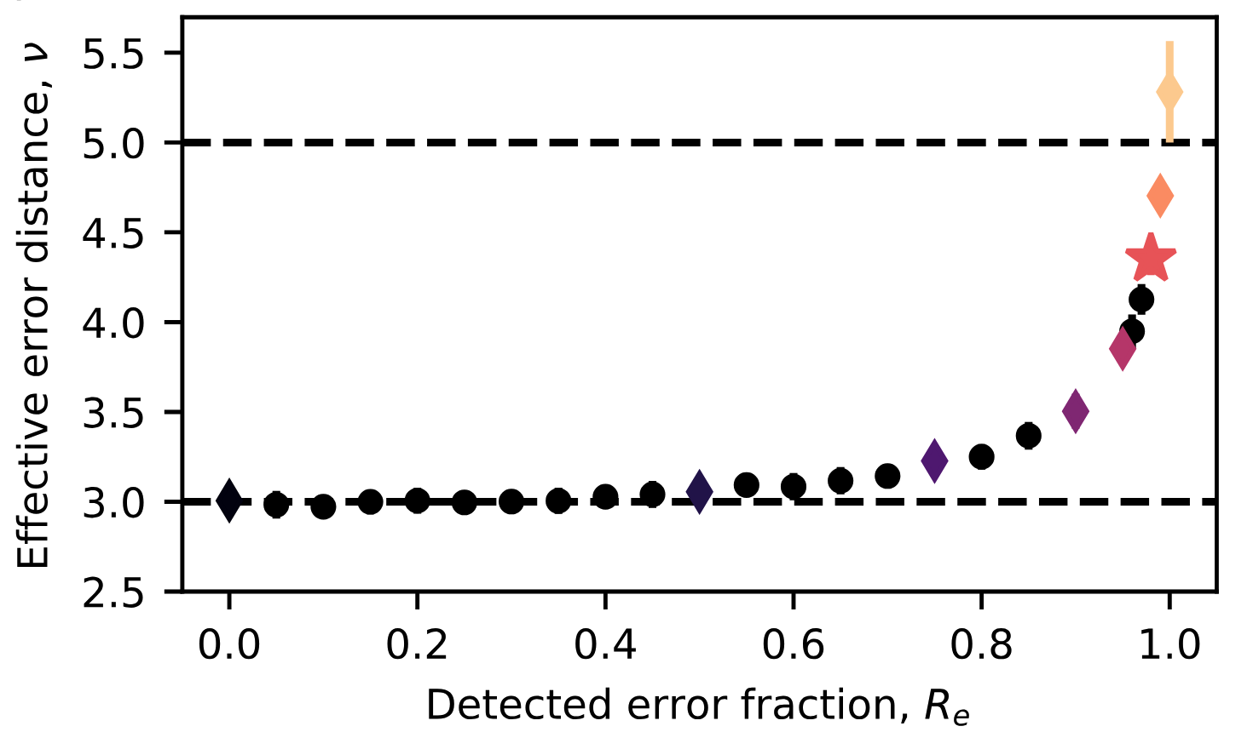
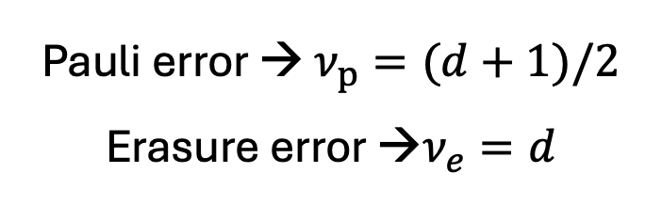





$$R_{e}=0$$
$$R_{e}=1$$
$$d$$
$$p_{L}∝{A∗p}^{ν}$$
Pauli error → $ν_{p}=(d+1)/2$
Erasure error →$ν_{e}=d$
$$(d+1)/2$$

Slide 6
