Slide 1
E-mail addresses: wandahang@mail.hfut.edu.cn (D. Wan)
Random Interpolation Resize: A free image data augmentation method for object detection in industry
School of Instrument Science and Opto-electronic Engineering, Hefei University of Technology, Hefei 230009, China
Dahang Wan, Rongsheng Lu ∗, Ting Xu, Siyuan Shen, Xianli Lang, Zhijie Ren
E-mail addresses: wandahang@mail.hfut.edu.cn (D. Wan)
论文链接：https://www.sciencedirect.com/science/article/pii/S0957417423008576
开源地址： https://github.com/wandahangFY/RIR .

Slide 2
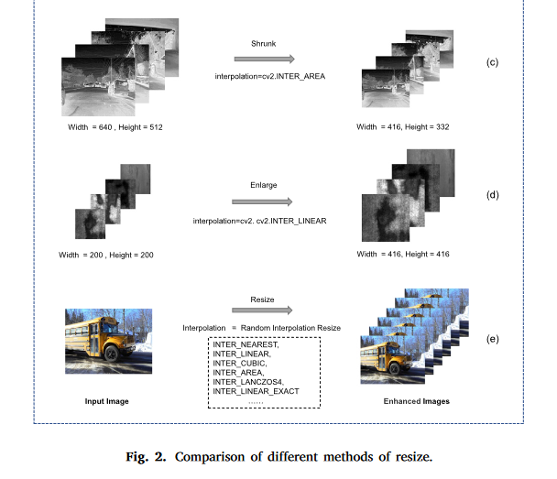
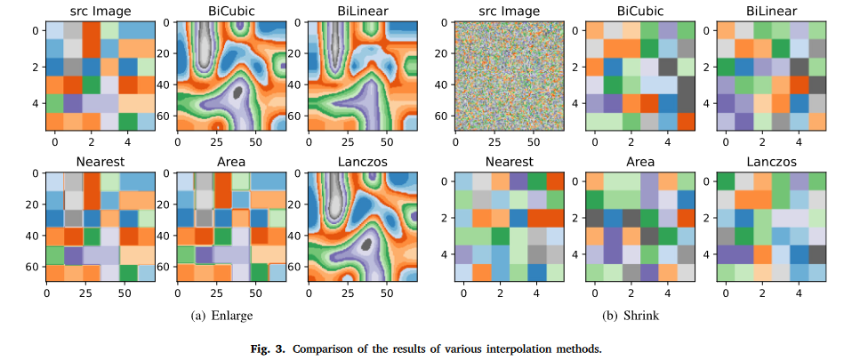
1.论文动机：从插值方式的角度进行数据增强（详情请看原文）
不使用RIR 方法：多个epoch迭代，每张图片只有一种插值方式
使用RIR 方法：多次迭代，每张图片可以有不同的插值方式
图3采用不同的插值方式对原图（src Image ）进行放大或缩小
从图中可以看出，不同的插值方式之间是有差异的

Slide 3
2.原理：在训练阶段随机使用插值方式，在测试阶段采用默认的插值方式
训练阶段
验证阶段
使用RIR 方法
不使用RIR 方法
（采用常规的插值方式）
（YOLOv8，11月之前有两种插值方式，
11月以后全部变成了双线性插值）
interp = random_interpolation_resize( cv_resize_flags_with_weights=self.cv_resize_flags_with_weights)
interp = cv2.INTER_LINEAR if (self.augment or r > 1) else cv2.INTER_AREA
# ----------------------------------------------------rir start------------------------------------------ if self.use_rir: if self.val_flag: interp = cv2.INTER_LINEAR if (self.augment or r > 1) else cv2.INTER_AREA # print("use_rir={},val_flag={}".format(self.use_rir,self.val_flag)) else: interp = random_interpolation_resize( cv_resize_flags_with_weights=self.cv_resize_flags_with_weights) # print("use_rir={},val_flag={}".format(self.use_rir, self.val_flag)) else: interp = cv2.INTER_LINEAR if (self.augment or r > 1) else cv2.INTER_AREA im = cv2.resize(im, (min(math.ceil(w0 * r), self.imgsz), min(math.ceil(h0 * r), self.imgsz)), interpolation=interp) # ----------------------------------------------------rir end------------------------------------------
使用RIR 方法

Slide 4
3.添加教程
3.1 YOLOv8 添加步骤(已完成)
3.2 YOLOv5 添加步骤(TODO)
3.3 YOLOv7 添加步骤(已完成)
3.4 YOLOv5超参数进化 添加步骤(TODO)

Slide 5
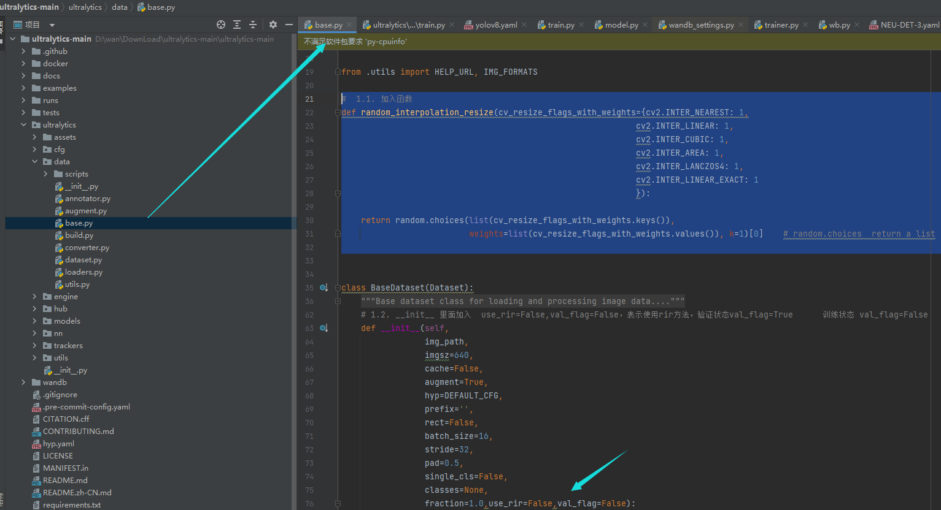
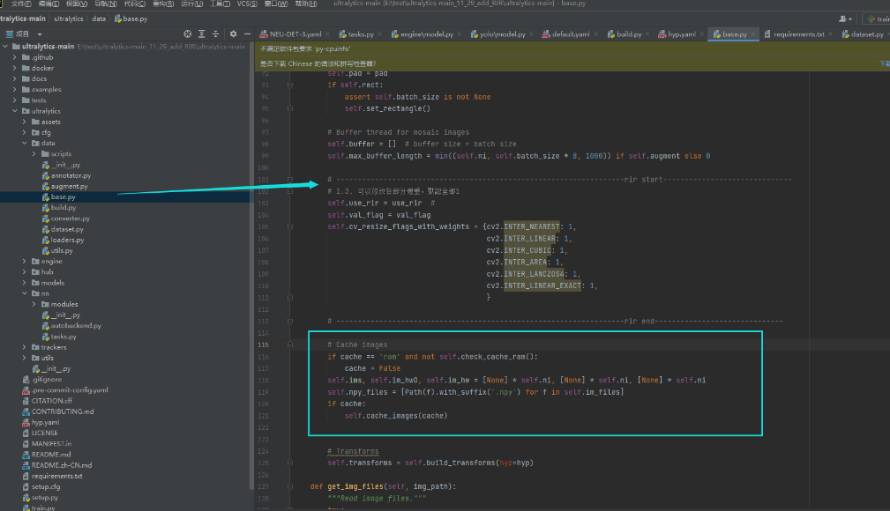
3.1 YOLOv8 添加步骤
ultralytics/data/base.py 11月以后版本（最新版）
1. base.py 内部更改
ultralytics/yolo/data/base.py 11月以前的版本
# 1.1. 加入函数 def random_interpolation_resize(cv_resize_flags_with_weights={cv2.INTER_NEAREST: 1, cv2.INTER_LINEAR: 1, cv2.INTER_CUBIC: 1, cv2.INTER_AREA: 1, cv2.INTER_LANCZOS4: 1, cv2.INTER_LINEAR_EXACT: 1 }): return random.choices(list(cv_resize_flags_with_weights.keys()), weights=list(cv_resize_flags_with_weights.values()), k=1)[0] # random.choices return a list
# 1.2. __init__ 里面加入 use_rir=False,val_flag=False 表示使用rir方法，验证状态val_flag=True 训练状态 val_flag=False
# -------------------------------------------------------------------rir start------------------------------ # 1.3. 引入相关参数，可以修改各部分權重，默認全部1 self.use_rir = use_rir # self.val_flag = val_flag self.cv_resize_flags_with_weights = {cv2.INTER_NEAREST: 1, cv2.INTER_LINEAR: 1, cv2.INTER_CUBIC: 1, cv2.INTER_AREA: 1, cv2.INTER_LANCZOS4: 1, cv2.INTER_LINEAR_EXACT: 1, } # -------------------------------------------------------------------rir end------------------------------
Rir初始化的部分一定要放在cache的前面

Slide 6
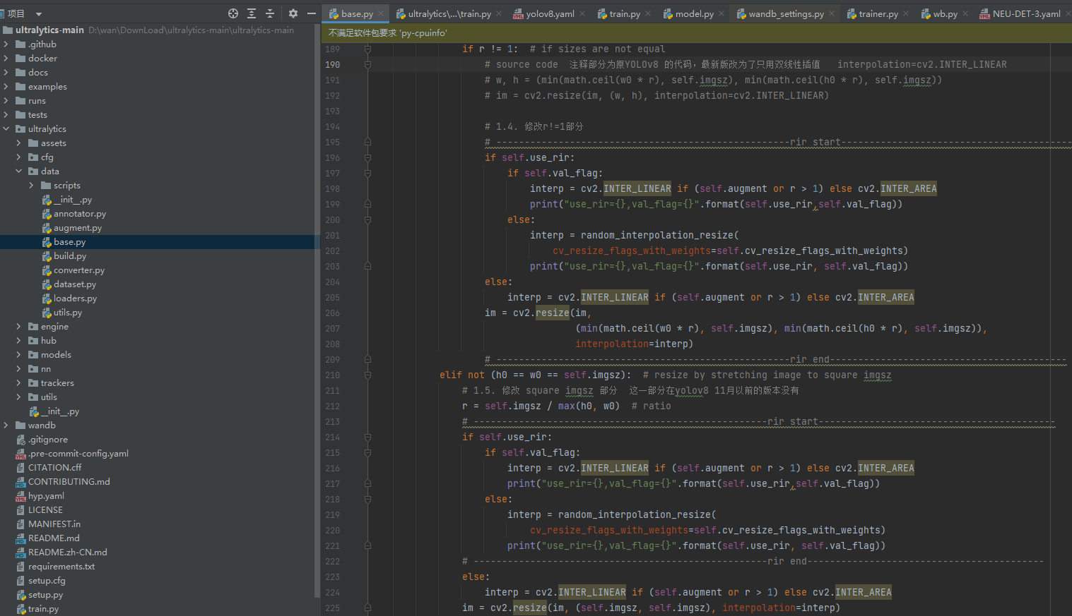
3.1 YOLOv8 添加步骤
if rect_mode: # resize long side to imgsz while maintaining aspect ratio r = self.imgsz / max(h0, w0) # ratio if r != 1: # if sizes are not equal # source code 注释部分为原YOLOv8 的代码，最新版改为了只用双线性插值 interpolation=cv2.INTER_LINEAR # w, h = (min(math.ceil(w0 * r), self.imgsz), min(math.ceil(h0 * r), self.imgsz)) # im = cv2.resize(im, (w, h), interpolation=cv2.INTER_LINEAR) # 1.4. 修改r!=1部分 # ----------------------------------------------------rir start------------------------------------------ if self.use_rir: if self.val_flag: interp = cv2.INTER_LINEAR if (self.augment or r > 1) else cv2.INTER_AREA print("use_rir={},val_flag={}".format(self.use_rir,self.val_flag)) else: interp = random_interpolation_resize( cv_resize_flags_with_weights=self.cv_resize_flags_with_weights) print("use_rir={},val_flag={}".format(self.use_rir, self.val_flag)) else: interp = cv2.INTER_LINEAR if (self.augment or r > 1) else cv2.INTER_AREA im = cv2.resize(im, (min(math.ceil(w0 * r), self.imgsz), min(math.ceil(h0 * r), self.imgsz)), interpolation=interp) # ----------------------------------------------------rir end------------------------------------------ elif not (h0 == w0 == self.imgsz): # resize by stretching image to square imgsz # 1.5. 修改 square imgsz 部分 这一部分在yolov8 11月以前的版本没有 r = self.imgsz / max(h0, w0) # ratio # ----------------------------------------------------rir start------------------------------------------ if self.use_rir: if self.val_flag: interp = cv2.INTER_LINEAR if (self.augment or r > 1) else cv2.INTER_AREA print("use_rir={},val_flag={}".format(self.use_rir,self.val_flag)) else: interp = random_interpolation_resize( cv_resize_flags_with_weights=self.cv_resize_flags_with_weights) print("use_rir={},val_flag={}".format(self.use_rir, self.val_flag)) # ----------------------------------------------------rir end------------------------------------------ else: interp = cv2.INTER_LINEAR if (self.augment or r > 1) else cv2.INTER_AREA im = cv2.resize(im, (self.imgsz, self.imgsz), interpolation=interp)
1. base.py 内部更改(11月以后)
1.4. 修改r!=1部分
1.5. 修改 square imgsz 部分 这一部分在YOLOv8 11月以前的版本没有
class BaseDataset(Dataset):
def load_image(self, i, rect_mode=True):

Slide 7
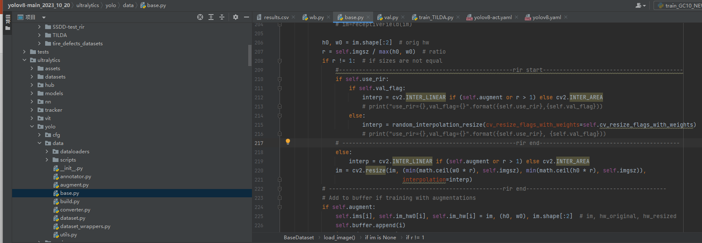
3.1 YOLOv8 添加步骤
1. base.py 内部更改(11月以前的版本)
1.4. 修改r!=1部分
class BaseDataset(Dataset):
if r != 1: # if sizes are not equal #----------------------------------------------------rir start------------------------------------------ if self.use_rir: if self.val_flag: interp = cv2.INTER_LINEAR if (self.augment or r > 1) else cv2.INTER_AREA # print("use_rir={},val_flag={}".format({self.use_rir},{self.val_flag})) else: interp = random_interpolation_resize(cv_resize_flags_with_weights=self.cv_resize_flags_with_weights) # print("use_rir={},val_flag={}".format({self.use_rir}, {self.val_flag})) # ----------------------------------------------------rir end------------------------------------------ else: interp = cv2.INTER_LINEAR if (self.augment or r > 1) else cv2.INTER_AREA im = cv2.resize(im, (min(math.ceil(w0 * r), self.imgsz), min(math.ceil(h0 * r), self.imgsz)), interpolation=interp) # ----------------------------------------------------rir end------------------------------------------
def load_image(self, i, rect_mode=True):

Slide 8
3.1 YOLOv8 添加步骤
if rect_mode: # resize long side to imgsz while maintaining aspect ratio r = self.imgsz / max(h0, w0) # ratio if r != 1: # if sizes are not equal # source code 注释部分为原YOLOv8 的代码，最新版改为了只用双线性插值 interpolation=cv2.INTER_LINEAR # w, h = (min(math.ceil(w0 * r), self.imgsz), min(math.ceil(h0 * r), self.imgsz)) # im = cv2.resize(im, (w, h), interpolation=cv2.INTER_LINEAR) # 1.4. 修改r!=1部分 # ----------------------------------------------------rir start------------------------------------------ if self.use_rir: if self.val_flag: interp = cv2.INTER_LINEAR if (self.augment or r > 1) else cv2.INTER_AREA print("use_rir={},val_flag={}".format(self.use_rir,self.val_flag)) else: interp = random_interpolation_resize( cv_resize_flags_with_weights=self.cv_resize_flags_with_weights) print("use_rir={},val_flag={}".format(self.use_rir, self.val_flag)) else: interp = cv2.INTER_LINEAR if (self.augment or r > 1) else cv2.INTER_AREA im = cv2.resize(im, (min(math.ceil(w0 * r), self.imgsz), min(math.ceil(h0 * r), self.imgsz)), interpolation=interp) # ----------------------------------------------------rir end------------------------------------------ elif not (h0 == w0 == self.imgsz): # resize by stretching image to square imgsz # 1.5. 修改 square imgsz 部分 这一部分在yolov8 11月以前的版本没有 r = self.imgsz / max(h0, w0) # ratio # ----------------------------------------------------rir start------------------------------------------ if self.use_rir: if self.val_flag: interp = cv2.INTER_LINEAR if (self.augment or r > 1) else cv2.INTER_AREA print("use_rir={},val_flag={}".format(self.use_rir,self.val_flag)) else: interp = random_interpolation_resize( cv_resize_flags_with_weights=self.cv_resize_flags_with_weights) print("use_rir={},val_flag={}".format(self.use_rir, self.val_flag)) # ----------------------------------------------------rir end------------------------------------------ else: interp = cv2.INTER_LINEAR if (self.augment or r > 1) else cv2.INTER_AREA im = cv2.resize(im, (self.imgsz, self.imgsz), interpolation=interp)
1. base.py 内部更改(11月以后的版本)
if rect_mode:
1.4. 修改r!=1部分
1.5. 修改 square imgsz 部分 这一部分在YOLOv8 11月以前的版本没有
class BaseDataset(Dataset):
def load_image(self, i, rect_mode=True):

Slide 9
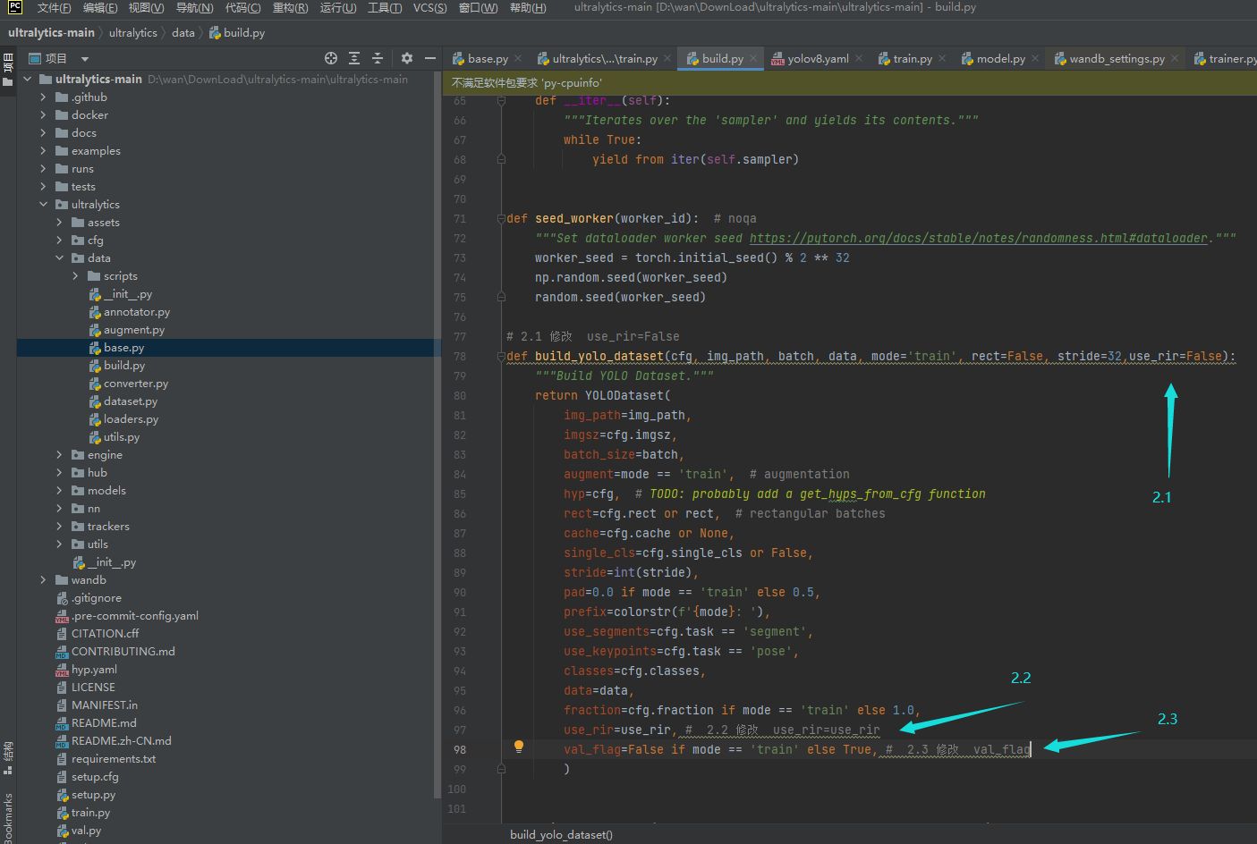
3.1 YOLOv8 添加步骤
ultralytics/data/build.py
2. build.py build_yolo_dataset
ultralytics/yolo/data/build.py
# 2.1 修改 use_rir=False def build_yolo_dataset(cfg, img_path, batch, data, mode='train', rect=False, stride=32,use_rir=False): """Build YOLO Dataset.""" return YOLODataset( img_path=img_path, imgsz=cfg.imgsz, batch_size=batch, augment=mode == 'train', # augmentation hyp=cfg, # TODO: probably add a get_hyps_from_cfg function rect=cfg.rect or rect, # rectangular batches cache=cfg.cache or None, single_cls=cfg.single_cls or False, stride=int(stride), pad=0.0 if mode == 'train' else 0.5, prefix=colorstr(f'{mode}: '), use_segments=cfg.task == 'segment', use_keypoints=cfg.task == 'pose', classes=cfg.classes, data=data, fraction=cfg.fraction if mode == 'train' else 1.0, use_rir=use_rir, # 2.2 修改 use_rir=use_rir val_flag=False if mode == 'train' else True, # 2.3 修改 val_flag )

Slide 10
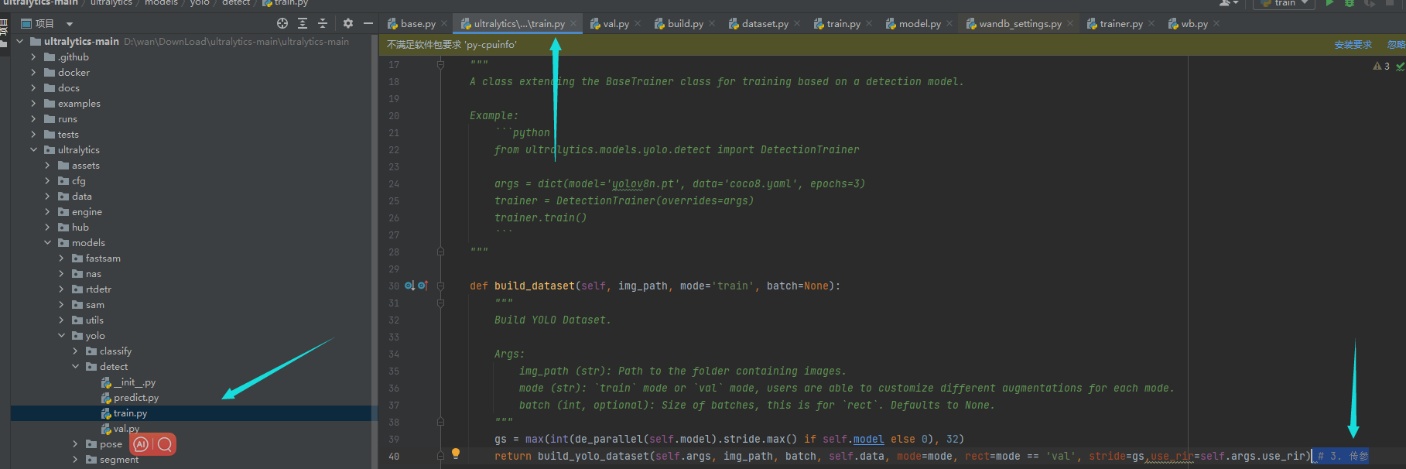
3.1 YOLOv8 添加步骤
ultralytics/models/yolo/detect/train.py
def build_dataset(self, img_path, mode='train', batch=None): """ Build YOLO Dataset. Args: img_path (str): Path to the folder containing images. mode (str): `train` mode or `val` mode, users are able to customize different augmentations for each mode. batch (int, optional): Size of batches, this is for `rect`. Defaults to None. """ gs = max(int(de_parallel(self.model).stride.max() if self.model else 0), 32) return build_yolo_dataset(self.args, img_path, batch, self.data, mode=mode, rect=mode == 'val', stride=gs,use_rir=self.args.use_rir) # 3. 传参
3.
class DetectionTrainer(BaseTrainer):
传参

Slide 11
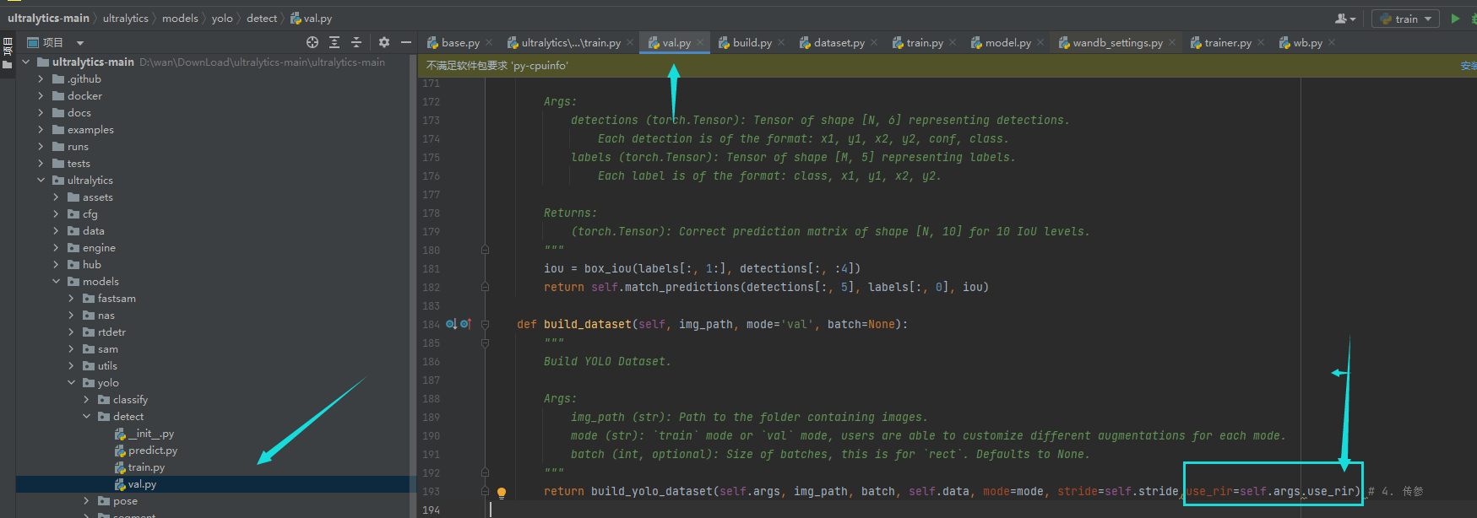
3.1 YOLOv8 添加步骤
def build_dataset(self, img_path, mode='val', batch=None): """ Build YOLO Dataset. Args: img_path (str): Path to the folder containing images. mode (str): `train` mode or `val` mode, users are able to customize different augmentations for each mode. batch (int, optional): Size of batches, this is for `rect`. Defaults to None. """ return build_yolo_dataset(self.args, img_path, batch, self.data, mode=mode, stride=self.stride,use_rir=self.args.use_rir) # 4. 传参
ultralytics/models/yolo/detect/val.py
4.
传参
class DetectionValidator(BaseValidator):

Slide 12
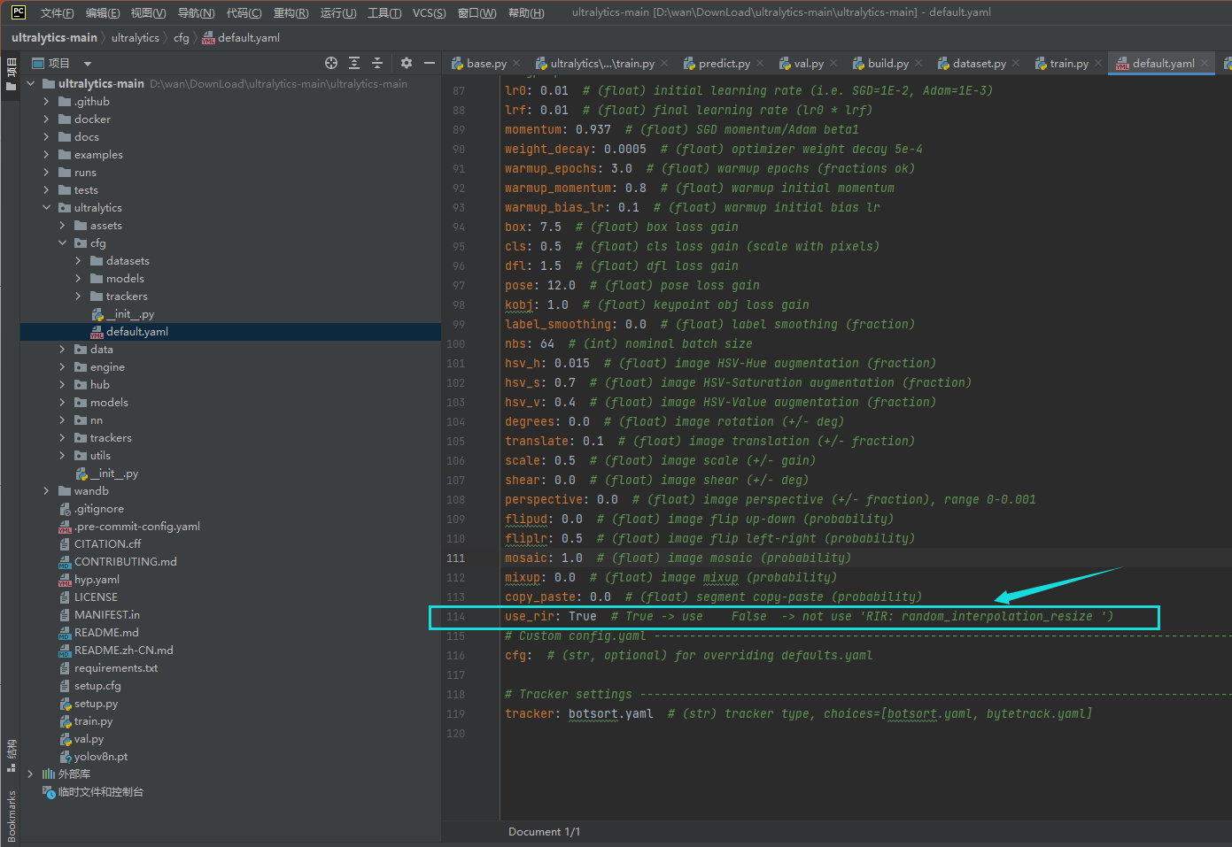
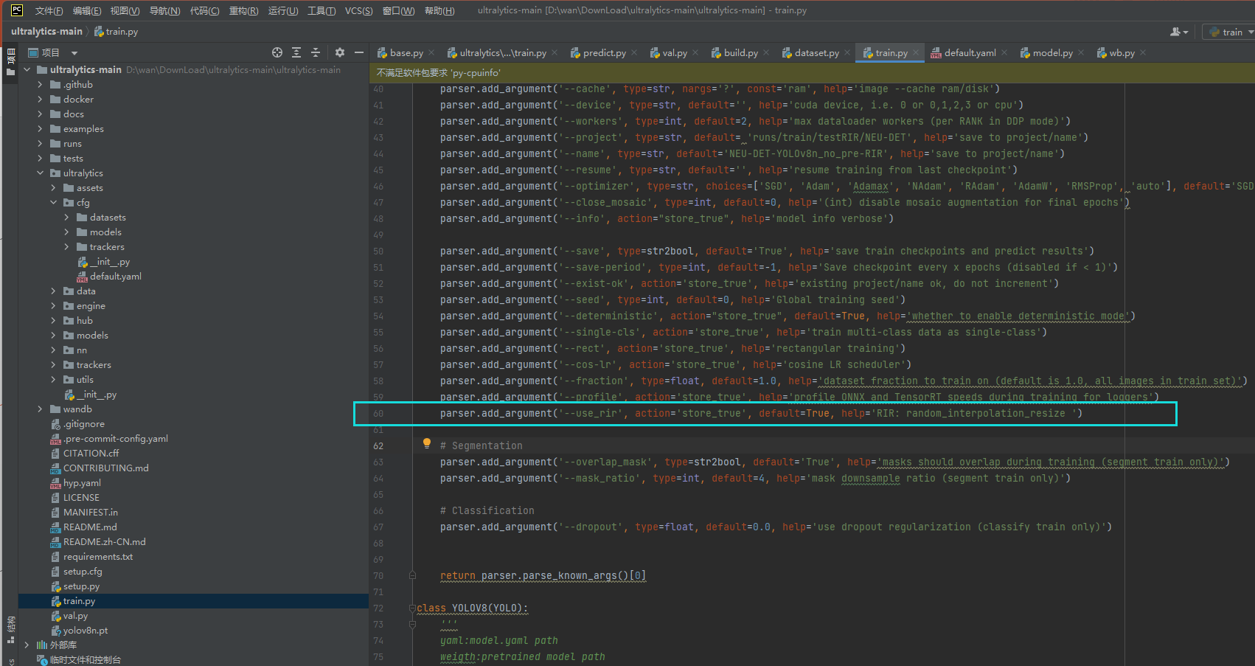
3.1 YOLOv8 添加步骤
5. ultralytics/cfg/default.yaml 添加
use_rir: True # True -> use False -> not use 'RIR: random_interpolation_resize ')
train.py 添加（如果有的话）
parser.add_argument('--use_rir', action='store_true', default=True, help='RIR: random_interpolation_resize ')

Slide 13
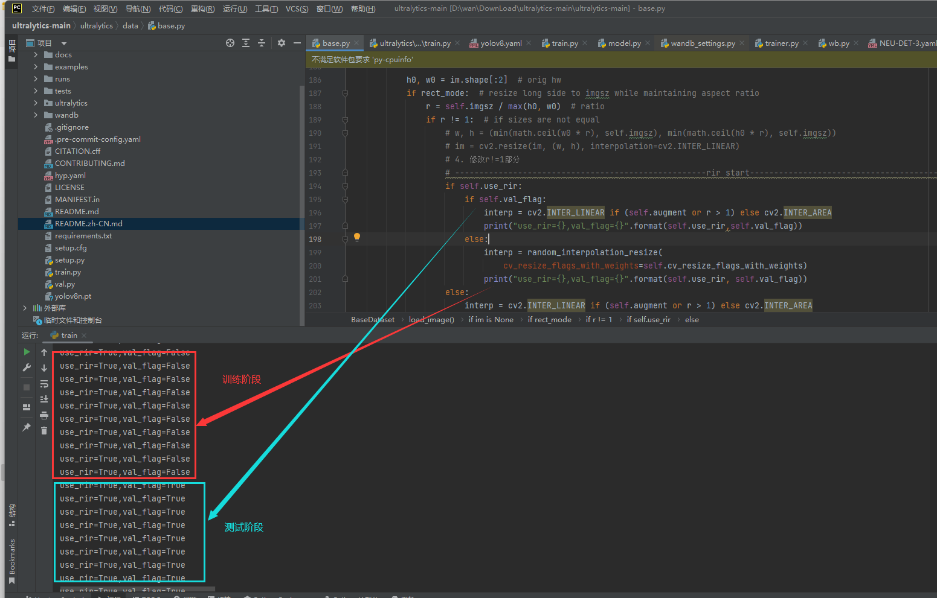
3.1 YOLOv8 添加步骤
6.验证
（1）按照正常YOLOv8的训练步骤进行模型训练
（2）如果正确显示图中的内容，则表示添加成功，注释掉print，按原本的步骤运行即可

Slide 14
3.3 YOLOv7 添加步骤
1.utils/dataset.py
（1）添加 random_interpolation_resize 函数
（2）更改load_image函数内的插值方式
（3）在 LoadImagesAndLabels 内添加use_rir和 val_flag __init__
（4）在 create_dataloader 内添加use_rir和 val_flag
2.train.py
（5）在 两处create_dataloader 内传入use_rir和 val_flag
（6）添加 顶层的 use_rir 参数
YOLOv7 项目地址（采用最新版进行演示，2023.12.19）
https://github.com/WongKinYiu/yolov7

Slide 15
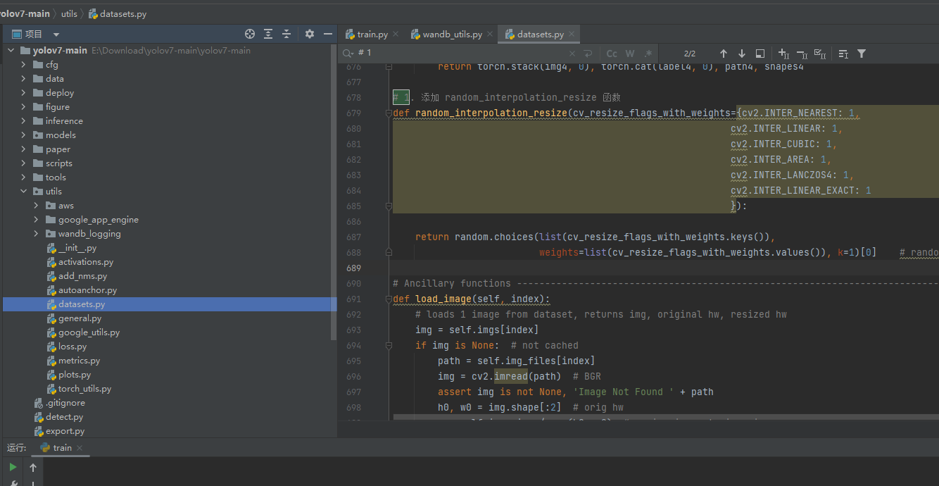
3.3 YOLOv7 添加步骤
1.utils/dataset.py
（1） 添加 random_interpolation_resize 函数
# 1. 添加 random_interpolation_resize 函数 def random_interpolation_resize(cv_resize_flags_with_weights={cv2.INTER_NEAREST: 1, cv2.INTER_LINEAR: 1, cv2.INTER_CUBIC: 1, cv2.INTER_AREA: 1, cv2.INTER_LANCZOS4: 1, cv2.INTER_LINEAR_EXACT: 1 }): return random.choices(list(cv_resize_flags_with_weights.keys()), weights=list(cv_resize_flags_with_weights.values()), k=1)[0] # random.choices return a list

Slide 16
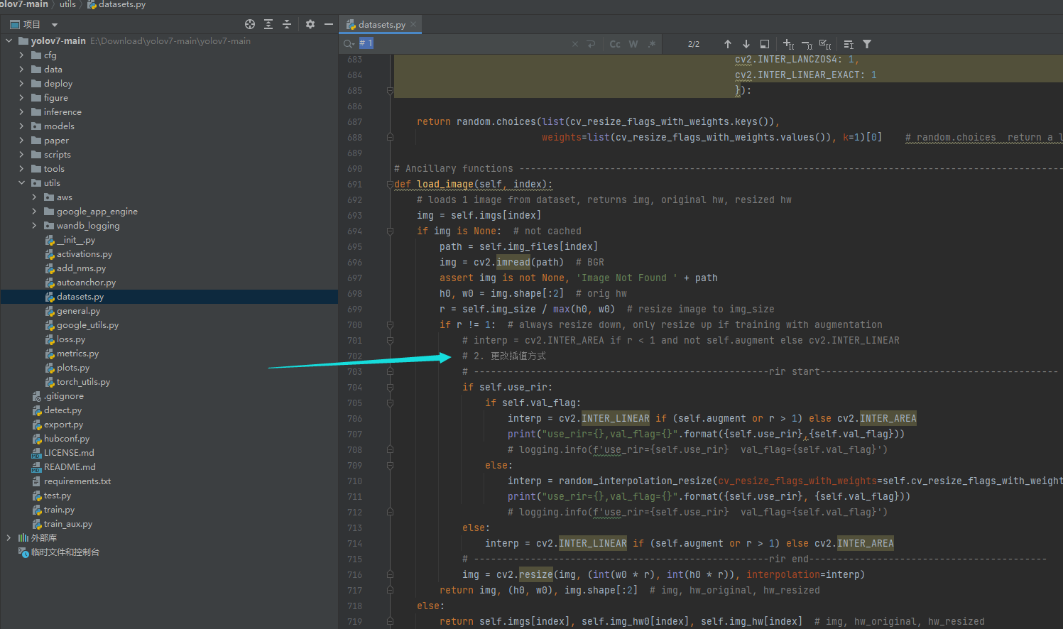
3.3 YOLOv7 添加步骤
1.utils/dataset.py
（2）更改load_image函数内的插值方式
# Ancillary functions -------------------------------------------------------------------------------------------------- def load_image(self, index): # loads 1 image from dataset, returns img, original hw, resized hw img = self.imgs[index] if img is None: # not cached path = self.img_files[index] img = cv2.imread(path) # BGR assert img is not None, 'Image Not Found ' + path h0, w0 = img.shape[:2] # orig hw r = self.img_size / max(h0, w0) # resize image to img_size if r != 1: # always resize down, only resize up if training with augmentation # interp = cv2.INTER_AREA if r < 1 and not self.augment else cv2.INTER_LINEAR # 2. 更改插值方式 # ----------------------------------------------------rir start------------------------------------------ if self.use_rir: if self.val_flag: interp = cv2.INTER_LINEAR if (self.augment or r > 1) else cv2.INTER_AREA # print("use_rir={},val_flag={}".format({self.use_rir},{self.val_flag})) # logging.info(f'use_rir={self.use_rir} val_flag={self.val_flag}') else: interp = random_interpolation_resize(cv_resize_flags_with_weights=self.cv_resize_flags_with_weights) # print("use_rir={},val_flag={}".format({self.use_rir}, {self.val_flag})) # logging.info(f'use_rir={self.use_rir} val_flag={self.val_flag}') else: interp = cv2.INTER_LINEAR if (self.augment or r > 1) else cv2.INTER_AREA # ----------------------------------------------------rir end------------------------------------------ img = cv2.resize(img, (int(w0 * r), int(h0 * r)), interpolation=interp) return img, (h0, w0), img.shape[:2] # img, hw_original, hw_resized else: return self.imgs[index], self.img_hw0[index], self.img_hw[index] # img, hw_original, hw_resized

Slide 17
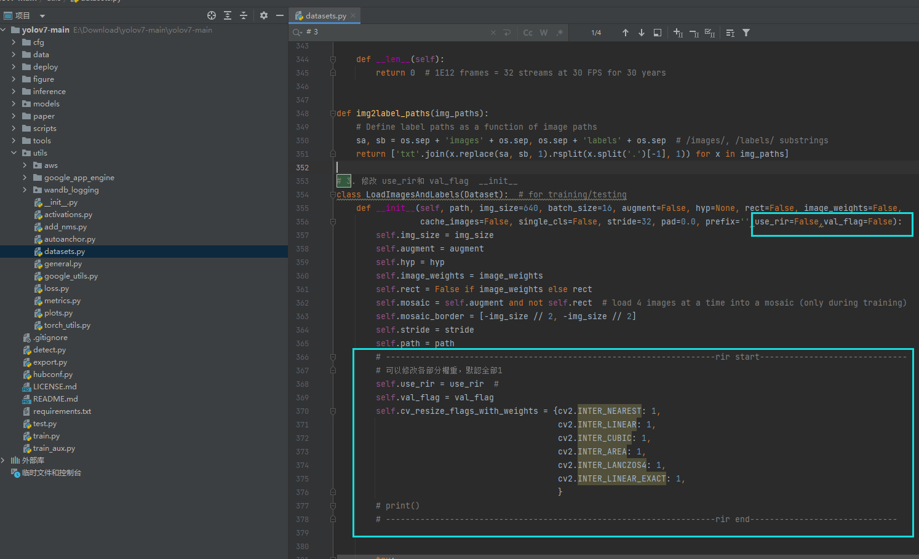
3.3 YOLOv7 添加步骤
1.utils/dataset.py
（3）在 LoadImagesAndLabels 内添加use_rir和 val_flag __init__
# 3. 修改 use_rir和 val_flag __init__ class LoadImagesAndLabels(Dataset): # for training/testing def __init__(self, path, img_size=640, batch_size=16, augment=False, hyp=None, rect=False, image_weights=False, cache_images=False, single_cls=False, stride=32, pad=0.0, prefix='',use_rir=False,val_flag=False): self.img_size = img_size self.augment = augment self.hyp = hyp self.image_weights = image_weights self.rect = False if image_weights else rect self.mosaic = self.augment and not self.rect # load 4 images at a time into a mosaic (only during training) self.mosaic_border = [-img_size // 2, -img_size // 2] self.stride = stride self.path = path # -------------------------------------------------------------------rir start------------------------------ # 可以修改各部分權重，默認全部1 self.use_rir = use_rir # self.val_flag = val_flag self.cv_resize_flags_with_weights = {cv2.INTER_NEAREST: 1, cv2.INTER_LINEAR: 1, cv2.INTER_CUBIC: 1, cv2.INTER_AREA: 1, cv2.INTER_LANCZOS4: 1, cv2.INTER_LINEAR_EXACT: 1, } # print() # -------------------------------------------------------------------rir end------------------------------

Slide 18
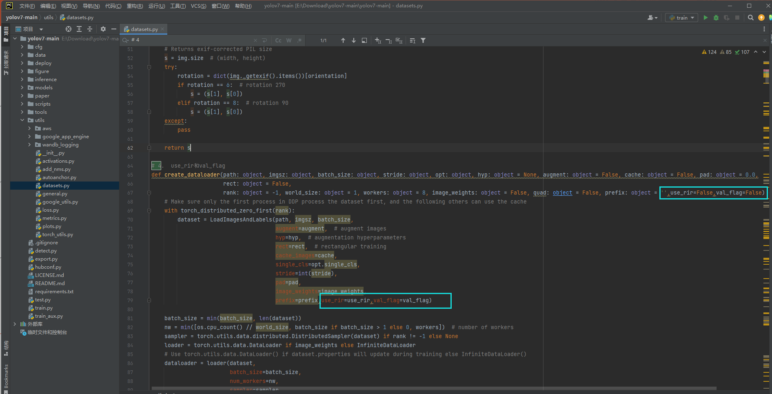
3.3 YOLOv7 添加步骤
1.utils/dataset.py
（4）在 create_dataloader 内添加use_rir和 val_flag __init__
# 4. use_rir和val_flag def create_dataloader(path: object, imgsz: object, batch_size: object, stride: object, opt: object, hyp: object = None, augment: object = False, cache: object = False, pad: object = 0.0, rect: object = False, rank: object = -1, world_size: object = 1, workers: object = 8, image_weights: object = False, quad: object = False, prefix: object = '',use_rir=False,val_flag=False) -> object: # Make sure only the first process in DDP process the dataset first, and the following others can use the cache with torch_distributed_zero_first(rank): dataset = LoadImagesAndLabels(path, imgsz, batch_size, augment=augment, # augment images hyp=hyp, # augmentation hyperparameters rect=rect, # rectangular training cache_images=cache, single_cls=opt.single_cls, stride=int(stride), pad=pad, image_weights=image_weights, prefix=prefix,use_rir=use_rir,val_flag=val_flag) batch_size = min(batch_size, len(dataset)) nw = min([os.cpu_count() // world_size, batch_size if batch_size > 1 else 0, workers]) # number of workers sampler = torch.utils.data.distributed.DistributedSampler(dataset) if rank != -1 else None loader = torch.utils.data.DataLoader if image_weights else InfiniteDataLoader # Use torch.utils.data.DataLoader() if dataset.properties will update during training else InfiniteDataLoader() dataloader = loader(dataset, batch_size=batch_size, num_workers=nw, sampler=sampler, pin_memory=True, collate_fn=LoadImagesAndLabels.collate_fn4 if quad else LoadImagesAndLabels.collate_fn) return dataloader, dataset

Slide 19
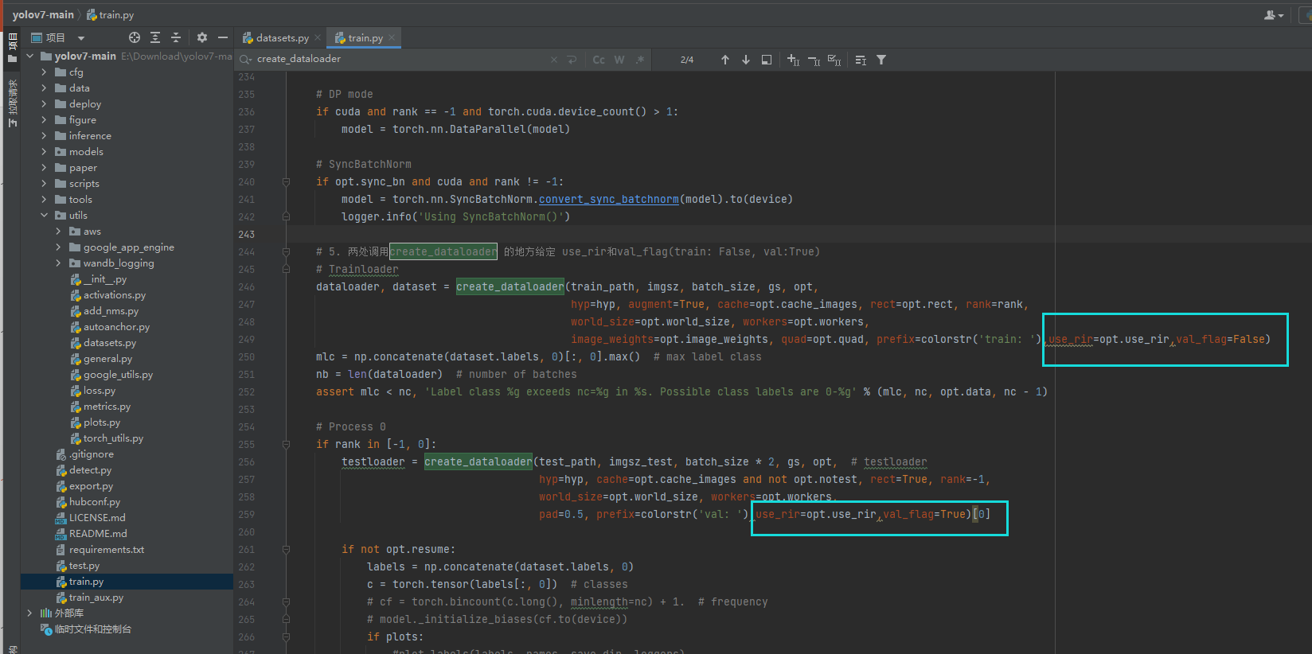
3.3 YOLOv7 添加步骤
2.train.py
（5）在 两处create_dataloader 内传入use_rir和 val_flag
# Trainloader dataloader, dataset = create_dataloader(train_path, imgsz, batch_size, gs, opt, hyp=hyp, augment=True, cache=opt.cache_images, rect=opt.rect, rank=rank, world_size=opt.world_size, workers=opt.workers, image_weights=opt.image_weights, quad=opt.quad, prefix=colorstr('train: '),use_rir=opt.use_rir,val_flag=False)
testloader = create_dataloader(test_path, imgsz_test, batch_size * 2, gs, opt, # testloader hyp=hyp, cache=opt.cache_images and not opt.notest, rect=True, rank=-1, world_size=opt.world_size, workers=opt.workers, pad=0.5, prefix=colorstr('val: '),use_rir=opt.use_rir,val_flag=True)[0]

Slide 20
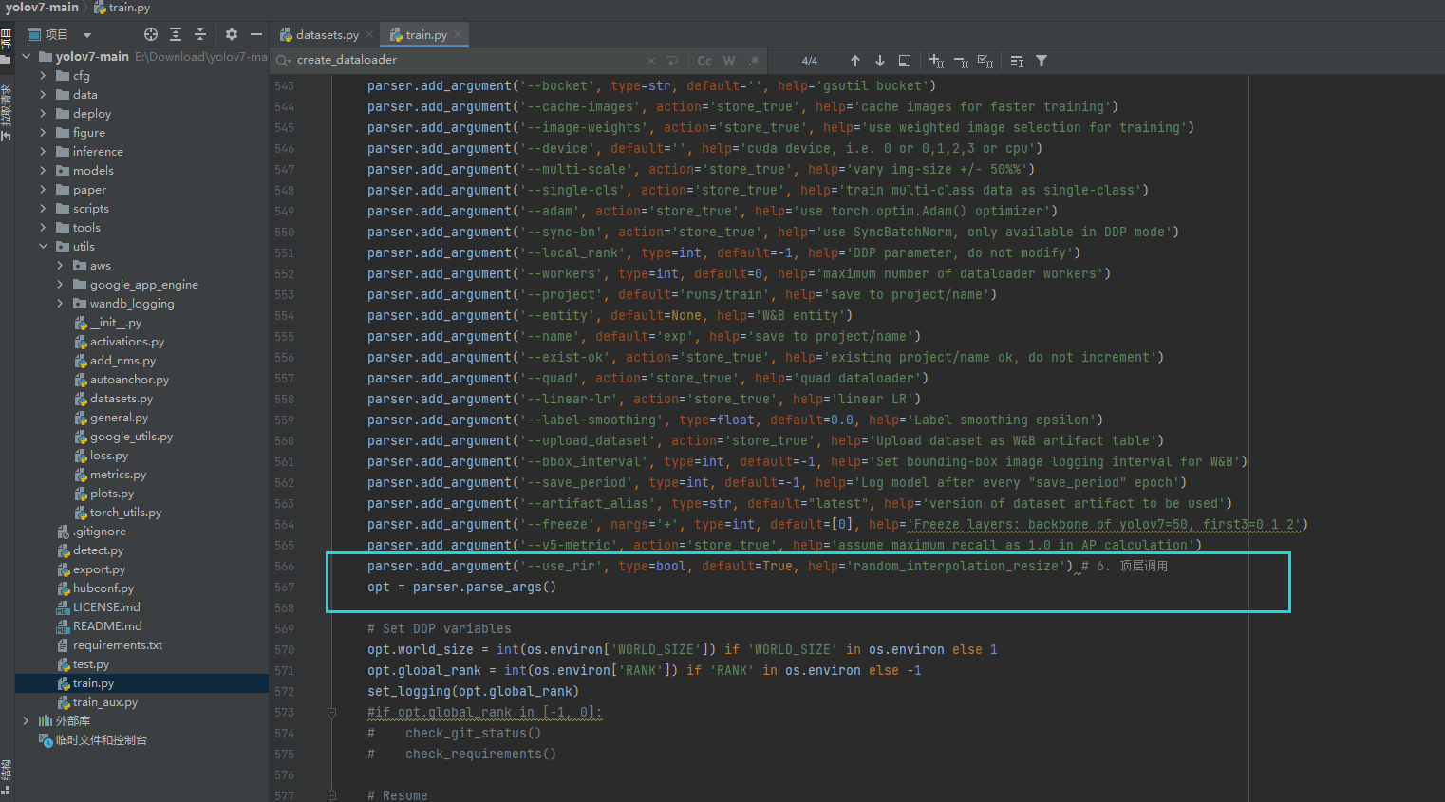
3.3 YOLOv7 添加步骤
2.train.py
（6）添加 顶层的 use_rir 参数
parser.add_argument('--use_rir', type=bool, default=True, help='random_interpolation_resize') # 6. 顶层调用

Slide 21
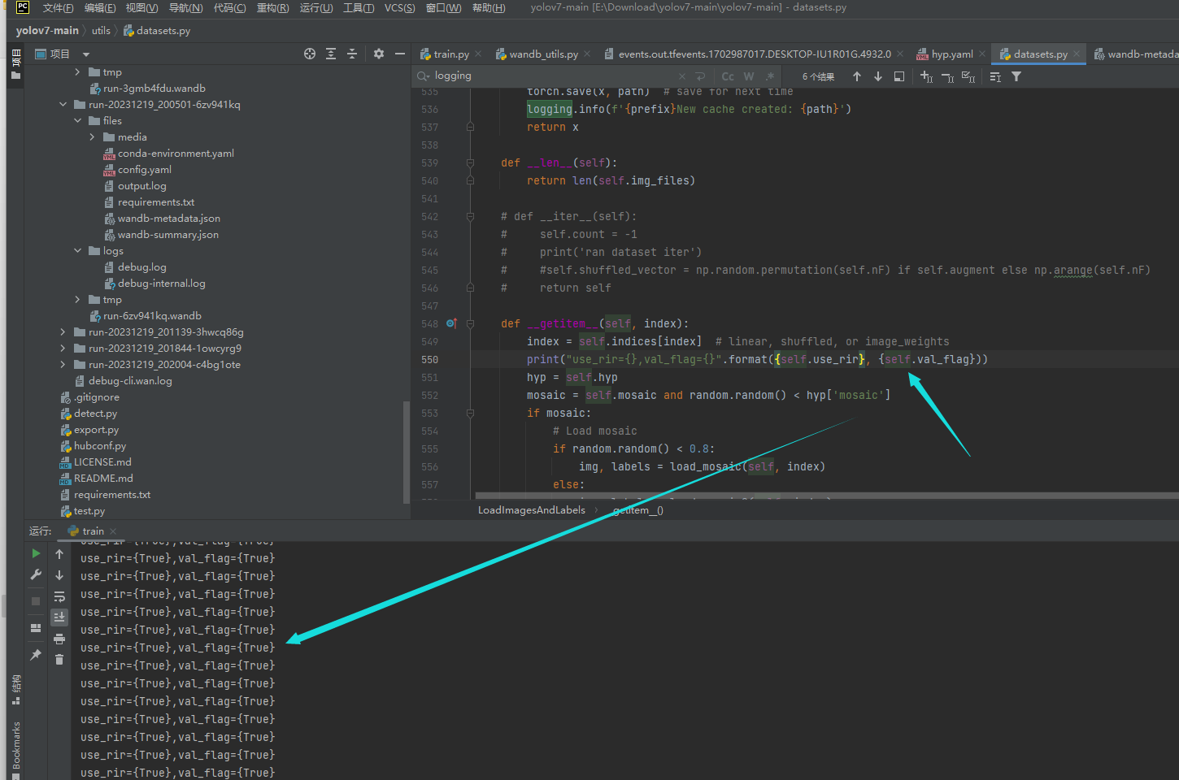
3.3 YOLOv7 添加步骤
3.验证
（1）按照正常YOLOv7的训练步骤进行模型训练
（2）如果正确显示图中的内容，则表示添加成功，注释掉print，按原本的步骤运行即可
utils/dataset.py
LoadImagesAndLabels
__getitem__

Slide 22
4.延伸创新点：（未做试验，欢迎继续探讨）
（1）分patch，每个patch采用不同的插值方式
（2）在训练和测试阶段均采用随机的插值方式
（3）在训练阶段最后n(n=30)个epoch
（4）其他可以类比的方法也可以采用 random，试试效果
加工作量：
（1）搭配超参数进化，提升工作量（已在YOLOv5-6.1版本添加）
（2）搭配其他数据增强方法，组合成特定数据集（比如NEU-DET、GC10等）或者特定领域（工业检测、遥感领域等）的方法

