Slide 1

fise_solarDaylight.mlx

Slide 2
These are major H₂O absorption bands that impact infrared imaging and astronomical observations.
1130 nm and longer: Water vapor absorbs significantly in the near-IR and mid-IR, strongly affecting remote sensing and infrared astronomy.
Major Absorption Lines from Atmospheric Molecules
Notable Water Vapor Absorption Bands
Absorbing Molecule | Wavelength (nm) | Designation | Notes
H₂O (Water Vapor) | 718, 820, 912, 960, 1130 | Various (e.g., Y & X bands) | Strong in near-IR, affects astronomical observations
O₂ (Molecular Oxygen) | 686.7, 759.4, 822.7 | B, A, Z bands | Important in the red/NIR spectrum
CO₂ (Carbon Dioxide) | ~1400, ~1600, ~2000 | Infrared bands | Primarily in IR, greenhouse effect contributor
O₃ (Ozone) | 500-700 (weak), ~250 (strong) | Chappuis bands, Hartley bands | UV and blue absorption affect sky color
N₂ (Molecular Nitrogen) | Scattering effect | Rayleigh scattering | Causes blue sky and red sunsets
Notes:
https://chatgpt.com/c/679ebbfc-b510-8002-b372-489cd173d5d0

Slide 3
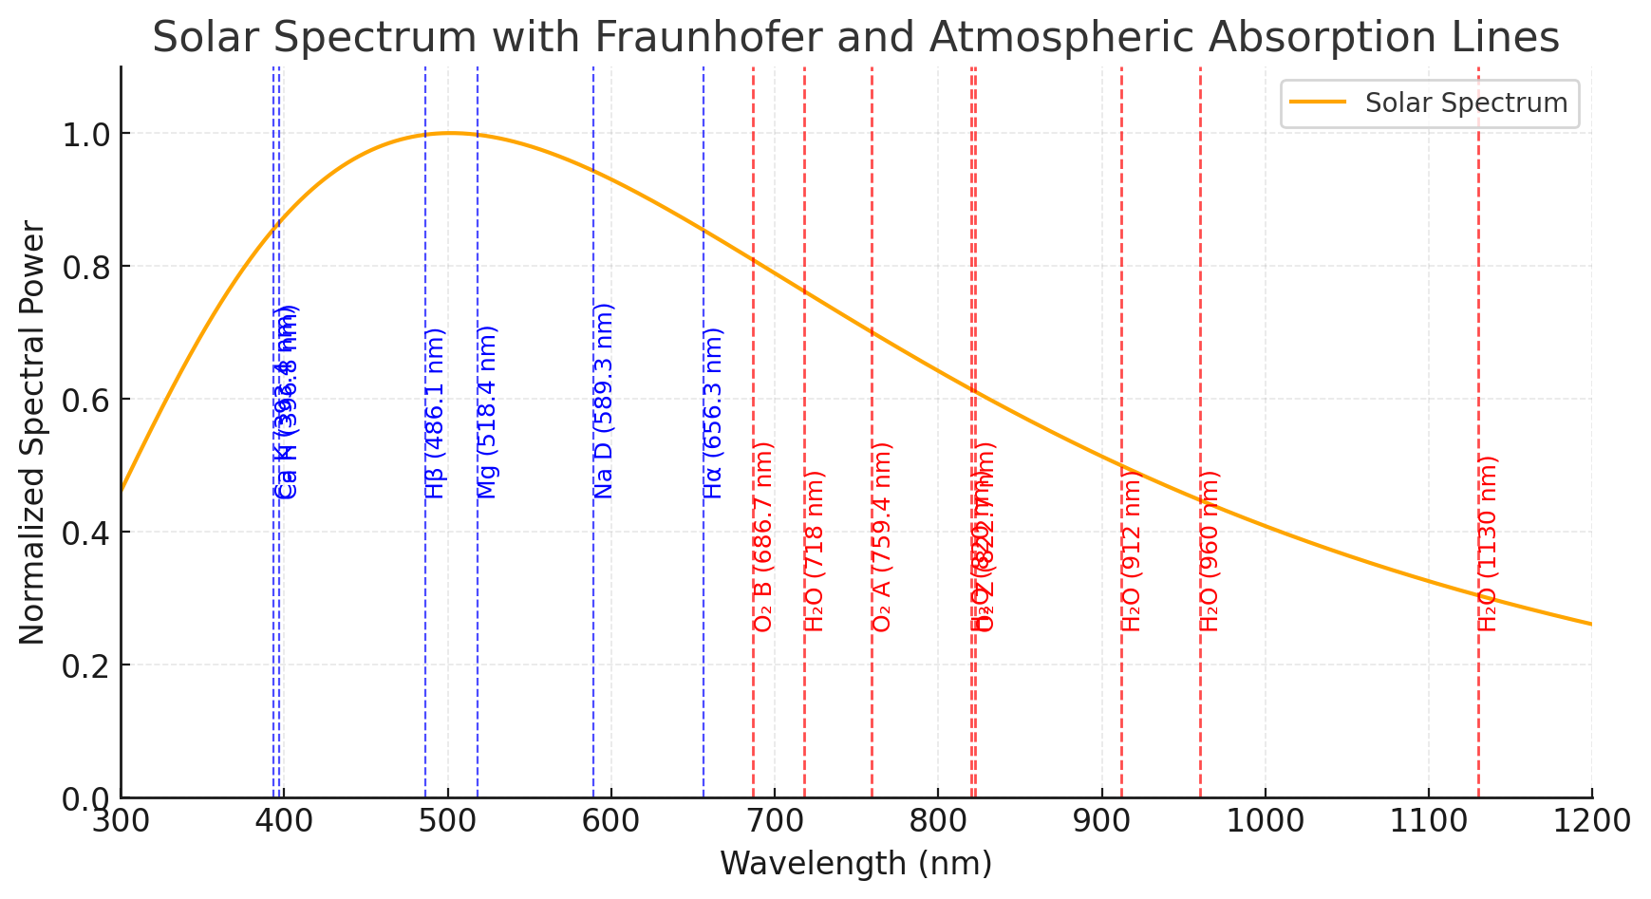
Notes:
https://chatgpt.com/c/679ebbfc-b510-8002-b372-489cd173d5d0

Slide 4
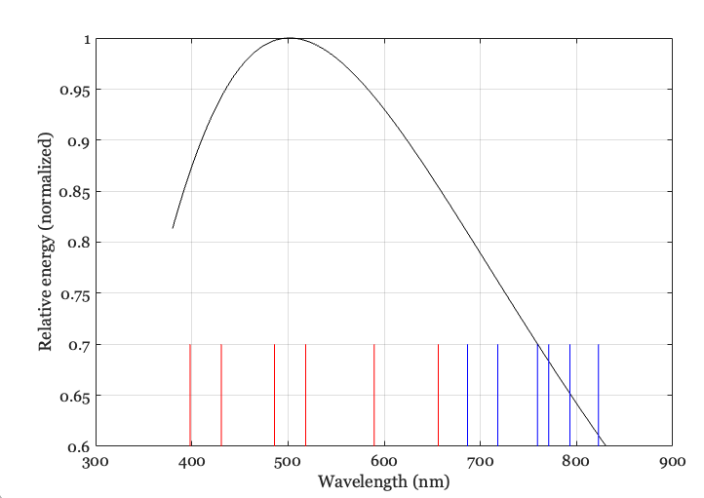

Slide 5
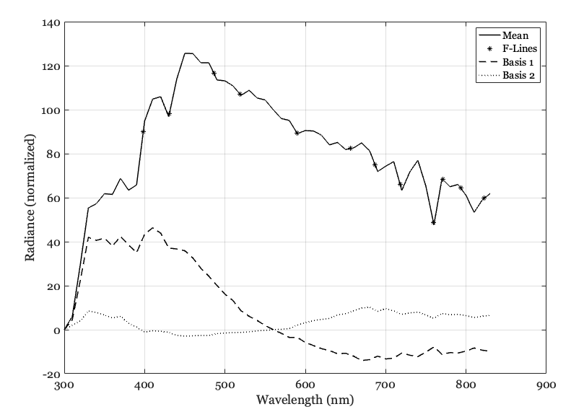

Slide 6
