Slide 1
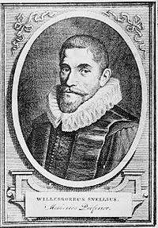
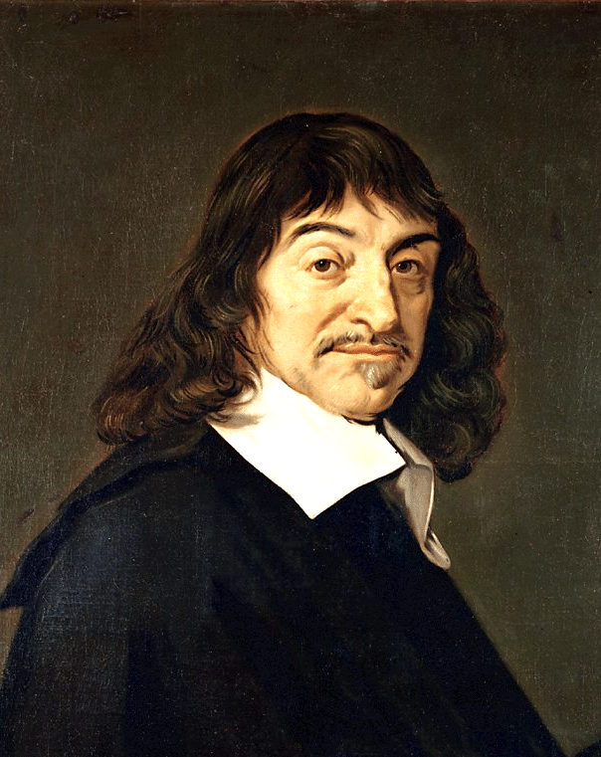
Notes:
https://en.wikipedia.org/wiki/Ren%C3%A9_Descartes#/media/File:Frans_Hals_-_Portret_van_Ren%C3%A9_Descartes.jpg
https://en.wikipedia.org/wiki/Willebrord_Snellius#/media/File:Willebrord_Snellius.jpg

