Slide 1
Storm Worm
Штормовой червь

Slide 2



Storm Worm
The Storm Worm is a phishing backdoor Trojan horse that affects computers using Microsoft operating systems
// Штормовой червь является фишинг-бэкдором троянский конь, который распространяется на компьютеры с операционной системой Microsoft

Slide 3
Number of infected
The Storm Worm began attacking thousands of (mostly private) computers in Europe and the United States on Friday, January 19, 2007, using an e-mail message with a subject line about a recent weather disaster, "230 dead as storm batters Europe".
During the weekend there were six subsequent waves of the attack. As of January 22, 2007, the Storm Worm accounted for 8% of all malware infections globally.
6 WAVE
3 DAY

Slide 4
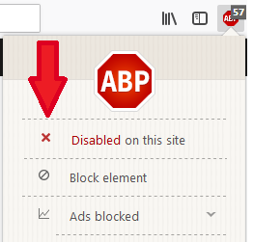

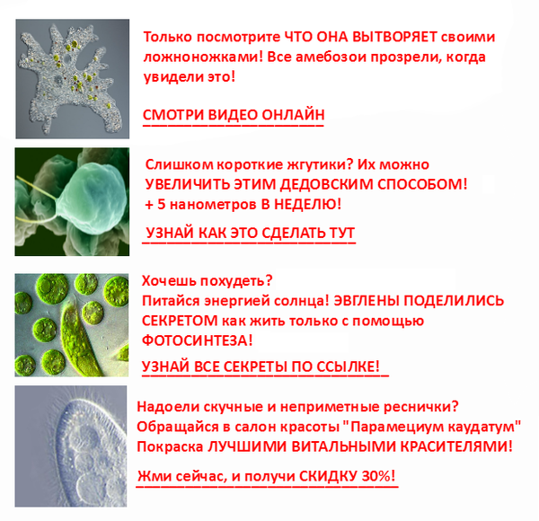
The Storm Worm has spread to the following topics:
A killer at 11, he's free at 21 and kill again!
British Muslims Genocide
Naked teens attack home director.
Re: Your text
Radical Muslim drinking enemies's blood.
Chinese/Russian missile shot down Russian/Chinese satellite/aircraft
If I Knew…
FBI vs. Facebook
// Storm Worm позже распространялся под следующими темами: [перечисление]

Slide 5
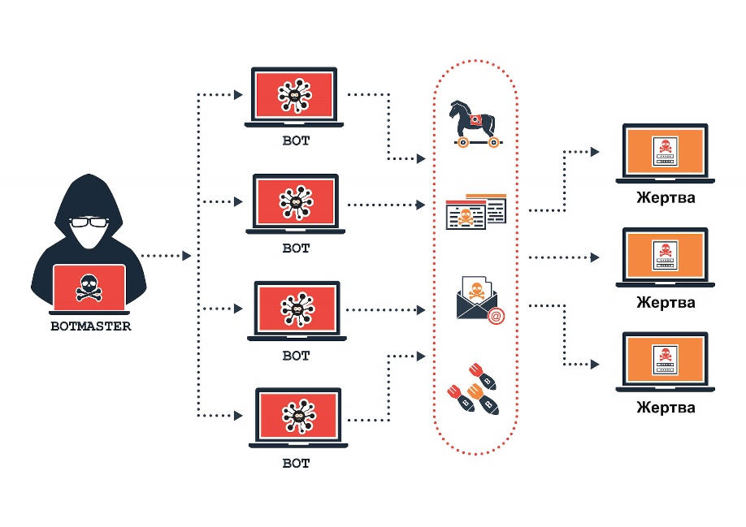
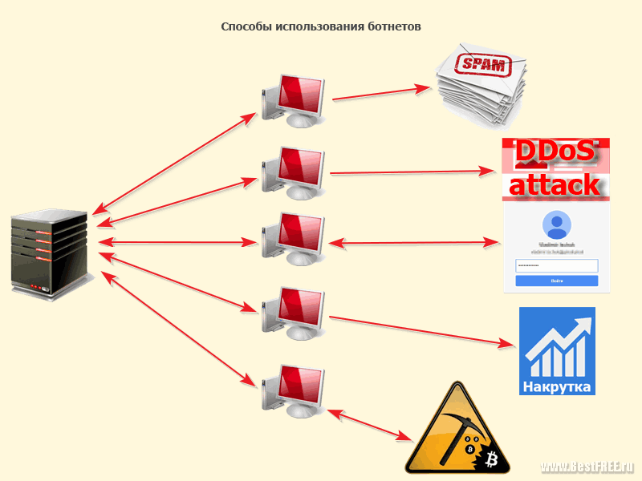
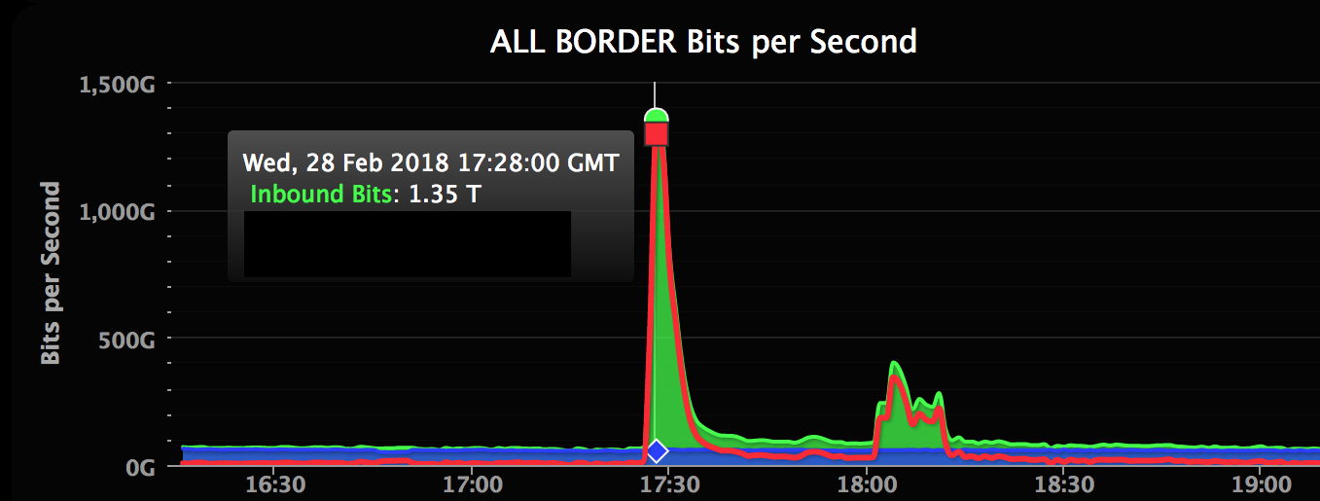
BotNetting
The compromised machine becomes merged into a botnet.
BotNet - is a remotely controlled network of "zombie" computers (or "botnet") that have been linked by the Storm Worm.
// Заражённые машины объединяются в ботнет:
BotNet - является дистанционным управлением сетью «зомби» компьютеры (или « ботнет ») , которые были связаны с Storm Worm

