Slide 1

DBMS INNOVATIVE PROJECT
Dynamic Query Forms for Database Queries
Liang Tang, Tao Li, Yexi Jiang, and Zhiyuan Chen
Submitted By :
Kumar Apurva (2K18/MC/058)
Kunal Sharma (2K18/MC/060)

Slide 2
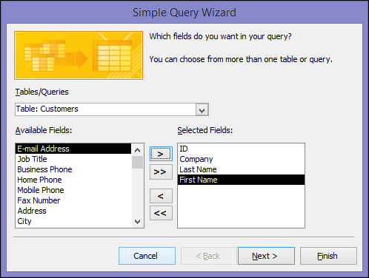
INTRODUCTION
Modern scientific databases and web databases maintain large and heterogeneous data. Traditional predefined query forms are not able to satisfy various ad-hoc queries from users on those databases.
This paper proposes DQF, a novel database query form interface, which is able to dynamically generate query forms.
It helps in querying the Database even for non SQL programmers. We can write general queries and it will be automatically converted into SQL query.

Slide 3
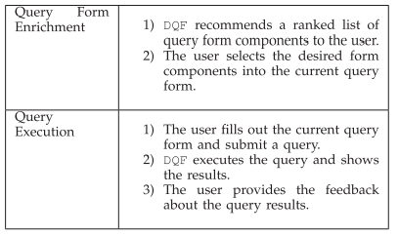
METHODOLOGY
DQF aims to capture a user’s preference and rank query form components. The generation of a query form is an iterative process and is guided by the user.
At each iteration, the system automatically generates ranking lists of form components and the user then adds the desired form components into the query form. The ranking of form components is based on the captured user preference.
F-measure is used for measuring the goodness of a query form. A probabilistic model is developed for estimating the goodness of a query form in DQF.

Slide 4
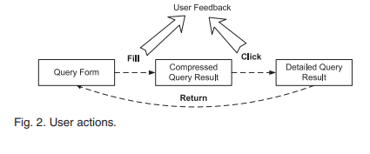

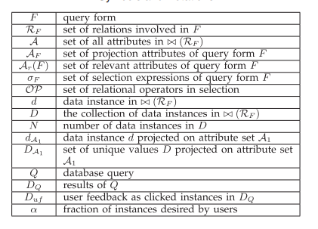
APPROACH
A query form F is defined as a tuple (A_{F,} R_{F}, σ_{F}, Natural Join (R_{F})), which represents a database query template as follows:
The user enters the queries not in SQL format but as in general queries, all the queries that user enters is converted into the form shown above using splitting function, all the tables and columns required according to users query is joined using Natural join and the corresponding results are shown based on the best guess of what users want.

Slide 5
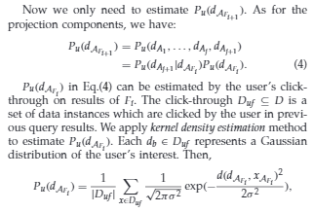
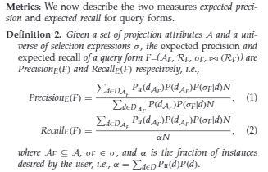
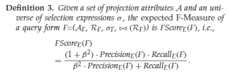
Concepts from Paper
Query forms are designed to return the user’s desired result. There are 2 traditional measures to evaluate the quality of the query results, precision and recall.
FScore E(Fi+1) is the estimated goodness of the next query form Fi+1. Since we aim to maximize the goodness of the next query form, the form components are ranked in descending order of FScore E(Fi+1). In the next section, we will discuss how to compute the FScore E(Fi+1) for a specific form component.
Expected precisions the expected proportion of the query results which are interested by the current user. Expected recall is the expected proportion of user interested data instances which are returned by the current query form.

Slide 6
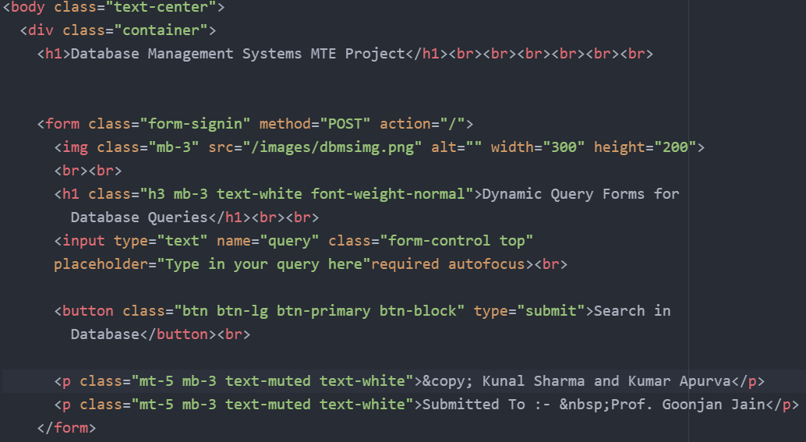
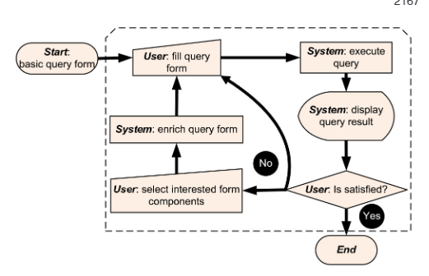
IMPLEMENTATION
The implementation includes the User filling in the query, then the query is parsed and the statement is divided into simpler words each containing some information about different columns from different tables, we created a function named queryBuilder() which recombines these words in such a way that it creates a valid SQL query from the generalized English query written by non SQL user.
After the display of the query User has an option to go with the query or re-select queries generated iteratively by the underlying Feed-Forward Neural Network, whenever a query that interests user is generated the User selects the query and the Web App understands what queries need to be generated when fed with specific keywords.
First step is to setup a method from user to enter query forms in English language and parsing that to our server.
We hosted this projects’s database on the phpMyAdmin Apache server, then we have created Node.js localhost server which acts as the user side.
All the SQL queries are handled using NPM package named mySQL, using the package we have connected the phpMyAdmin server to the client side and then we can execute queries from client side which gets transferred to backend server and are then executed.

Slide 7
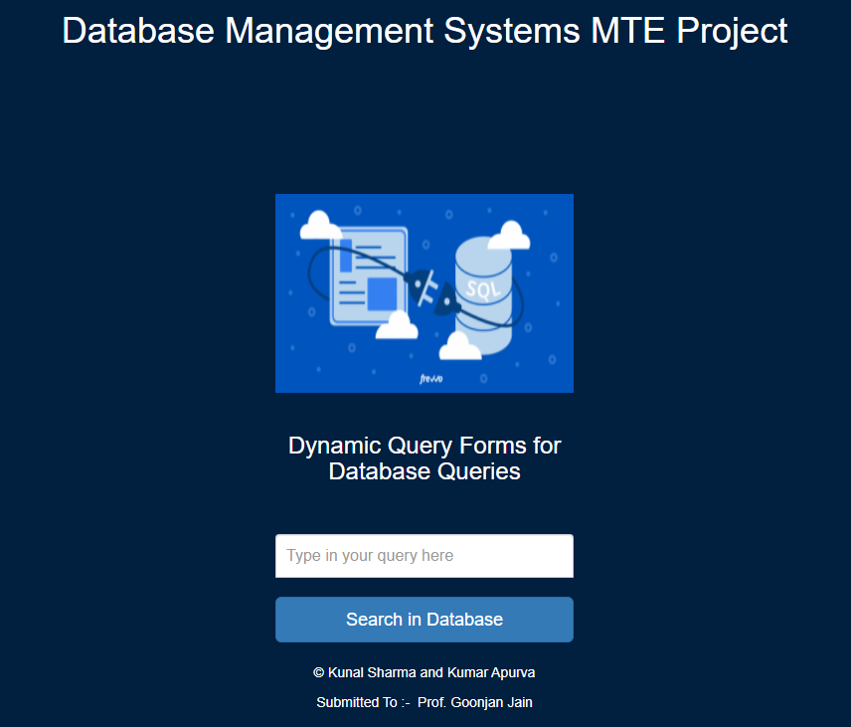
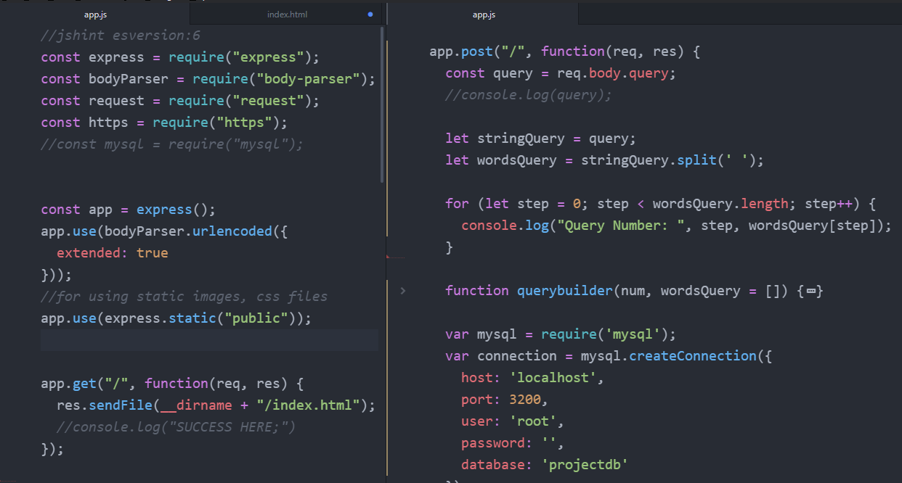
Programming Web App
Since we have used Express.js so we called the function require() to import packages, we called SQL package from here and create and instance of it.
Using createConnection() function we connected the Express and Node Server to the phpMyAdmin Apache Server where our database is hosted.
Using stringQuery.split() function we divided the query into individual components and then reconstruct the SQL query corresponding to it using queryBuilder() function.
This is the query form generated on the client side, the user enter query in general English language and can access database from here. The client side is hosted on the localhost:3000 port.
If the user wants to enter SQL queries or semi SQL queries then the Web App will detect what is expected from the query and will create the corresponding SQL query using Natural Join Operation on multiple tables.

Slide 8
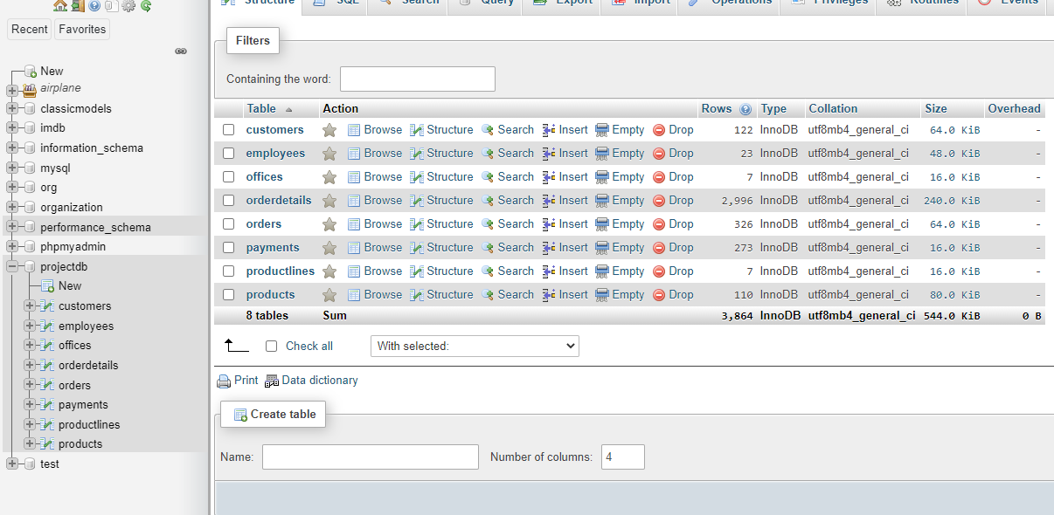
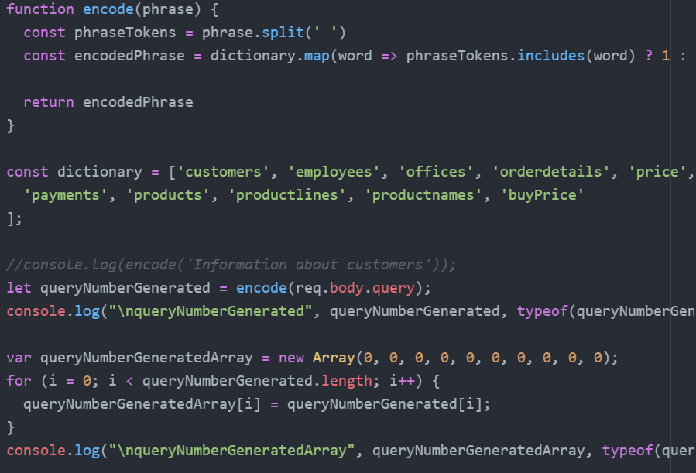
Building the query using Natural Join
How we interpret queries ?
To get the non SQL queries into SQL queries, we used the technique of One-Hot Encoding, in which we first constructed a list of all possible keywords of interests that user can enter like products, prices, due Payments etc and added them in a dictionary.
Each time a user enters a query, those keywords from the dictionary are turned Hot (symbolised as 1) and others are remaining Cold (symbolised as 0) which are not in the query as entered by user.
Based upon the keywords that are turned Hot (or 1) and using the concept of Natural Join, an intermediate dataset is created in JSON format containing the most likely information selected from tables. This information is then sent back to user side from the Express Server as JSON data and can be easily viewed and copied from there.
The database we are working on is of a Company that supplies different products worldwide ranging from Cars, Motorcycles, Ships and Planes.
There are 8 tables in the Database namely, Customers, Employees, Offices, OrderDetails, Payments, Product Lines and Products.

Slide 9
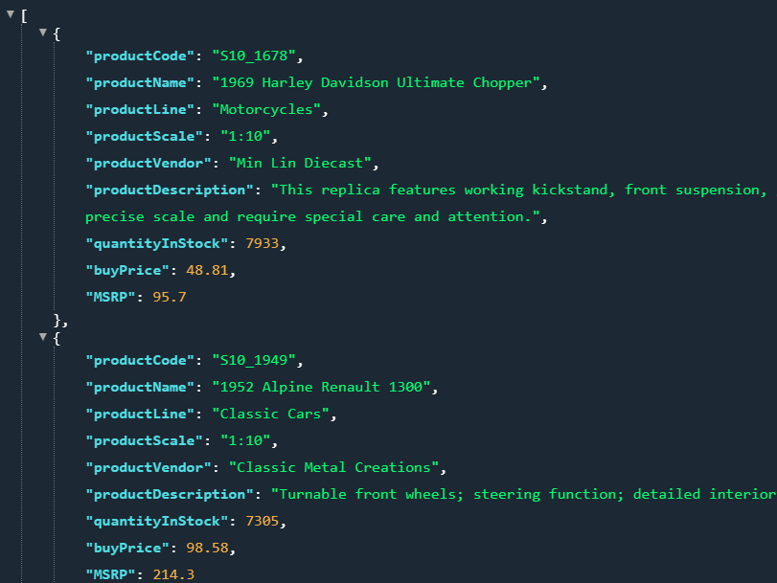
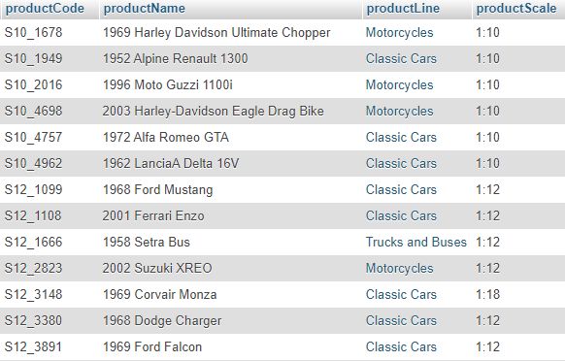
Results
As we can see from the database snippet above, we can enter queries in SQL form, semi SQL form, or even general English sentence, we will always get the information from the Product and Product Lines table.
The Web Application creates Natural Join by the important information extracts the relevant data from the table and show it in JSON format.
We have tested the working on all the tables by entering complicated English statements but the App detects the relevant and important information automatically and projects the corresponding results.
To verify the results of the Web Application we wrote different queries related to the product and product lines tables expecting results from that table.
The app understands the most important Attributes and automatically selects the corresponding Product information from different tables.

Slide 10
CONCLUSION AND LEARNING
We can conclude from the project that SQL queries can be generated from the Semi-SQL and English sentences given that we can reconstruct the meaning of the query using the concepts of Dynamic Query Forms for Database Queries.
We understood the relevance of the Expected Recall and Precision which tells us about how many queries returned by the user are the actual queries that User wants and what proportion of queries are not the actual queries of User interest.
The F-score or F-measure is a measure of a test's accuracy. It is calculated from the precision and recall of the test, where the precision is the number of true positive results divided by the number of all positive results, including those not identified correctly, and the recall is the number of true positive results divided by the number of all samples that should have been identified as positive. This score helps in maintaining the relevance of a particular search within Database.
We understood how we can use Express.js with Node.js to create a Server and also learned how we can integrate SQL database into phpMyAdmin Apache server for communication.
We learned how to approach and understand the Research papers related to DBMS and how we can implement the Database based Servers on LocalHost computer.

Slide 11
Thanks Everyone

