Slide 1
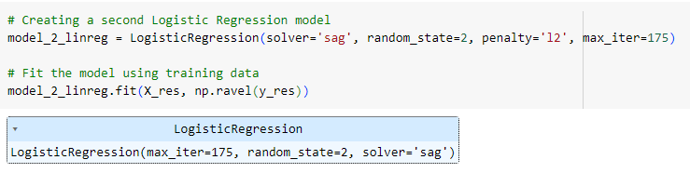
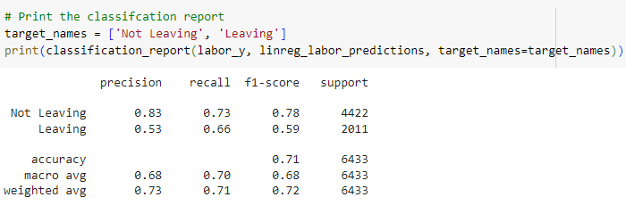
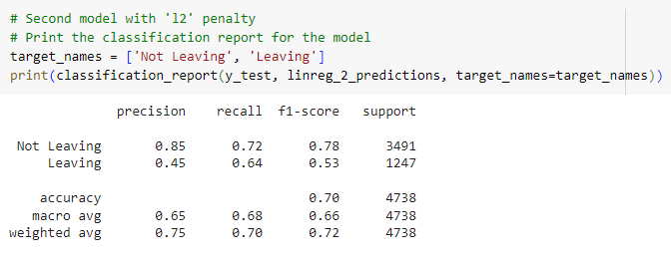
Logistic Regression Model to
Predict Agency Turnover
Initial Model
Testing Outcome, Dept of Labor
Training Outcome, Dept of Commerce

Slide 2
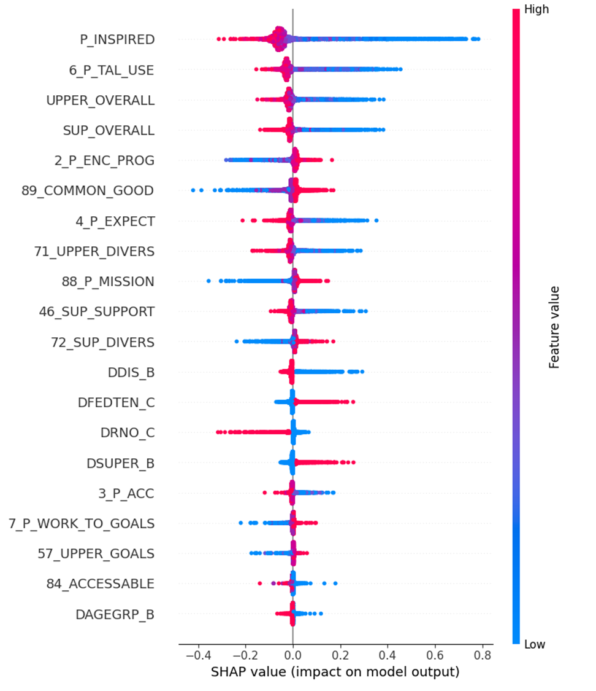
Feature Importance with SHAP
The most features that affected the predictions the most were:
P_INSPIRED – an average of questions 85, 86, and 87
6_P_TAL_USE – asking employees how if their talents are used effectively at work
UPPER_OVERALL – an average of questions about upper management
SUP_OVERALL – an average of questions about supervisors
SHAP Summary Plot

Slide 3

Summary:
After running both logistic regression models and neural networks, the logistic regression model was chosen as the best predictor of employee turnover. The 3 biggest factors of turnover are the employee’s own connection and sense of accomplishment at work, how upper management is perceived, and direct interactions with supervisors.
Questions?

