Slide 1


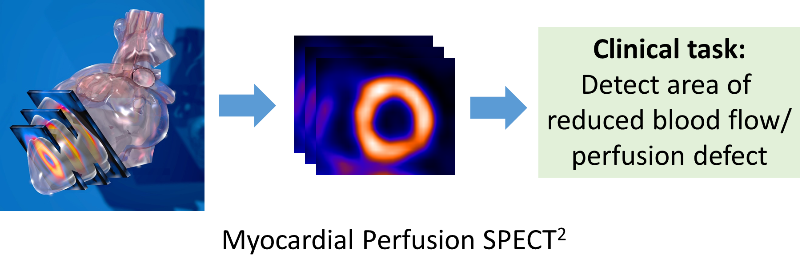
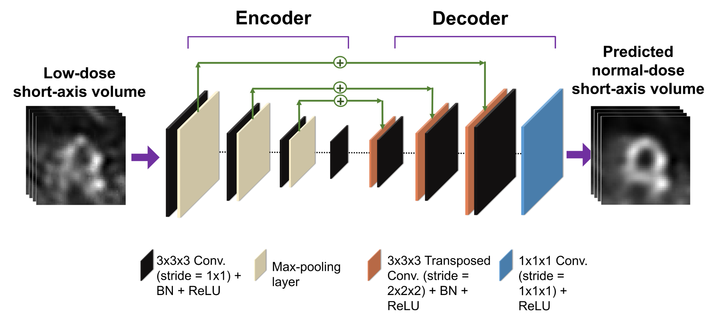
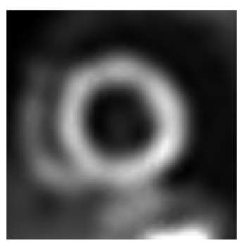
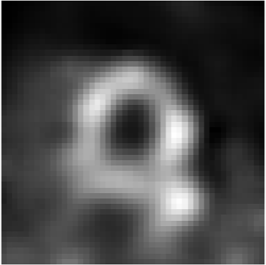
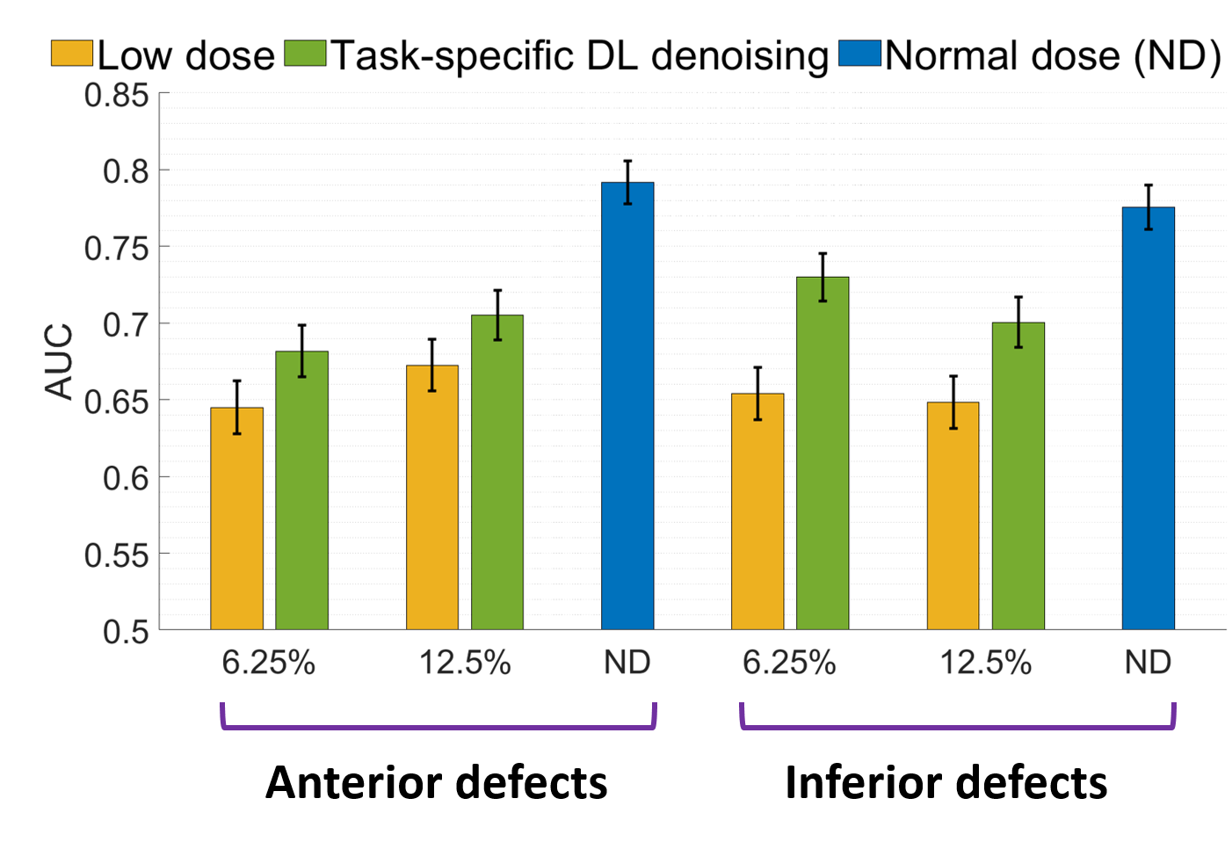




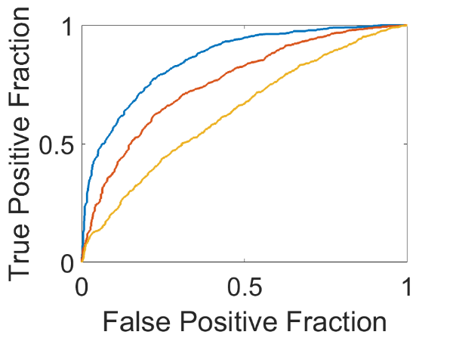
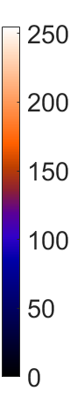




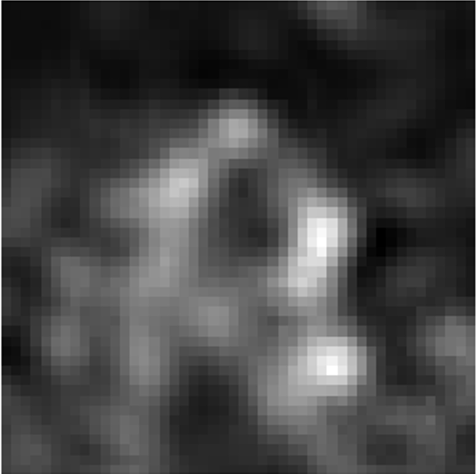




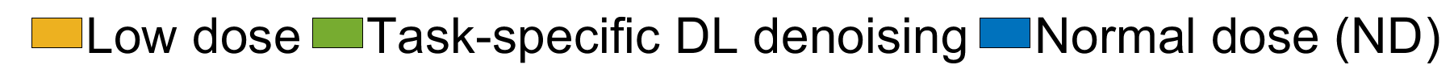
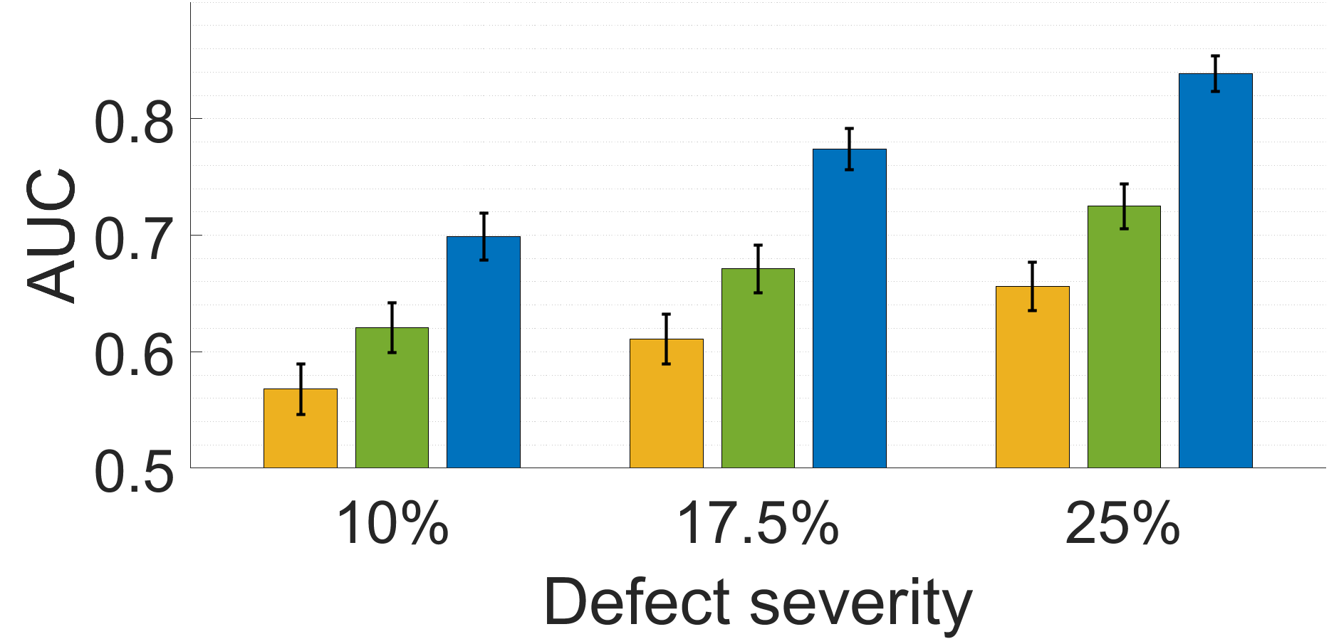
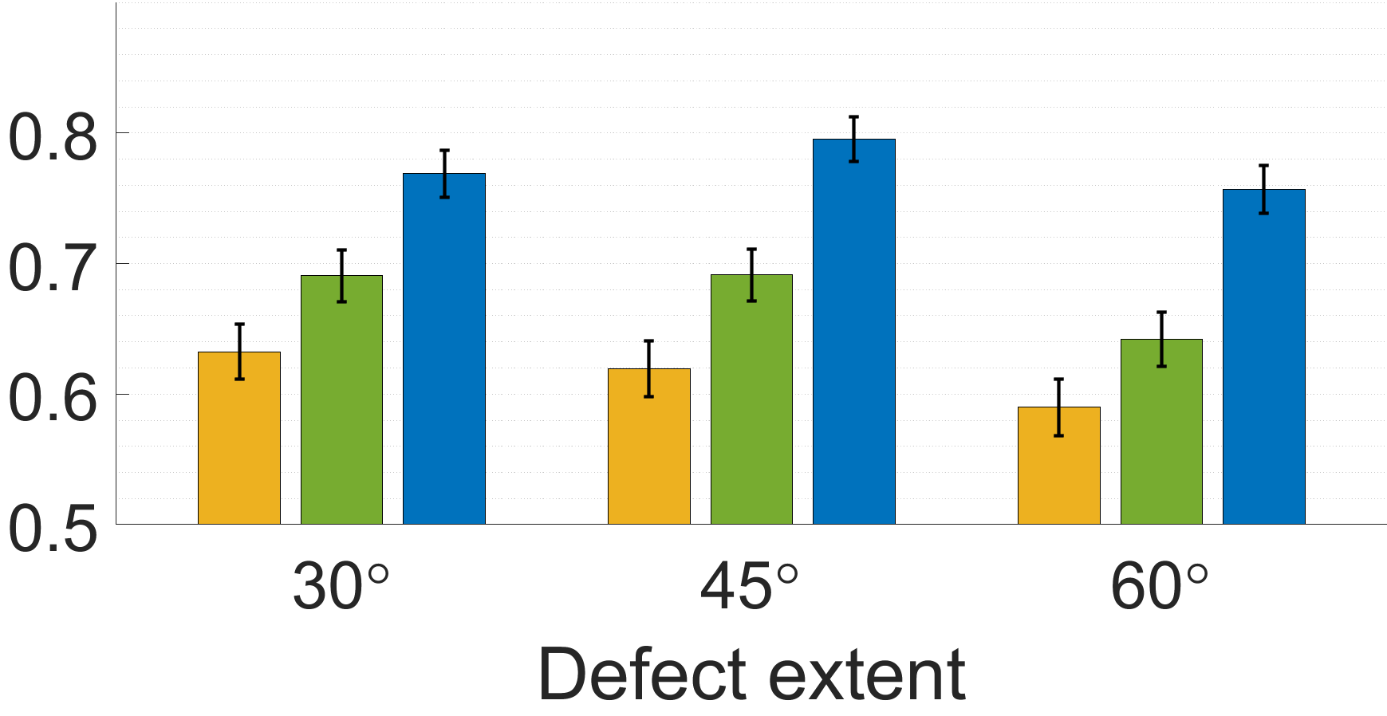
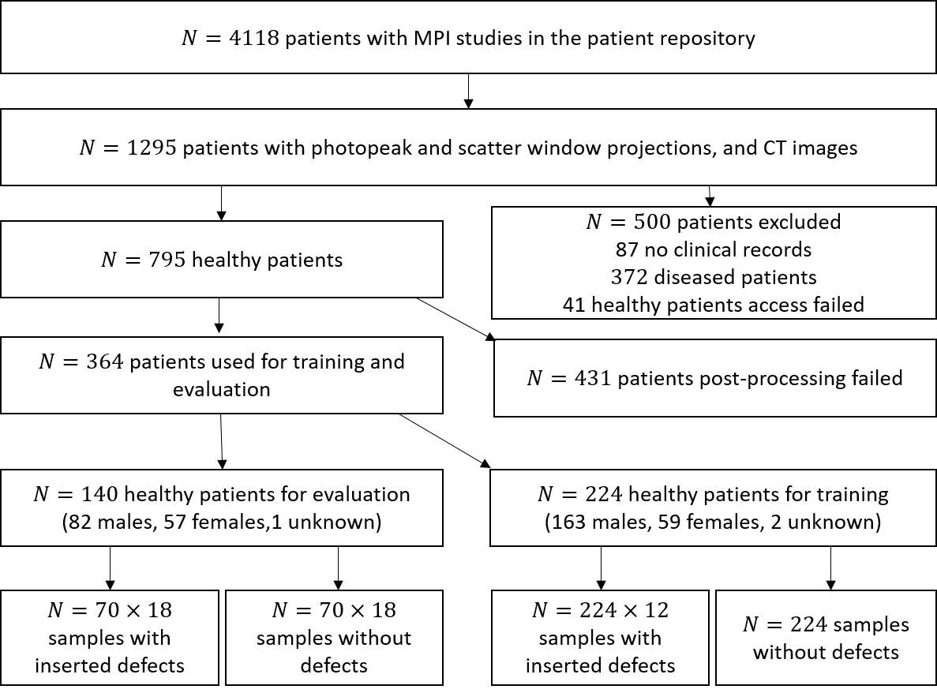
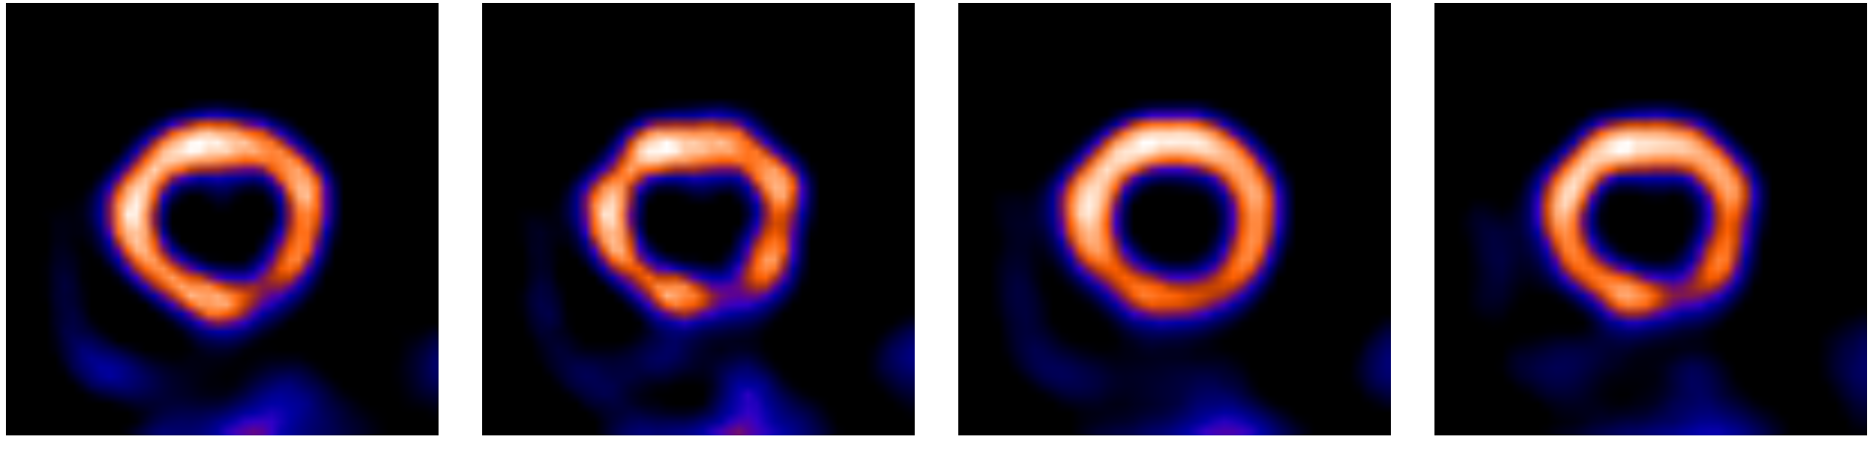
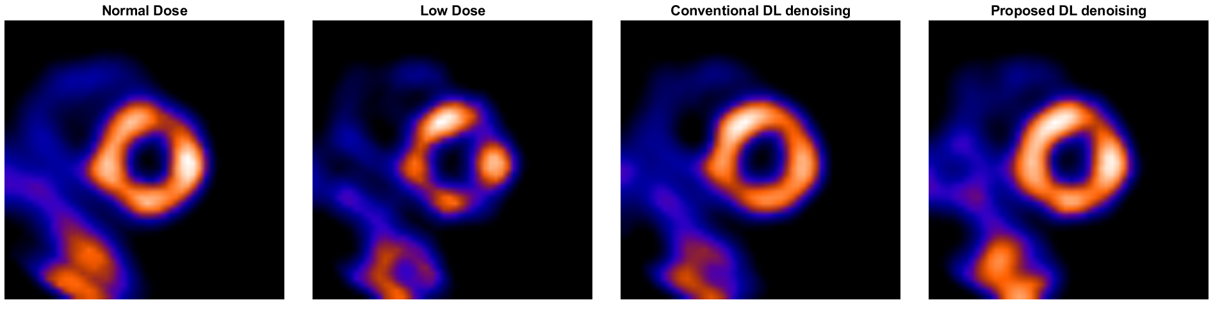
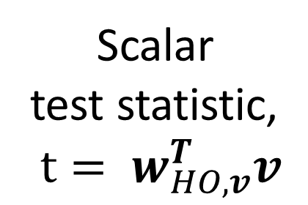

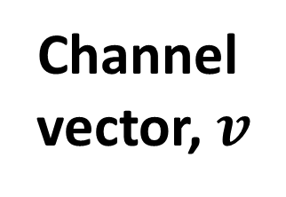
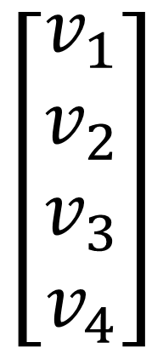
Validation of a task-specific deep-learning-based denoising approach for myocardial perfusion SPECT Md Ashequr Rahman², Zezhang Yang¹, Zitong Yu², Barry A. Siegel³ and Abhinav K. Jha^{1,2,3} ¹Department of Electronic and System Engineering, Washington University in St. Louis, St. Louis, MO, USA
²Department of Biomedical Engineering, Washington University in St. Louis, St. Louis, MO, USA
³Mallinckrodt Institute of Radiology, Washington University in St. Louis, St. Louis, MO, USA
1. Introduction
2. Task-specific deep-learning-based denoising method (DEMIST)
Important need for methods to process myocardial perfusion imaging (MPI) SPECT images at lower dose/acquisition time¹.
Background: Channel mechanism of observer
Proposed denoising method
Human visual system process images through frequency selective channels⁵. Motivated by this fact, channelized Hotelling observers (CHOs) have been proposed.
Frequency selective channels
$$\left[\begin{aligned}v_{1} \\ v_{2} \\ v_{3} \\ v_{4}\end{aligned}\right]$$
Apply Hotelling template, $w_{HO,v}$
Scalar test statistic,
$$t= w_{HO,v}^{T}v$$
Deep-learning-based methods have been developed for this goal, but they have shown limited efficacy on clinical task of defect detection³.
We recently developed DEMIST: A task-specific deep-learning-based denoising method to process low-count MPI-SPECT scans⁴. Here, we expand on the validation of that technique.
Image
Loss function, $ℒ=fidelity loss+λ ∗observer loss$
Channel vector, $v$
Minimizes the mean square error of channel vectors between true normal-dose and predicted normal-dose image
CHO with rotationally symmetric square channels was shown to emulate human-observer performance⁶.
Minimizes the mean square error between true normal-dose and predicted normal-dose image
3. Evaluation of the DEMIST methodology
Evaluation framework
Evaluation results
Qualitative evaluation: Specificity of DEMIST
Normal-dose image
CHO-based model-observer evaluation on defect-detection task
Normal dose
Proposed task-specific DL denoising
Denoised image
Low-dose image
ROC analysis to determine AUC
Low dose
6.25% and 12.5% denote the low-dose levels.
ROC analysis was performed on the test statistics derived with the CHO. The area under the empirical ROC curve (AUC) was used as the figure of merit.
(a)
DEMIST
We observe that multiple false defects are visible in the low-dose scans. DEMIST either removes or mitigates these false defects, resulting in improved specificity compared to low-dose images.
Study design: Data collection and curation
(b)
(c)
4. Conclusion
The DEMIST method significantly improved performance on defect-detection task compared to low-dose images for defects located in anterior and inferior walls of left ventricle (a) over entire population and (b) for all severities considered at 6.25% dose level and (c) for all defect extent.
As per RELAINCE guidelines⁷, the following claim is derived for DEMIST: DEMIST, a deep-learning-based denoising method for myocardial perfusion SPECT yielded statistically significant improved performance compared to the low-dose images on the task of detecting perfusion defects as evaluated using a retrospective clinical study with single-center data and with an anthropomorphic model observer.
Further, we observe in qualitative evaluations that DEMIST also has improved sensitivity and specificity compared to low-dose images The results motivate further evaluation of the method.
Qualitative evaluation: Sensitivity of DEMIST
Normal dose
Low dose
Task-agnostic DL denoising
DEMIST
5. References
Beller et al, J. Nuc. Card. 2010
“Heart SPECT Imaging” by Patrick J. Lynch, licensed under CC BY 2.5, adapted
Li et al., Med. Phys. 2023
Rahman et al., ArXiv. 2023
5. Barrett & Myers, Found. of Image Science 2013
6. Sankaran et al., J. Nucl. Med. 2002
7. Jha et al., J. Nucl. Med. 2022
DEMIST denoising method tend to wash out the defect. The DEMIST method was able to preserve the defect contrast.
Financial support: NIBIB R01-EB031051, R01-EB031962, NSF CAREER award || Contact information: y.zezhang@wustl.edu || Lab website: jhalab.wustl.edu

