Slide 1
Investigations on the model parametrization
How to compute the reflection coefficient curve in regions with and without hydrocarbons.
by Wanderson Ferreira

Slide 2
Final objective
An equation to compute the reflection coefficient as a function of incidence angle:
  Able to model background reflectivity
  Able to model deviations caused by hydrocarbon
Notes:
The main idea of this study is to understand the “error prediction” variables that are introduced to accommodate the hydrocarbon influence in the reflection coefficient when we model the background reflectivity to obey Gardner and Castagna relationships.
If in my inversion scheme I need to iterate on the d(Vs) and d(rho) {the prediction error variables} I will need to know some “physical boundary values” to set in the genetic algorithm scheme. So, I wanted to see how much these variables change for different content of fluid {and percentages} in the rocks.

Slide 3
Outline of the presentation
Verification of Simmons and Backus (1996) implementation of a RC equation incorporating the prediction-error components.
Verification of the order of magnitude of the prediction-error components using fluid substitution.
Conclusions and ideas for future work

Slide 4
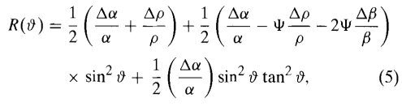
Mathematical description
The development was basically done using Simmons and Backus (1996).
We first start with the classical Aki and Richards (1980) approximation to the Zoeppritz equation:
where Ψ = 4(β/α)² and ν is the averaged angle between incident and transmitted angles.
Notes:
I choose to use the same numbers to the equation as it is used in the original paper. It will make my life easier here and also to look for the equations in the manuscript if needed.
The fractional changes and the local averages background are defined as classically in literature.

Slide 5

Mathematical description
Define a normal-incidence compressional-wave and shear-wave reflection coefficients Rp and Rsh as:
  R_{P} = R_{α} + R_{ρ} and R_{sh} = R_{β} + R_{ρ} (6)
where R_{α} = 1/2(Δα/α), R_{β} = 1/2(Δβ/β) and R_{ρ}=1/2(Δρ/ρ)
Re-writing equation (5) to compute the RC

Slide 6
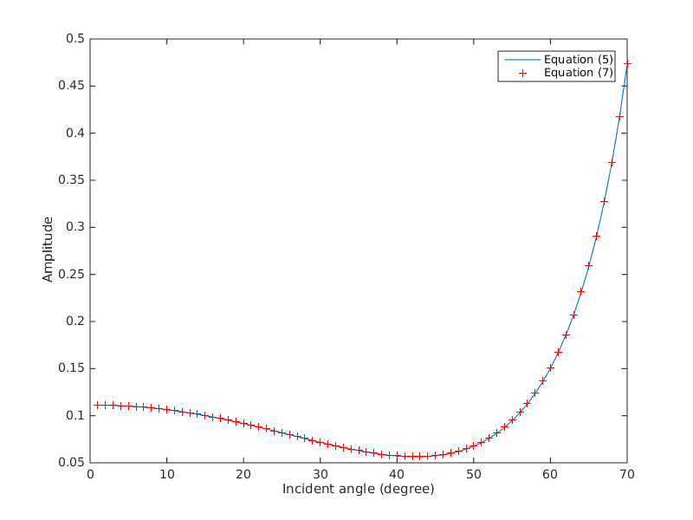
Numerical verification
I questioned if (5) and (7) are really the same as Simmons and Backus (1996) stated.
There are no assumptions about the parameters between equation (5) and (7).
Rock model used:
Vp1= 2500m/s Vp2=2990m/s
Vs1= 982 m/s Vs2=1400m/s
Rho1=2.024 g/cc Rho2= 2.116 g/cc
Notes:
They are the same indeed. When the author said “we define..” I thought he was making an assumption about the behavior of the reflectivity which could lead to differences between equations (5) and (7)

Slide 7

Mathematical description
Now, Gardner et. al, (1974) relationship is introduced in terms of fractional changes (Fatti et. Al, 1994)
(Δα/α)=0.25(Δρ/ρ) or
R_{α} = 0.25 R_{ρ} (8)
The next step is to assume the mudrock curve (Castagna et. Al, 1985)
(9)
where the velocities are in m/s.
In terms of reflectivity, the mudrock curve will be expressed as:
R_{β} = kR_{α}, (10)
where k is 0.86(α/β).

Slide 8

Mathematical description
Using equations (8), (10) and the previous set of equations (6), we can write the reflection coefficient curve in terms only of the normal-incidence compressional-wave reflectivity R_{P} or R_{o} as the paper used.
Equation (18) should hold for rocks following the Gardner and the mudrock curves.
Notes:
In this slide I wrote that Rp and Ro are the same, however in the paper Ro is a new weighted quantity that is unkown and their inversion scheme tries to solve it for.

Slide 9
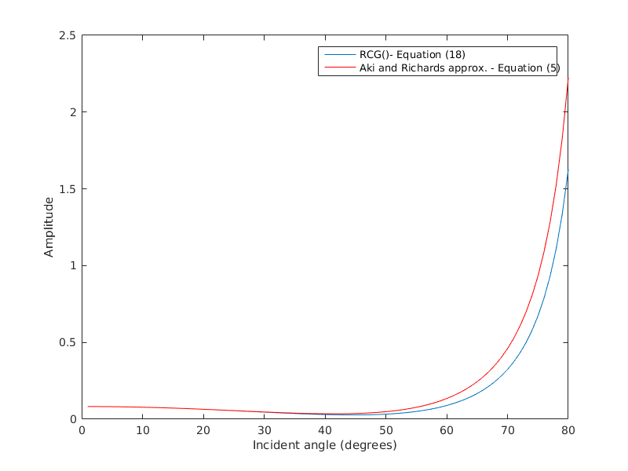
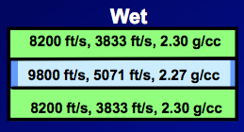
Numerical verification
Model not following Gardner and Castagna curves.
Rock model used:
The reflection is from the top of the reservoir.

Slide 10
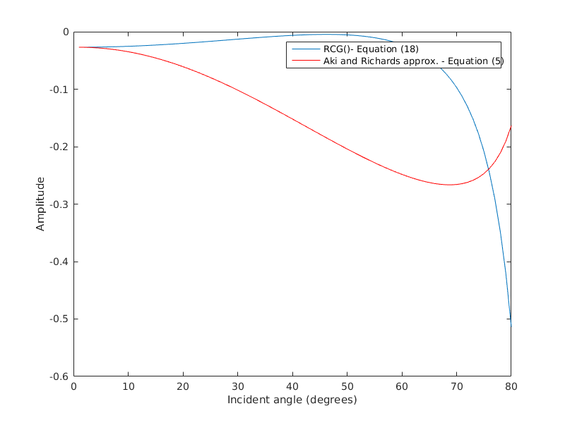
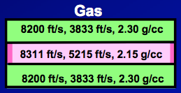
Numerical verification
Model not following Gardner and Castagna curves.
Rock model used:
The reflection is from the top of the reservoir.

Slide 11
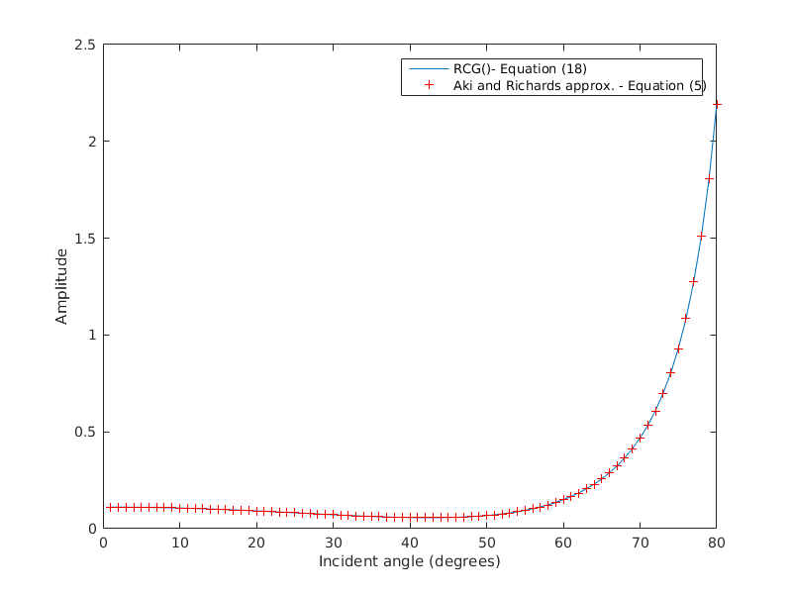
Numerical verification
Model following Gardner and Castagna curves.
Rock model used:
VP (ft/s) | VS (ft/s) | ρ (g/cm³)
8200 | 3222.46 | 2.024
9800 | 4601.77 | 2.116
ρ = 0.2127 V_{P}^{0.25 (Vp in ft/s)}
V_{S} = (1360 – V_{P})/1.16 ^{(Vp in m/s)}

Slide 12
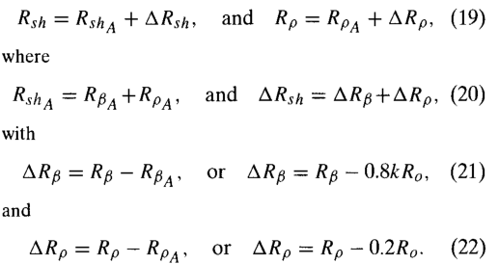
Mathematical description
Presence of hydrocarbon produces deviations from background reflectivity (modeled with equation (18))
To account for these effects R_{SH} and R_{ρ} from equations (6) {slide 5} are re-written adding the prediction-error components ΔR_{SH} and ΔR_{ρ} by the following couple of equations.

Slide 13
Small explanation – What are these prediction-error components?

Slide 14

Mathematical description
Developing the Aki and Richards approximation using the new definitions of shear-wave reflectivity and the density contribution we get:
That is finally the function that will be used in the inversion scheme.
In the next slides, I will show a study using the implementation of Gassmann's equation for fluid substitution that I implemented based on Smith (2003) and Batzle and Wang (1992) to verify the order of magnitude of the prediction-error components when increasing the amount of hydrocarbon in a rock.

Slide 15
Required parameters for Fluid Substitution
Mineral Matrix portion
Shale volume = 0
Pressure = 3200 psi
Initial water saturation = 1
Temperature = constant at 150ºC
Salinity = 3800 ppm
Porosity = 10%
GOR (L/L) = 160
Oil Gravity (rho_o) = 42
Gas Gravity (rho_g) = 0.9
Water or Brine
Hydrocarbon portion
Mineral Matrix portion
Water/Brine new
Hydrocarbon portion new

Slide 16
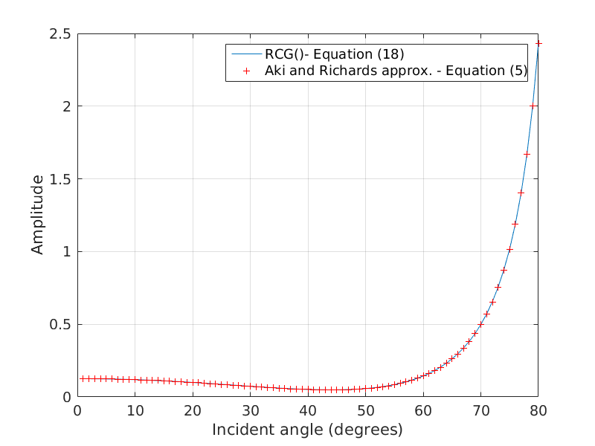
Gas Example – Step 1
Following Gardner and Castagna
9000ft/s, 3912ft/s, 2.24g/cc
11000ft/s, 5636ft/s, 2.35g/cc
ΔR_{ρ} | ΔR_{SH}
-1.5*10⁻⁵ | -1.3*10⁻³

Slide 17
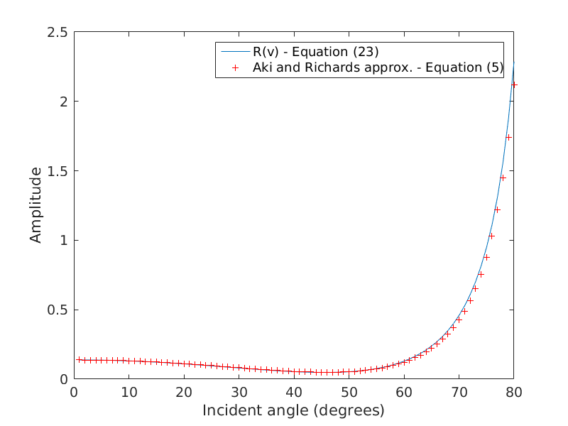
Gas Example – Step 2
WS: 100% of brine
9000 ft/s, 3912ft/s, 2.24 g/cc
10730ft/s, 5497.8ft/s, 2.478g/cc
ΔR_{ρ} | ΔR_{SH}
1.588*10⁻² | -2.43*10⁻³

Slide 18
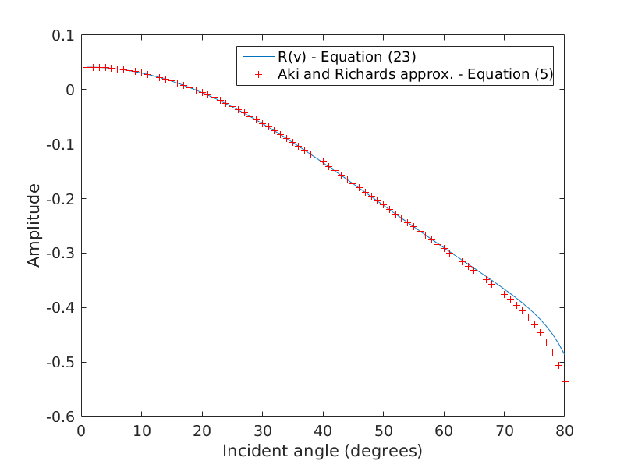
Gas Example – Step 3
WS: 80% of brine, 20% gas
9000 ft/s, 3912ft/s, 2.24 g/cc
8889.7ft/s, 5514.6ft/s, 2.463g/cc
ΔR_{ρ} | ΔR_{SH}
-5.70*10⁻³ | -4.68*10⁻²

Slide 19
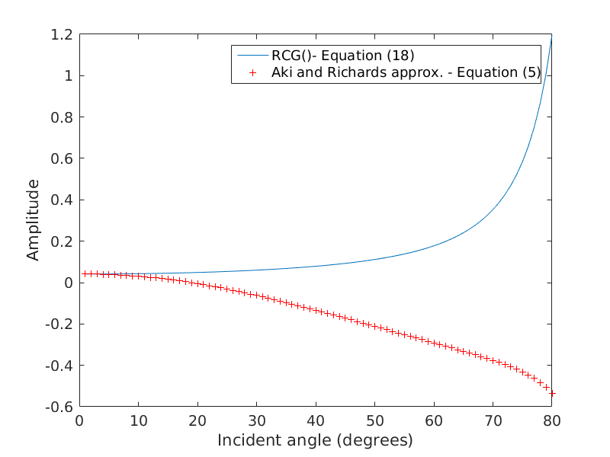
Gas Example – Step 3
WS: 80% of brine, 20% gas
9000 ft/s, 3912ft/s, 2.24 g/cc
8889.7ft/s, 5514.6ft/s, 2.463g/cc
ΔR_{ρ} | ΔR_{SH}
-5.70*10⁻³ | -4.68*10⁻²

