Slide 1
Smart Devices
And Access Control

Slide 2
GROUP MEMBERS
 | NAME | REG NO
 | Irumba Paul | 2021/HD05/2293U
 | Wenareeba Innocent | 2021/HD05/2315U
 | Businge Joshua Muleesi | 2021/HD05/2289U
 | Bukenya Andrew | RegNo 2021/HD05/2288U

Slide 3
What is a smart device?
A smart device, is an electronic gadget that has ability to connect to a network, share resources and interact remotely with its user and other smart devices
Several notable types of smart devices are smartphones, smart cars, smart thermostats, smart doorbells, smart locks, smart refrigerators, phablets and tablets, smartwatches, smart bands, smart key chains, and many others.
What is smart access control
Smart access control devices takes mobile phones , smart phones , tablets , and wearable electronic devices and allows them to function as users credentials to enter office or business facilities . Smart devices also enable biometric authentication.

Slide 4
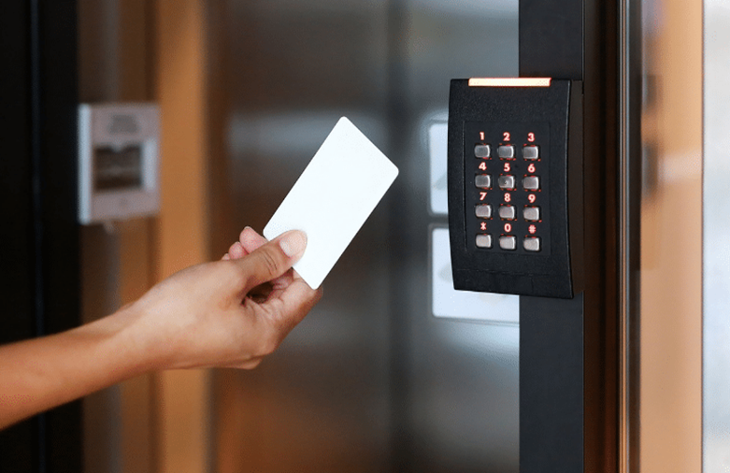
How Smart Mobile Devices access control works
In the majority of cases, device access control is powered by Bluetooth, nfc , wifi , devices to easily communicate
Smart Card Access , is where smart cards are used to access premises such as banks , or corporate offices , the smart cards control access to premises and limit it to only employees or users who have authenticated cards to gain access.

Slide 5
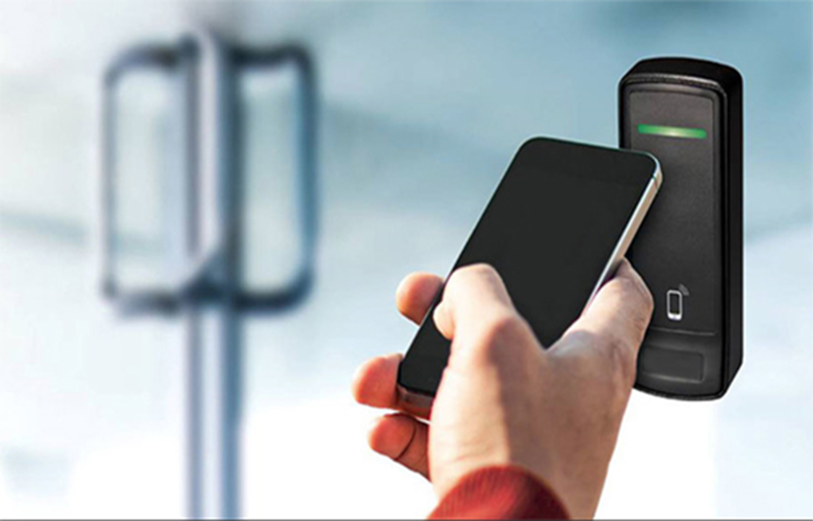
MOBILE ACCESS CONTROL
Mobile access credentials For many reputable institutions, controlling access to office spaces can be a big concern. With mobile access credentials , it enables employees , to be granted access to a certain physical location , with just a few clicks on their phone, all access is managed in the cloud allowing an administrator to allow or revoke mobile credentials.

Slide 6
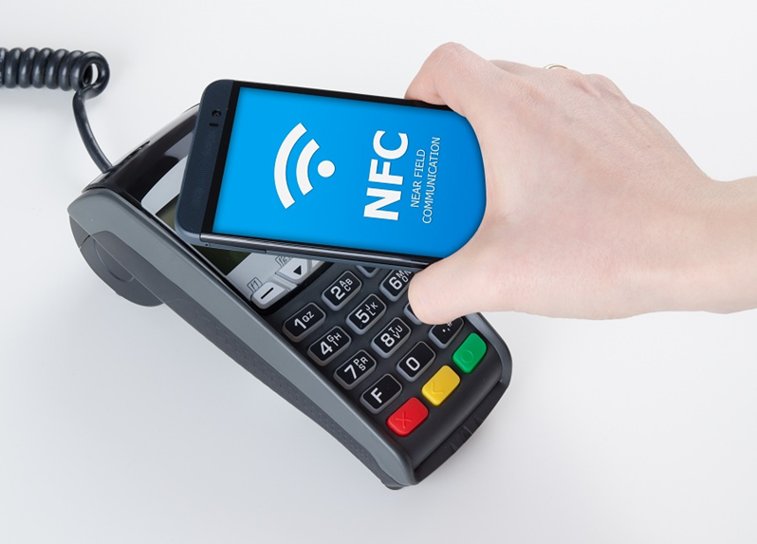
NFC (near field communication) technology is often applied in mobile access control. It is commonly used for payments but it works within a small range .

Slide 7
The future of access control in smart devices.
With the current rise in the technology adoption , the smart devices are becoming more common than ever before , the fact that technology simplifies most of the operations , of the human race , its clear that smart devices are now the future.
Access control of any technology is one of the key things that is to be put into consideration , and this is being solved by the smart devices where for a user to be able to access the service or get access to a building , they have to have the right permissions and this is device specific , this has made it a technology of choice since also it can be automated

