Slide 1
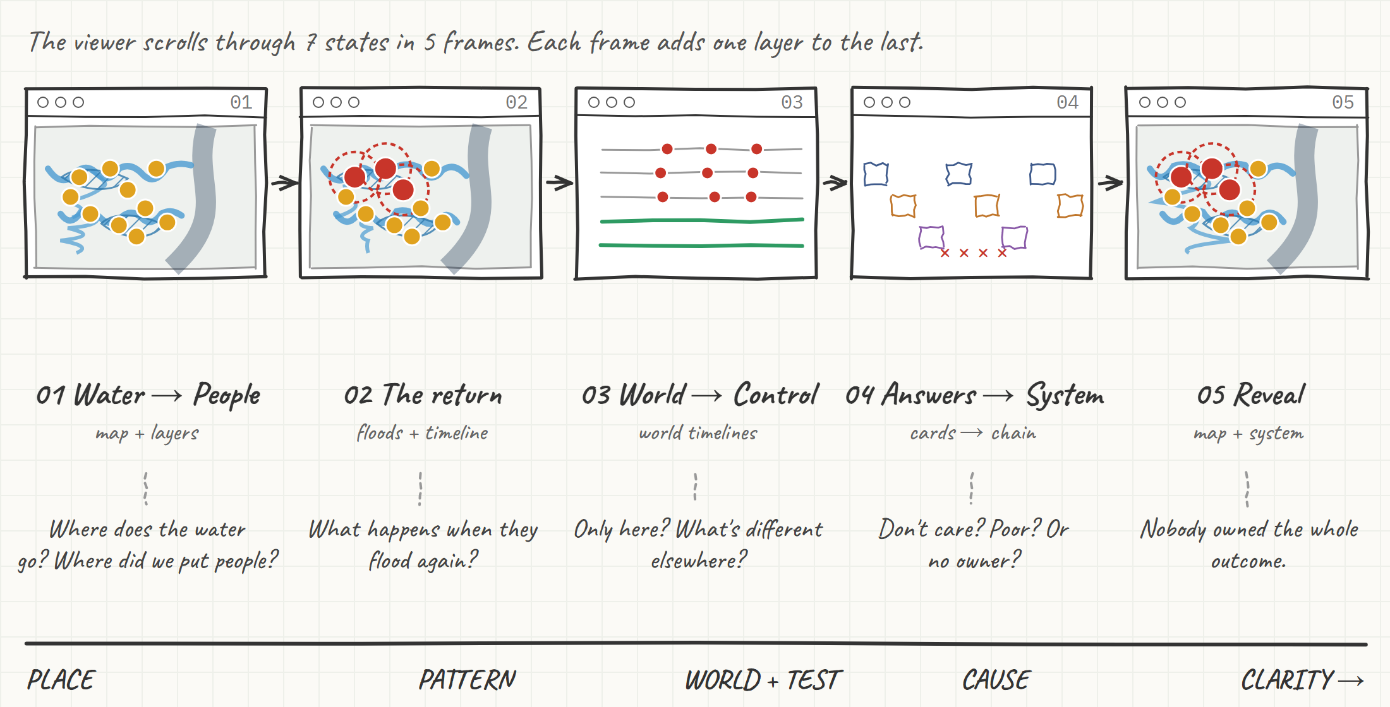
Who owns the flood?
Hollie & Wandile · Harvard GSD MDE · wireframes v1
The flow: 7 states in 5 frames. Scroll, and each frame adds one layer.
Notes:
WHAT THE VIEWER DOES: Scrolls. Each scroll adds one layer. No clicking needed.
HOW THE STORY BUILDS: A place, then a pattern, then the world, then a test, then the cause.
WHAT THEY LEAVE WITH: “The information existed. Nobody owned the outcome.”

Slide 2
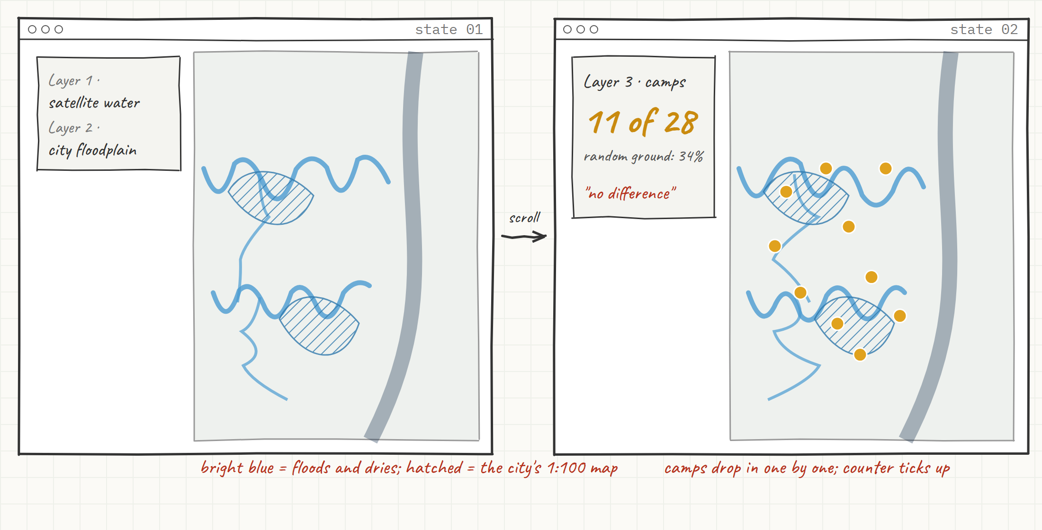
01 · Water → People
Hollie & Wandile · Harvard GSD MDE · wireframes v1
Where does the water go? Where did we put people?
Notes:
SEES FIRST: Durban from space. Satellite water, then the city's own 1-in-100-year floodplain.
WHAT CHANGES: Scroll, and 28 amber camps drop onto the map. A stat card counts them.
TAKEAWAY: Camps land on flood ground about as often as chance (11 of 28, 39%, vs 34% of random ground; binomial p = 0.34). The flood map made no difference.

Slide 3
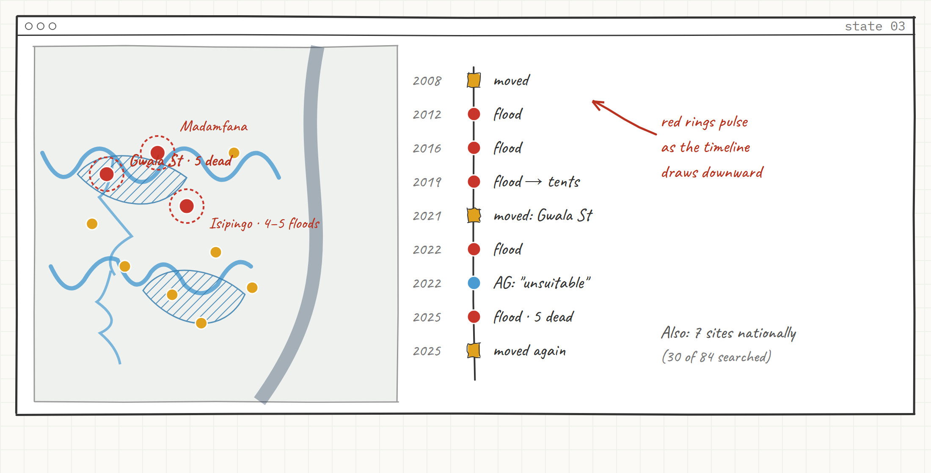
02 · The return
Hollie & Wandile · Harvard GSD MDE · wireframes v1
What happens when the people we moved flood again?
Notes:
SEES: The same map. The water pulses back over 3 camps (Gwala St, Madamfana, Isipingo).
WHAT CHANGES: A timeline builds beside it: moved, flooded, moved, flooded, 5 dead (Feb 2025).
TAKEAWAY: It isn't one bad flood. It's a loop along the same river. 7 sites nationally (30 of 84 searched).

Slide 4
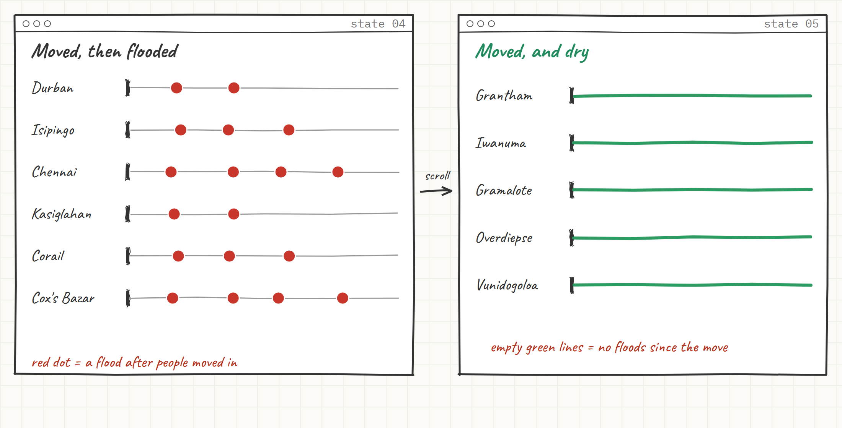
03 · Comparison → Control group
Hollie & Wandile · Harvard GSD MDE · wireframes v1
Is this uniquely South African? So what is different?
Notes:
SEES: Zoom out to timelines of relocation sites worldwide (Chennai, Kasiglahan, Corail, Cox's Bazar). Red dots are floods after the move.
WHAT CHANGES: Scroll, and the control group slides in (Grantham, Iwanuma, Gramalote, Overdiepse, Vunidogoloa): green lines, no dots.
TAKEAWAY: Same rain, different outcome. Something in how they're run differs.

Slide 5
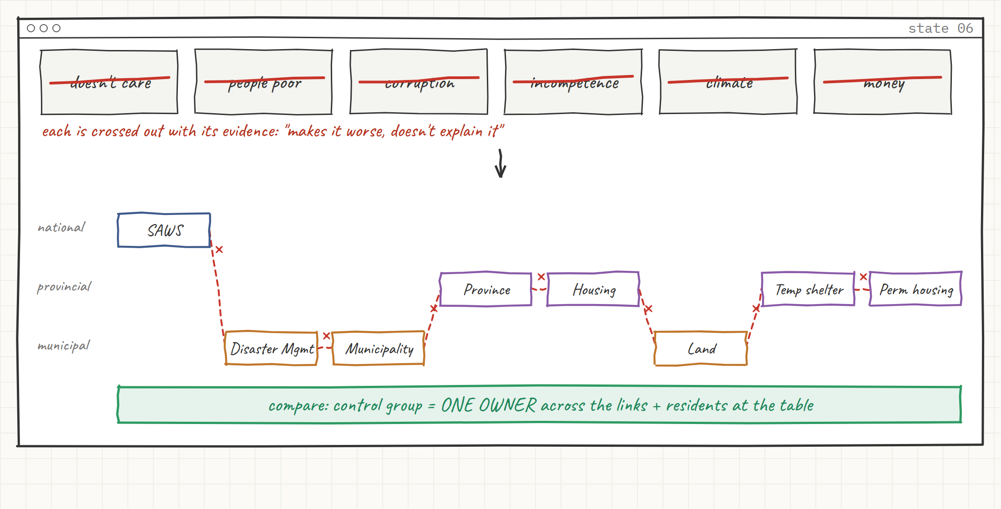
04 · Usual answers → The system
Hollie & Wandile · Harvard GSD MDE · wireframes v1
Is it that they don't care? That people are poor?
Notes:
SEES: Six usual answers as cards (doesn't care, people are poor, corruption, incompetence, climate, money), each crossed out with its evidence: makes it worse, doesn't explain it.
WHAT CHANGES: The cards clear. South Africa's chain draws itself: SAWS, Disaster Mgmt, Municipality, Province, Housing, Land, Temporary shelter, Permanent housing. 8 links, 3 spheres, x at every hand-off.
TAKEAWAY: Different institutions, budgets and authority. No end-to-end owner. Compare: the control group has ONE owner plus residents at the table.

Slide 6
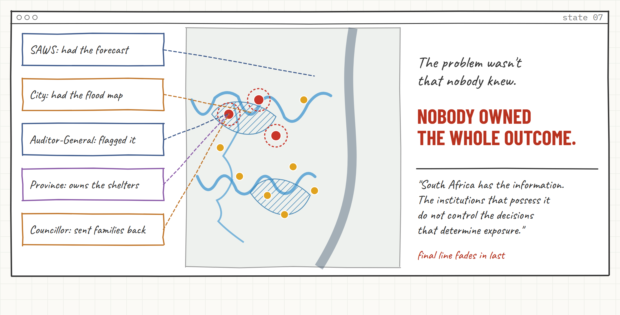
05 · The reveal
Hollie & Wandile · Harvard GSD MDE · wireframes v1
The problem wasn't that nobody knew.
Notes:
SEES: The first map returns, with the system drawn over it.
WHAT CHANGES: Each holder of information lights up: SAWS had the forecast, the city had the flood map, the Auditor-General flagged the site, the province owns the shelters, the councillor sent families back. None is connected to the camp.
TAKEAWAY: “South Africa has the information. The institutions that possess it do not control the decisions that determine exposure.”

