Slide 1
Who owns the flood?
2000
A sketch deck of the interaction states and the first prototype of our data visualization.
Hollie & Wandile · Harvard GSD MDE · Sept 2026
2010
Each vertical line is one of South Africa's 75 dated “temporary” relocation sites. It runs from the year the site opened to 2026. Pink = opened for flood survivors. Red = flooded again after people moved in (7 sites; 30 of 84 searched).
2020
Source: SA TRAs 2022-2026 site list; reflooding sweep (data/tra_sites_exposure.csv)
2026

Slide 2
03 · MOCK-UP · PROJECT INTERACTION ACROSS STATES
Hollie & Wandile · Harvard GSD MDE
Seven states, one scroll
01
02
03
04
05
06
07
The response
Add the flood map
Ground truth
Not just a map
Only South Africa?
What changes?
The reveal
Geography
Evidence
People
Institutions
Comparison
Systemic reveal
The viewer scrolls. Each state adds one layer to the last: the map, then the evidence, then the people, then the institutions behind it, then the world, and finally the reveal.
2

Slide 3
03 · MOCK-UP · STATE 1 OF 7
Hollie & Wandile · Harvard GSD MDE
Frame 1 — The response
01
eThekwini (Durban)
relocation sites (TRAs / TEAs)
After the 2022 floods, government identified and relocated displaced residents.
Indian Ocean
INTERACTION
The map loads. Relocation sites fade in one by one as the viewer scrolls.
black dot = relocation site
frame 1 2 3 4 5 6 7
3

Slide 4
03 · MOCK-UP · STATE 2 OF 7
Hollie & Wandile · Harvard GSD MDE
Frame 2 — Add the flood map
02
LAYERS
1:100 floodline
1:50 floodline (not yet)
Same map. Add the city's 1:100 floodline (1:50 not yet obtained).
Indian Ocean
INTERACTION
Toggle the floodline layer. Relocation sites become visible against known flood risk.
Are these places actually safer?
sites light up where they touch the floodline
hatched = eThekwini 1:100 floodplain (open data)
frame 1 2 3 4 5 6 7
4

Slide 5
03 · MOCK-UP · STATE 3 OF 7
Hollie & Wandile · Harvard GSD MDE
Frame 3 — Ground truth
03
Some relocated communities experienced flooding again. Gwala St (Lamontville), Isipingo and Madamfana are documented Durban examples; nationally, 7 sites (30 of 84 searched).
photo: Gwala St, 2022
photo: Isipingo
“We have been moved from one place to another.”
Indian Ocean
INTERACTION
Zoom into a site: photographs, testimony and the flood incidents open in a side panel.
resident, GroundUp (headline)
INCIDENTS AT THIS CAMP
2019
2022
flood
flood
2008
2021
2025
moved
moved
5 dead
frame 1 2 3 4 5 6 7
5

Slide 6
03 · MOCK-UP · STATE 4 OF 7
Hollie & Wandile · Harvard GSD MDE
Frame 4 — This is not just a map problem
fades as it moves down the chain
04
risk information
national
SAWS
The risk information exists, but it passes through a fragmented decision chain.
×
provincial
Province
×
Human Settlements
Temporary housing
×
Permanent housing
INTERACTION
×
×
×
Pull back from the sites. The chain draws itself link by link; a red x appears at every hand-off.
municipal
Disaster Mgmt
×
Municipality
Land
8 links · 3 spheres · 7 hand-offs · 0 end-to-end owners
frame 1 2 3 4 5 6 7
6

Slide 7
03 · MOCK-UP · STATE 5 OF 7
Hollie & Wandile · Harvard GSD MDE
Frame 5 — Is this only South Africa?
Failure-like systems
Different architectures
05
dash = move-in; red = flood after the move
2000
International cases: failure-like systems on the left, different architectures on the right.
2010
INTERACTION
Scroll: red flood marks drop onto each timeline after the move. The right-hand timelines stay clean.
2020
South Africa
Chennai
Kasiglahan
Corail-Canaan
Cox's Bazar
Bentiu
Mozambique
Grantham
Vunidogoloa
Iwanuma
Overdiepse
Gramalote
frame 1 2 3 4 5 6 7
7

Slide 8
03 · MOCK-UP · STATE 6 OF 7
Hollie & Wandile · Harvard GSD MDE
Frame 6 — What changes?
06
Failure pattern
Compare the two decision architectures.
Information
Multiple institutions
Fragmented authority
Temporary solution
Repeated exposure
loops back after the next flood
INTERACTION
The two flows animate in parallel. The failure flow loops back on itself.
Alternative pattern
Government owner
Land + budget + authority
Residents participate
Risk information is binding
Long-term settlement
✓ stays dry
Separates the cases: one owner (0% vs 90%), residents choose the site (0% vs 90%), binding flood maps (8% vs 100%).
frame 1 2 3 4 5 6 7
8

Slide 9
03 · MOCK-UP · STATE 7 OF 7
Hollie & Wandile · Harvard GSD MDE
Frame 7 — The reveal
07
SAWS
had the forecast
Return to the original Durban map, with the system drawn over it.
City
had the flood map
Indian Ocean
INTERACTION
Auditor-General
flagged the site
Each institution lights up and links to what it knew. None connects to the decision about the site.
Why are people living in dangerous places?
Who owns the decision that determines where they live?
Province
owns the shelters
South Africa has the information. The institutions that possess it do not control the decisions that determine exposure.
Councillor
sent families back
frame 1 2 3 4 5 6 7
9

Slide 10
04 · PROTOTYPE DATA VISUALIZATION
Hollie & Wandile · Harvard GSD MDE
What are we actually building?
An interactive scroll story that moves between:
Geography
Evidence
People
Institutions
Comparison
Systemic reveal
frames 1-2
frames 2-3
frame 3
frame 4
frames 5-6
frame 7
HIGH-FIDELITY FIRST PROTOTYPE
Frame 2: the eThekwini map with relocation sites and floodline data.
Why this frame first: it uses our actual dataset (84 sites, the city floodplain, 300 random comparison points) and it establishes the visual language of the whole project: map, points, layers.
10

Slide 11
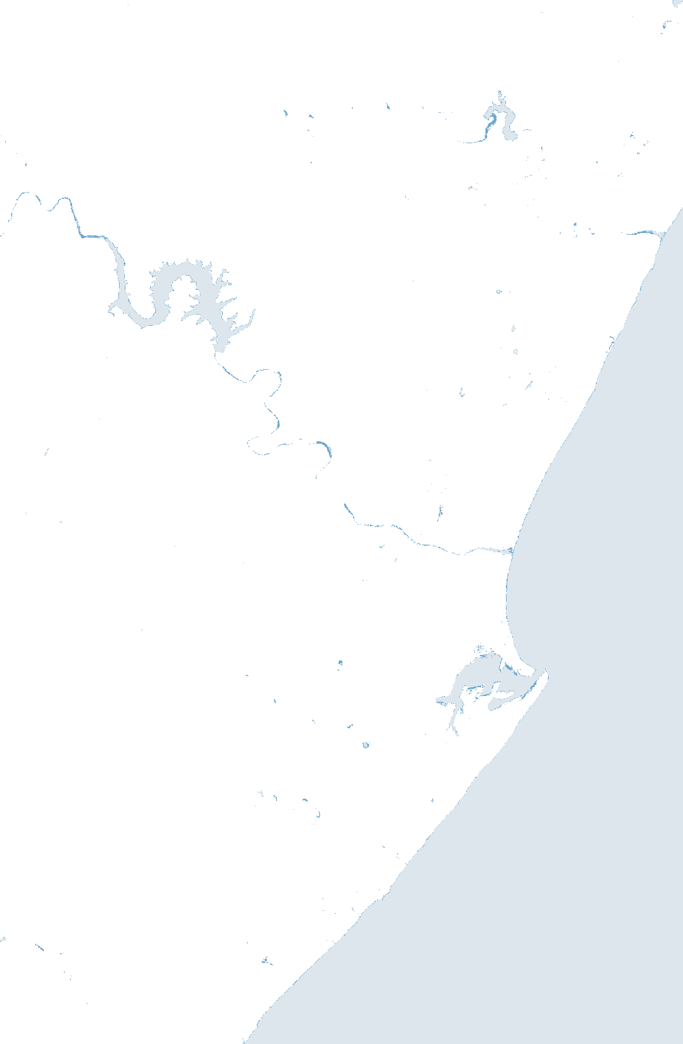
04 · PROTOTYPE · HIGH-FIDELITY FRAME 2
Hollie & Wandile · Harvard GSD MDE
Are these places actually safer?
LAYERS (toggle)
Satellite water, 1984-2021
1:100 floodline
Relocation sites
Documented reflooding
INANDA
1:50 floodline (not yet)
Madamfana
11 of 28
Durban relocation sites inside the city's 1:100 floodplain or within 250 m of it.
PINETOWN
DURBAN CBD
Random ground across Durban: 34%.
The flood map made no difference to where people were put (binomial p = 0.34).
Gwala St, Lamontville
site inside / within 250 m of floodplain
UMLAZI
site farther away
Isipingo
flooding documented after the move
10 km
11
Data: eThekwini Flood Plain 100yr (open data); JRC Global Surface Water 1984-2021; SA TRAs 2022-2026 site list (28 Durban sites with coordinates, +/-1-3 km); 300 seeded random points. methods/scripts/build_tra_exposure.ps1

Slide 12
04 · PROTOTYPE
Hollie & Wandile · Harvard GSD MDE
Core visual typology
Map
Points
Layers
Flow diagram
Comparison matrix
= geography / exposure
= people / sites
= evidence
= institutional responsibility
= system architecture
One visual language across the scroll: geography and evidence are layered on the map, then the story pulls back to flows (who is responsible) and a matrix (how the systems compare).
12

