Slide 1
Research Update Platelet Rolling and the Addition of RBCs
Elizabeth Pumford 23/5/18

Slide 2
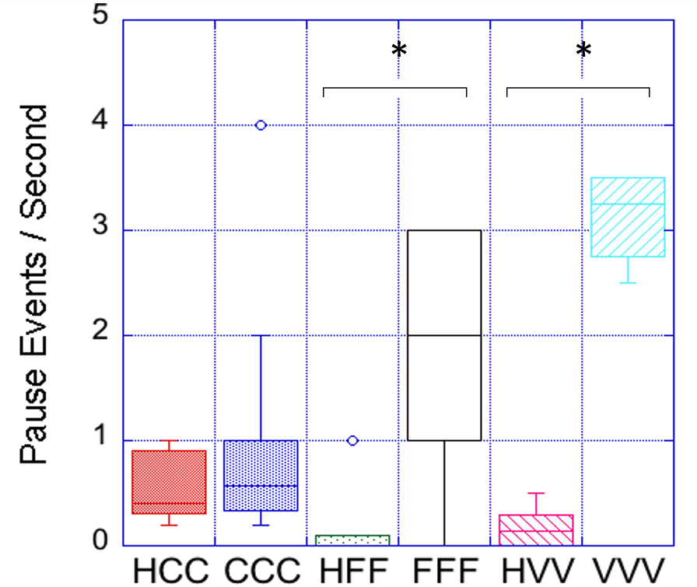

Slide 3
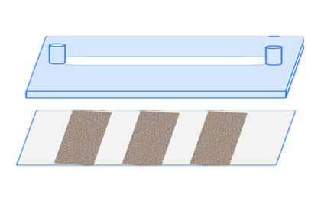
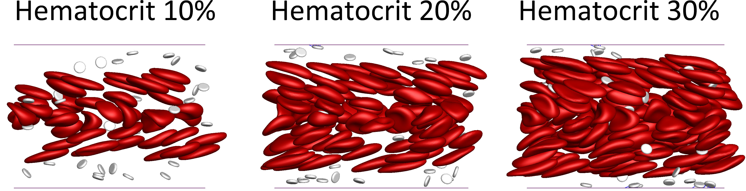
Hematocrit Experiments:
Same platelet concentration
Varied % hematocrit
0%, 15%, 25%, 50%
Changes ratio of platelets to RBCs
Hemodilution Experiments:
Whole blood diluted to different factor
0x, 2x, 4x, 5x
Ratio of platelets to RBCs remains constant
C C C
Biophys J. 2016 Aug 9; 111(3): 577–588.

Slide 4
Hematocrit Experiments
Blood concentration: ~2.1 million RBC/µL
2.5x10⁷ platelets/mL
0% original hematocrit [0 RBC/mL]
15% original hematocrit [31,500,000 RBC/mL]
25% original hematocrit [52,500,000 RBC/mL]
50% original hematocrit [105,000,000 RBC/mL]
Platelet-to-RBC ratio varies
0% | 1 : 0
15% | 1 : 1.26
25% | 1 : 2.1
50% | 1 : 4.2
Notes:
3.46 million rbc/ul prior to replacing removed PRP

Slide 5
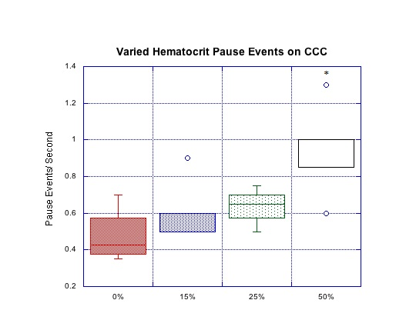
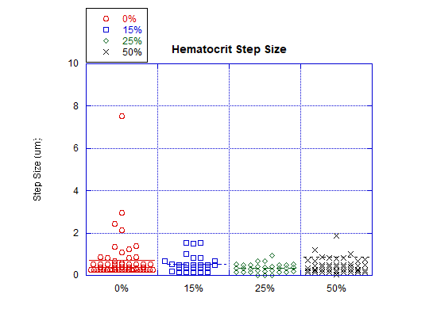
Platelet-to-RBC ratio
0% | 1 : 0
15% | 1 : 1.26
25% | 1 : 2.1
50% | 1 : 4.2

Slide 6
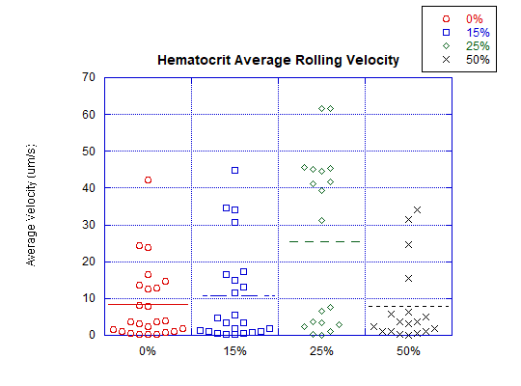
Platelet-to-RBC ratio
0% | 1 : 0
15% | 1 : 1.26
25% | 1 : 2.1
50% | 1 : 4.2
Notes:
0% vs 25% significant with p value 0.002

Slide 7
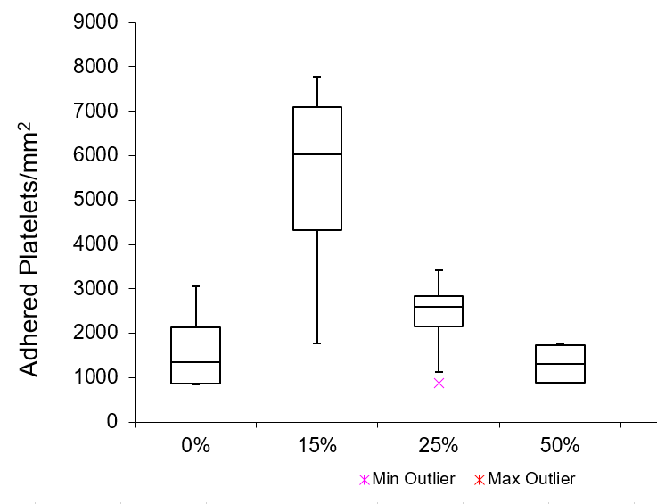
Number of adhered platelets per mm² following 5 minute perfusion
Platelet-to-RBC ratio
0% | 1 : 0
15% | 1 : 1.26
25% | 1 : 2.1
50% | 1 : 4.2

Slide 8
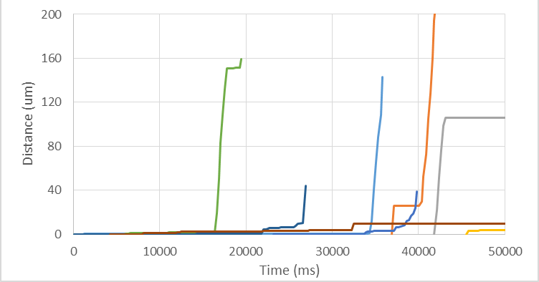
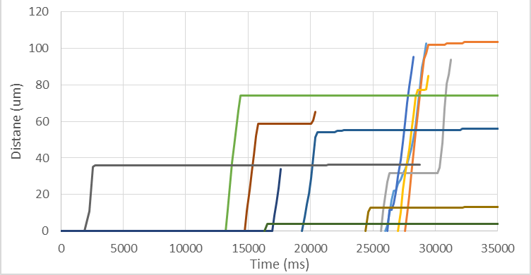
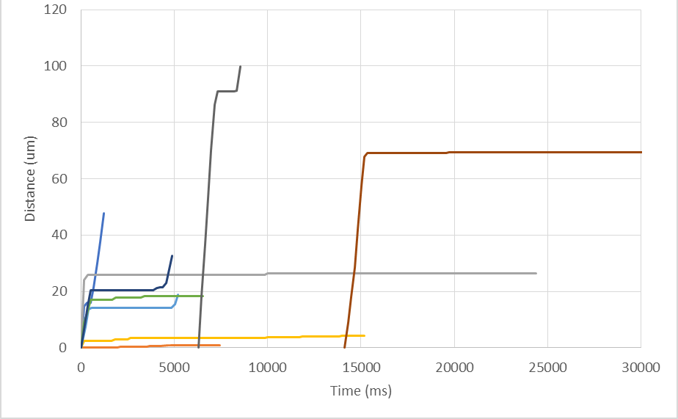
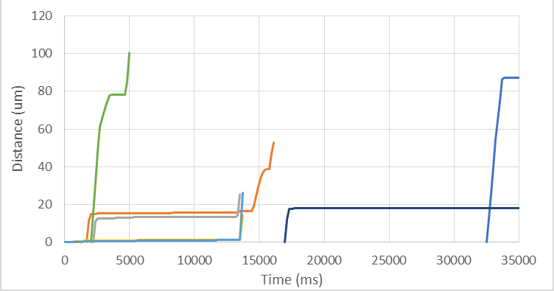
0%
15%
25%
50%

Slide 9
Whole blood dilution
100% of platelets fluorescently labeled for 2x, 4x, 5x dilutions
50% of platelets labeled for 1x dilution
1x dilution
2x dilution
4x dilution
5x dilution
Platelet-to-RBC ratio remains constant 1:1

Slide 10
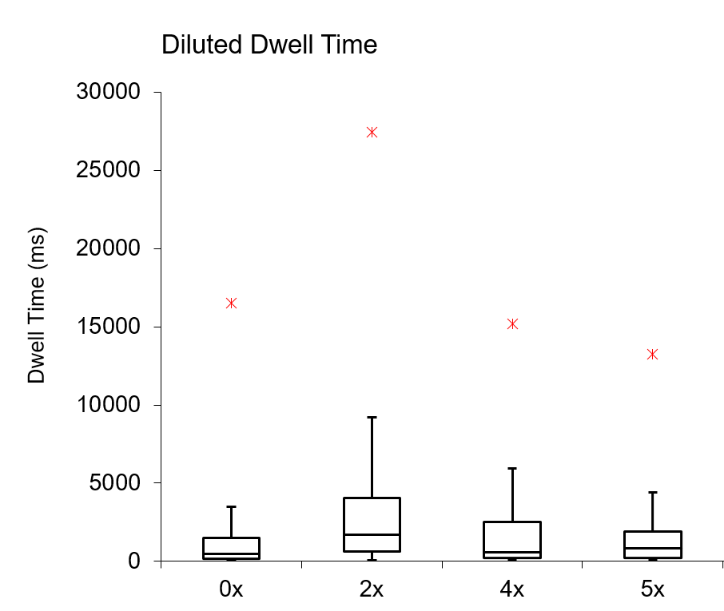




* p < 0.05
** p < 0.005
*** p < 0.0001

Slide 11
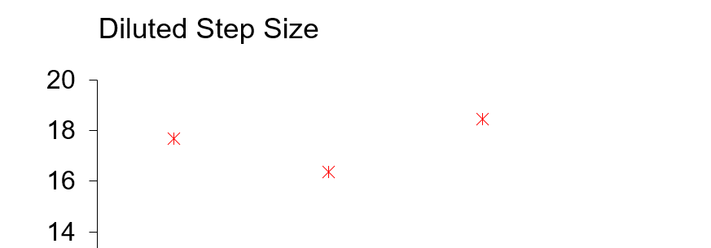
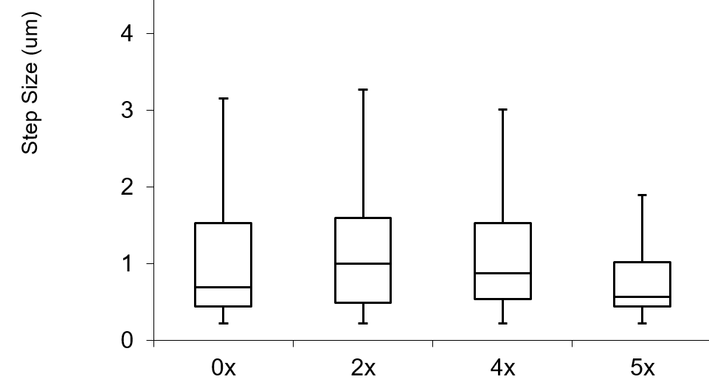
HEMODILUTION

Slide 12
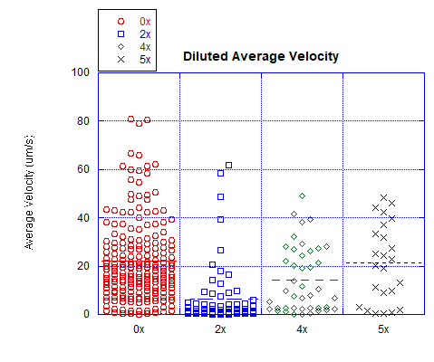
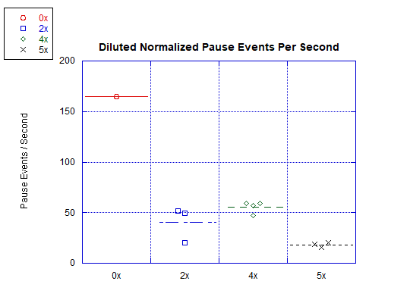
HEMODILUTION

Slide 13
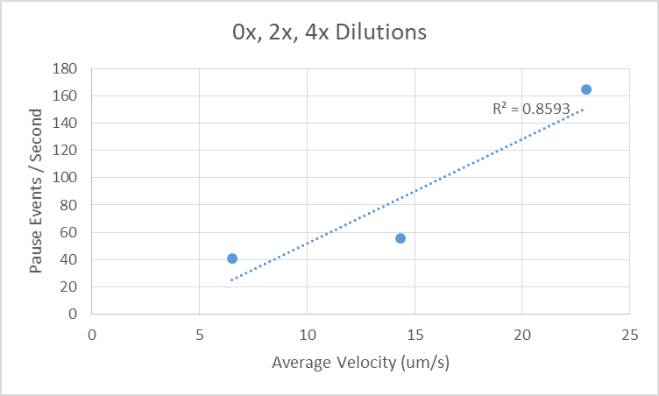
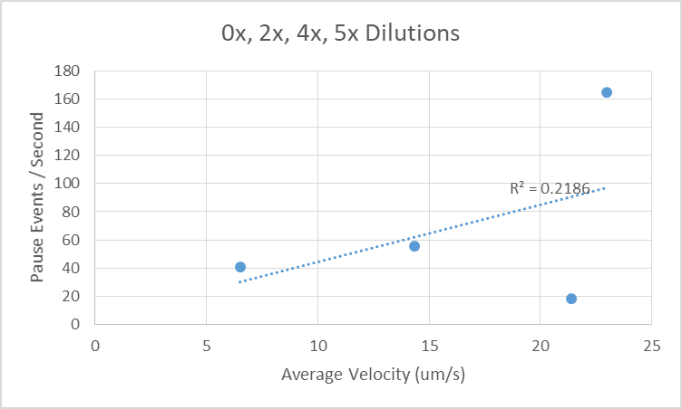
Correlation Analysis: Pause Events vs Avg Vel
HEMODILUTION
R² = 0.8593
R² = 0.8593 R² = 0.2186

Slide 14
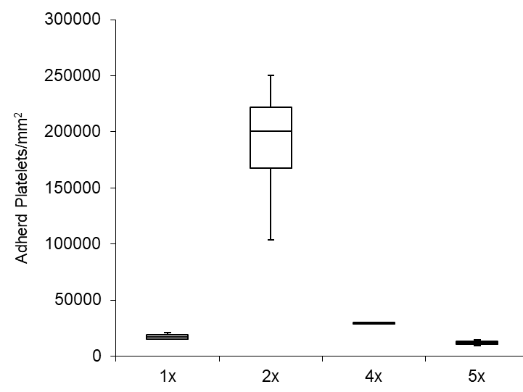
HEMODILUTION
Number of adhered platelets per mm² following 5 minute perfusion
*
* p < 0.05
** p < 0.005
*** p < 0.0001

Slide 15
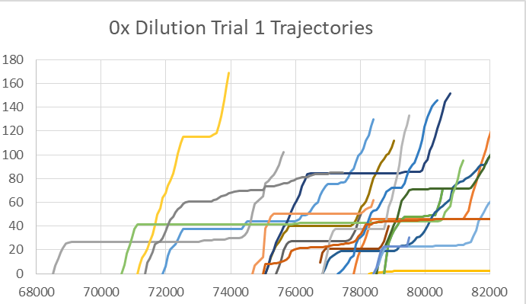
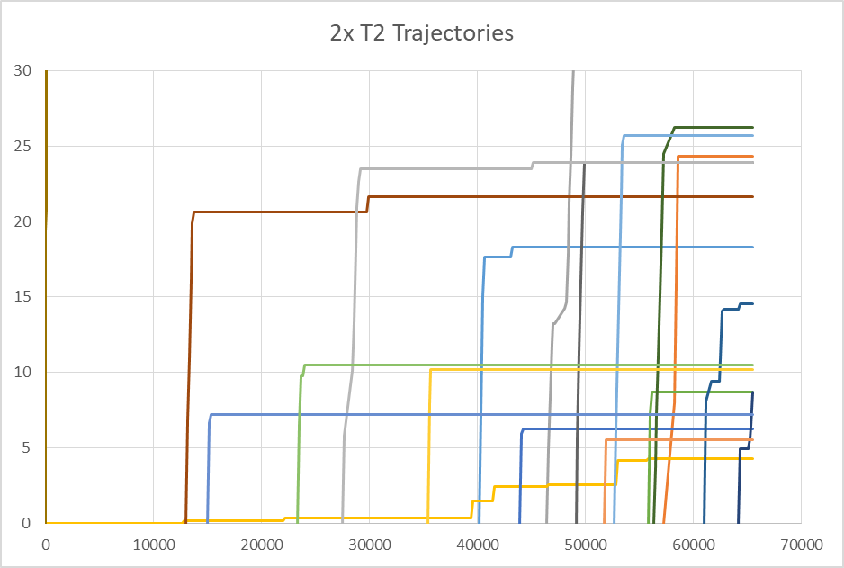
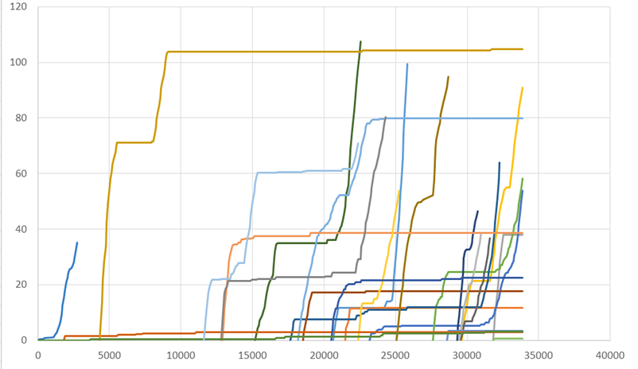
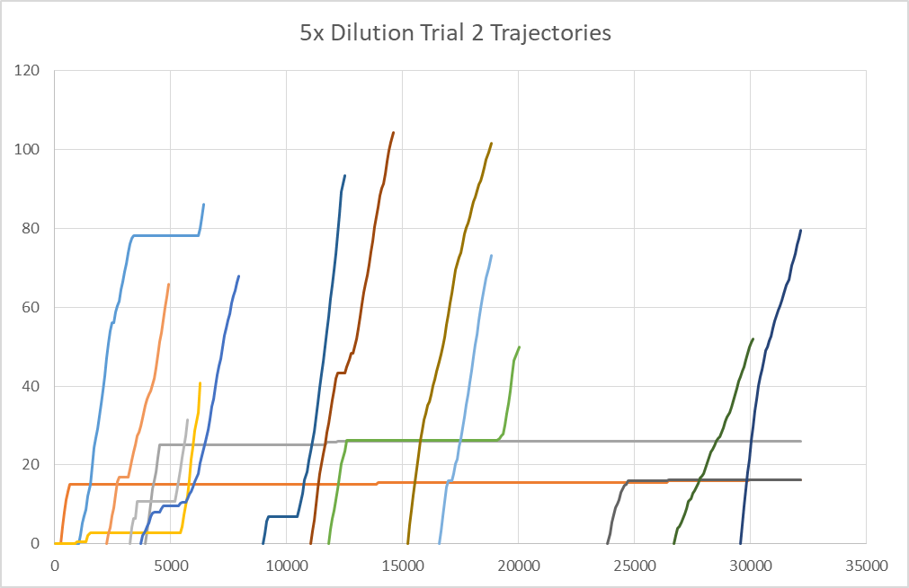
4x Dilution Trial 2 Trajectories

Slide 16
Future Work
Repeat hematocrit experiments with upstream HSA opposed to collagen
Assess capture region for both hematocrit and dilution experiments
Attempt stop-go analysis

