Slide 1
Mathematical Rolling Model

Slide 2
Description
Assume we have a circular platelet of radius R in a 2D shear flow
The platelet is separated from the wall by distance d
The shear flow applies “target” angular and linear velocities Ωf and Vf.
Receptors cover the surface of the circle, and bonds can form between points on the circle and points on the wall.
Notes:
The target velocities are the linear and angular velocities of a platelet flowing freely in the fluid

Slide 3
Description
These bonds can stretch and compress, and they exert a force on the platelet proportional to their length
These forces influence the rolling speed and rotation rate of the platelet
The formation and breaking rates of a bond depend on the distance between its two attachment points
Notes:
The force causes the true linear and angular velocities to deviate from the target velocities

Slide 4
Continuous Equations
$$\frac{∂n}{∂t}=Ω\frac{∂n}{∂θ}+V\frac{∂n}{∂x}+α(L)\left(N_{T}-∫_{-∞}^{∞}n(x,θ,t)dx\right)-β(L)n(x,θ,t)$$
$$α(L)=k_{on}exp\left(-\frac{k_{f}L^{2}}{2k_{B}T}\right)$$
$$β(L)=k_{off}exp\left(\frac{k_{f}L}{f_{0}}\right)$$
$$ξ_{τ}(Ω_{f}-Ω)+τ=0$$
$$ξ_{v}(V_{f}-V)+F_{h}=0$$
Notes:
We assume that everything is continuous
n(x,θ,t) gives the bond density between the point x on the wall, and theta on the circle at a given time
Omega and V are the unknown platelet rotation and rolling rates
The first two terms incorporate the movement of the platelet
The third term represents bond formation, and alpha gives the formation rate. Note that the rate of bond formation decreases with increasing distance
The fourth term represents bond breaking, and beta gives the breaking rate. This increases as length increases
The last two equations represent the effect of force and torque generated by the bonds on platelet motion

Slide 5
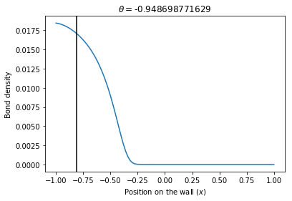
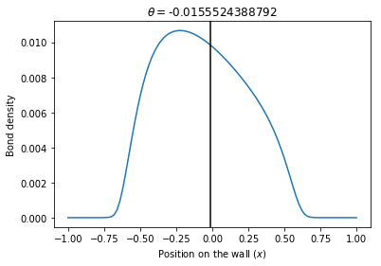
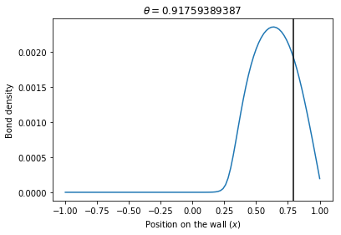
Results—Steady State Bond Distribution Example

Slide 6
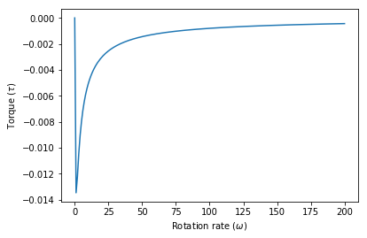
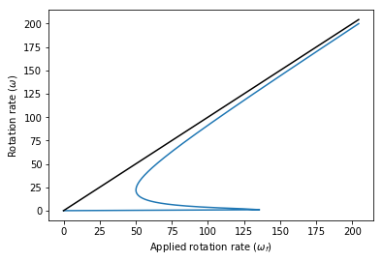
Results—Steady State Pure Rolling
Simple case: d=0, V=RΩ
1st plot: shows torque generated when a platelet is rotating at rate Ω
2nd plot: shows platelet rotation rate as a function of applied rotation rate
Bistable system: stationary platelets and fast-moving platelets
Notes:
There is some small rotation rate that generates the largest torque. When the platelet is rotating faster, fewer bonds form and less torque is generated by the bonds
Bistable-there are two steady state rolling behaviors

Slide 7
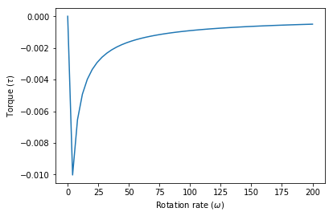
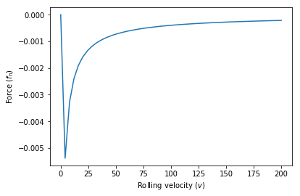
Steady State Rolling and Sliding
Can solve for bond densities given V and Ω
Then find the necessary forces and torques generated at those velocities, and calculate the right applied V and Ω
Haven’t found a good way to present this data yet
Need to solve a system of nonlinear equations to find the right Vf and Ωf

Slide 8
Next Steps
Solve the time dependent problem
Solve the stochastic problem
Find parameter values that match experimental results

