Slide 1
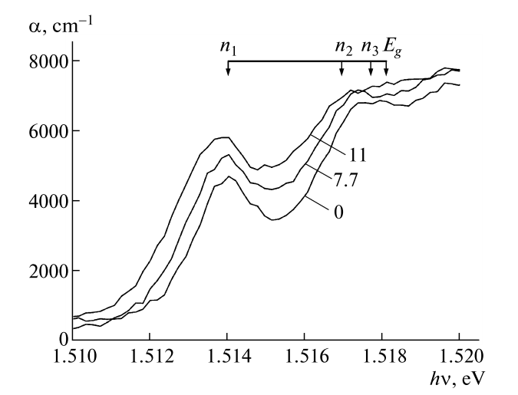
(a)
Single-particle representation
Two-particle representation
E
E
CB
CB
n = 3
Electron
n = 2
E_{B}
n = 1
Photon
Exciton
E_{F}
E_{g}
Photon
Hole
VB
VB
k
k
(b)
α
n = 1
(c)
2
3
E_{g}
E

