Slide 1
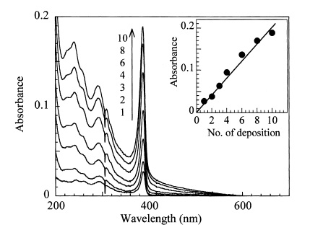
(a)
(b)
Hydrophobic tail
Hydrophilic head
Barrier
Water

