Slide 1
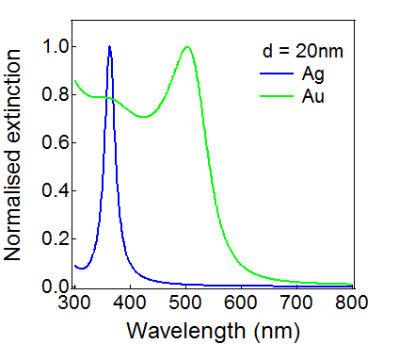
(b)
(a)
d
r
E
θ
z
ε_{m}
ε_{d}
(c)
Electric field
-
-
-
Nanoparticle
+
+
+
Electron cloud
+
+
+
-
-
-

