Slide 1
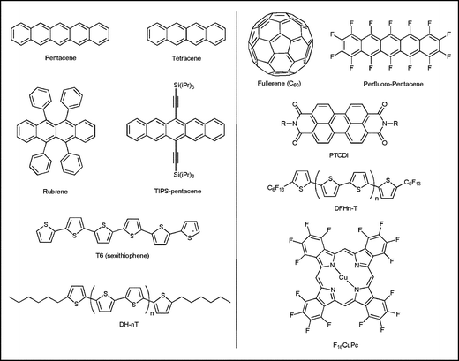

(a)
(b)
Pentacene
Tetracene
Fullerene (C₆₀)
Perfluoro-Pentacene
PTCDI
Rubrene
TIPS-pentacene
DFHn-T
T6 (sexthiophene)
DH-nT
F₁₆CuPc

