Slide 1
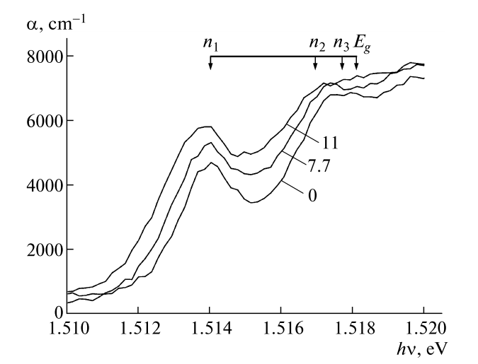
(a)
Insulator
E
(b)
E
Semiconductor
CB
Metal
CB
E_{F}
n = 3
E_{g}
n = 2
VB
E _{B}
n = 1
k
(c)
α
n = 1
(d)
2
3
E_{g}
E

