Slide 1
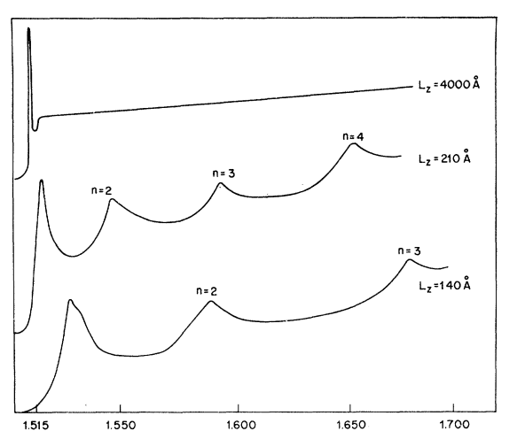
(a)
Type I
Type II
Type III
(b)
E
u = 3
u=3
u = 2
Staggered
Broken-gap
E
u=2
u=1
Barrier
u=1
Well
Barrier
u=2
u = 1
u=3
k
n = 1
(d)
(c)
α
n = 1
n = 1
L = 400nm
u = 3
u = 4
α
u = 2
u = 3
L = 21nm
u = 2
u = 3
u = 1
u = 2
L = 14nm
E
E (eV)

