Slide 1
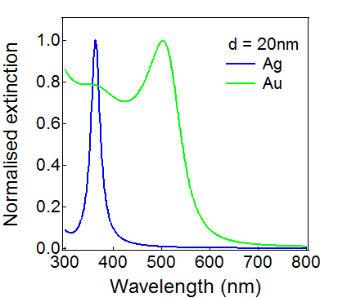
(a)
LSP field
d
r
E₀
θ
z
ε_{m}
ε_{d}

