Slide 1
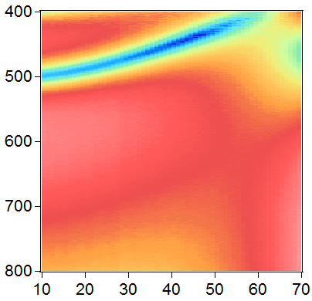
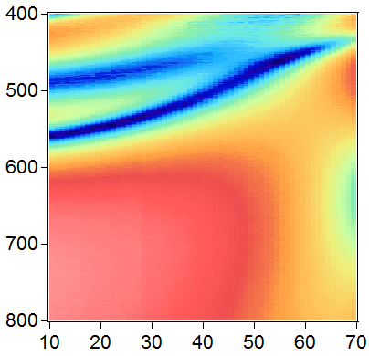
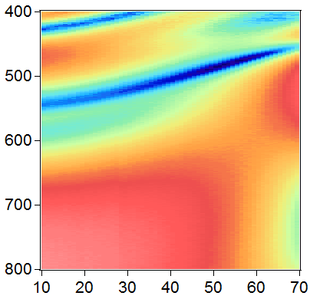
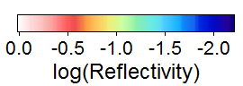
(a)
20nm
(b)
10nm
(c)
5nm
PS
100nm
350nm
D = 417nm
Ag
Wavelength (nm)
θ (deg)

