Slide 1
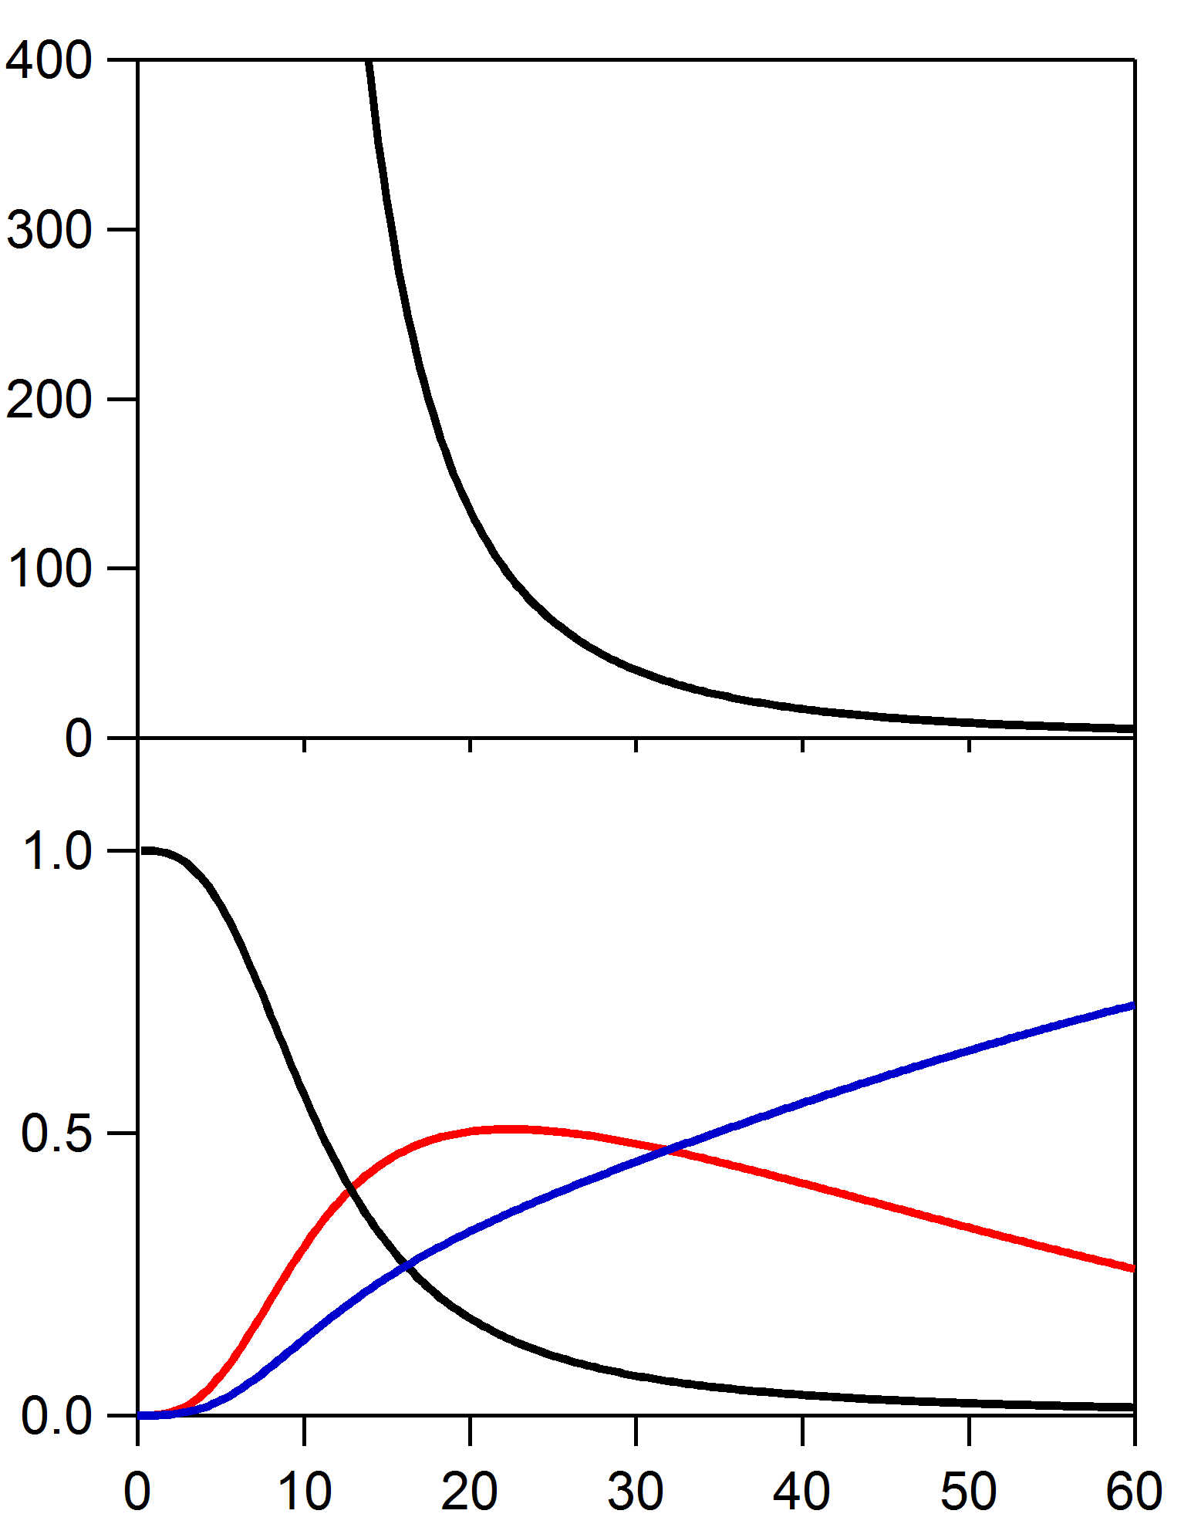
(a)
Outcoupled via grating
+
-
ΔE_{ex} (meV)
(b)
l
Exciton - Polariton
Ag
+
-
Emission to SPP
CHPI QWs
-
+
+
-
l
Photon
-
-
+
+
+
-
Emission probability
SPP
-
+
Ag
-
SPP
+
Nonradiative
-
+
Image
l (nm)

