Slide 1
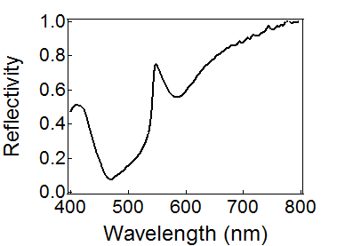
Wood’s anomaly
Threshold anomaly
Resonance anomaly
Photon
Photon
SPP

