Slide 1
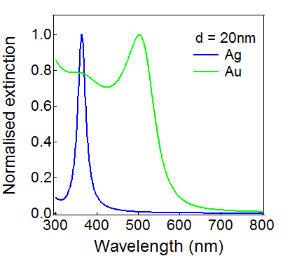
(a)
(b)
d
r
E
θ
z
ε_{m}
ε_{d}
(c)
Electric field
-
-
-
Nanoparticle
+
+
+
Electron cloud
+
+
+
-
-
-

