Slide 1
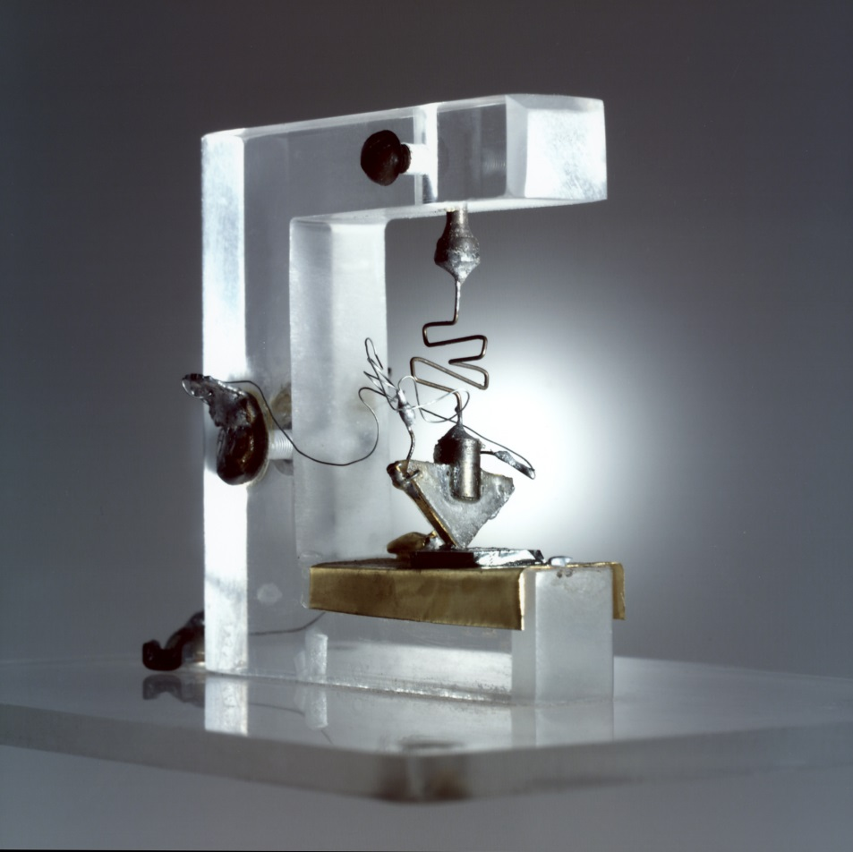
(a)
(b)
Sand
SiO₂ + C
HCl
HCl
H₂
Metallurgical Grade Silicon
High purity HSiCl₃
Coke reduction in arc furnace (1800°C)
Dissolve in HCl (300°C)
+ distallation
High-purity polysilicon (electronic-grade)
Siemens process (900°C)
Modified Siemens process (900°C)
Polysilicon
Various gases
Ungraded metallurgical silicon (solar-grade)
Chemical refinement

