Slide 1
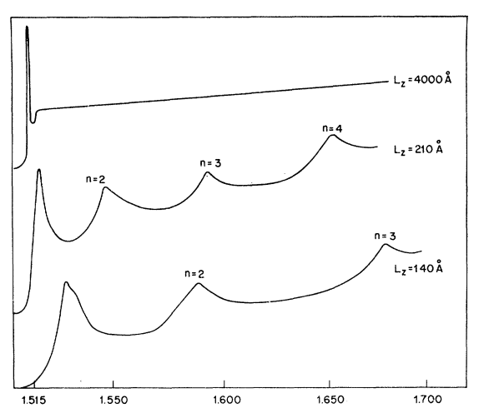
(a)
Type I
Type II
Type III
Staggered
Broken-gap
E
Barrier
Well
Barrier
(b)
E
u = 3
u=3
u = 2
u=2
u=1
u=1
u=2
u = 1
u=3
k
(c)
α
n = 1
n = 1
n = 1
u = 3
u = 2
u = 1
E
(d)
u = 1
L = 400nm
u = 4
u = 1
u = 2
u = 3
L = 21nm
α
u = 3
u = 1
u = 2
L = 14nm
E (eV)

