Slide 1
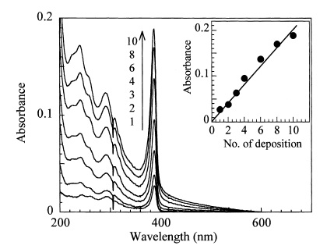
(b)
(a)
Hydrophobic tail
Hydrophilic head
Barrier
Water

