Slide 1
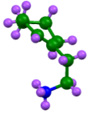
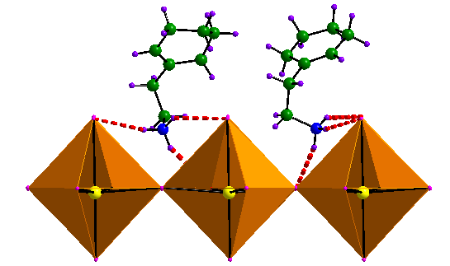
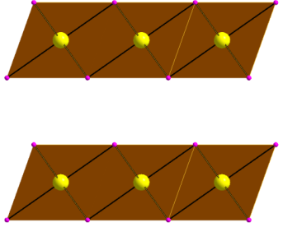
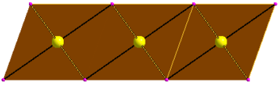
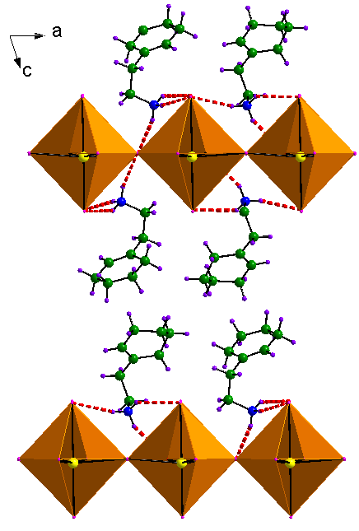
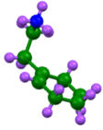

PbI₂
top layer exposed to organic
top layer turns into PbI₄²⁻
~6.97Å
Organic intercalation via interstitial spaces
(a)
(b)
(c)
Second layer exposed to organic
Organic intercalation via interstitial spaces
second layer turns into PbI₄²⁻
~18.32Å
Organic intercalation via interstitial spaces
Pb-I layers exfoliation
(e)
(d)

