Slide 1
Digital Control System Analysis and Design
Chap. 1 Introduction
Chap. 2 Discrete Time Systems and the z-Transform
Chap. 3 Sampling and Reconstruction
Chap. 4 Open-Loop Discrete-Time Systems
Chap. 5 Closed-Loop Systems
Chap. 6 System Time-Response Characteristics
Chap. 7 Stability Analysis Techniques
Chap. 8 Digital Controller Design

Slide 2
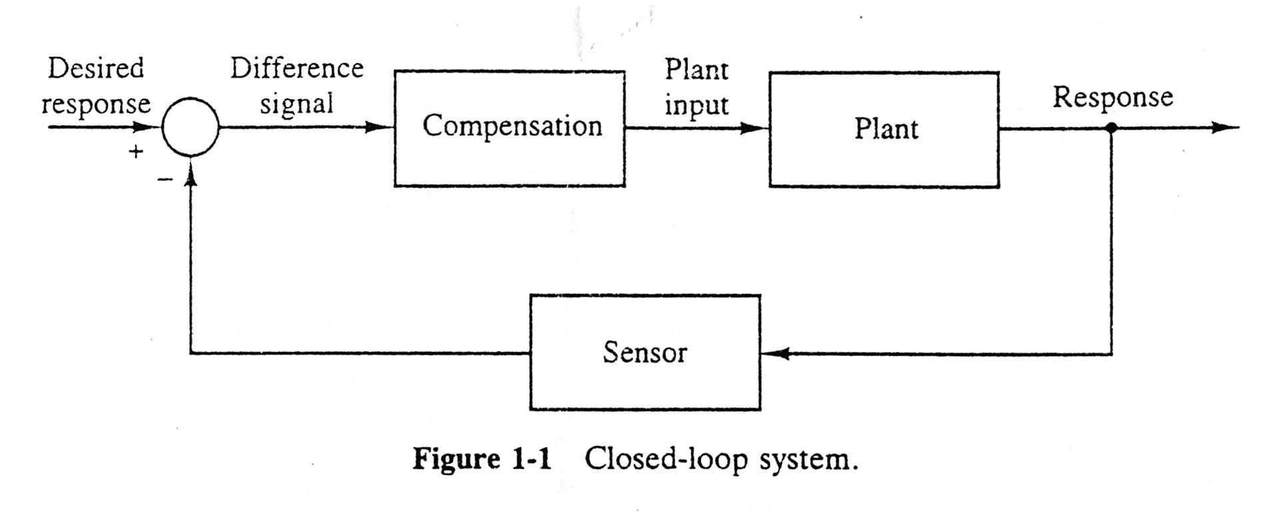
1.1 Overview
Compensator, controller, filter
Linear time-invariant discrete-time systems
Superposition principle
System parameters

Slide 3
1.2 Digital Control System
Control System: 4 Areas to be developed
Process or Plant -- Dynamic systems
Measurement Technology --- Sensors
Computer Technology ------- VLSI, CPU, I/O
Control Theory ----- Discrete and continuous control
. Sampled Theorem
. Difference Eqn.
. z-Transform
. State-Space Model
---------------------------
. System Identification
. Adaptive Control
. Optimal Control
. Neural Fuzzy Control
. Stochastic Processes

Slide 4
Advantages of digital Control
Digital components are less susceptible to aging and environmental variations
Less sensitive to noise and disturbance
Digital processors are more compact and lightweight
Single chip (e.g. DSP) can be made very versatile and powerful
Cost down
More flexibility in programming
Changing a design doesn’t require an alternation of hardware
More reliable
Provide improved sensitivity to parameter variations

Slide 5
Disadvantages
Computing speed limit.
  Analog controllers --- Real Time and Resolution is theoretically infinite
The finite wavelength of digital processor often translate into system instability in limit cycle
Computing speed cost time delays in control System---may be unstable reason in closed loop system

Slide 6
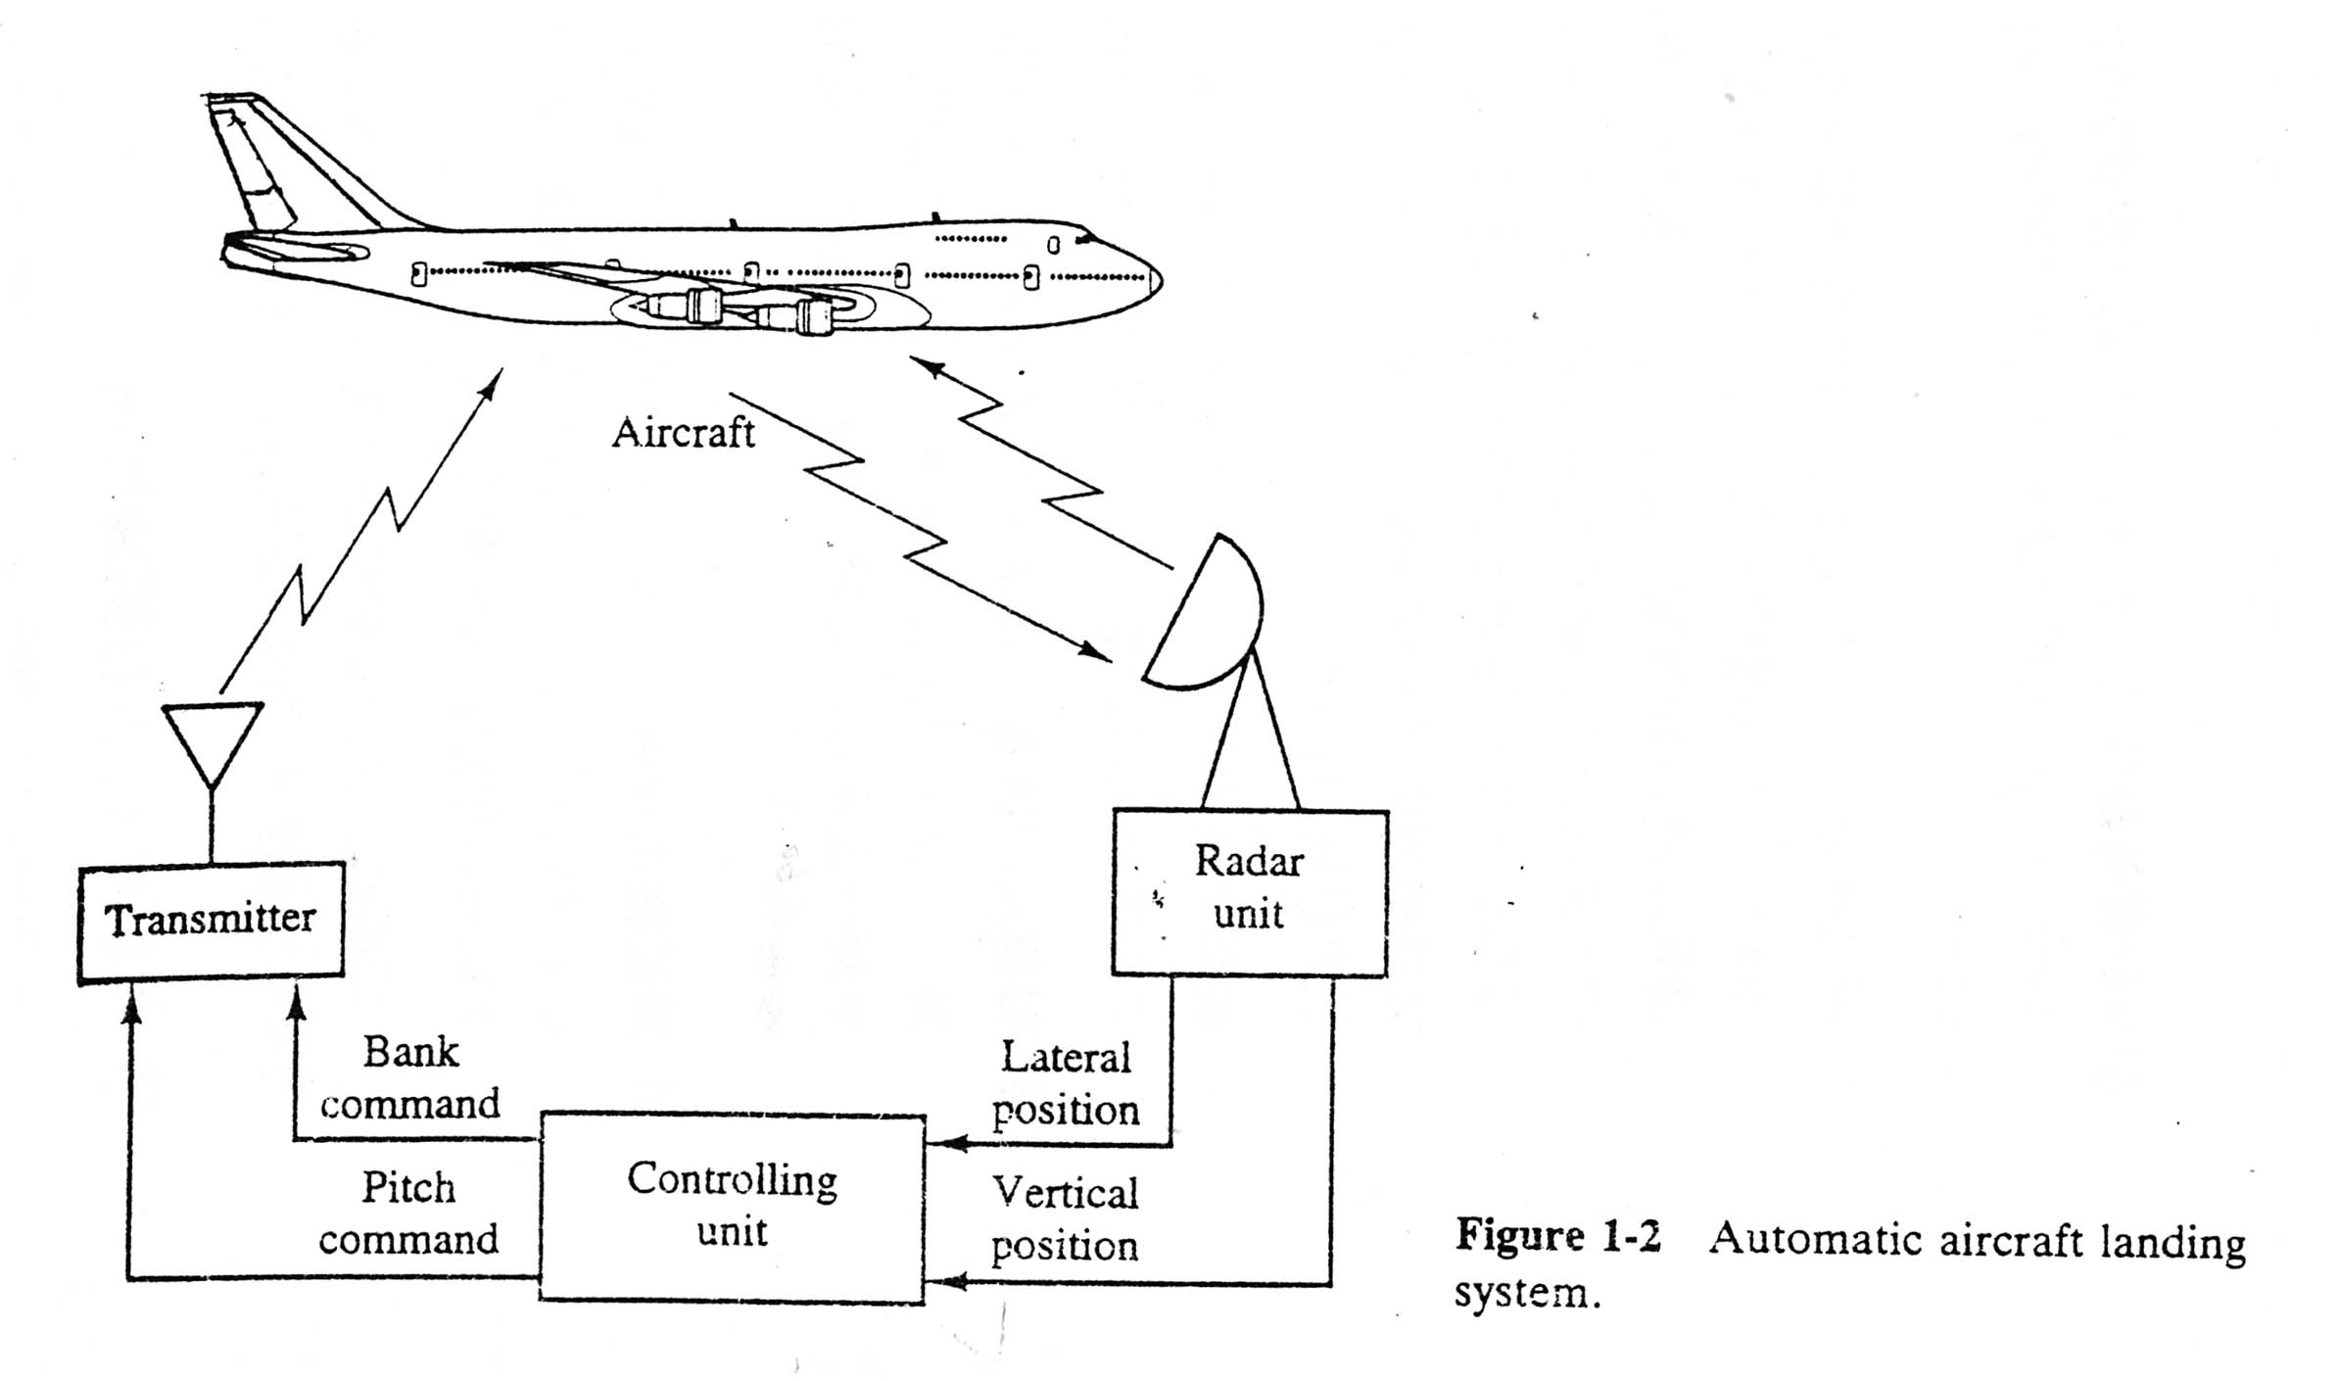
傾斜角
仰角

Slide 7
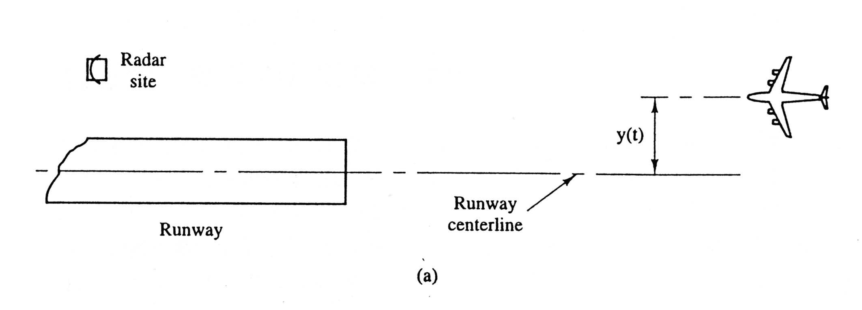
Lateral control: maintain y(t) small

Slide 8
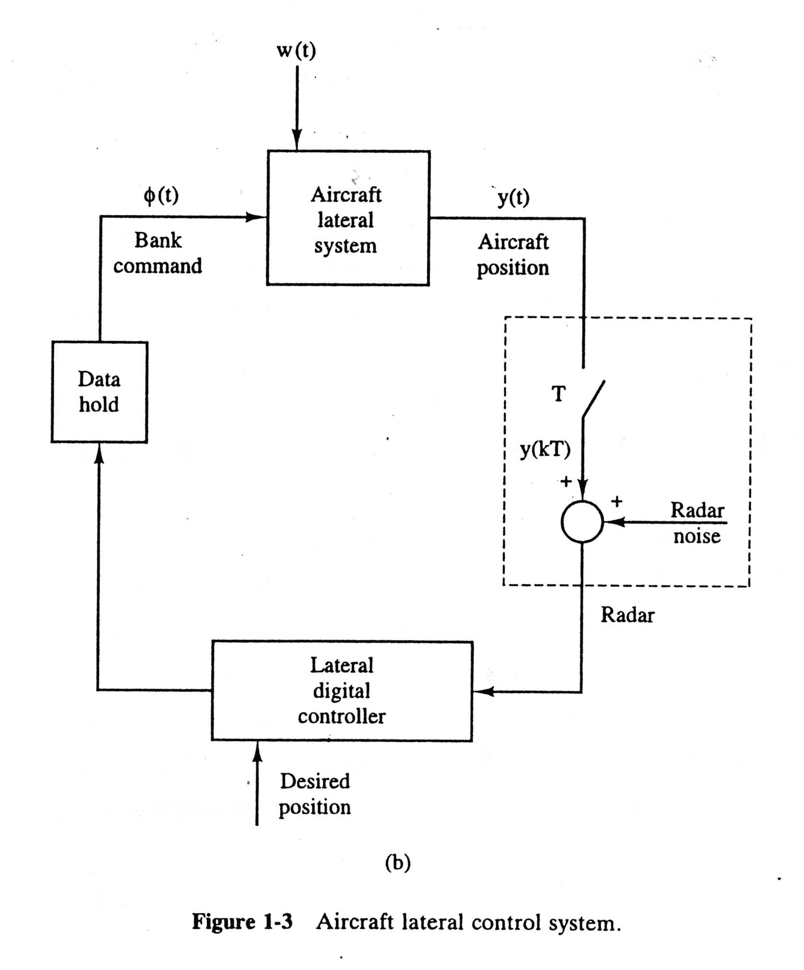
wind
disturbance
reconstruction
sampling
sensor
noise
No sensor is perfect!

Slide 9
1.3 The Control Problem
What are the Control System Main Problems?
Disturbance Rejection: 閉迴路
Steady-State Errors: 準
Transient Response (incl. Stability) : 快、穩
Sensitivity of Parameter Variation: : 狠
打靶: 快、穩、狠、準!

Slide 10
Solve Control Problem
Choosing sensors
Choosing actuators
Develop plant, sensor & actuator models
Design a controller ( Based on control law and model)
Evaluating the Design by Simulation & Testing
Iterating the Procedure

Slide 11
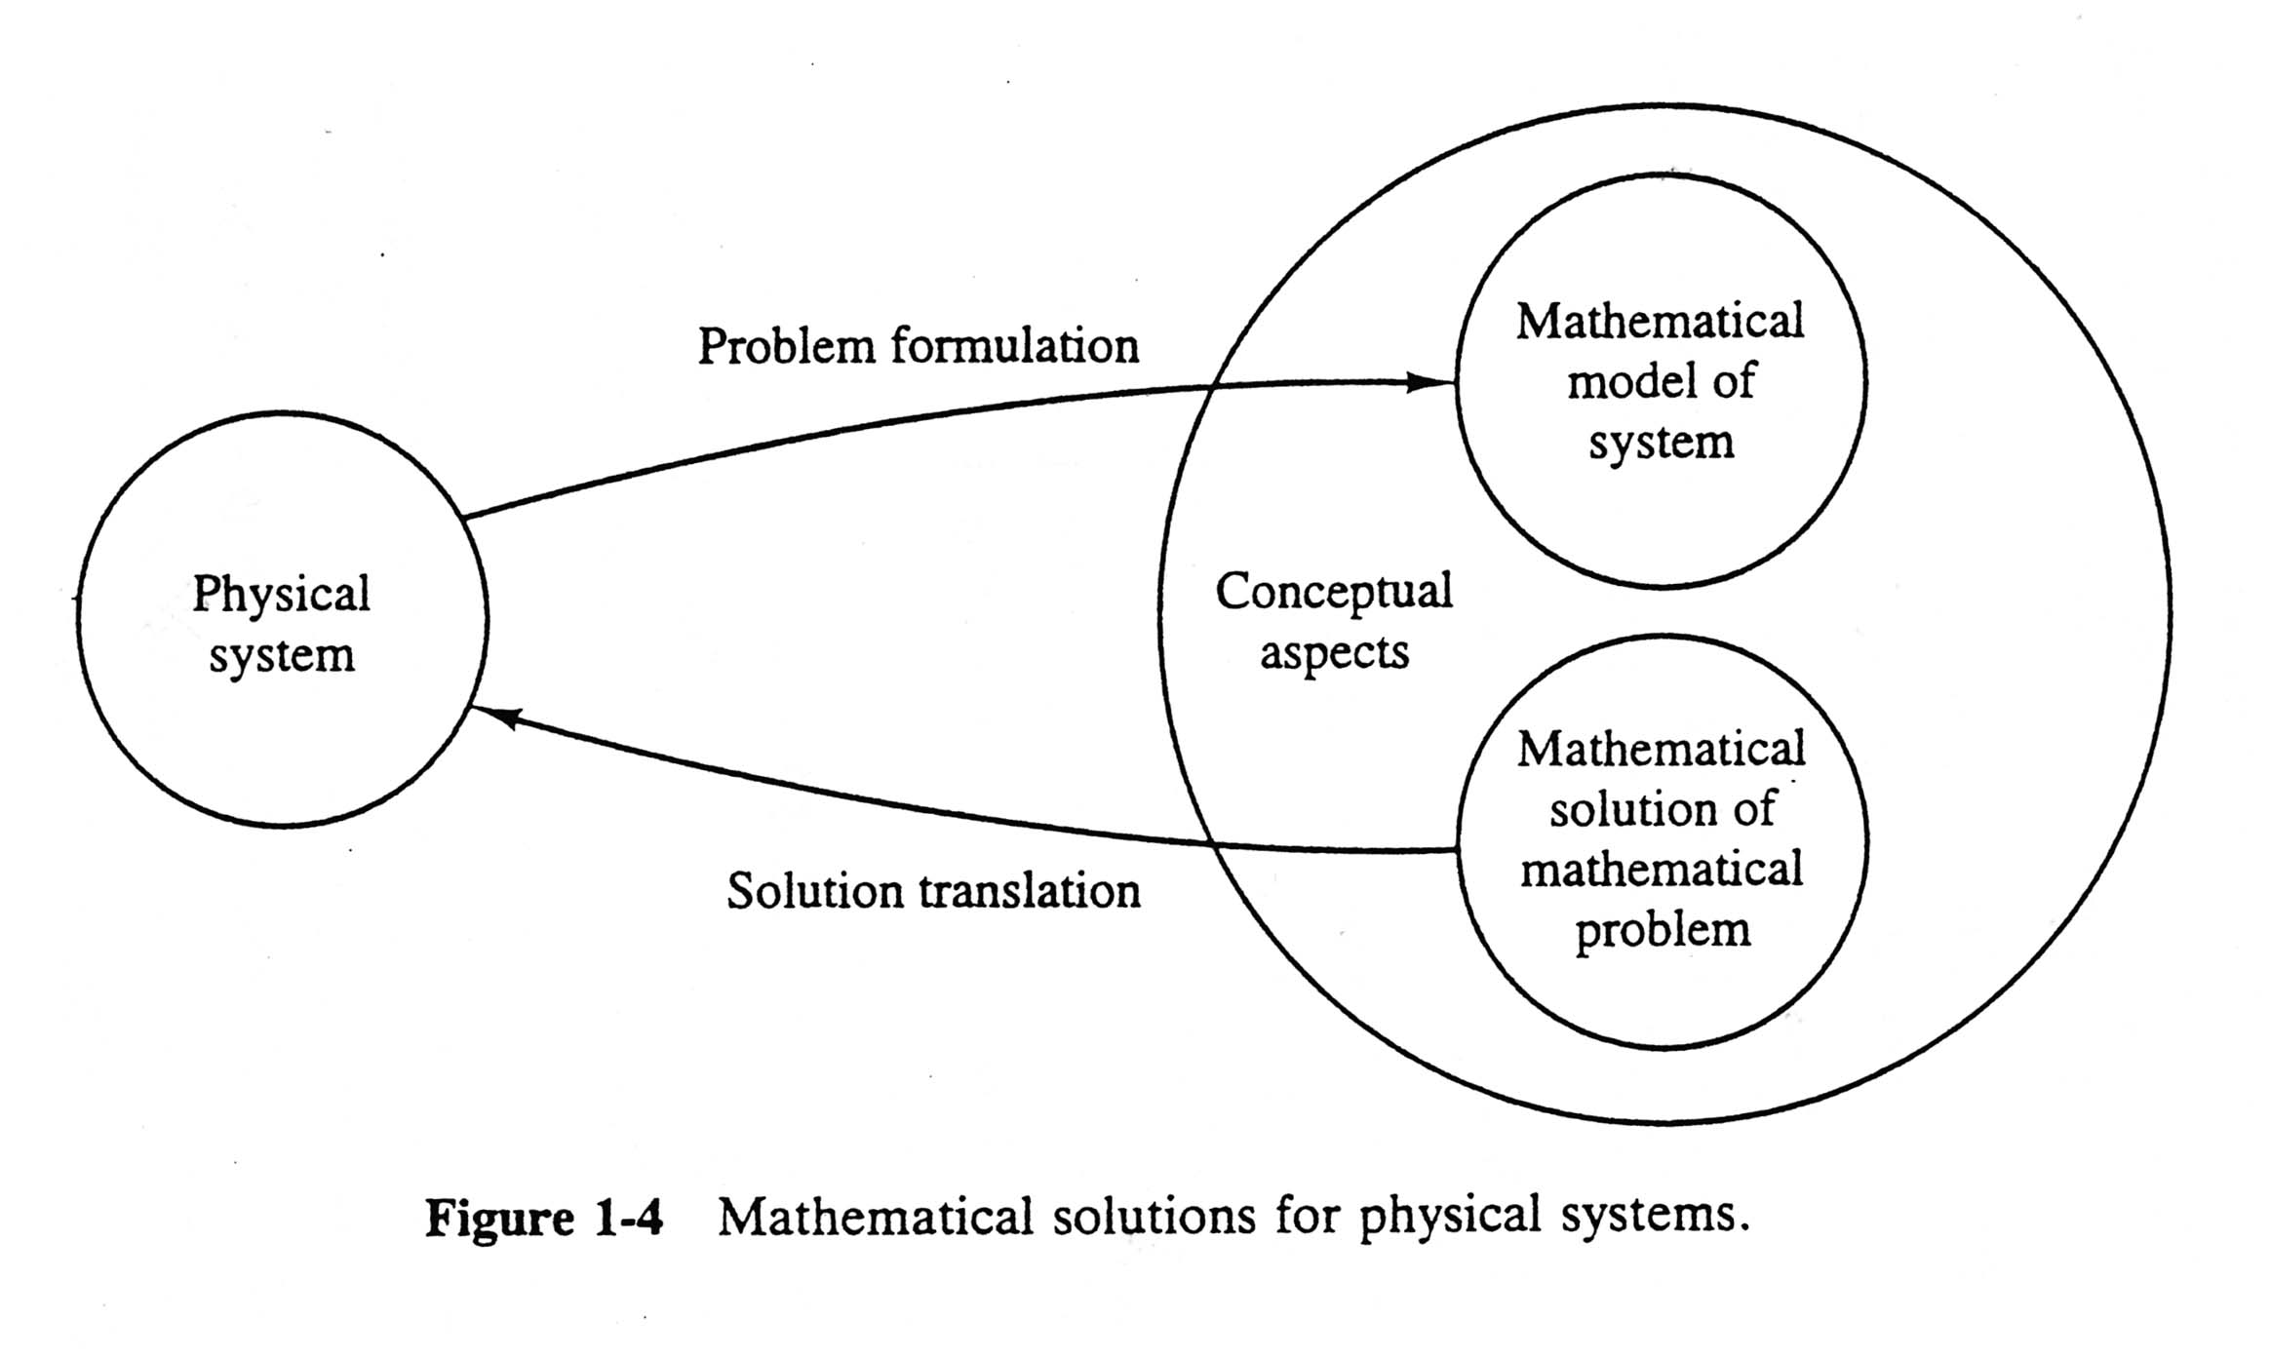
數學
將實際問題→數學化
真實世界
將數學解答→實現化

Slide 12
1.4 Satellite Model
1.5 Servomotor System Model
1.6 Temperature Control System

Slide 13
See Summary (P18)
Problems: 1-2, 1-3, 1-4, 1-5, 1-6
Test Bank

Slide 14
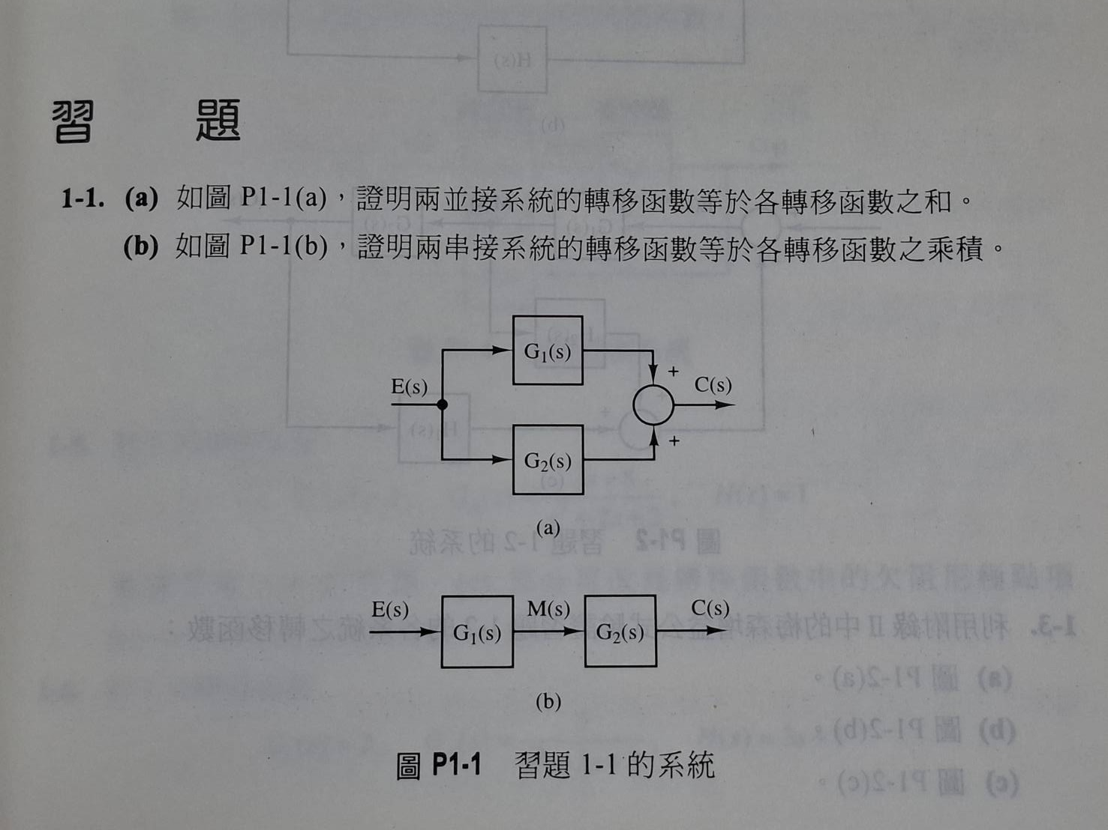
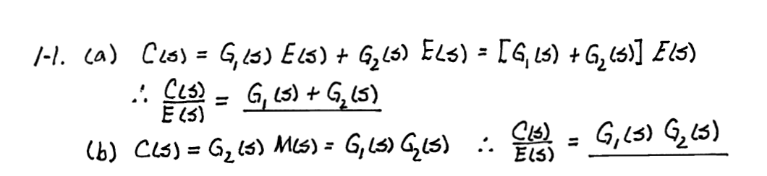
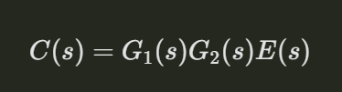

Slide 15
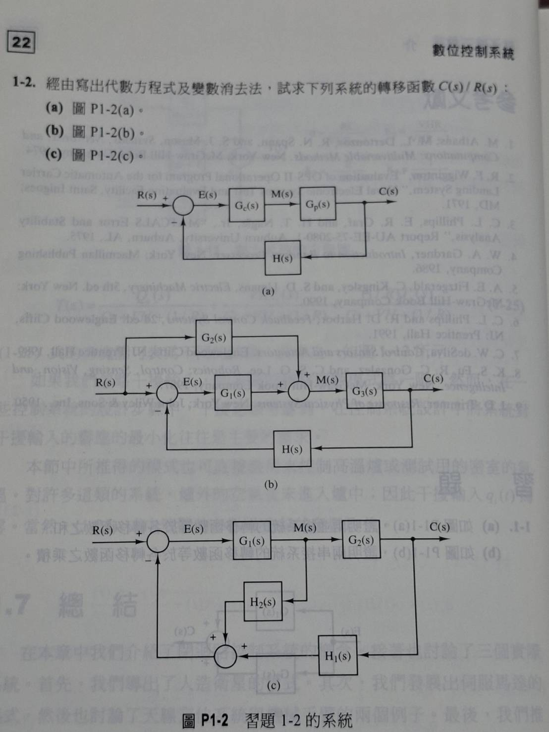

Slide 16
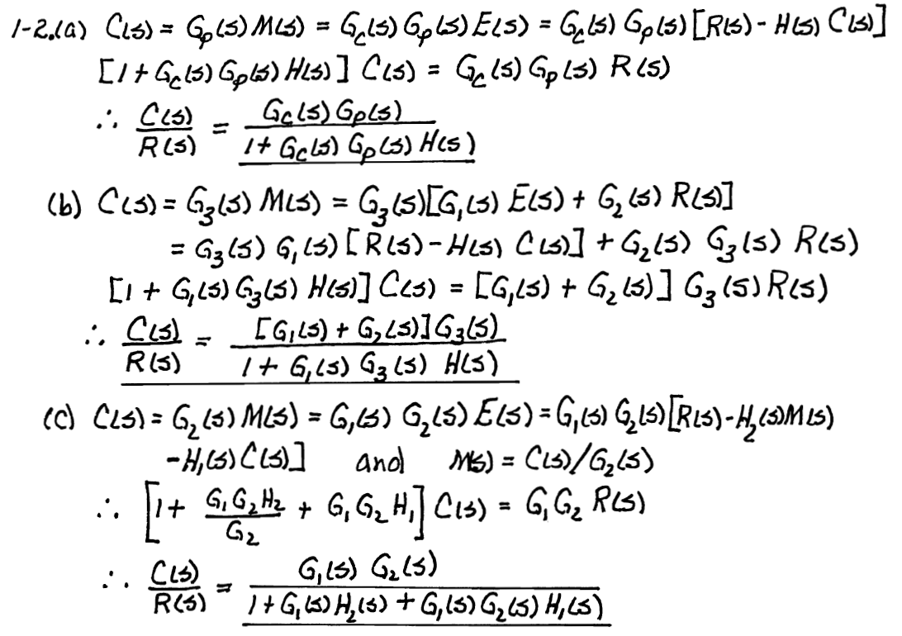

Slide 18
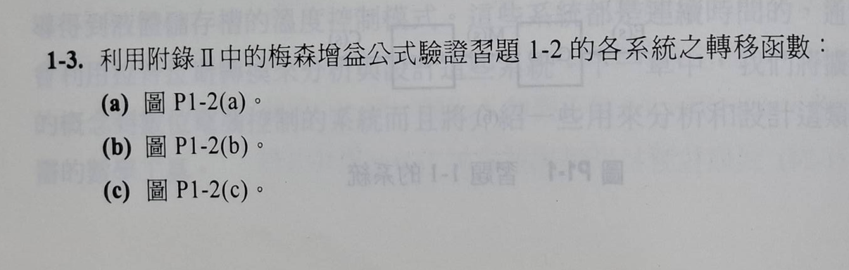
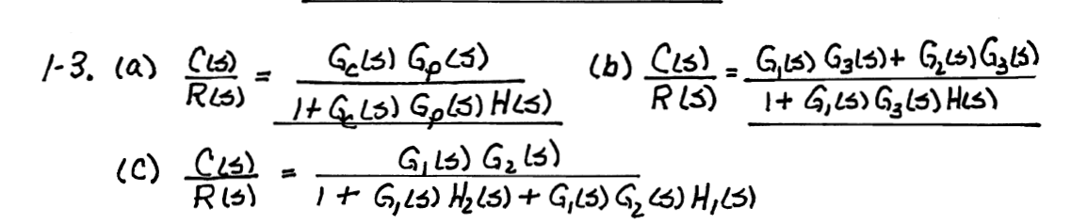

Slide 19
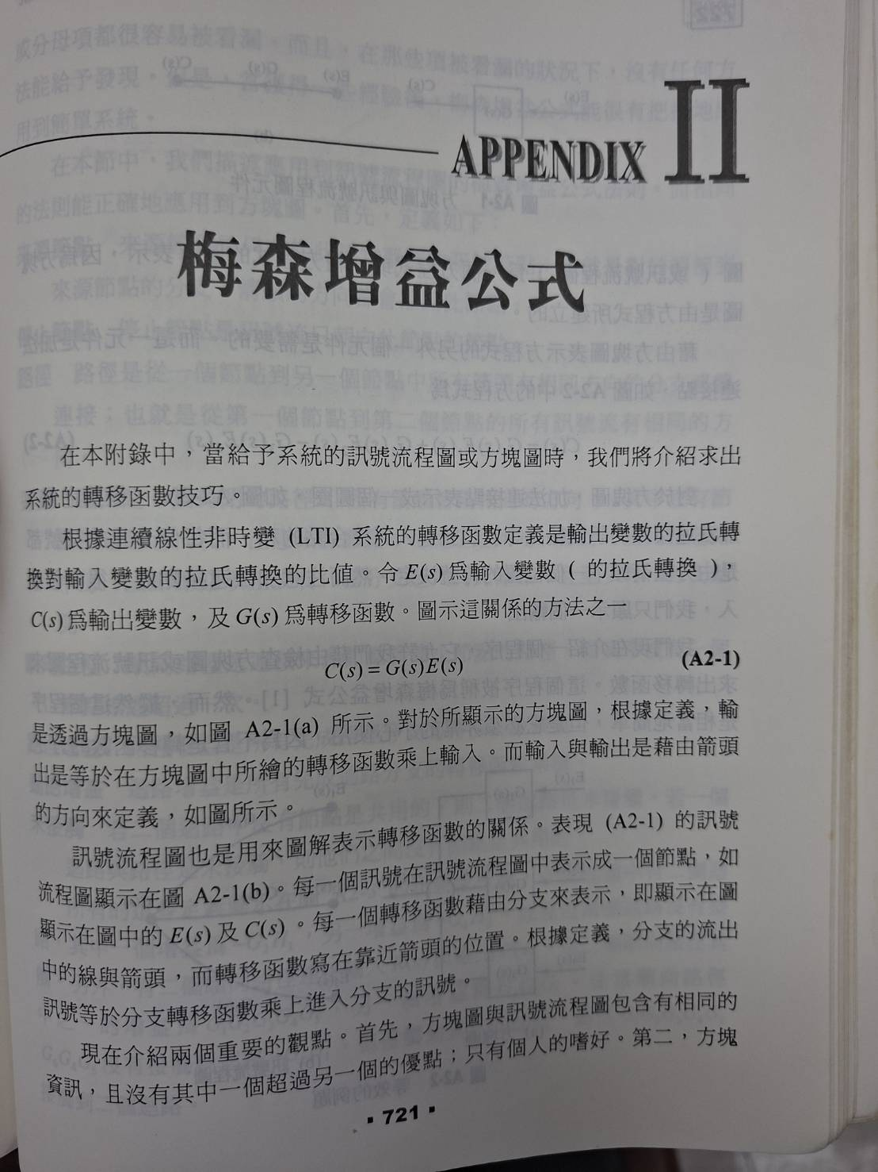

Slide 20
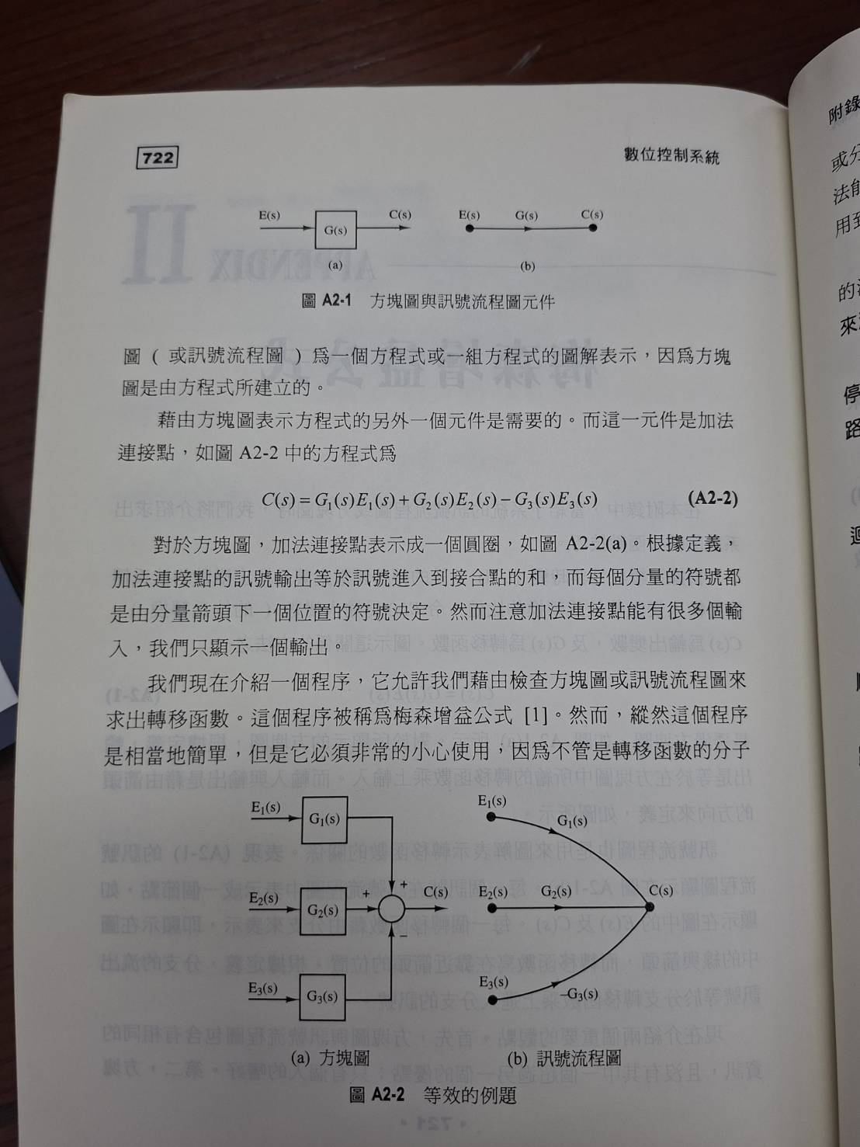

Slide 21
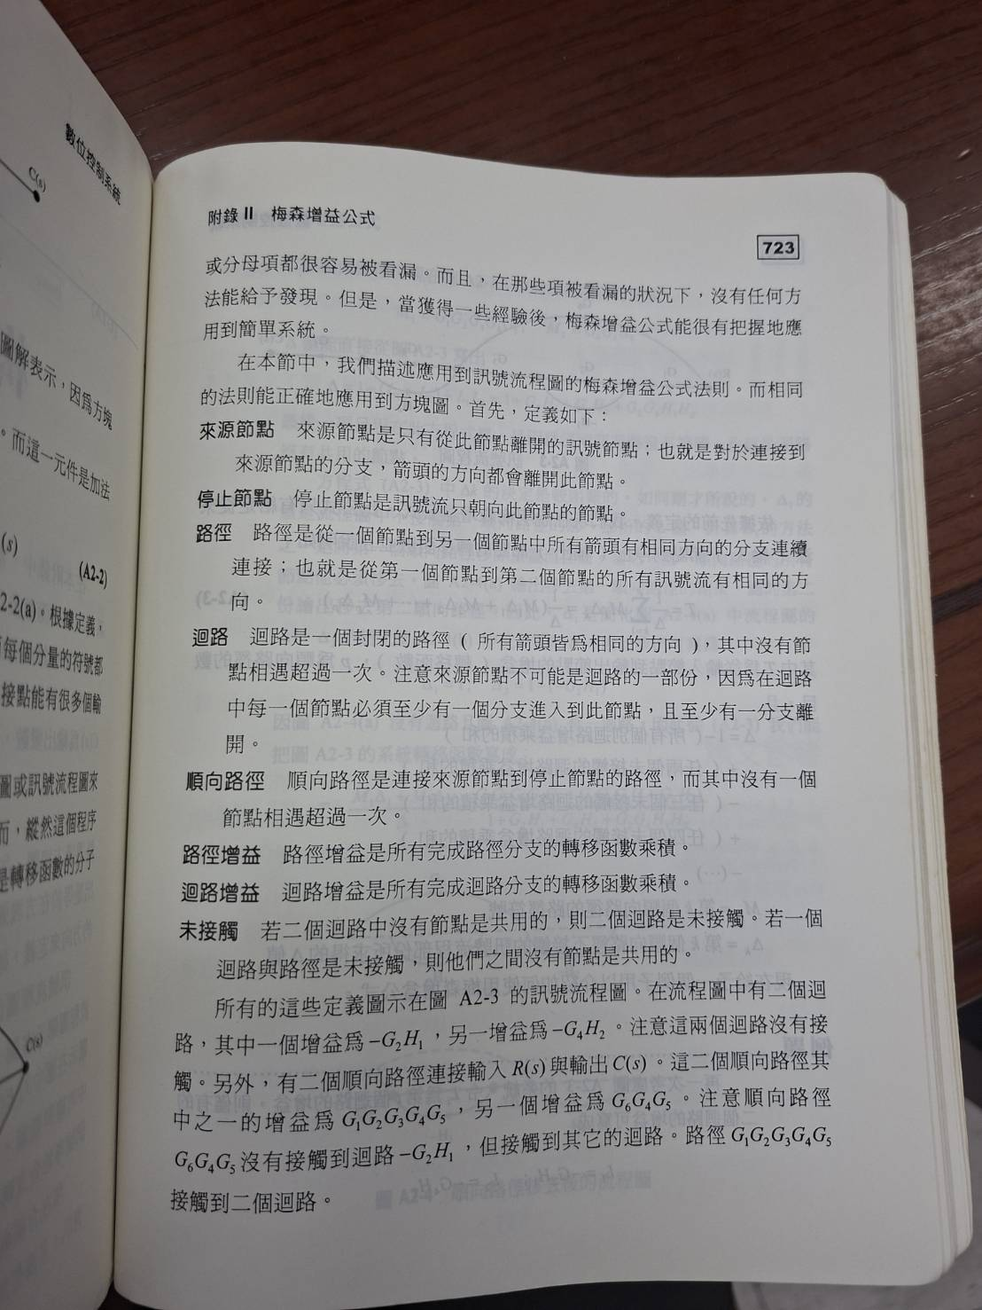

Slide 22
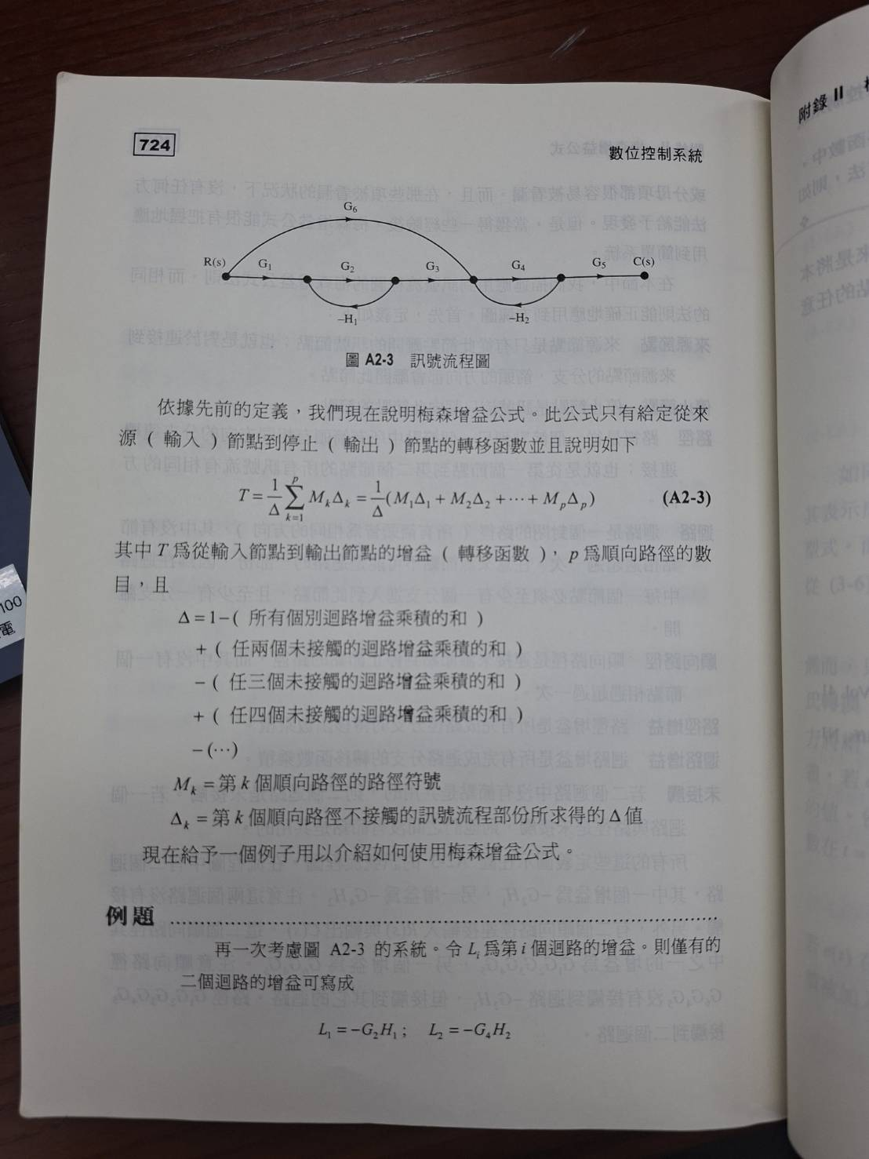
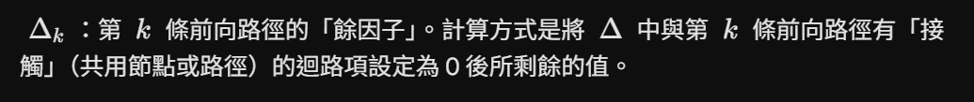

Slide 23
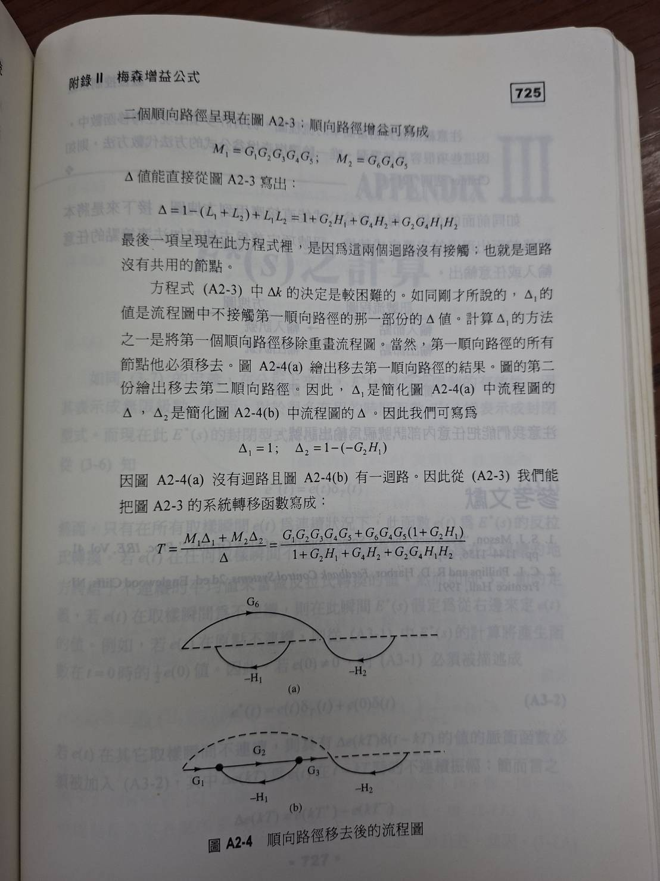

Slide 24
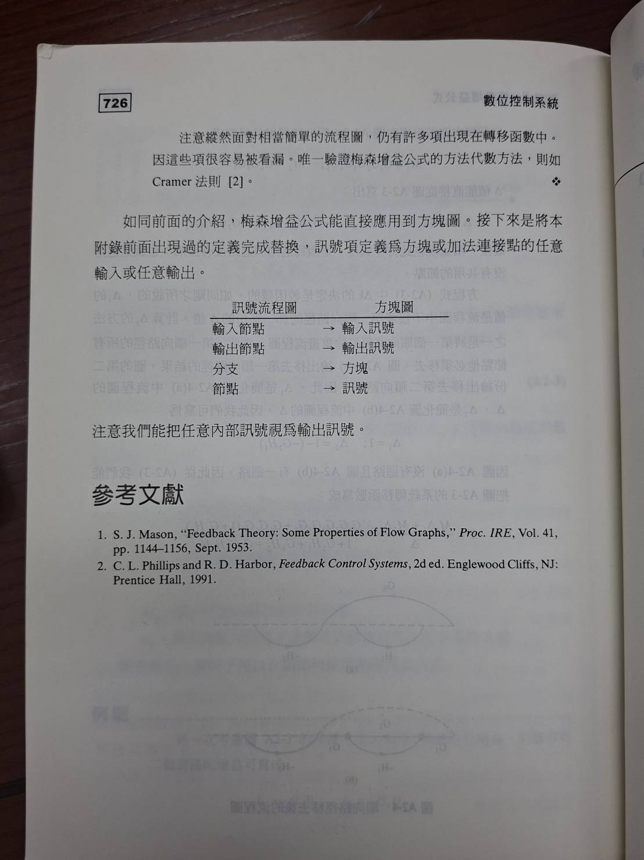

Slide 25
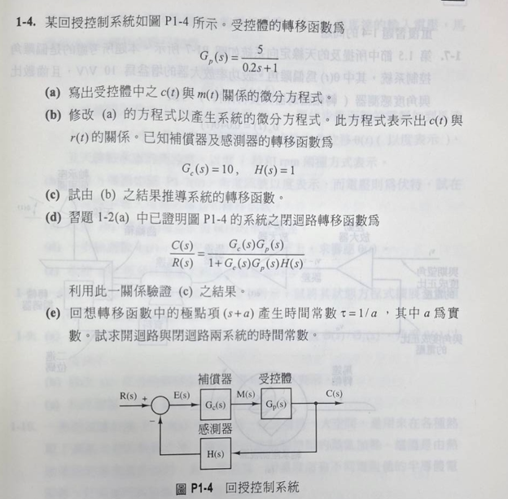


Slide 26
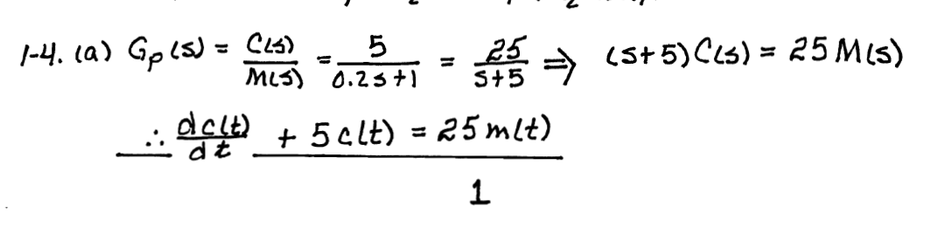
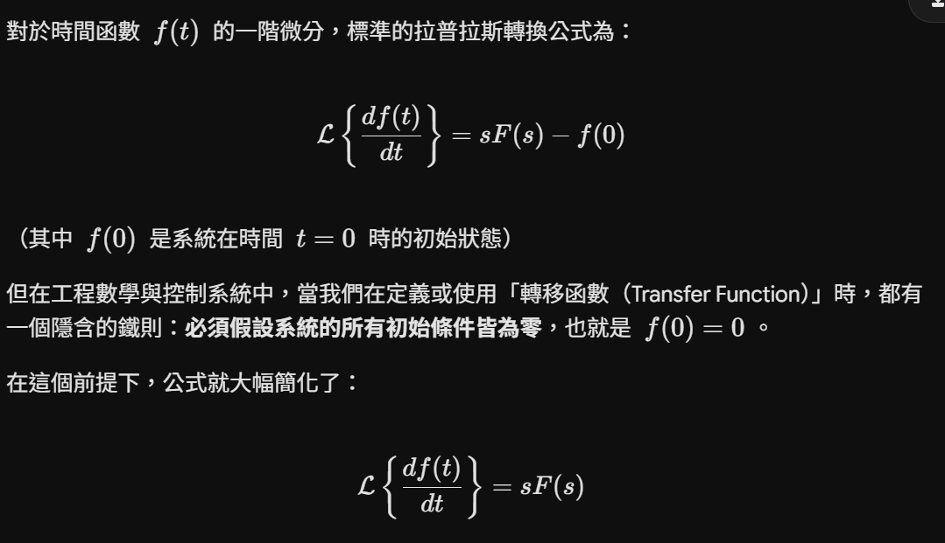

Slide 27
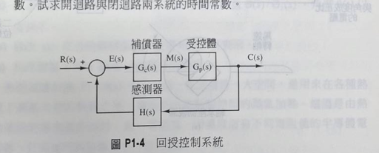


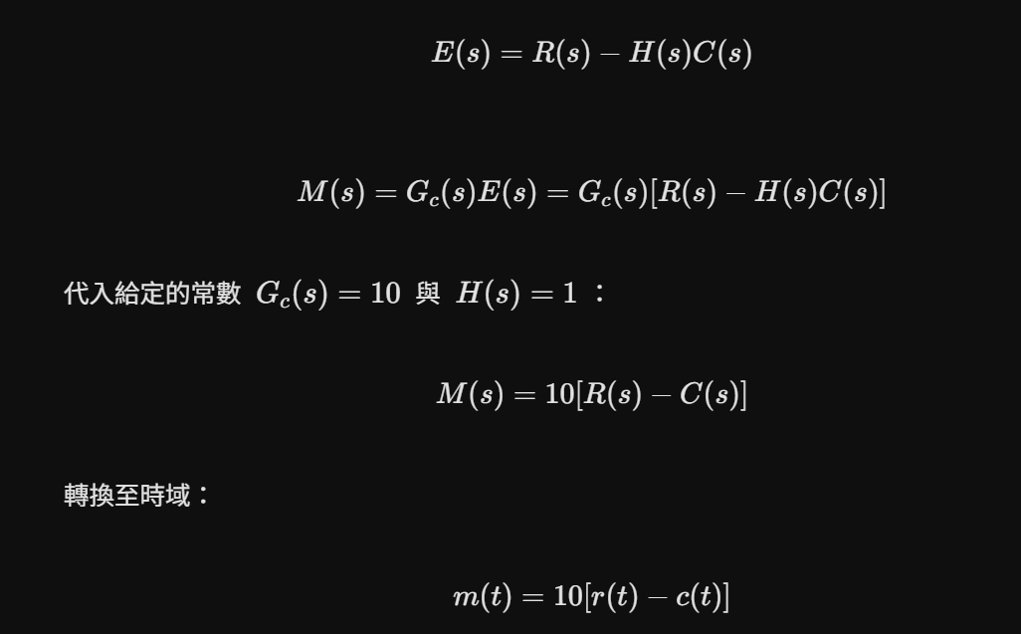

Slide 28

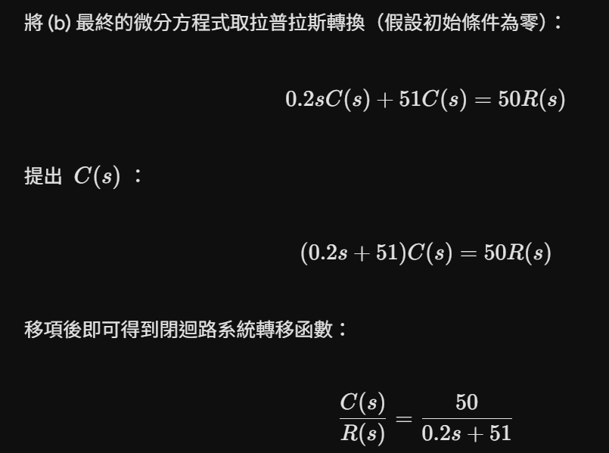

Slide 29
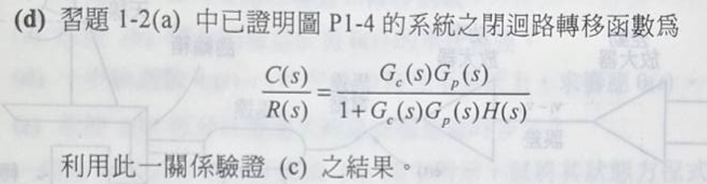
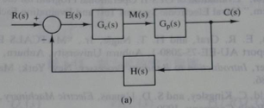
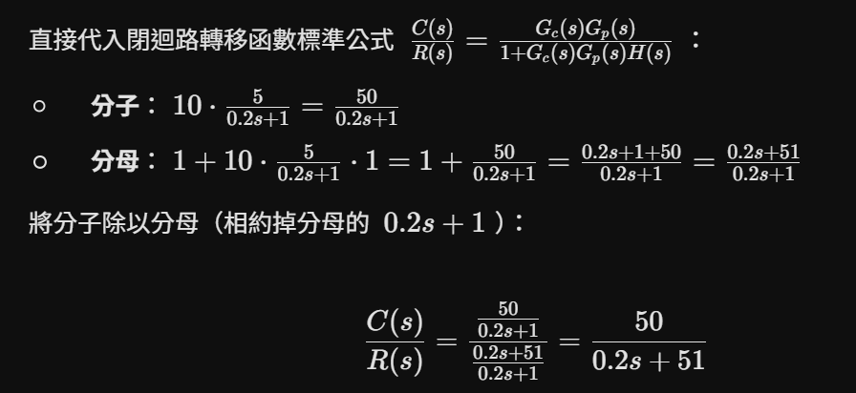

Slide 30
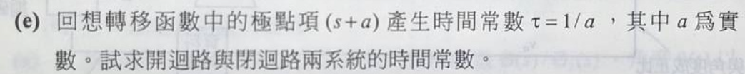
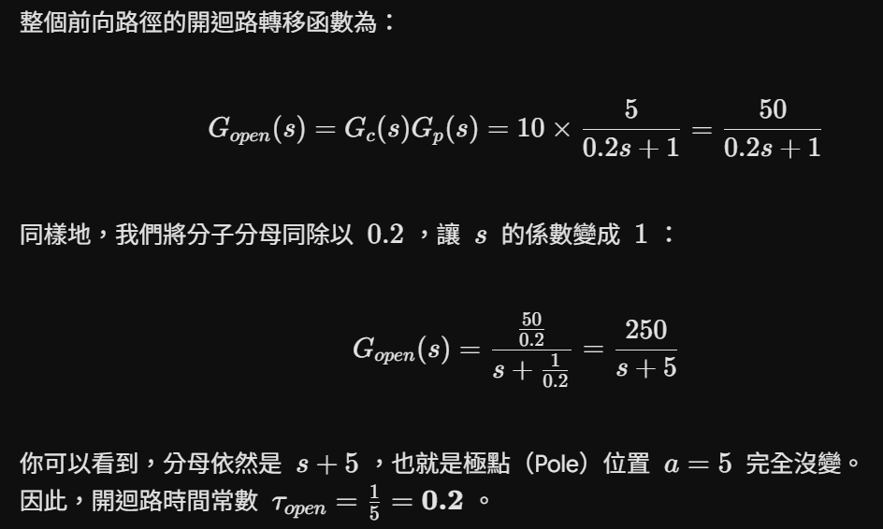

Slide 31
