Slide 1
Impact analysis through SCG

Slide 2
Attacker Objectives
S.No | Objective
1 | Disturb Chemical Dosing
2 | Increase or Decrease Conductivity in Water
3 | Increase or Decrease pH level in Water
4 | Increase or Decrease ORP(Oxidation Reduction Potential) level in Water

Slide 3
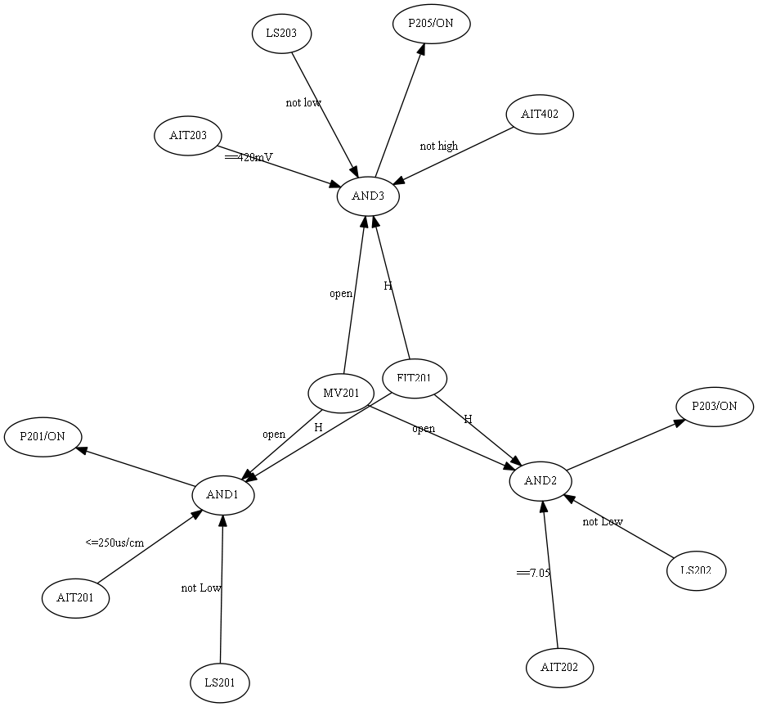
SCG for P2 stage of SWaT

Slide 4
Impact of cyber attacks on stage-2 using SCG
Compromised sensor | Effects on Actuators through SCG | Impact of the attack
FIT201 (Stage 2 attack) | Stage 2:P201,P203,P205 (three Dosing pumps) | Disturb Chemical Dosing
AIT201 (Stage 2 attack) | Stage 2:P201;(NaCl dosing pump) | Increase or Decrease Conductivity in Water
AIT202 (Stage 2 attack) | Stage 2:P203; ( HCl dosing pump) Stage 2:P601; | Increase or Decrease pH level in Water
AIT203 (Stage 2 attack) | Stage 5:P205;(NaOCl dosing pump) | Increase or Decrease ORP(Oxidation Reduction Potential) level in Water

Slide 5
Impact of Attacks on Real System
Compromised sensor | Effects on Actuators through SCG | Impact of the attack
FIT201 (Stage 2 attack) | Stage 2:P201,P203,P205 (three Dosing pumps) | Disturb Chemical Dosing
AIT201 (Stage 2 attack) | Stage 2:P201; | Increase or Decrease Conductivity in Water
AIT202 (Stage 2 attack) | Stage 2:P203; Stage 2:P601; | Increase or Decrease pH level in Water
AIT203 (Stage 2 attack) | Stage 5:P205; | Increase or Decrease ORP(Oxidation Reduction Potential) level in Water

Slide 6
Attack on FIT201, conductivity plot(AIT201)

Slide 7
Attack on FIT201, pH plot(AIT202)

Slide 8
Attack on FIT201, ORP plot (AIT203)

Slide 9
Attack on AIT201, set to HH(Conductivity sensor): Conductivity plot

Slide 10
Attack on AIT202, set to 6(pH sensor): pH plot

Slide 11
Attack on AIT203, set to 600mV(ORP sensor): ORP plot

Slide 12
AIT203 PLOT :Attack on AIT203 for 8 hours

Slide 13
AIT402(ORP): Attack on AIT203

Slide 14
AIT202 PLOT: Attack on AIT202 for 8 hours

Slide 15
Compare the Results from both the methods
Compromised Sensor | Effects on Actuators through SCG | Effects on Actuators by running the system | Impact of the attack | Remarks
FIT201 (Stage 2 attack) | Stage 2:P201,P203,P205 (three Dosing pumps) | Same as SCG | Disturb Chemical Dosing | No
AIT201 (Stage 2 attack) | Stage 2:P201; | Same as SCG | Increase or Decrease Conductivity in Water | No
AIT202 (Stage 2 attack) | Stage 2:P203; Stage 2:P601; | Same as SCG | Increase or Decrease pH level in Water | No
AIT203 (Stage 2 attack) | Stage 5:P205; | Same as SCG | Increase or Decrease ORP(Oxidation Reduction Potential) level in Water | No

Slide 16
Summary
SCG is used to analyse the impact of the attacks on CPS.

