Slide 1
Web Design Lecture-1A
Instructor: Vishal Chawla

Slide 2
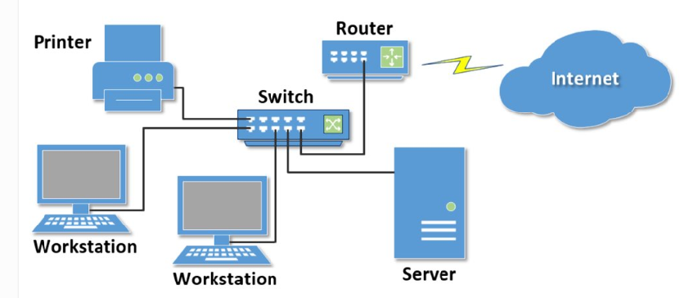
Network computers connected together for the purpose of communicating and sharing resources

Slide 3
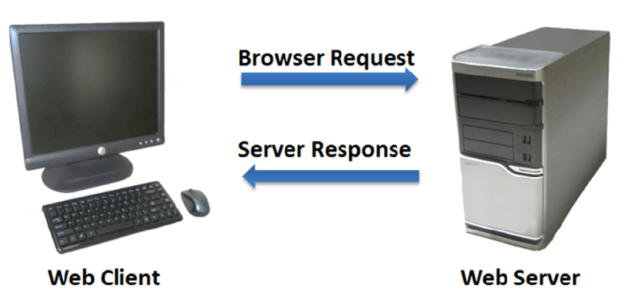
The Client/Server Model
The Internet Client/Server Model
Client: Web Browser
Server: Web Server

Slide 4
Internet Protocols
Protocols
Rules that describe the methods used for clients and servers to communicate with each other over a network.
Internet has number of protocols working together

Slide 5
Hypertext Transfer Protocol
A set of rules for exchanging files such as text, graphic images, sound, video, and other multimedia files on the Web.
Web browsers send HTTP requests for web pages and their associated files.
Web servers send HTTP responses back to the web browsers.
HTTP Request
HTTP Response

Slide 6
IPAddress and Domain Name
Each device connected to the Internet has a unique numeric IP address.
Domain Name locates an organization or other entity on the Internet
Domain Name System
Divides the Internet into logical groups and understandable names
Associates unique computer IP Addresses with the text-based domain names you type into a web browser
Browser: http://google.com
IP Address: 74.125.73.106

Slide 7
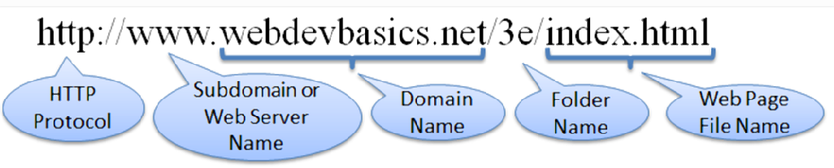
URI - Uniform Resource Indicator
URL Uniform Resource Locator
Represents the address of a resource on the Internet.

Slide 8
Top-Level Domain Name
A top-level domain (TLD) identifies the right-most part of the domain name.
Some generic TLDs: .com, .org, .net, .mil, .gov, .edu, .int, .aero, .asia, .cat, .jobs, .name, .biz, .museum, .info, .coop, .pro, .travel

Slide 9
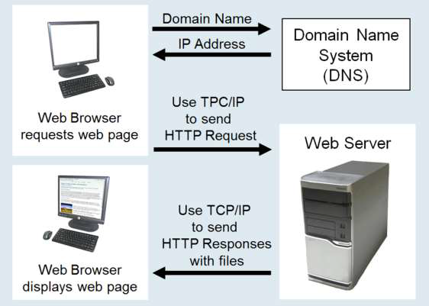
Domain Name System
The Domain Name System (DNS) associates Domain Names with IP addresses.

Slide 10
Markup Languages
SGML – Standard Generalized Markup Language
A standard for specifying a markup language or tag set
HTML – Hypertext Markup Language
The set of markup symbols or codes placed in a file intended for display on a web browser.
Element or tag – individual markup code
Attribute – modifies the purpose of a tag

Slide 11
Markup Languages
XML – eXtensible Markup Language
A text-based language designed to describe, deliver, and exchange structured information.
It is not intended to replace HTML – it is intended to extend the power of HTML by separating data from presentation.

Slide 12
Markup Languages
XHTML – eXtensible Hypertext Markup Language
Developed by the W3C as the reformulation of HTML 4.0 as an application of XML.
It combines the formatting strengths of HTML 4.0 and the data structure and extensibility strengths of XML.

Slide 13

Markup Languages
HTML 5
The next version of HTML 4 and XHTML 1
Incorporates features of both HTML and XHTML
Adds new elements
Eliminates some elements
Intended to be backward compatible
http://www.w3.org/html/

Slide 14
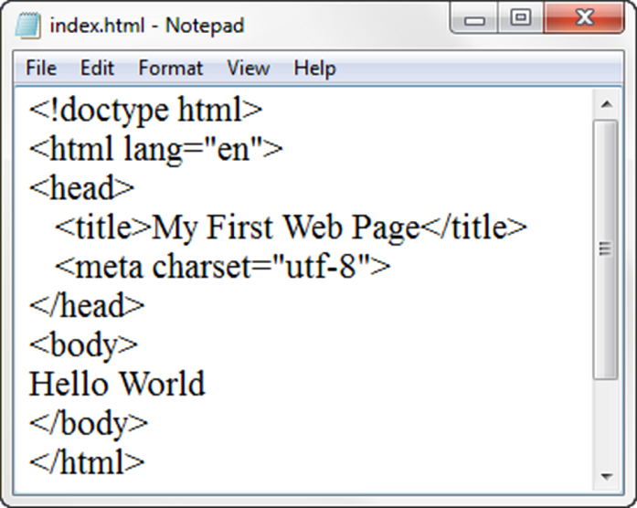
Under the Hood of a Web Page
DTD – describes the markup language syntax
HTML element– contains the web page document
Head element – contains the head section The head section contains information that describes the
web page document
Title element– Text displays in title bar of window
Meta element – describes the character encoding
Body element – contains the body section
The body section contains the text and elements that display in the browser viewport.

Slide 15
Student Resources URL
http://www.pearsonhighered.com/cs-resources/products/product.html#product,isbn=0133970744
http://www.pearsonhighered.com/felke-morris

Slide 16
The Paragraph Element <p> tag
Paragraph element
<p> …paragraph goes here… </p>
Groups sentences and sections of text together.
Configures empty space above and below the paragraph

Slide 17
The Line Break Element <br> tag
Line Break element
Stand-alone tag
Called a void element in HTML5
…text goes here <br> This starts on a new line….
Causes the next element or text to display on a new line
Read Reviews

Slide 18
The Horizontal Rule Element <hr> tag
Horizontal Rule element
void element
<hr >
Configures a horizontal line on the page
In HTML5, it should be used to indicate a thematic break at the paragraph level
Read Reviews

Slide 19
The Blockquote Element <blockquote>
Blockquote element
Indents a block of text for special emphasis
<blockquote>
…text goes here…
</blockquote>

Slide 20
Phrase Elements
Indicate the context and meaning of the text
Display inline with the text
Common Phrase Elements
<b></b>
Text is displayed in bold font
<strong></strong>
Text has strong importance and is displayed in bold
<i></i>
Text is displayed in italic font
<em></em>
Text has emphasis and is displayed in italic font

Slide 21
Proper Nesting
CODE:
<p><i>Call for a free quote for your web development needs: <strong>222.555.5555 </strong></i></p>
BROWSER DISPLAY:
Call for a free quote for your web development needs: 222.555.5555

Slide 22
HTML List Basics
Unordered List
Description List (XHTML Definition List)
Ordered List

Slide 23
Unordered List
Displays information with bullet points
Unordered List Element
<ul> Contains the unordered list
List Item Element <li> Contains an item in the list

Slide 24
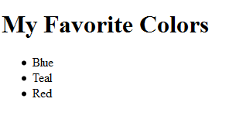
Unordered List Example
<h1>My Favorite Colors</h1>
<ul>
<li>Blue</li>
<li>Teal</li>
<li>Read</li>
</ul>

Slide 25
Ordered List
Conveys information in an ordered fashion
Ordered List Element
<ol> Contains the ordered list
type attribute determines numbering scheme of list
default is numerals
List Item Element <li> Contains an item in the list

Slide 26
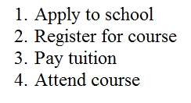
Ordered List Example
<ol>
<li>Apply to school</li>
<li>Register for course</li>
<li>Pay tuition</li>
<li>Attend course</li>
</ol>

Slide 27
Description List
Formerly called a definition list in XHTML and HTML 4.0
Uses:
Display a list of terms and descriptions
Display a list of FAQ and answers
The Description List element <dl> tag Contains the definition list
The dt Element <dt> tag Contains a term or name
The dd Element <dd> tag Contains a definition or description Indents the text

Slide 28
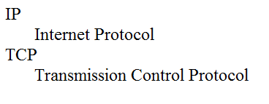
Description List Example
<dl>
<dt>IP</dt>
<dd>Internet Protocol</dd>
<dt>TCP</dt>
<dd>Transmission Control Protocol</dd>
</dl>

Slide 29
Special Entity Characters
Display special characters such as quotes, copyright symbol, etc.
Character Code
© &copy;
< &lt;
> &gt;
& &amp;
&nbsp;

Slide 30
The div element <div>
Purpose:
Configure a specially formatted division or area of a web page
Block display with empty space above and below the div
Can contain other block display and inline display elements

Slide 31
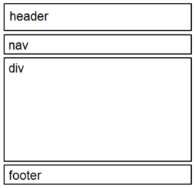
HTML5 Structural Elements
Header Element
<header></header> Contains the headings
Nav Element
<nav></nav> Contains the main navigation
Main Element
<main></main> Contains the main content
Footer Element
<footer></footer> Contains the footer
main

Slide 32
The Anchor Element <a>
The anchor element
Inline display element
Specifies a hyperlink reference (href) to a file
Text between the <a> and </a> is displayed on the web page.
<a href="contact.html">Contact Us</a>
href Attribute
Indicates the file name or URL Web page document, photo, pdf, etc.

Slide 33
More on Hyperlinks
Absolute link
Link to other websites
<a href="http://yahoo.com">Yahoo</a>
Relative link
Link to pages on your own site
Relative to the current page
<a href="index.html">Home</a>

Slide 34
Opening a Link in a New Browser Window
The target attribute on the anchor element opens a link in a new browser window or new browser tab.
<a href="http://yahoo.com" target="_blank">Yahoo!</a>

Slide 35
Email Hyperlinks
Automatically launch the default mail program configured for the browser
If no browser default is configured, a dialog box is displayed
<a href="mailto:me@hotmail.com">me@hotmail.com</a>

Slide 36
Writing Valid HTML
Check your code for syntax errors
Benefit:
Valid code → more consistent browser display
W3C HTML Validation Tool
http://validator.w3.org
Additional HTML5 Validation Tool
http://html5.validator.nu

