Slide 1
Web Design Lecture-1B
Instructor: Vishal Chawla

Slide 2
Web Page Design Browser Compatibility
Web pages do NOT look the same in all the major browsers
Test with current and recent versions of:
Internet Explorer
Firefox, Mozilla
Opera
Safari
Chrome
Add enhancements with CSS3 and/or HTML5 for display in modern browsers

Slide 3
Web Page Design Screen Resolution
Test at various screen resolutions
Most widely used: 1024x768, 1366x768, and 1280x800
Design to look good at various screen resolutions
Centered page content
Set to either a fixed or percentage width
Source: Basics of Web Design (HTML5 and CSS3)

Slide 4
Website Organization
Hierarchical
Linear
Random

Slide 5
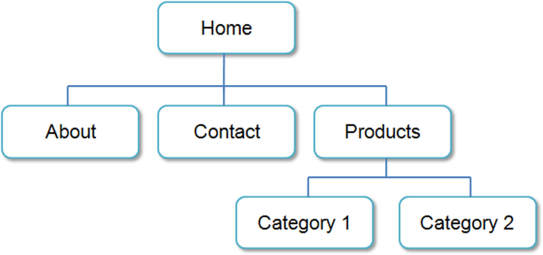
Hierarchical Organization
A clearly defined home page
Navigation links to major site sections
Often used for commercial and corporate websites

Slide 6
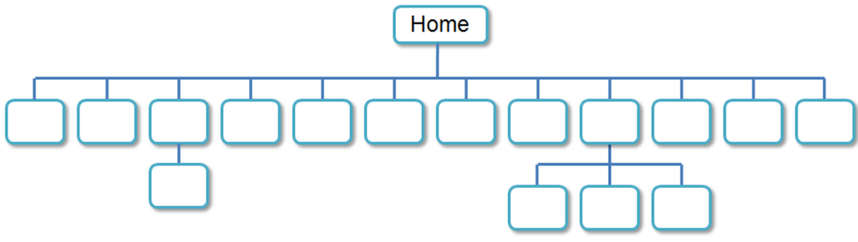
Hierarchical: Too Shallow
Be careful that the organization is not too shallow.
Too many immediate choices → a confusing and less usable website.
Group, or “chunk”, related areas

Slide 7
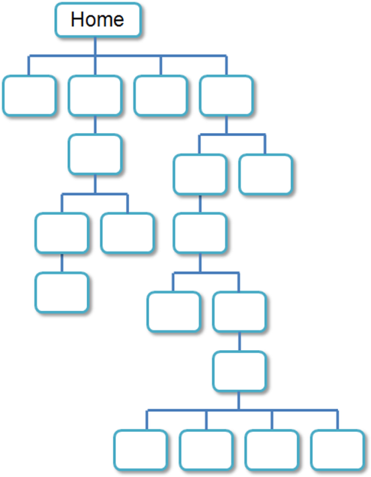
Hierarchical: Too Deep
Be careful that the organization is not too deep.
This results in many “clicks” needed to drill down to the needed page.
User Interface “Three Click Rule”
A web page visitor should be able to get from any page on your site to any other page on your site with a maximum of three hyperlinks.
Source: Basics of Web Design (HTML5 and CSS3)

Slide 8
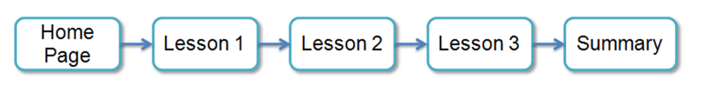
Linear Organization
A series of pages that provide a tutorial, tour, or presentation.
Sequential viewing

Slide 9

Random Organization
Sometimes called “Web” Organization
Usually there is no clear path through the site
May be used with artistic or concept sites
Not typically used for commercial sites

Slide 10
Visual Design Principles
Repetition
Repeat visual elements throughout design
Contrast
Add visual excitement and draw attention
Proximity
Group related items
Alignment
Align elements to create visual unity
Source: Basics of Web Design (HTML5 and CSS3)

Slide 11
Design to Provide for Accessibility
“The power of the Web is in its universality. Access by everyone regardless of disability is an essential aspect.” – Tim Berners-Lee
Who benefits from increased accessibility?
A person with a physical disability
A person using a slow Internet connection
A person using an old, out-dated computer
A person using a mobile phone
Legal Requirement: Section 508
Standards: WCAG 2.0

Slide 12
Design for Accessibility
Web Content Accessibility Guidelines 2.0 WCAG 2.0
http://www.w3.org/TR/WCAG20/Overview
http://www.w3.org/WAI/WCAG20/quickref
Based on Four Principles (POUR)
Perceivable Content must be easy to see or hear
Operable Interface components in the content must be operable by both mouse and keyboard
Understandable Content and controls must be easy to read and well-organized
Robust. Content use correct syntax and function on popular operating systems, browsers, and assistive technologies.

Slide 13
Writing for the Web
Avoid long blocks of text
Use bullet points
Use headings and subheadings
Use short paragraphs
Source: Basics of Web Design (HTML5 and CSS3)

Slide 14
Design “Easy to Read” Text
Use common fonts:
Arial, Helvetica, Verdana, Times New Roman
Use appropriate text size:
medium, 1em, 100%
Use appropriate line length
Between 50-75 characters is recommended
Use strong contrast between text & background
Use columns instead of wide areas of horizontal text

Slide 15
More Text Design Considerations
Carefully choose text in hyperlinks
Avoid “click here”
Hyperlink key words or phrases
Do not hyperlink not entire sentences
Chek yur spellin (Check your spelling)

Slide 16
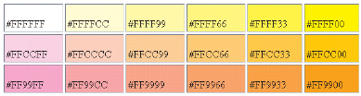
Using Color on Web Pages
Computer monitors display color as intensities of red, green, and blue light
RGB Color
The values of red, green, and blue vary from 0 to 255.
Hexadecimal numbers (base 16) represent these color values.

Slide 17
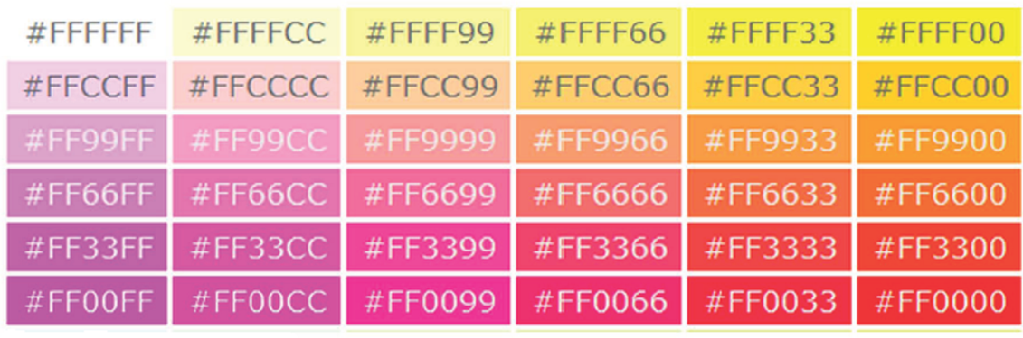
Web Color Palette
A collection of 216 colors
Display the most similar on the Mac and PC platforms
Hex values: 00, 33, 66, 99, CC, FF
Color Chart : http://webdevbasics.net/color

Slide 18
Navigation Design
Make your site easy to navigate
Provide clearly labeled navigation in the same location on each page
Most common – across top or down left side
Consider:
Navigation Bars
Breadcrumb Navigation
Using Graphics for Navigation
Dynamic Navigation
Site Map
Site Search Feature

Slide 19
Wireframe
A sketch of blueprint of a web page
Shows the structure of the basic page elements, including:
Logo
Navigation
Content
Footer

Slide 20
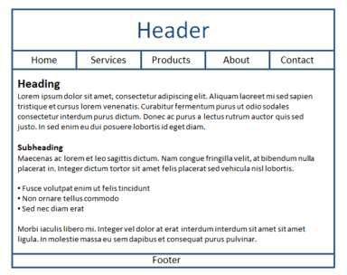
Web Page Design Page Layout
Place the most important information "above the fold"
Use adequate "white" or blank space
Use an interesting page layout
This is usable, but a little boring. See the next slide for improvements in page layout.

Slide 21
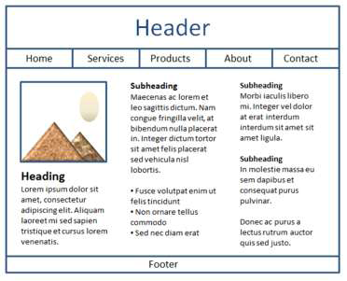
Web Page Design Page Layout
Better
Columns make the page more interesting and it’s easier to read this way.

Slide 22
Design for the Mobile Web
Predicted that by 2015, more users will access websites using mobile devices than with desktop computers
Three Approaches:
Separate .mobi mobile site
Host the mobile site within your current domain
Configure your current website for mobile display using responsive web design techniques

Slide 23
Mobile Design Quick Checklist
Small screen size
Bandwidth issues
Single-column layout
Maximize contrast
Optimize images for mobile display
Descriptive alternate text for images
Avoid display of non-essential content
Source: Basics of Web Design (HTML5 and CSS3)

