Slide 1
Web Design
Lecture-1C
Instructor: Vishal Chawla

Slide 2
Overview of
Cascading Style Sheets (CSS)
See what is possible with CSS:
  Visit http://www.csszengarden.com
Style Sheets
  used for years in Desktop Publishing
  apply typographical styles and spacing to printed media
CSS
  provides the functionality of style sheets (and much more) for web developers
  a flexible, cross-platform, standards-based language developed by the W3C.
Source: Basics of Web Design (HTML5 and CSS3)

Slide 3
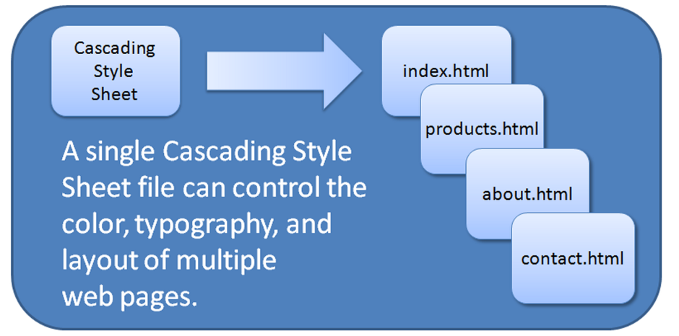
CSS
Advantages
Greater typography and page layout control
Style is separate from structure
Styles can be stored in a separate document and linked to from the web page
Potentially smaller documents
Easier site maintenance
Source: Basics of Web Design (HTML5 and CSS3)

Slide 4
Types of Cascading Style Sheets
Inline Styles
Embedded Styles
External Styles
Imported Styles
Source: Basics of Web Design (HTML5 and CSS3)

Slide 5
Description of the Types of
Cascading Style Sheets
Inline Styles
  Configured in the body of the web page
  Use the style attribute of an HTML tag
  Apply only to the specific element
Embedded Styles
  Configured in the head section of a web page.
  Use the HTML <style> element
  Apply to the entire web page document
External Styles
  Configured in a separate text file with .css file extension
  The HTML <link> element in the head section of a web page associates it with the .css file
Imported Styles
  Similar to External Styles
  We’ll concentrate on the other three types of styles.
Source: Basics of Web Design (HTML5 and CSS3)

Slide 6
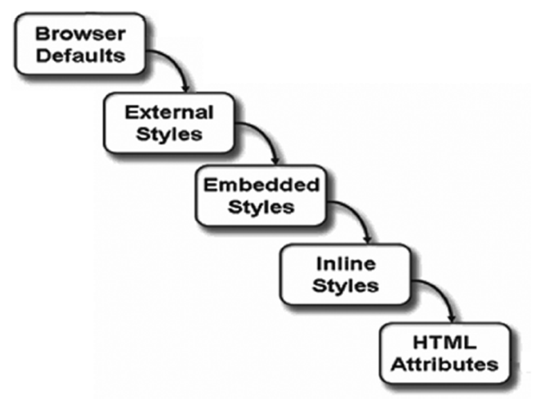
The “Cascade”
Source: Basics of Web Design (HTML5 and CSS3)

Slide 7
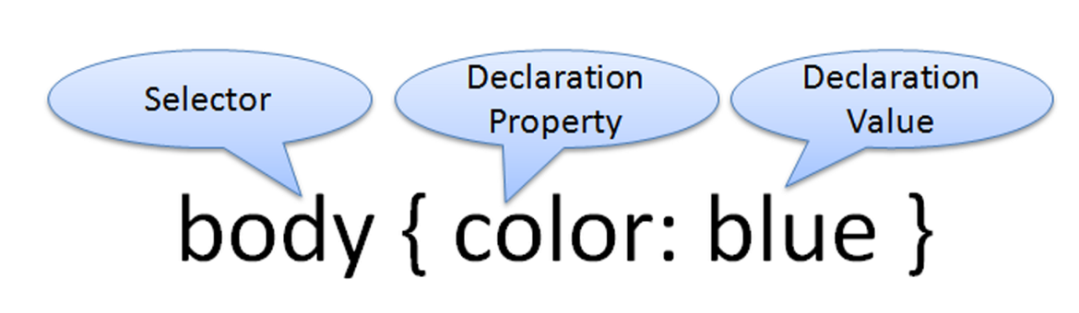
CSS Syntax
Style sheets are composed of "Rules" that describe the styling to be applied.
Each rule contains a Selector and a Declaration
Source: Basics of Web Design (HTML5 and CSS3)

Slide 8
CSS Syntax Sample
Configure a web page to display blue text and yellow background.
body { color: blue;
background-color: yellow; }
This could also be written using hexadecimal color values as shown below.
body { color: #0000FF;
background-color: #FFFF00; }
Source: Basics of Web Design (HTML5 and CSS3)

Slide 9
CSS Syntax for Color Values
Table 4.2 Syntax to configure a paragraph with red text
CSS Syntax | Color Type
p { color: red } | Color name
p { color: #FF0000 } | Hexadecimal color value
p { color: #F00 } | Shorthand hexadecimal (one character for each hexadecimal pair – only used with web safe colors)
p { color: rgb(255,0,0) } | Decimal color value (RGB triplet)
p { color: rgba(255,0,0,0.5) } | CSS3: Decimal color value (RGB triplet) followed by the alpha opacity (a value from 0 to 1). The CSS3 Color Module is in draft status and is not yet uniformly supported by browsers.
p { color: hsl(0, 100%, 50%) } | HSL color values. The CSS3 Color Module is in draft status and is not yet uniformly supported by browsers. See http://www.w3.org/TR/css3-color/#hsl-color
Source: Basics of Web Design (HTML5 and CSS3)

Slide 10

Inline CSS with the Style Attribute
Inline CSS
  Configured in the body of the Web page
  Use the style attribute of an HTML tag
  Apply only to the specific element
The Style Attribute
  Value: one or more style declaration property and value pairs
Examples
<h1 style="color:#ff0000">Heading text is red</h1>
<h1 style="color:#FF0000;background-color:#cccccc">This is displayed as a red heading with gray background</h1>
Source: Basics of Web Design (HTML5 and CSS3)

Slide 11
Configure Embedded CSS with the Style Element
Configured in the head section of a web page.
Use the HTML <style> element
Apply to the entire web page document
Style declarations are contained between the opening and closing <style> tags
The optional type attribute indicates the MIME type of text/css
Example:
<style>
body { background-color: #000000;
color: #FFFFFF;
}
P { background-color: #00FF00;
color: #FFFFFF;
}
</style>
Source: Basics of Web Design (HTML5 and CSS3)

Slide 12
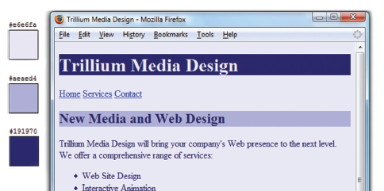
CSS Embedded Styles
The body selector sets the global style rules for the entire page.
These global rules are overridden for <h1> and <h2> elements by the h1 and h2 style rules.
<style>
body { background-color: #E6E6FA;
color: #191970;}
h1 { background-color: #191970;
color: #E6E6FA;}
h2 { background-color: #AEAED4;
color: #191970;}
</style>
Source: Basics of Web Design (HTML5 and CSS3)

Slide 13
External Style Sheets - 1
CSS style rules are contained in a text file separate from the HTML documents.
The External Style Sheet text file:
  extension ".css"
  contains only style rules
  does not contain any HTML tags
Source: Basics of Web Design (HTML5 and CSS3)

Slide 14
External Style Sheets - 2
  Multiple web pages can associate with the same external style sheet file.
index.html
site.css
body { background-color: #E6E6FA;
color: #000000;
}
h2 { color: #003366; }
clients.html
about.html
etc…
Source: Basics of Web Design (HTML5 and CSS3)

Slide 15
The <link> Element
A self-contained tag
Placed in the header section
Purpose: associates the external style sheet file with the web page.
Example:
<link rel="stylesheet" href="color.css">
Source: Basics of Web Design (HTML5 and CSS3)

Slide 16
Using an
External Style Sheet
External Style Sheet color.css
body { background-color: #0000FF;
color: #FFFFFF;
}
To associate with the external style sheet called color.css, place the following code in the head section:
<link rel="stylesheet" href="color.css">
Source: Basics of Web Design (HTML5 and CSS3)

Slide 17
CSS Selectors
Common Types of Selectors:
  class selector
  id selector
  descendant selector
Source: Basics of Web Design (HTML5 and CSS3)

Slide 18
Using CSS with “class”
class Selector
  Apply a CSS
  rule to
  ONE OR MORE
  elements on a web page
  Does not associate the
  style to a particular
  HTML element
Configure with .classname
The sample creates a class called “new” with red italic text.
To use the class, code the following HTML:
<p class=“new”>This text is red</p>
<style>
.new { color: #FF0000;
}
</style>
This text is red.
Source: Basics of Web Design (HTML5 and CSS3)

Slide 19
Using a CSS id Selector
id Selector
  Apply a CSS
  rule to ONLY ONE element
  on a web page.
Configure with #idname
The sample creates an id called “new” with red, large, italic text.
To use the id, code the following HTML:
<p id=“new”>This text is red.</p>
<style>
#new { color: #FF0000;
}
</style>
This text is red.
Source: Basics of Web Design (HTML5 and CSS3)

Slide 20
Using a CSS Descendant Selector
Descendant Selector
  Apply a CSS
  rule within the context of
  the container (parent) element.
  Sometimes called a
  contextual selector.
Configure by listing the
container selector followed by the selector you are styling.
The sample specifies a green text color for only the paragraph elements located within the footer element.
<style>
footer p {color: #00ff00; }
</style>
Source: Basics of Web Design (HTML5 and CSS3)

Slide 21
The div element
<div>
A block-display element
Purpose: configure a specially formatted division or area of a web page
  There is a line break before and after the division.
  Can contain other block-level and inline elements
Useful to define a generic area that will contain other block display tags (such as paragraphs or spans) within it.
Source: Basics of Web Design (HTML5 and CSS3)

Slide 22
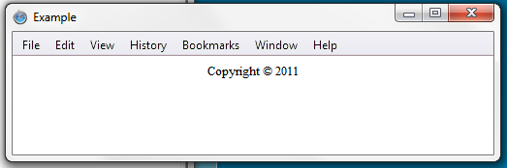
<div> Example
Configure a page footer area
Embedded CSS:
<style>
.notes { font-size: small;
text-align: center; }
</style>
HTML:
<div class="notes">Copyright &copy; 2014</div>
Source: Basics of Web Design (HTML5 and CSS3)

Slide 23
The Span Element
<span>
An inline-level element
Purpose:
  Configure a specially formatted area displayed in-line with other elements, such as within a paragraph.
There is no line break before and after the span.
Source: Basics of Web Design (HTML5 and CSS3)

Slide 24
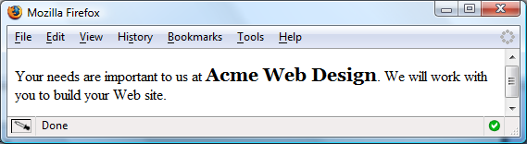
<span> Example
Embedded CSS:
<style>
.companyname { font-weight: bold;
font-family: Georgia, "Times New Roman", serif;
font-size: 1.25em; }
</style>
HTML:
<p>Your needs are important to us at <span class=“companyname">Acme Web Design</span>. We will work with you to build your website.</p>
Source: Basics of Web Design (HTML5 and CSS3)

Slide 25
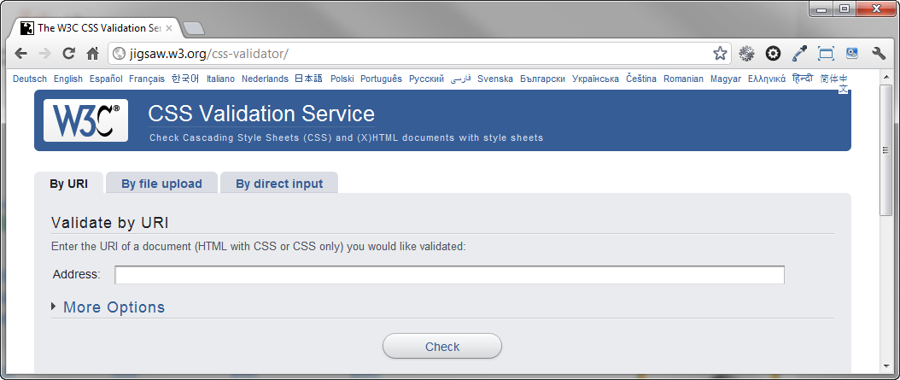
W3C CSS Validation
http://jigsaw.w3.org/css-validator

Slide 26
CSS Troubleshooting Tips
Verify you are using the : and ; symbols in the right spots—they are easy to confuse.
Check that you are not using = signs instead of : between each property and its value.
Verify that the { and } symbols are properly placed
Check the syntax of your selectors, their properties, and property values for correct usage.
If part of your CSS works, and part doesn’t:
  Review your CSS
  Determine the first rule that is not applied.
  Often the error is in the rule above the rule that is not applied.
Validate your CSS at http://jigsaw.w3.org/css-validator
Source: Basics of Web Design (HTML5 and CSS3)

