Slide 1
Web Design Lecture-1E
Instructor: Vishal Chawla

Slide 2
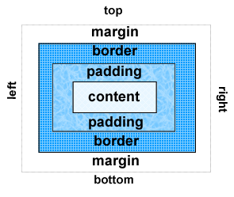
The Box Model
Content
Text & web page elements in the container
Padding
Area between the content and the border
Border
Between the padding and the margin
Margin
Determines the empty space between the element and adjacent elements
Source: Basics of Web Design (HTML5 and CSS3)

Slide 3
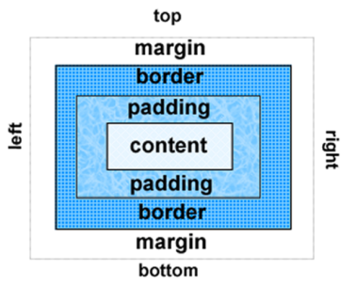
Configure Margin with CSS
The margin property
Related properties:
margin-top, margin-right, margin-left, margin-bottom
Configures empty space between the element and adjacent elements
Syntax examples
h1 { margin: 0; }
h1 { margin: 20px 10px; }
h1 { margin: 10px 30px 20px; }
h1 { margin: 20px 30px 0 30px; }
Source: Basics of Web Design (HTML5 and CSS3)

Slide 4
Configure Padding with CSS
The padding property
Related properties:
padding-top, padding-right, padding-left, padding-bottom
Configures empty space between the content of the HTML element (such as text) and the border
Syntax examples
h1 { padding: 0; }
h1 { padding : 20px 10px; }
h1 { padding : 10px 30px 20px; }
h1 { padding : 20px 30px 0 30px; }
Source: Basics of Web Design (HTML5 and CSS3)

Slide 5

The CSS border Property
Configures a border on the top, right, bottom, and left sides of an element
Consists of
border-width
border-style
border-color
h2 { border: 2px solid #ff0000 }
Source: Basics of Web Design (HTML5 and CSS3)

Slide 6
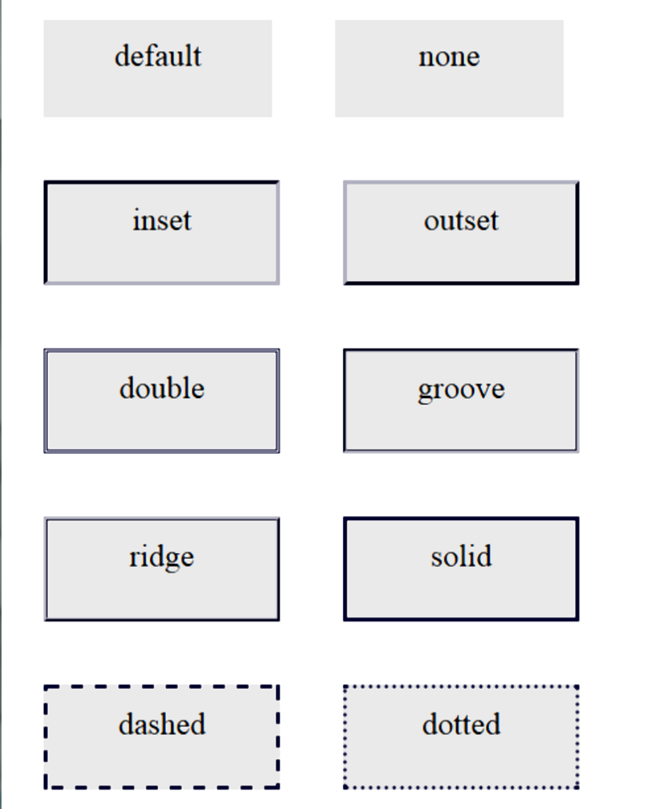
Valid border-style Values
Source: Basics of Web Design (HTML5 and CSS3)

Slide 7

Configuring Specific Sides of a Border
Use CSS to configure a line on one or more sides of an element
border-bottom
border-left
border-right
border-top
h2 { border-bottom: 2px solid #ff0000 }
Source: Basics of Web Design (HTML5 and CSS3)

Slide 8
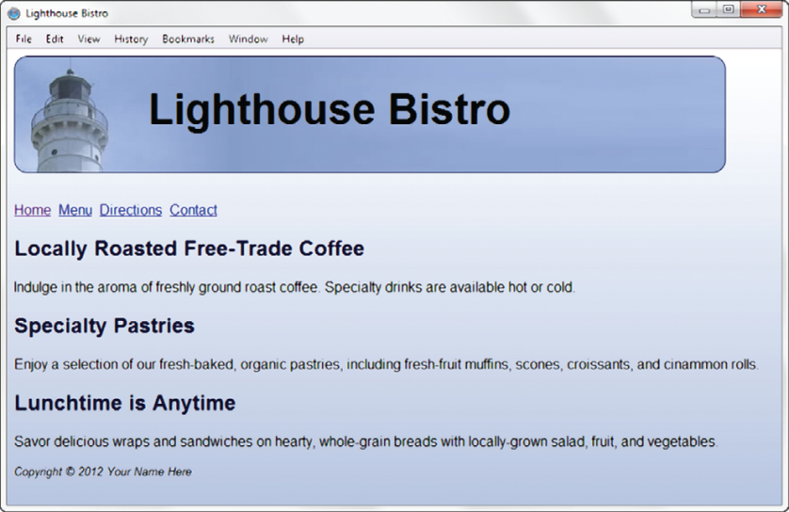
CSS3 Rounded Corners
border-radius property
Example:
h1 { border: 1px solid #000033;
border-radius: 15px; }
Source: Basics of Web Design (HTML5 and CSS3)

Slide 9

Centering Page Content with CSS
#container { margin-left: auto;
margin-right: auto;
width:80%; }
Source: Basics of Web Design (HTML5 and CSS3)

Slide 10
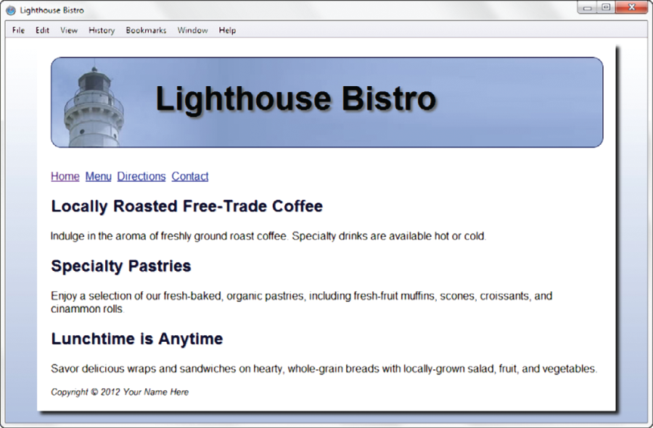
CSS3 box-shadow Property
Configure the horizontal offset, vertical offset, blur radius, and valid color value
Example:
#wrapper { box-shadow: 5px 5px 5px #828282;}
Note: Optional keyword: inset
Source: Basics of Web Design (HTML5 and CSS3)

Slide 11
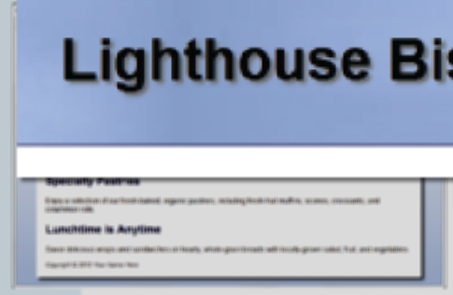
CSS3 text-shadow Property
Configure the horizontal offset, vertical offset, blur radius, and valid color value
Example:
#wrapper { text-shadow: 3px 3px 3px #666; }
Source: Basics of Web Design (HTML5 and CSS3)

Slide 12
CSS3 Background Image Properties
background-clip
confines the display of the background image
background-size
can be used to resize or scale the background image
Source: Basics of Web Design (HTML5 and CSS3)

Slide 13
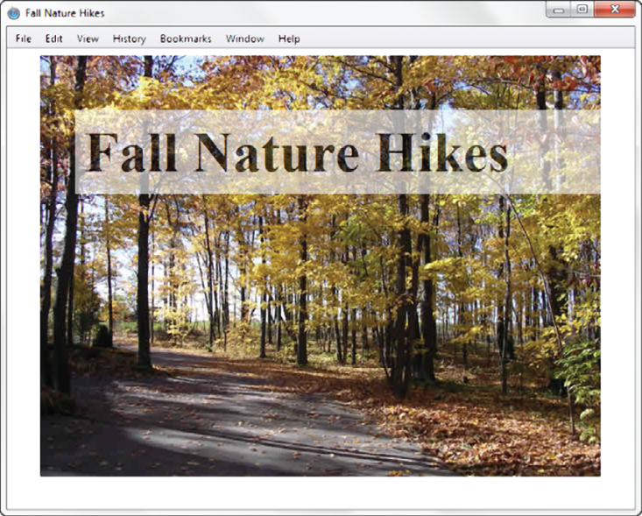
CSS3 opacity Property
Configure the opacity of the background color
Opacity range:
0 Completely Transparent
1 Completely Opaque horizontal offset, vertical offset, blur radius, and valid color value
Example:
h1{ background-color: #FFFFFF;
opacity: 0.6; }
Source: Basics of Web Design (HTML5 and CSS3)

Slide 14
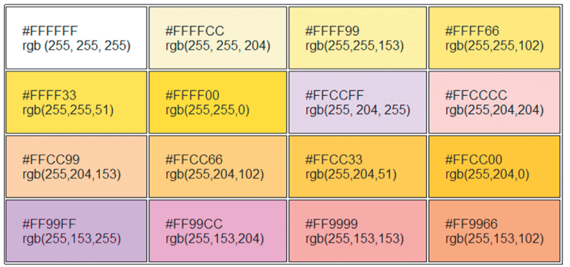
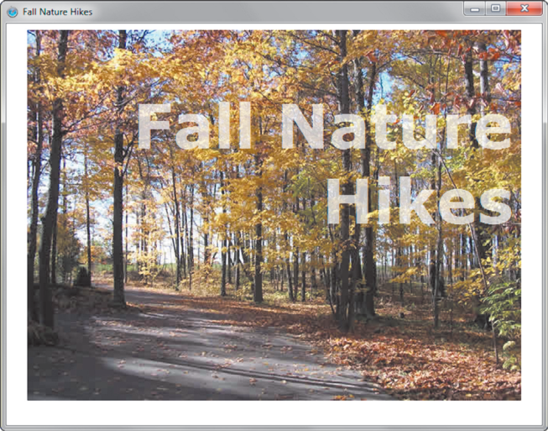
RGBA Color
Four values are required:
red color, green color, blue color, and alpha(transparency)
The values for red, green, and blue must be decimal values from 0 to 255.
The alpha value must be a number between 0 (transparent) and 1 (opaque).
Example:
h1 { color: #ffffff;
color: rgba(255, 255, 255, 0.7);
font-size: 5em; padding-right: 10px;
text-align: right; font-family: Verdana, Helvetica, sans-serif;
}
Source: Basics of Web Design (HTML5 and CSS3)

Slide 15
CSS3 Gradients
Gradient: a smooth blending of shades from one color to another
Use the background-image property
Linear Gradient
Example:
body { background-color: #8FA5CE;
background-image: linear-gradient (to bottom, #FFFFFF, #8FA5CE);
}
Radial Gradient
Example:
body { background-color: #8FA5CE;
background-image: radial-gradient(#FFFFFF, #0000FF);
}
Source: Basics of Web Design (HTML5 and CSS3)

