Slide 1
Demining Robots
The primary goal for this robot's group is to safely locate the landmine and remove the landmine without physical interaction.
The reason why to separate detecting process and demining process into two robots is if the landmine was triggered unintentionally, instead of destroy the whole robot unit, some sensors and machines could be saved for further usage. Disadvantage would be, it requires two pairs of GPS and IMU for navigation system.
Drone Unit
The primary goal for drone unit is to locate the landmine and send the coordinate back to base. The drone unit will not interact with landmine.
The drone will carry both metal detector and portable x-ray machine to locate the landmine. The metal detector will work at first to determine a location and x-ray machine can send a clear view of landmine image back to base for technician to discuss how to remove the landmine.
The navigation system on the drone unit will use both GPS sensor and IMU sensor to give an accurate location.
Demining Unit
The demining unit is a vehicle shaped robot with mounted navigation system and robotic arm refer to surgical robot.
The rover will first drive to the location which sent back from drone and start demining process. The technician can operate the robotic arm to demine the landmine.

Slide 2
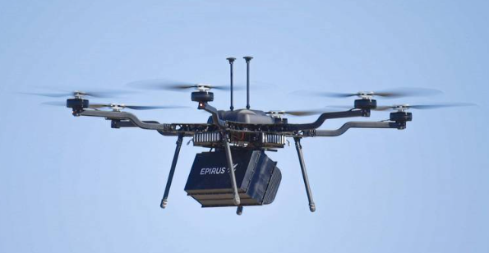
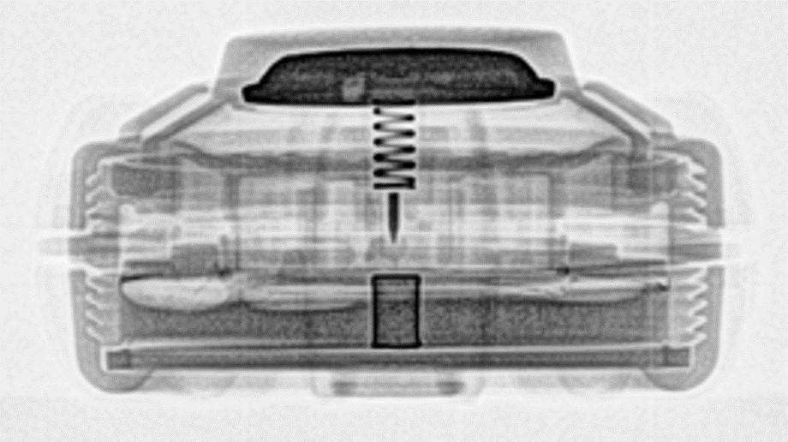
Drone Unit
Power Consumption
X-ray generator works at 150kV and 5mA. Total power used in field test is less than 5kW.
Metal detector works at 3V – 6V
Navigation system, GPS works at 0.1W, 30mA, IMU works at 0.2W, 40mA.
Raspberry Pi works at minimum 2.8W during idle time, estimate power consumption at maximum 10W
Drone Propulsion and Power Consumption
Drone itself power consumption will depend on how many weight it must lift, for a heavy lift drone, the power consumption usually at 20 to 200 W/kg. If we assume the total weight is 50kg in this drone, the maximum power consumption is 10kW.
Looking for a solar battery that can charge itself while on mission.

Slide 3
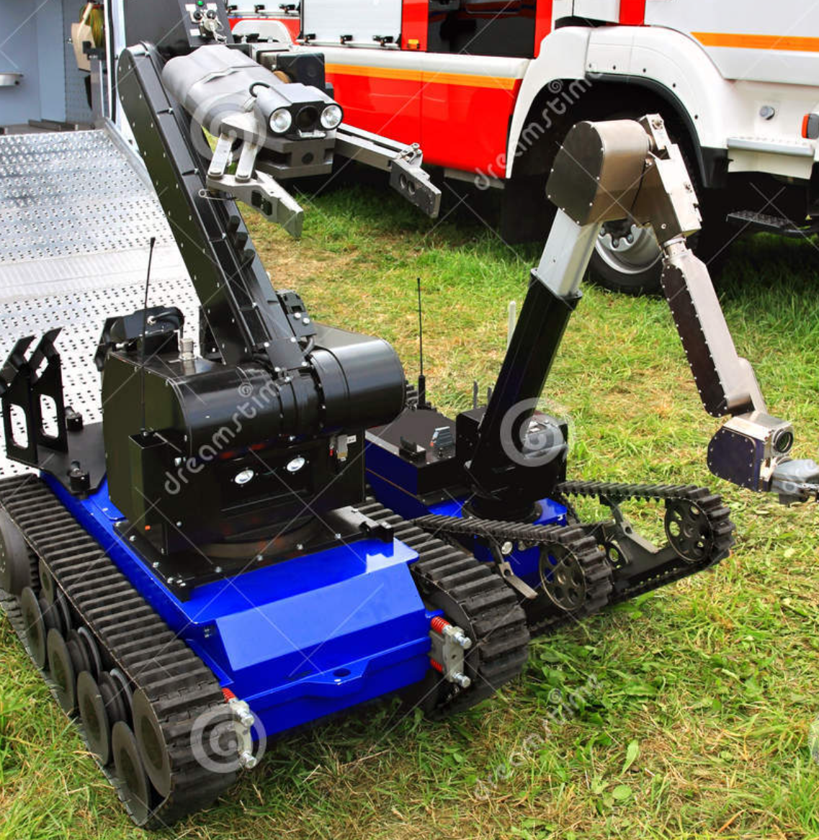
Rover Unit
Motor power consumption and propulsion on rover unit is not much. Compared to industrial motor, the motor on rover is more like toy electric motor. Therefore, the power consumption is estimated in 20W
Referred to Real Man robot arm, it requires 24V and at full load situation, the power consumption is less than 200W.
The navigation system is the same as drone. The power consumption is ~0.5W.
Raspberry Pi works at minimum 2.8W during idle time, estimate power consumption at maximum 10W.
Consider the case that a landmine is very hard to remove, the battery should support all components to work at least 5 hour.

Slide 4
Sensors
GPS – Locate the landmine and record the coordinates
IMU – Main navigation system. Using dead reckoning technique to design the route to remove the landmine
Metal Detector – Locate landmine
X-Ray Generator – Scan the landmine structure

Slide 5
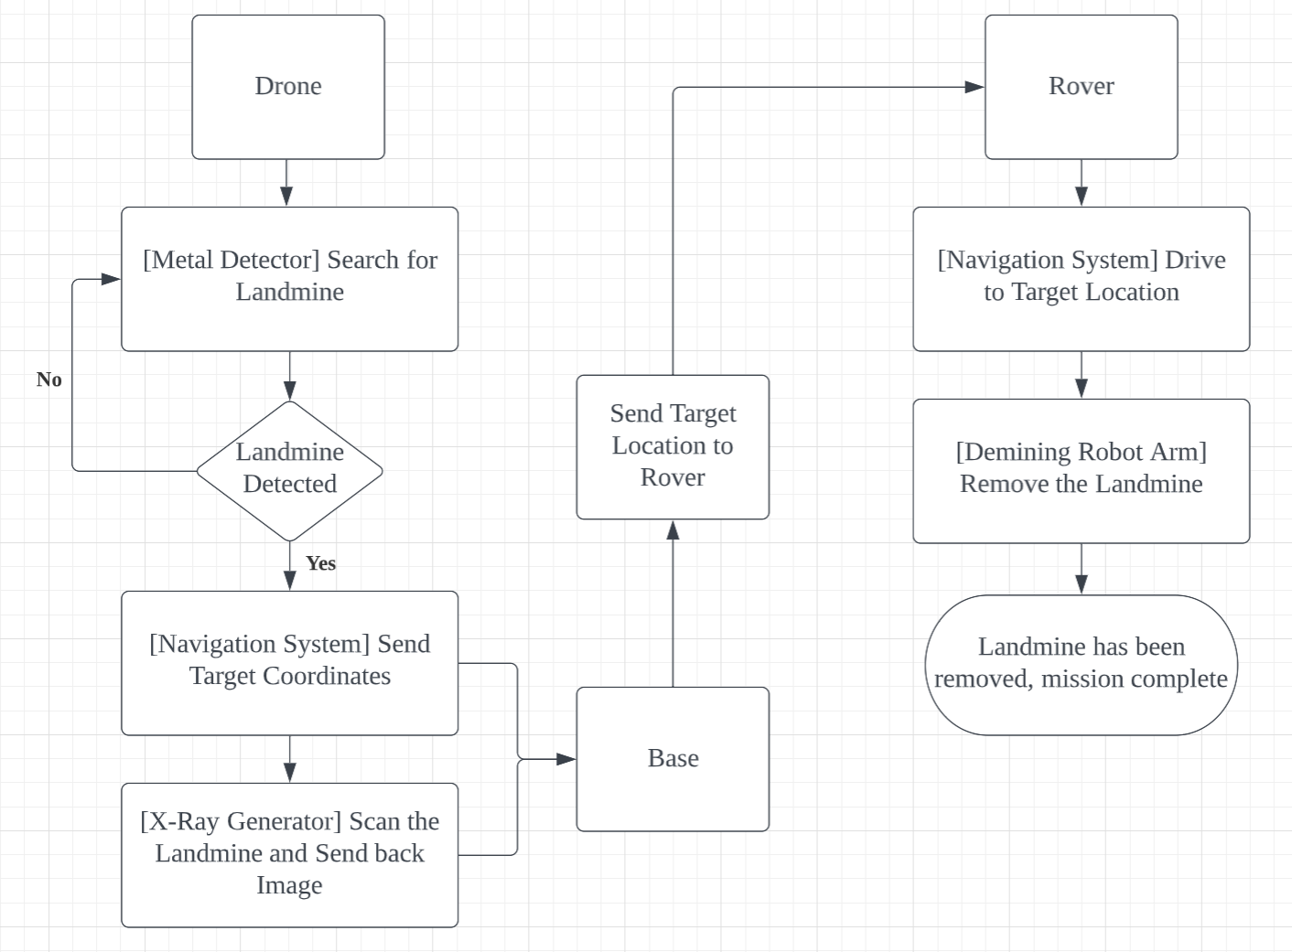
Demining Process
Drone searches for landmine over an area
If landmine detected, send target coordinates and x-ray image back to base
If all landmine has been located, withdraw drone unit
After the base discuss about the solution, the rover unit has been deployed
The rover unit drive to the target location
The technician operate robot arm to remove the landmine
After the landmine has been removed, process on next landmine
If all landmine had been removed, mission complete, withdraw rover unit

Slide 6
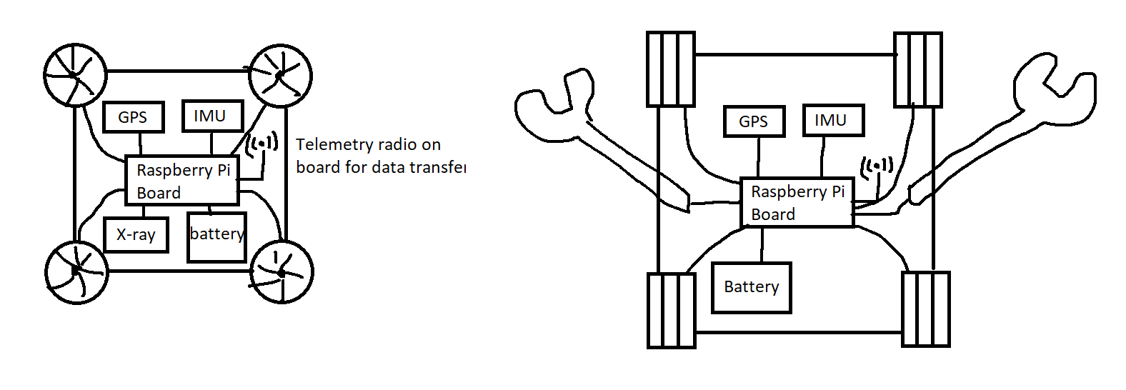
Conceptual Sketch
Drone Unit
Rover Unit

Slide 7
Reference
https://www.army.mil/article/238237/new_landmine_detection_method_to_reduce_false_alarm_rates
https://www.flyingtech.co.uk/blog/efficiency-vs-performance-how-build-drone-long-flight-time
https://www.quora.com/How-much-power-is-required-to-lift-at-lift-150-kg-weight-by-drone
https://solarcalculator.com.au/battery-storage/size/#:~:text=Battery%20size%20for%20a%205kW,likely%2C%20up%20to%2013.5%20kWh.
https://www.osti.gov/servlets/purl/9016
http://www.realman-robotics.com/uploadfile/2022/0315/20220315013637586.pdf

