Slide 2
GroundWork Monitor License Automailer
Marketing and Support Training
GroundWork Galactic Headquarters
February 16, 2010

Slide 3
Course Outline
What the License Automailer Does
Installation
Operation
Email Output Format
Audit Logging
Test Facilities
Troubleshooting
Futures
Notes:
Tuesday, February 16, 2010
© 2009 GroundWork Open Source, Inc.
10

Slide 4
GroundWork Monitor 6.1.X License Key Automailer
license key email
outgoing email templates
(plain/html) and images
GMail orders
Sent Mail
(To: Customer)
(Bcc: support)
key database
config file
new
order
key generator
config options,
email content
GMail orders
Sent Mail: debug
(To: sbennett)
(Bcc: support)
outgoing email
NetSuite
key request
license key
Automailer
key
request
email
Order Number
Customer Name
optional
obfuscator
GMail orders
Sent Mail: audit
(To: sbennett)
request
validator
GMail
license_reg
Inbox
outgoing
email
generator
GMail orders
Sent Mail: trouble
(To: support)
From:
Reply-To:
To:
Subject:
extraction:
Customer Name
Customer Email
Order Number
Order SKU
valid Order SKU
ignored Order SKU
Customer Name
Customer Email
Order Number
GMail license_reg
Invalid Requests
GMail license_reg
Processed Requests
log data
debug log
audit log
GMail license_reg
Bounced
undeliverable; uncaught spam; etc.
GMail orders Inbox
forwarded by GMail
GMail support Inbox
reply-to

Slide 5
Installation, Part I (GMail setup)
disable POP to incoming/outgoing email accounts
enable IMAP to incoming acct, disable to outgoing acct
  can still send via IMAP using outgoing account (weird mystery)
required folders will be created as needed by the scripting
work with Fikret so mail comes from gwos, not gwoslabs
forward email from the outgoing account to a secondary account, to catch bounces and notify the humans
mark undeliverable-email notices as not-spam for the support account, so they're not hidden away
Notes:
Tuesday, February 16, 2010
© 2009 GroundWork Open Source, Inc.
10

Slide 6
Installation, Part II (automailer build)
check out code from Subversion (all in one directory)
  http://geneva/groundwork-professional/trunk/
  licenseServer/automailer
make tarball
  generate_quickstart_license.tar.gz
copy created tarball to install location
  production location: lancy:/home/license/automailer/
  production user: install and run as license
un-tar the tarball
make build; make clean
  creates Perl packages not found in OS-provided Perl libraries
Notes:
Tuesday, February 16, 2010
© 2009 GroundWork Open Source, Inc.
10

Slide 7
Installation, Part III (automailer config)
edit config file
  generate_quickstart_license.conf
  lots of options, all documented in the config file
edit startup script
  quickstart_automailer
  set automailer_path value only, to reflect installation location
install the startup script cron job
  run as the same non-root user the package is installed as
  sample line in generate_quickstart_license script:
  */5 * * * * /home/license/automailer/quickstart_automailer start
Notes:
Tuesday, February 16, 2010
© 2009 GroundWork Open Source, Inc.
10

Slide 8
Operation
startup script (quickstart_automailer) cron job will automatically start/restart the daemon (run every 5 minutes)
automailer processing cycle time typically set to 300 seconds (5 minutes)
  will process all available incoming requests in each cycle
handled input email is moved aside so it’s not reprocessed
  bad requests are shuffled off to “Invalid Requests” folder
  good requests are moved to “Processed Requests” folder
  failed requests are left in “Inbox” folder for processing in next cycle
self-maintaining: debug log is automatically rotated
audit log grows forever
Notes:
Tuesday, February 16, 2010
© 2009 GroundWork Open Source, Inc.
10

Slide 9

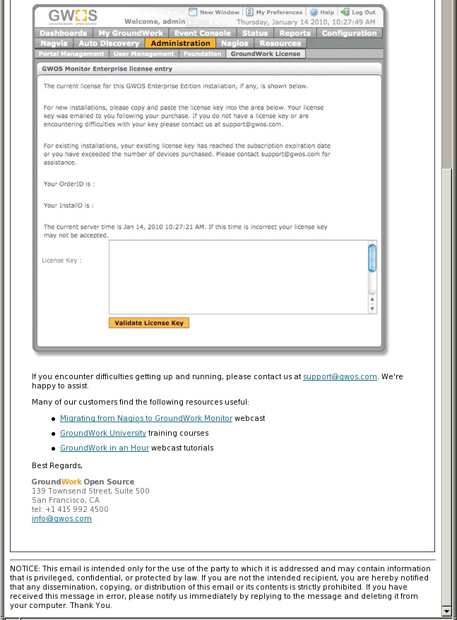
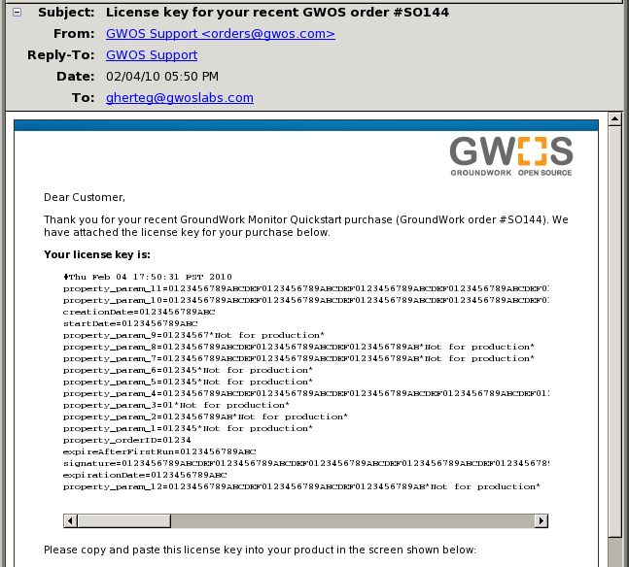
license key
where to plug into product
links to training materials

Slide 10
Email Output Format
text/plain (always) + text/html (optional, but standard)
  separate template files for plain and html parts
  templates have certain fields substituted with customer data and generated license key when outgoing email is created
image files are included, not referenced on the web
reply-to goes back to support, not to orders
blind copy sent to support
both plain and html parts are base64-encoded to avoid problems with possibly very long lines in license keys
  this encoding causes a problem with forwarding license-key email, as content appears mangled; reply and change address instead
Notes:
Tuesday, February 16, 2010
© 2009 GroundWork Open Source, Inc.
10

Slide 11
Audit Logging
audit log location:
  /home/license/logs/quickstart_license_issuance_log
  fixed path survives version upgrades in ~/automailer/ directory
these fields are recorded for each successful key request:
  date/time of request processing
  order number
  order SKU
  customer name
  customer email
  request source (should always be from NetSuite now)
  network service hash
audit email sent for each successful or ignored valid request
  ignored requests are to be handled manually, not via automailer
Notes:
Tuesday, February 16, 2010
© 2009 GroundWork Open Source, Inc.
10

Slide 12
Test Facilities
generate_quickstart_license command-line options:
  -c file: use an alternate config file (not likely, but available)
  -d: dump config-file entries (then stop) so you can see if they're being interpreted as you expect (use the options -i -o -d)
  -i: run interactively, not as a daemon; the most common way to run tests to process just a few requests
  -o: debug-log messages go also to standard output (easy to see)
  -r: process just one valid request, then stop
  -s: run just a single cycle, then stop
config-file options:
  enable debug target (don't send trial data to customer)
  key obfuscation (guard against valid keys escaping into the wild)
  logging debug level (usually set to INFO; can bump up to DEBUG)
Notes:
Tuesday, February 16, 2010
© 2009 GroundWork Open Source, Inc.
10

Slide 13
Troubleshooting, Part I
take action when you receive trouble email
look at production setup
  log in as user license on lancy
  installation is in /home/license/automailer/
  debug log: ./logs/generate_quickstart_license.log
debug level is set in config file
  generate_quickstart_license.conf
  DEBUG logging level will spill out extensive detail on actions taken
to bounce automailer after changing configuration:
  quickstart_automailer restart
  or (better), just let the active cron job start it within 5 minutes after:
  quickstart_automailer stop
Notes:
Tuesday, February 16, 2010
© 2009 GroundWork Open Source, Inc.
10

Slide 14
Troubleshooting, Part II
bogus requests are incoming messages with invalid headers
  we might sometimes receive mailing-list or spam messages
  the only email sent to license_reg should be valid requests
  other validation/processing failures generate different trouble email
pay attention to bounced email (sent to orders, forwarded to support)
  watch out: GMail/Postini may deflect it as supposed spam
look in license_reg “Invalid Requests” folder for all types of improper incoming email
requests can be reprocessed by just moving back to Inbox
  very useful in development testing, perhaps also in production fixes
Notes:
Tuesday, February 16, 2010
© 2009 GroundWork Open Source, Inc.
10

Slide 15
Troubleshooting, Part III
key generator might fail
  most likely internal failure
  Roger is point-man for investigation / restart
max_faults_since_trouble_email
  config-file setting to count soft failures up to a limit before sending trouble email
  allows transient failures to pass unnoticed, while persistent failures do eventually generate a notification
  you will therefore see many more failures in the debug log than you got trouble email for
Notes:
Tuesday, February 16, 2010
© 2009 GroundWork Open Source, Inc.
10

Slide 16
Futures
add back the Customer Name into the outgoing email
  personalize the email instead of generic “Dear Customer”
  NetSuite doesn’t currently provide a way to copy name into request
  we’re getting customer organization rather than name in request
email the entire audit log periodically to Simon
  to provide a backup of this data
  to allow him to analyze it in bulk
properly validate the customer email address
  the Email::Valid module is appropriate, but look at its bug-list first
validate the incoming order info against internal GW systems
  extra protection against attacks
Notes:
Tuesday, February 16, 2010
© 2009 GroundWork Open Source, Inc.
10

